Slide 1
DAIRY FARMING
ABC01(0-4-0)
Session: 11
Skill of milking procedure- hand milking as well as machine milking, knowledge of retention of milk in the udder, letting down procedure etc.

Slide 2

External Anatomy
The udder consists of 4 separate glands
Located in the inguinal region of the ventral aspect.
Each gland has one teat Each teat has one opening
The glands are covered with hair
Teats do not have hair.

Slide 3

The right and left halves are entirely separate externally indicated by intermammary groove.
The rear quarters account for 55-60% of the milk produced and 55-60% of udder weight.


Rear teats are usually shorter than the front teats.

Slide 4
The Teats - (papilla mammae)
Functions as the only exit for the mammary secretion
The only means for the calf to receive milk. Usually, only one teat drains one gland.
No hair, sweat glands or sebacious glands on the teats.





Slide 5
Supernumerary Teats
About 50% of all cows have extra teats- supernumerary teats.
Some of these extra teats open into a "normal" gland, but many do not.



Slide 6
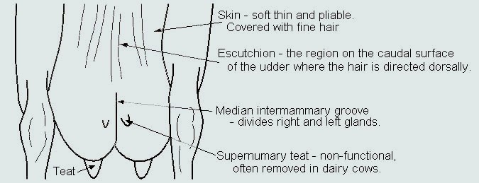

Slide 7
Streak canal (ductus papillaris)

Functions as the only orifice of the gland between the internal milk secretory system and the external environment.
The streak canal is the main barrier against infection.
Lined with a skin-like epidermis.
Closed by sphincter muscles around the streak canal.
streak canal length increases with increasing lactation number.





Slide 8

The interior of the gland is made up of:
Connective tissue - fibrous tissue (collagen) and fatty tissue (adipose cells).
Secretory tissue - secretory epithelial cells-produce the milk.


The relative amount of connective vs. secretory tissue varies from animal to animal, by stage of mammary development

Slide 9
Gland Cistern - (sinus lactiferus)

Also called the udder cistern or milk cistern opens directly into the teat cistern.
The cisterns function for milk storage (holds ~100- 400 ml). The gland cistern varies greatly in size and shape.
There are often pockets formed in the cistern at the end of the larger ducts. The major ducts which empty into the gland cistern sometimes are called cisternal ducts.



Slide 10

Secretory tissue in the udder is organized into lobes- many lobules-lobule contains 150-220 microscopic alveoli.
Alveoli - (acini)

Sack-like structures where milk is synthesized and secreted.
A single layer of secretory epithelial cells lines the lumen.
Contractile myoepithelial cells surround the epithelial lining.



Slide 11
Myoepithelial cells contract in response to the hormone oxytocin-milk being squeezed out of the alveolar lumen and into the small ducts.


Outside of the myoepithelial cells the alveolus is surrounded by a connective tissue basement membrane.

Slide 12

The capillary bed on the outside of the alveolus is part of the stromal connective tissue between alveoli.

A group of alveoli can be visualized as a clump of grapes, with the stems acting as the small ducts leading from the alveoli.

Slide 13
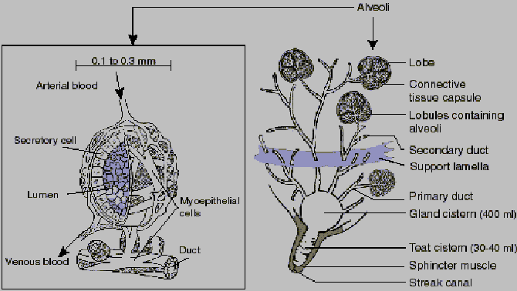

Slide 14
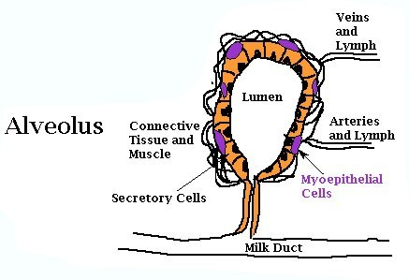

Slide 15

Lobules - Clusters of 150-220 alveoli are encapsulated by a connective tissue sheath and are organized as a lobule (~.7-.8 mm dia.).

Lobes - Groups of lobules are surrounded by a connective tissue sheath and comprise a lobe.
Each mammary gland is made of numerous lobes.


Slide 16

Ducts -tubules by which milk drains from the alveoli down to the gland cistern.
Interlobar or primary ducts drain multiple lobes.





Intralobar ducts or secondary ducts are within a lobe -drain several regions of the lobe.
Intercalary or tertiary ducts -small ducts which exit from the alveolus.

Slide 17
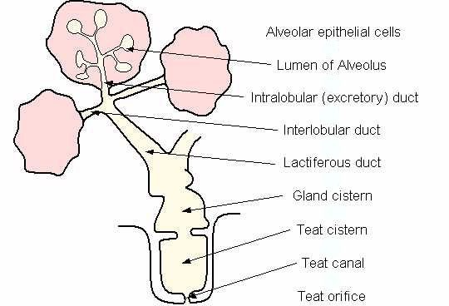

Slide 18

A strong suspensory system required-high producers.


Mammary gland is a skin gland, and is therefore external to the body cavity.

Slide 19
The tissues, which provide some degree of support for the udder:
Skin -minor support..
Superficial fascia or Areolar subcutaneous tissue
-attaches the skin to the underlying tissues.
Suspensory ligaments-main suspensory structures.
Suspensory ligaments are three:




Superficial Lateral suspensory ligament
Deep Lateral suspensory ligament
Median suspensory ligaments

Slide 20
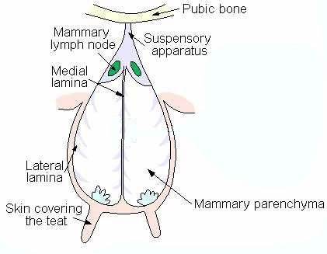

Slide 21

Blood supply to the mammary gland - extremely important for mammary function.
All of the milk precursors come from blood.



On average 400 - 500 units of blood passes
through the udder for each unit of milk synthesized
Total udder blood volume for lactating cows is
about 8% of total body blood volume, non-lactating cow -about 7.4%.
There is a 2-6 fold increase in blood flow in the mammary gland starting 2-3 days prepartum.



Slide 22
Arterial System

Blood leaves the heart and flows towards the rear of the cow -abdominal aorta
.When it reaches the pubic area -called the common iliac arteries.
These divide into the internal and external iliac arteries.
The external iliac artery becomes the femoral artery (supplies the leg muscles)




Slide 23

A branch off of the femoral artery forms the prepubic artery from which branches the posterior abdominal artery and the external pudic (or external pudental) artery.

The external pudic artery passes through the inguinal canal and out of the body cavity.

Slide 24
The inguinal canal -orifice in the body cavity in the inguinal region where blood vessels, lymph vessels and nerves enter and leave the body wall to supply the skin in the posterior part of the animal.

As the external pudic artery passes out of the body cavity it becomes the mammary artery.
Once it enters the gland, the mammary artery then divides into the anterior (or cranial) and posterior (or caudal) mammary arteries, which then it further branches as it descends down into the gland



Slide 25
A small amount of blood also reaches the mammary gland by the perineal artery (from the internal iliac artery), but this only supplies the upper rear portion of gland.


Slide 26
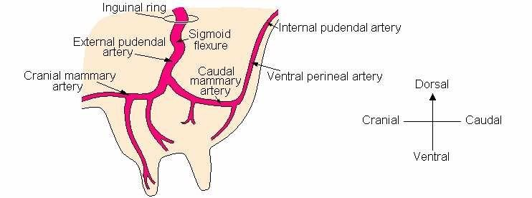

Slide 27
Venous System
Veins leave the mammary gland anti-parallel to the arteries.
There are three veins on each side that carry blood away from the gland:
External pudic vein leaves the udder anti-parallel to the external pudic artery
Subcutaneous abdominal vein (milk vein) exits the gland at the anterior end of the front quarters and passes along the abdominal wall-large vein visible under the skin on the belly of the cow.

Slide 28
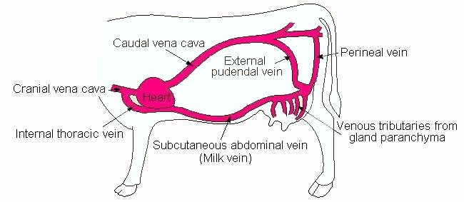

Slide 29
Nervous System

Innervation of the udder is sparse compared with other tissues.
Sensory nerves are found in the teats and skin; these are involved in the afferent pathway of the milk ejection reflex.
There is no parasympathetic innervation to the gland; this is similar to other skin glands.
There is no innervation of the secretory system: myoepithelial cells are not innervated; they do not contract in response to direct innervation, but rather they contract in response to the blood- borne hormone, oxytocin.




Slide 30
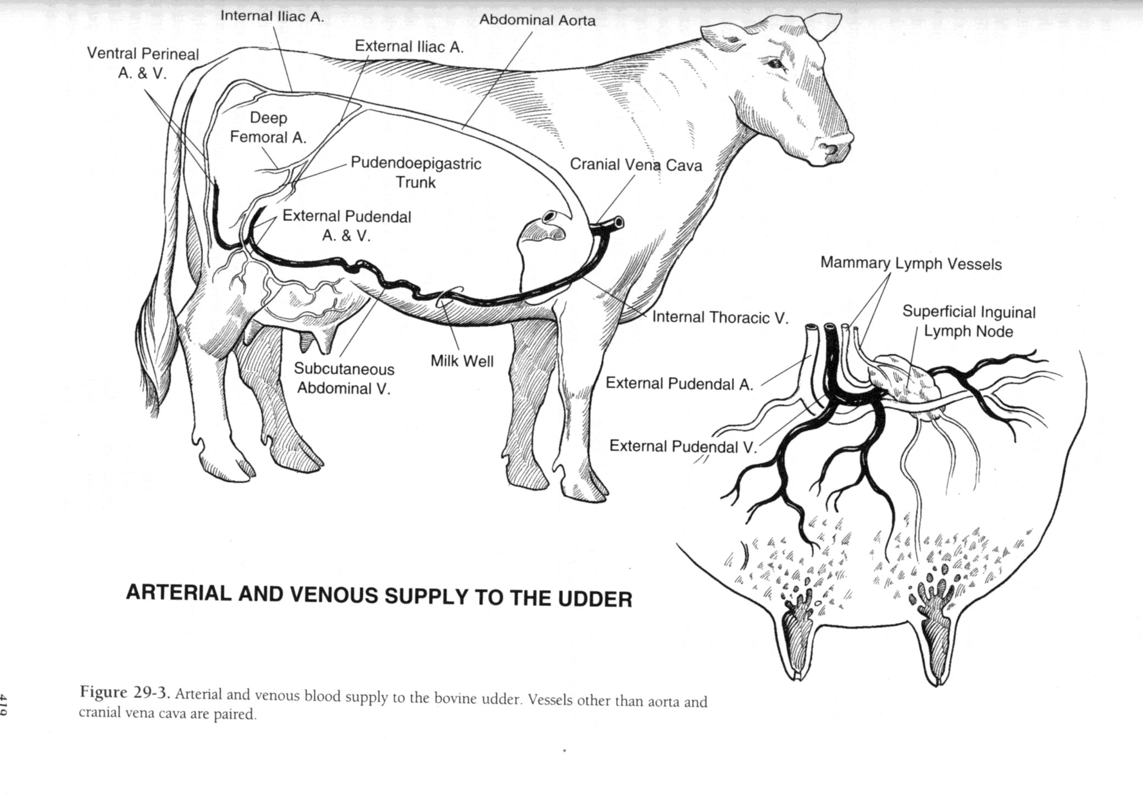

Slide 31
The lymphatic network
There is extensive lymph drainage from the teats.

originates in tissue spaces as lymphatic capillaries.
Lymph capillaries converge to form larger vessels.
Lymph flow is undirectional from the udder through lymphatic vessels, eventually dumping lymph into the vena cava.
Lymph is a clear, colorless liquid with a composition similar to blood plasma.




Slide 32
Valves in the lymphatic vessels prevent retrograde flow.


In the udder, the lymph system flows through the supramammary lymph nodes.

Slide 33
Mastitis
Inflammation of udder due to bacterial or fungal infection.
Physical and chemical composition of the milk will be changed.
In our condition one of the reasons for poor production from local cattle could be due to subclinical mastitis that go on undetected in the field.




Slide 34
Mammary gland abalation: Surgical removal of mammary glands as a remedy to disease process. Carried out only in pets for saving their life.


Slide 35
Thank you

