Slide 1
FLAME PHOTOMETRY
BASIC CONCEPTS, INSTRUMENTATION, AND APPLICATION
By
Dr. Basil, B – MBBS (Nigeria),
Department of Chemical Pathology/Metabolic Medicine,
Benue State University Teaching Hospital, Makurdi.
September 2014.

Slide 2
INTRODUCTION:
Flame photometry (more accurately called Flame Atomic Emission Spectrometry)is a branch of spectroscopy in which the species examined in the spectrometer are in the form of atoms
A photoelectric flame photometer is an instrument used in inorganic chemical analysis to determine the concentration of certain metal ions among them sodium, potassium, calcium and lithium.
Flame Photometry is based on measurement of intensity of the light emitted when a metal is introduced into flame.
The wavelength of colour tells what the element is (qualitative)
The colour's intensity tells us how much of the element present (quantitative)

Slide 3
The basic principle upon which Atomic Spectroscopy works is based on the fact that "Matter absorbs light at the same wavelength at which it emits light".
Atoms of elements → subjected to hot flame → specific quantum of thermal energy absorbed by orbital electrons → become unstable at high energy level → release energy as photons of particular wavelength → change back to ground state.
When a metal salt solution is burned, the metal provides a colored flame and each metal ion gives a different colored flame.
Flame tests, therefore, can be used to test for the absence or presence of a metal ion

Slide 4
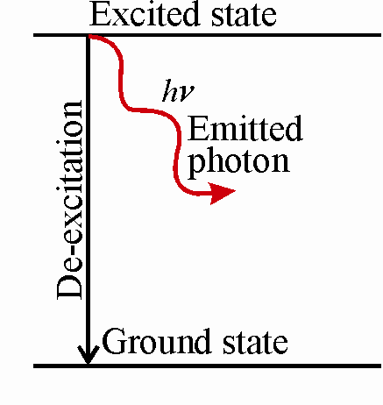
BASIC CONCEPT:
Liquid sample contaning metal salt solution is introduced into a flame,
Solvent is first vaporized, leaving particles of solid salt which is then vaporised into gaseous state
Gaseous molecule dissociate to give neutral atoms which can be excited (made unstable) by thermal energy of flame
The unstable excited atoms emit photons while returning to lower energy state
The measurement of emitted photons forms the basis of flame photometry.

Slide 5
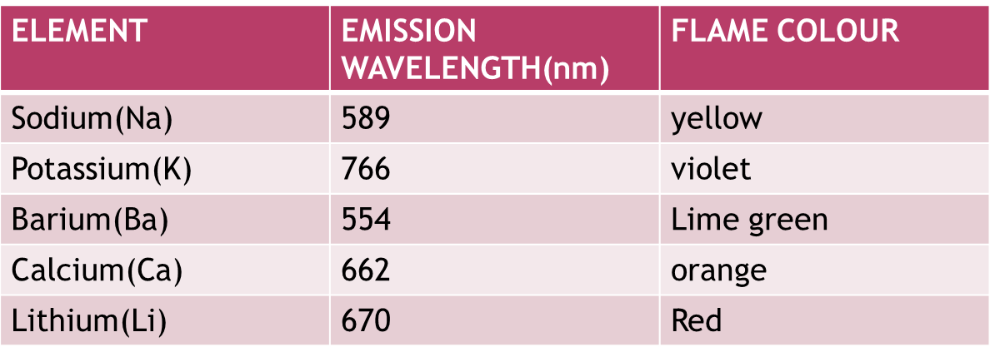
Under constant and controlled conditions, the light intensity of the characteristic wavelength produced by each of the atoms is directly proportional to the number of atoms that are emitting energy, which in turn is directly proportional to the concentration of the substance of interest in the sample.
Various metals emit a characteristic colour of light when heated.

Slide 6
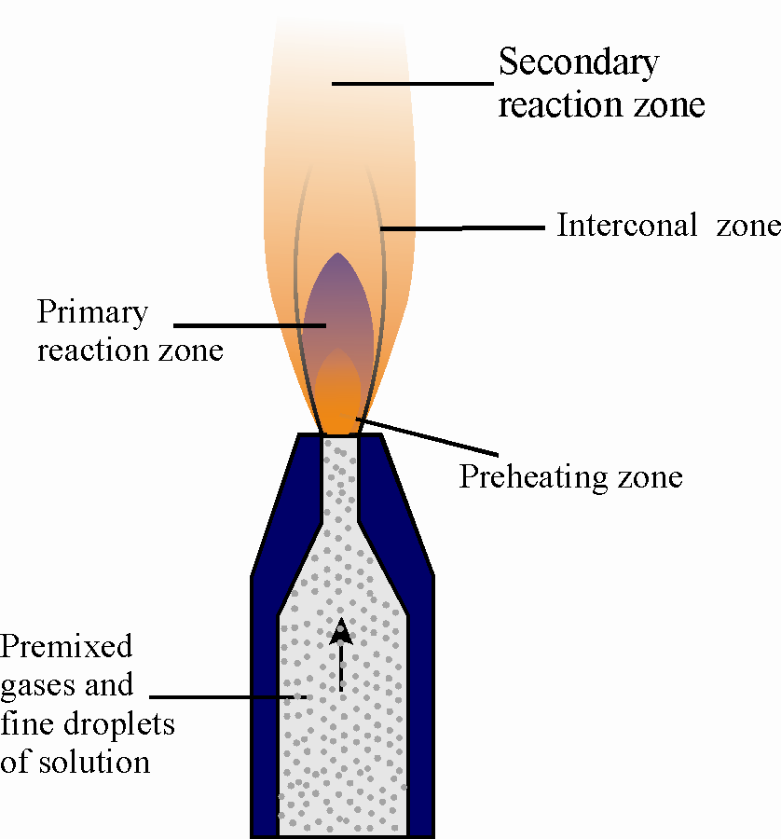
Structure of Flame:
As seen in the figure, the flame may be divided into the following regions or zones.
Preheating zones
Primary reaction zone or inner zone
Internal zone
Secondary reaction zone

Slide 7
preheating zone- In this, combustion mixture is heated to the ignition temperature by thermal conduction from the primary reaction zone.
primary reaction zone- This zone is about 0.1 mm thick at atmospheric pressure
There is no thermodynamic equilibrium in this zone and the concentration of ions and free radicals is very high.
This region is not used for flame photometry.
interconal zone – It can extend up to considerable height. The maximum temperature is achieved just above the tip of the inner zone.
This zone is used for flame photometry.
secondary reaction zone - In this zone, the products of the combustion processes are burnt to stable molecular species by the surrounding air.

Slide 8
INTERFERENCES:
In determining the amount of a particular element present, other elements can also affect the result.
Such interference may be of 3 kinds:
Spectral interferences: occurs when the emission lines of two elements cannot be resolved or arises from the background of flame itself.
They are either too close, or overlap, or occur due to high concentration of salts in the sample
Ionic interferences: high temperature flame may cause ionisation of some of the metal atoms, e.g. sodium.
The Na⁺ ion possesses an emission spectrum of its own with frequencies, which are different from those of atomic spectrum of the Na atom.

Slide 9
Chemical interferences: The chemical interferences arise out of the reaction between different interferents and the analyte. Includes:
Cation-anaion interference:
The presence of certain anions, such as oxalate, phosphate, sulfate, in a solution may affect the intensity of radiation emitted by an element. E.g.,
calcium + phosphate ion forms a stable substance, as Ca3(PO4)2 which does not decompose easily, resulting in the production of lesser atoms.
Cation-cation interference:
These interferences are neither spectral nor ionic in nature
Eg. aluminum interferes with calcium and magnesium.

Slide 10
INSTRUMENTATION:
THE FLAME PHOTOMETER

Slide 11
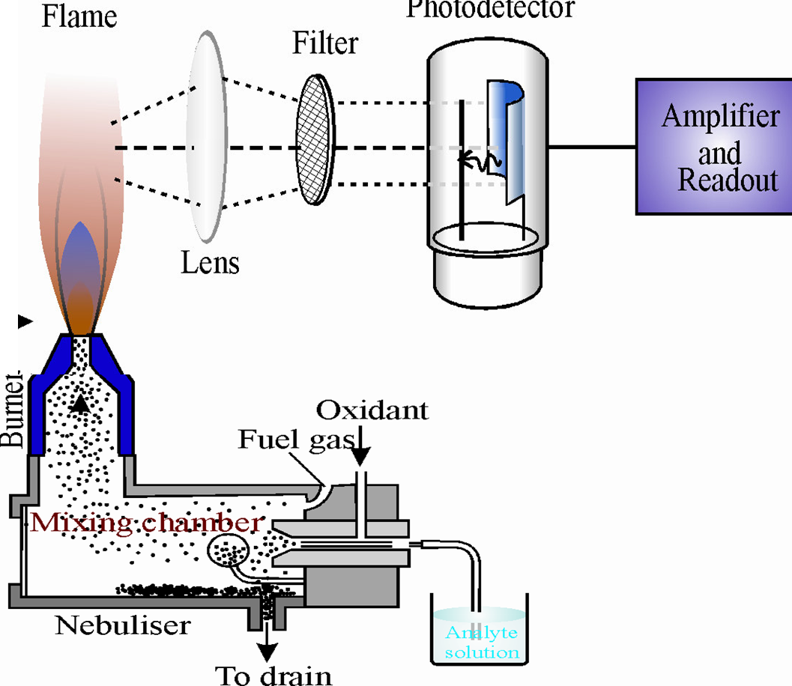
Schematic Representation of the Flame Photometer
Major Components:
Sample Delivery System
Source
Monochromator
Detector
Read out device
11

Slide 12
Sample Delivery System:
There are three components for introducing liquid sample:
Nebulizer – it breaks up the liquid into small droplets.
Nebulization the is conversion of a sample to a mist of finely divided droplets using a jet of compressed gas.
The flow carries the sample into the atomization region.
Pneumatic Nebulizers: (most common)
Aerosol modifier – it removes large droplets from the stream and allow only smaller droplets than a certain size to pass
Flame or Atomizer – it converts the analyte into free atoms

Slide 13
Source:
A Burner used to spray the sample solution into fine droplets.
Several burners and fuel+oxidant combinations have been used to produce analytical flame including: Premixed, Mecker, Total consumption, Lundergarh, Shielded burner, and Nitrous oxide-acetylene flames
Pre-mixed Burner:
widely used because uniformity in flame intensity
In this energy type of burner , aspirated sample , fuel and oxidant are thoroughly mixed before reaching the burner opening.

Slide 14
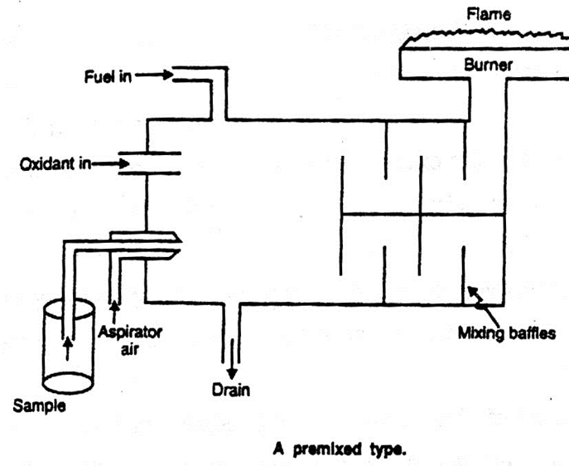
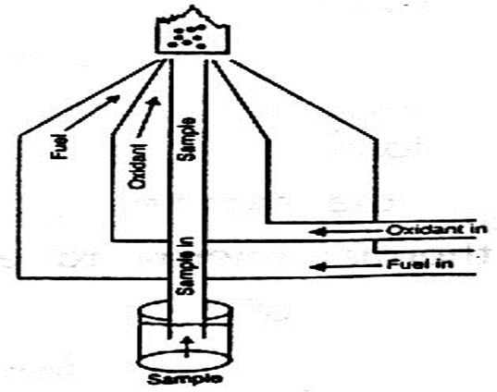
Total Consumption Burner:
In this fuel and oxidant are hydrogen and oxygen gases
Sample solution is aspirated through a capillary by high pressure of fuel and Oxidant and burnt at the tip of burner
Entire sample is consumed.
Pre-mixed burner
Total Consumption Burner

Slide 15
Monochromator:
Prism: Quartz material is used for making prism, as quartz is transparent over entire region
Grating: it employs a grating which is essentially a series of parallel straight lines cut into a plane surface
Detectors:
Photomultiplier tubes
Photo emissive cell
Photo voltaic cell
Photovoltaic cell:
It has a thin metallic layer coated with silver or gold which act as electrode, also has metal base plate which act as another electrode
Two layers are separated by semiconductor layer of selenium, when light radiation falls on selenium layer.
This creates potential diff. between the two electrode and cause flow of current.

Slide 16
Read-out Device:
It is capable of displaying the absorption spectrum as well absorbance at specific wavelength
Nowadays the instruments have microprocessor controlled electronics that provides outputs compatible with the printers and computers
Thereby minimizing the possibility of operator error in transferring data.
Element | wavelength | Detection limit | Element | wavelength | Detection limit
Al | 396 | 0.5 | Pb | 406 | 14
Ba | 455 | 3 | Li | 461 | 0.067
Ca | 423 | 0.07 | Mg | 285 | 1
Cu | 325 | 0.6 | Ni | 355 | 1.6
Fe | 372 | 2.5 | Hg | 254 | 2.5
Elements, their characteristic emission wavelengths and detection limits

Slide 17
APPLICATIONS:
To estimate sodium, potassium, calcium, lithium etc. level in sample of serum, urine, CSF and other body fluids.
Flame photometry is useful for the determination of alkali and alkaline earth metals.
Used in determination of lead in petrol.
Used in the study of equilibrium constants involving in ion exchange resins.
Used in determination of calcium and magnesium in cement.

Slide 18
REFERENCES:
Tietz Textbook of Clinical Chemistry and Molecular Diagnostics.
Basic Clinical Biochemistry Practice, second edition, editied by O. A. Afonja.
College Analytical Chemistry, Himalaya Publishing House, 19th Edition (2011), By K.B.Baliga et al. Chapter 4 - Optical Methods, Pages : 135-148.
http://www.hindawi.com/journals/chem/2013/465825/
Practical Biochemistry, Principles & Techniques, Cambridge low-price editions, 5th Edition, Edited By Keith Wilson & John Walker, Chapter: Spectroscopic Techniques, Pages : 486-490.

Slide 19
THANK YOU FOR LISTENING

