Slide 1
Criminal justice system

Slide 2
cONTENTS
Introduction
Structure of police
Police and forensic scientist relationship with reference to crime investigation
Modus operandi and its role in crime record
Maintenance of crime records
Prosecution and judicial organizations
Courts in India
Jurisdiction of courts in criminal cases and FIR

Slide 3
Introduction:-
Criminal justice system is the delivery of justice to those who have committed crimes .It is a series of govt. agencies and institutions whose goal is to identify and catch the law-breakers and to inflict a form of punishment on them.
Other goals include rehabilitations of offender, preventing other crimes and moral support for victims.
The primary institutions of the criminal justice system are the police, prosecution and defence lawyers ,the courts and prison.
The criminal justice system consists of 3 main parts:
1.law enforcement agencies , usually the police
2.Courts and accompanying prosecution and defence lawyer .
3.Agencies for detaining and supervising offender, such as prison and probation agencies.

Slide 4
Structure of police
The first contact a defendant has with the criminal justice system is usually with the police ,who investigated the suspected wrongdoing and make an arrest, but if the suspect is dangerous to the whole nation , a national level law enforcement agency is called in.
The word comes from the Latin word ‘politia’ [civil administrations] which itself derived from the Ancient Greek word ‘polis’-city.
Police are primarily concerned with keeping the peace and enforcing criminal law based on their particular mission and jurisdiction.
Formed in 1908 ,the federal bureau of investigation began as an entity which could investigate and enforce specific federal laws and ‘Law enforcement agency’ in the united states ,this however has constituted only a small portion of overall policing activity.

Slide 5
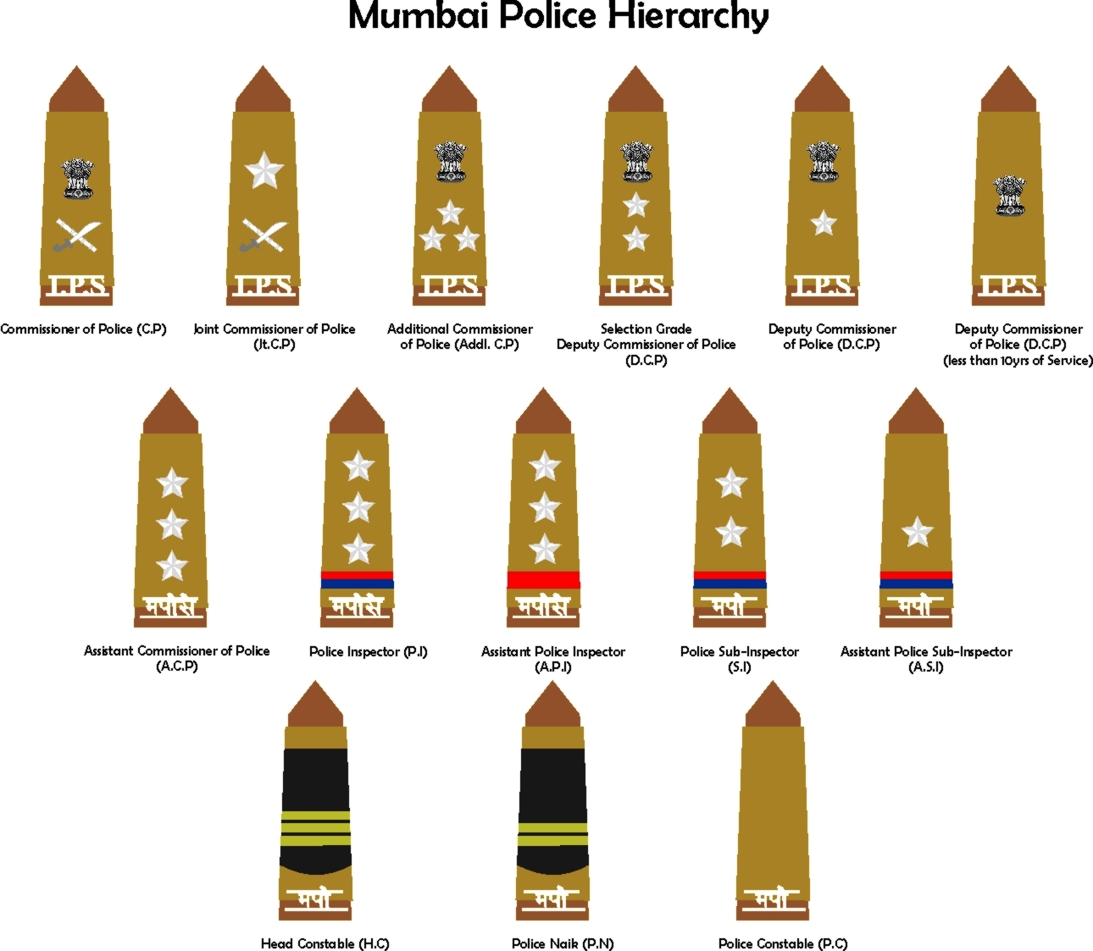

Slide 6
Police and forensic scientist relationship with reference to crime investigation
The relationship can be studied on the basis of the role they play in the same scene investigation.
A police person identifies an evidence while a forensic scientist examines the evidences in lab.
A police person dispatches the evidences while a scientist experiments ,makes observation collects necessary data and draws conclusion.
A police person maintains the chain of custody of evidencs while a forensic scientist prepares a report and pesent in the court.

Slide 7
Modus operandi
Modus operandi is a Latin word which means a ‘method of operating’.It is used by law enforcement agencies to refer to a criminal pattern of behaviour on his/her way of committing crime.
M.O has been defined as ‘the actions taken by a criminal to perpetrate a crime successfully. A criminal’s M.O is comprised of learned behaviours that can evolve and more confident .
Purpose for the offender
To protect identity
To ensure success
For proper line of approach
To facilitate escape
Types of modus operandi
Offense location selection
Use of a weapon during crime
Offender precautionary acts
Offender transportation to and from the crime scene

Slide 8
Influences on modus operandi
A criminal’s modus operandi behaviour is learned and therefore dynamic and malleable. This is because modus operandi behaviour is affected by time and can change as the criminal discovers that some of the thing done during a crime are more effective than others.
Criminals can subsequently recognize these effective actions repeat them in future offenses and become more skillful, refining their overall modus operandi. However ,behaviour may also change due to the influences of control substances.

Slide 9
Functions of modus operandi BUREAU
To maintain records of interstate and indistrict criminals.
To maintain complete history of related criminals
To complete monthly diaries and further submission, to NCRB .New Delhi
To disseminated information regarding crime
TENDENCY FOR LAW ENFORCEMENT
The tendency for law enforcement to rely solely on modus operandi behaviour like victim type, weapon selection and location type as a basis for case linkage.
The possibility that one predatory offender operating in or near the same general area as another confusing law enforcement effort.

Slide 10
Importance of modus operandi evidences
Modus operandi evidence is helpful to the prosecution .If the prosecution has evidence of crime committed by the defendant that are similar to the crime charged .The crime need to be identical .But the prosecution must make a strong and persuasive showing of similarity between the crime charged and other crimes.

Slide 11
Maintainance of crime records
FIR filing
Case diary maintenance
Maintenance of chain of custody
Hearing and legal proceedings
Charge-sheet

Slide 12
Prosecution and judicial organisation
The prosecutor is a lawyer who bring charges against a person ,persons or corporate entity. It is the prosecutor’s duty to explain to the court what crime was committed and to detail what evidence has been found which incriminates the accused.
The prosecutor should not be confused with a plaintiff or plaintiff’s counsel.
A defence attorney counsels the accused on the legal process, likely outcomes for the accused and suggests strategies.
It is the duty of defence attorney to represent the interests of the client, raise procedural and evidentiary issues, and hold the prosecution to its burden of proving guilty beyond a reasonable doubt.
The final determination of guilt or innocence is typically made by judge or a jury panel composed of unbiased citizens.

Slide 13
Courts in india
Place where ‘arguments’ get settled
Court applies the law to the argument at hand
Court give the punishment
There are mainly three types of court
Supreme court
High court
District court

Slide 16
Jurisdiction of courts
In India,justice is delivered through court of law .The Indian constitution outlines setup of Indian courts to administers the functioning of the laws within the country.
SUPREME COURT
It is the court of appellate jurisdiction (Article 132 to 136).In case of violation of Fundamental Rights granted under the consitutions of India,a Write petition(Article 32(2))can be filed in the supreme court of India.In addition, Supreme Court has original jurisdiction and advisaory jurisdiction of the supreme (Article 143).The supreme court and High courts also enjoy the power of judicial review.

Slide 17
HIGH COURT
Principally ,the high court also enjoy the appellate jurisdiction(Article 225), correspondingly High Courts at Calcutta, Mumbai, Delhi,chennai also enjoy original jurisdiction .
In case of violation of Fundamental Rights and ‘for any other purpose’ found in article 226 ,an aggrieved party can approach the high court by filing a writ petition.
DISTRICT AND SESSION COURTS
Generally ,each state is divided into judicial district presided over by a ‘District and sessions judge’.He is known as a District Judge when he presided over a civil case, and a sessions judge when presides over a criminal case. He is the highest judicial authority at district level.consitution of courts below this level varies from state to state.

Slide 18
Main components of court
Judge
Public prosecutors
Defence lawyer
Judge:-The judge, hears all the witnesses and see the evidence presented by both the parties
The judge decides whether the accused person is guilty or innocent
If the accused is convicted ,then the judge pronounces the sentence
He may send the person to jail or impose a fine or both according to the law prescribes.

Slide 19
Defence lawyer :-Represent the accused after arrest to give advice
Investigate details of the offense on behalf of the accused
Discuss the case with the prosecutor and test the strength of the state’s case
Represent the accused at bail hearings
Represent the accused at trail
Present an appeal
Public prosecutor:-
Lawyer who represent the state and conduct criminal cases against defendants.
The role of the prosecutor begins once the police filed charge-sheet in the court
The prosecutor must conduct the prosecution on behalf of the police investigation
It his/her duty to present all the facts ,witnesses and evidence before the court
He/she has the right to a speedy trial.

Slide 20
Fir(first information report)
1.What is an FIR?
FIR is a written document prepared by the police when they receive information about the commission of a cognizable offence.It is a report of information that reaches the police first in point of time and that is why it is called so.
2.Why is FIR important?
An FIR is a very important document as it sets the process of criminal justice in motion.It is only after the FIR is registered in the police station that the police takes up investigation of the case.
3.Who can lodge an FIR?
Anyone who knows about the commission of a cognizable offence can file an FIR.It is not necessary that only the victim of the crime should file an FIR.A police officer who comes to know about a cognizable offence can file an FIR himself/herself.

Slide 21
YOU CAN FILE AN FIR IF:
You are the person against whom the offence has been committed
You know yourself about an offence which has been committed
THE POLICE MAY NOT INVESTIGATE A COMPLAINT EVEN IF YOU FILE A FIR
When:-
The case is not serious in nature
The police feel that there is not enough ground to investigate.
however, the police must record the reasons for not conducting an investigation and in the later case must also inform you.-[Section 157, Criminal Procedure Code,1973]

Slide 22
WHAT IS THE PROCEDURE OF FILING AN FIR?
The procedure of filing an FIR is prescribed in section 154 of the Criminal Procedure Code ,1973.
When information about the commission of a cognizable offence is given orally , the police must write it down.
It is your right as a person giving information or making a complaint to demand that the information recorded by the police is read over to you.
Once the information has been recorded by the police is as per the details given by you.
You should sign the report only after verifying that the information recorded by the police as per the details given by you.
People who can not read or write must put their left thumb impression on the document after being satisfied that it is a correct record. Always ask for a copy of the FIR ,if the police do not give it to you. It is your right to get it free of cost.

Slide 23
What you should mention in the fir?
Your name and address
Date ,time and location of the incident you are reporting
The true facts of the incident as they occurred
Names and description of the persons involved in the incident
Refusal to register an FIR is against the law
Witnesses , if any
THINGS YOU SHOULD NOT DO-
Never file a false complaint or give wrong information to the police. You can be prosecuted under law for giving wrong information or for misleading the police .
Never exaggerate or distort facts
Never make vague or unclear statements

Slide 24
Benefits of early recording of fir
The early recording of FIR helps in the arrest of the real offenders and also helps in the collection of evidence of the crime.
The version given in the FIR recorded without undue delay is considered more reliable by the courts.Delay in reporting the matter to the police can raise suspicion that the version may be colored or concocted or an exaggerated account of the incident or innocent persons may have been roped in.
The reason for delay should also be explained in the FIR.

Slide 25
Improve criminal justice system in india
Simplification of rules and procedures
Repealing of outdated laws
Criminal law amendment
Police as investigative agency
Judicial accountability
Appointment, promotion and transfer of judges
Average judge-population ratio
Perjury and contempt of court
Efficient public prosecutor
Transparency of court proceedings
Time bound filling of vacant post in the judiciary

Slide 26
THANK YOU

