Slide 1
OVERVIEW OF STEM CELLS
Presented by ,
Tamosa Mukherjee

Slide 2
CONTENTS
Introduction
History
Unique properties
Division
Classification
Embryonic stem cells
Adult stem cells
Sources
Applications

Slide 3
WHAT ARE STEM CELLS ?
Stem cells are special human cells that have the ability to develop into many different cell types ;
These are biological cells found in all multicellular organisms.
A stem cell is “uncommitted”, until it receives a signal to develop into a specialized cell.

Slide 4
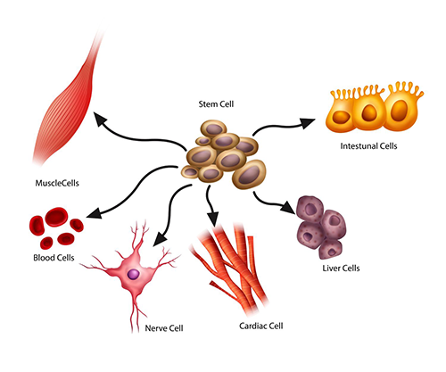

Slide 5
HISTORY
The term ‘stem cell’ was coined by Alexander Maximow in the year 1909.
In 1963, Ernest McCulloch and James Till demonstrated the presence of hematopoietic stem cells in mice.
Robert Good in 1968 performed the first successful bone marrow transplantation on a child.

Slide 6
UNIQUE PROPERTIES
Unspecialized, also called “Blank cells”.
Can divide in self renewal without undergoing senescence; called as proliferation.
Differentiates into several specialized cells, like heart muscle cells, blood cells or nerve cells.
Plasticity

Slide 7
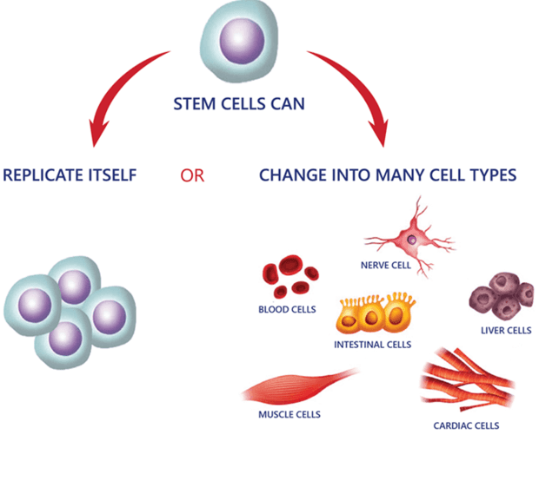

Slide 8
Stem cell division
Obligatory asymmetric replication
Stem cell divides into one cell identical to the original
Another cell that is differentiated
Stochasttic differentiation
One stem cell develops into two differentiated daughter cell
Or two identical stem cells are produced identical to the original

Slide 9
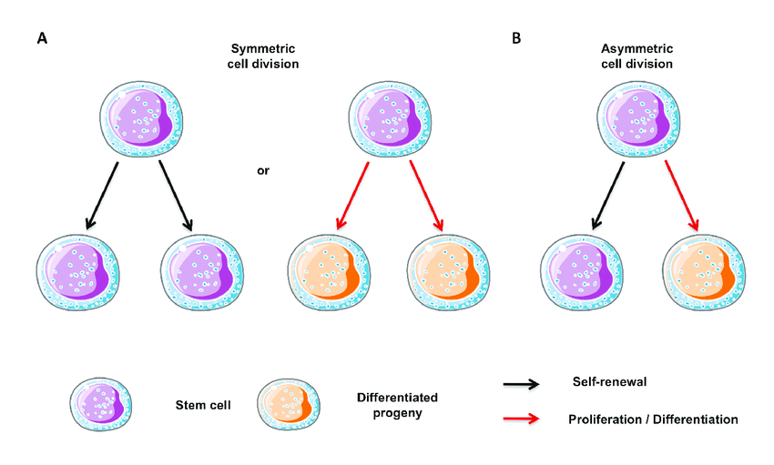

Slide 10
CLASSIFICATION
Stem cells
Source of origin
embryonic
adult
Potency
totipotent
Pluripotent
multipotent
Oligopotent
Unipotent

Slide 11
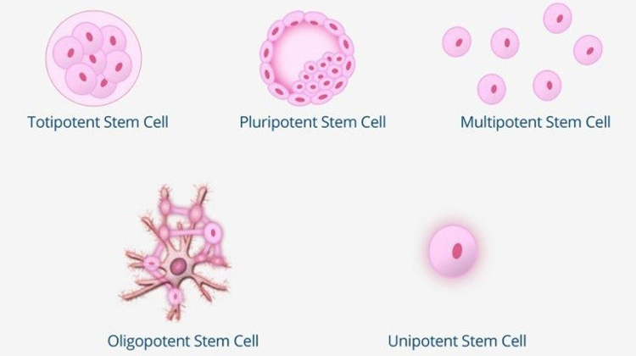

Slide 12
EMBRYONIC STEM CELLS
Pluripotent in nature and are derived from the inner cell mass of blastocyst or earlier morula stage.
4-5 days old and have 50-150 cells.
Able to differentiate into all derivatives of the three germ layers.
Do not contribute to extraembryonic membranes or the placenta.

Slide 13
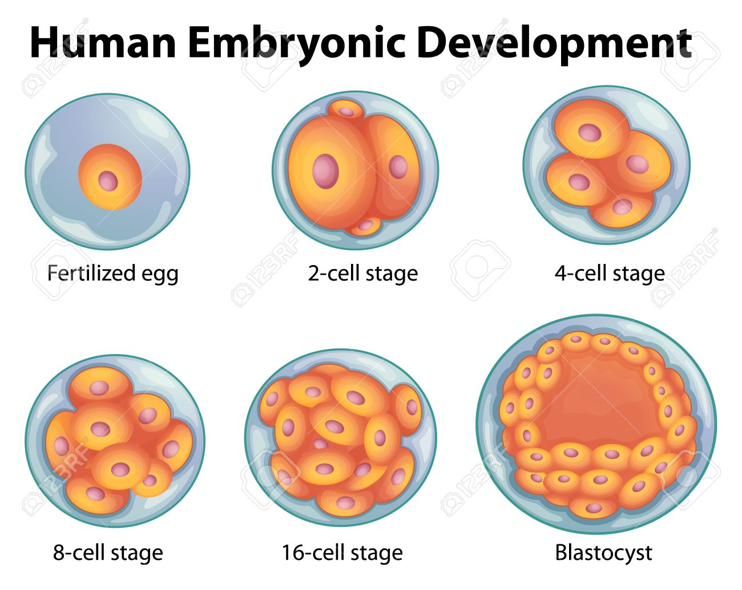

Slide 14
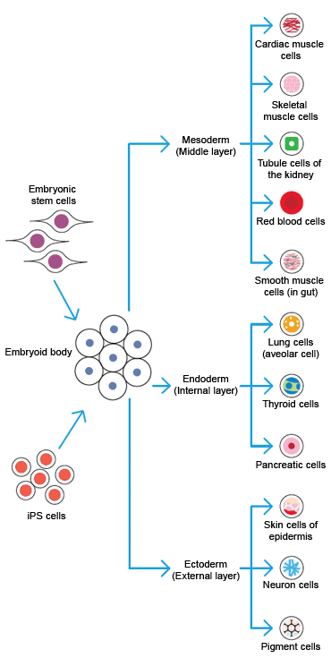

Slide 15
Advantages of embryonic stem cells
Flexible : potential to make any cell.
Immortal : can provide endless supply of cells
Availability
Disadvantages :
Uniform and homogenous differentiation is difficult
Immunogenic

Slide 16
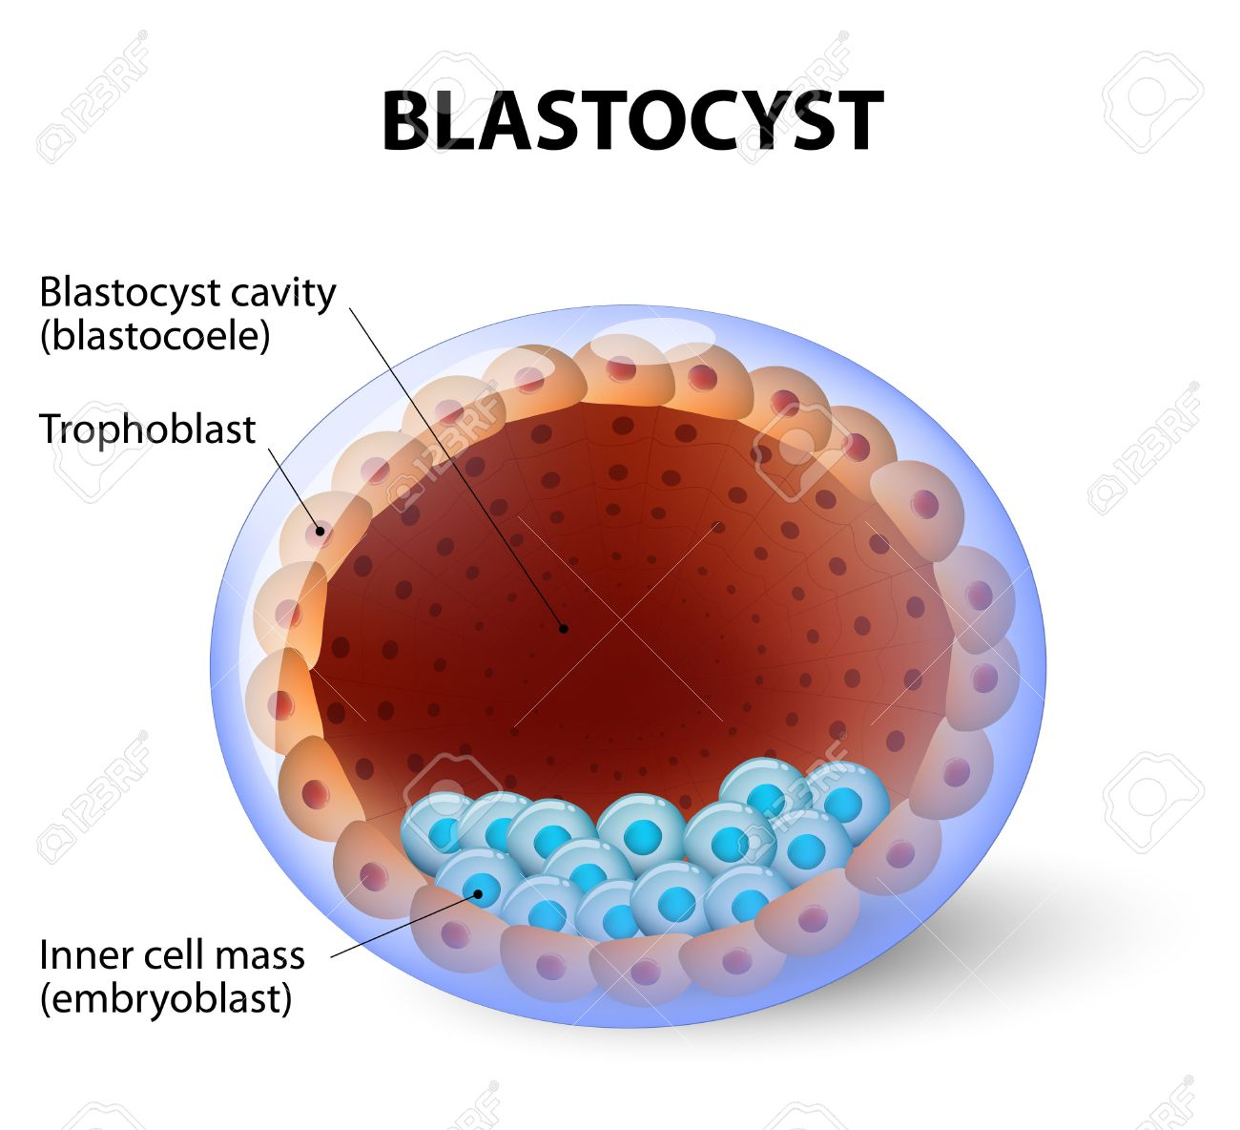

Slide 17
ADULT STEM CELLS
Also called somatic stem cells;
Undifferentiated cells found among differentiated cells or an organ .
Multipotent in nature
Present in bone marrow and other tissues.
Primary role is to maintain and repair the tissue in which they are found.

Slide 18
Advantages of Adult Stem Cells
Non-immunogenic to recipients who receive products of their own stem cells.
Relative ease of procurement.
No harm done to the donor.
Disadvantages :
Limited quantity
Finite
Less flexible

Slide 19
Sources of Stem Cells
Bone marrow
Blood
Umbilical cord blood
Fetal tissue (after abortion )
Embryos created by IVF

Slide 20
Induced Pluripotent Stem Cells (IPC’s)
Reprogrammed adult cells to give rise to pluripotent capabilities.
Used for therapeutic purposes.
Fetal Stem Cells
Fetal proper stem cells come from the tissue of the fetus obtained after an abortion.
Extraembryonic fetal stem cells come from extraembryonic membranes.

Slide 21
Amniotic Stem Cells
Multipotent stem cells derived from the amniotic fluid.
Can differentiate in cells of adipogenic, osteogenic, myogenic, endothelial, hepatic and also neuronal lines.

Slide 22
Applications
Stem cells can be used to study development.
Have the ability to repair and replace damaged cells.
Disease study
Provide resource for new medical treatments.

