Slide 1
TRANSGENIC PLANT
(DROUGHT/STRESS RESISTANCE AND DELAYED RIPENING)

Slide 2
TRANSGENE:
It is a foreign gene or genetic material that has been transferred naturally or by any of a number of genetic engineering techniques from one organism to another.
TRANSGENIC PLANT:
The plant whole genome is altered by adding one or more transgenes are known as transgenic plant.

Slide 3
HISTORY
1982- 1st transgenic plant produced which is an antibiotic resistance tobacco plant.
1984- 1st successful plant genetic engineering experiments using caulimovirus vector.
1994- 1st genetically modified crop approved for sale U.S. was Flavr Savr tomato.
1995- 1st pesticide producing crop, Bt potato was approved by U.S. Environmental Protection Agency.
2000- Golden rice with bita- carotene developed with increased nutrient value.

Slide 4
WHY GENETICALLY ENGINEERING PLANTS:
To improve the agricultural, horticultural or ornamental value of a crop plant.
To serve as a bioreactor for the production of economically important proteins or metabolites.
To provide a powerful means for studying the action of genes during development and other biological processes.

Slide 5
GENE TRANSFER METHODS
BIOLOGICAL METHODS
Agrobacterium mediated gene transfer
Plant virus vector
PHYSICAL METHODS
Electroporation
Microprojectile
Microinjection
Liposome fusion
CHEMICAL METHODS
Polyethylene glycol mediated
Diethylaminoethyl dextran mediated

Slide 6
APPLICATION OF PLANT GENETIC ENGINEERING:
Crop improvement
Genetically engineered traits
Biotech revolution
Genetically engineering foods

Slide 7
DROUGHT/ STRESS RESISTANCE
Drought or stress resistance is the ability to which a plant maintains its biomass production during drought or biotic and abiotic stress condition.
Specifically crops like corn, wheat and rice have become increasingly tolerant to drought with new varieties created via genetic engineering.
Abscisic acid, a plant stress hormone induces the closure of leaf stomata, thereby reducing water loss through transpiration.

Slide 8
SALT TOLERANT
Approximately ne- third of the world’s irrigated land has become unsuitable for growing crops because of contamination with high levels of salt.
To create more salt tolerant plants, scientists have tried to engineer an increase in the cellular accumulation of the following osmoprotectants: proline, thehalose, sugar, alcohol, d-ononitol, mannitol, sorbitol, glycine betaine etc.

Slide 9
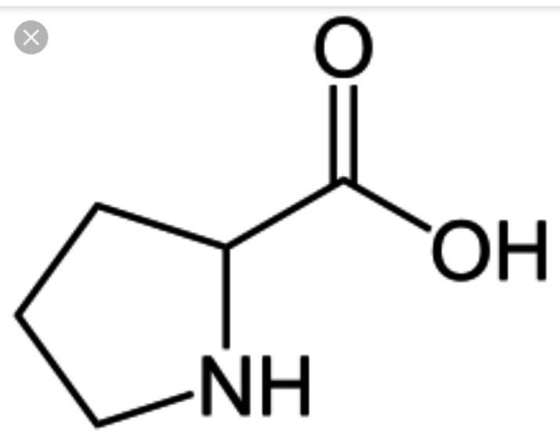
PROLINE
Proline accumulates I many organisms in response to drought and salinity.
Proline is encoded by a nuclear gene pyrolne 5- carboxylate synthatase (P5CS).
It acts as a drought, salt, heat tolerant and osmotic stress tolerance.

Slide 10
GLYCINE BETAINE
GB accumulates in the chloroplasts and plastids and increases the tolerance of plants to various abiotic stresses (drought, salinity and freezing)
It an also protects proteins and enzyme activities under water deficits and stabilize membranes during freezing.
Accumulation of GB is limited due to choline supply.
Transgenic potato plants expressing a bacterial choline oxidase (betA) gene leads to high levels of GB under drought.

Slide 11
SUGAR AND SUGAR ALCOHOLS
Accumulation of sugar related compounds response to osmotic stress.
These compounds stabilize the membranes and proteins during dehydration.
Eg: d-sorbitol, mannitol, sorbitol

Slide 12
TREHALOSE
it is a natural alfa-linked disaccharide formed by an alfa or alfa-1 bond between two alfa-glucose units.
It protect the plant against inhibition by high levels of salt in the soil.
Tps1 gene synthesis thehalose-6-phosphate.

Slide 13
DELAYED RIPENING
Ripening is a normal phase in the maturation process of fruits and vegetables.
Ethylene is a natural plant hormone associated it growth, development ripening and aging of many plants.
It is produced in varying quantities depending on the type of fruits.

Slide 14
Delay ripening can be done by blocking the expression of genes induced by ethylene and by blocking ethylene synthesis we can delayed ripening of fruits.
By the antisense technology ACC deaminase inhibits ACC oxidase and produce ammonia and alfa- ketobutyrate instead of ethylene.

Slide 15
Some of the genes that are induced during ripening encode the enzymes cellulose and polygalacturonase.
By interfering with the expression of these genes ripening process might be delayed.
The lowering of polygalacturonase production inhibited fruit ripening in tomatoes permitting the tomatoes to ripen on the vine insead of being harvested while they were still green.
The genetically engineered tomato is known as the flavr savr.

Slide 16
THANK YOU

