Slide 1
Transgenic Animals

Slide 2


Contents
1
Introduction
2
Creating Transgenic Animals
3
Examples of Transgenic Animals
Finite Cell Lines

Slide 3
Few Questions????
What is a Transgenic Organism?
  A transgenic organism is one which contains novel heritable genetic material, derived from a different species using molecular cloning techniques.
  Although the name “transgenic” can be applied to any organism which fits the definition, it is unusual for bacteria or single-celled eukaryotes which have been genetically modified to be referred to as being transgenic. Instead, the expression is mostly used to refer to multicellular eukaryotes.
  Often, the term “genetically modified organism” (or “GMO”) is used to refer to transgenic organisms.

Slide 4
Few Questions????
What kinds of organism can be made transgenic?
  Mammals - mice, rats, hamsters, rabbits, cows, sheep, goats and pigs.
  Amphibians such as frogs and toads have also been made transgenic.
  Birds such as chickens.
  Transgenic fishes - salmon, trout and catfish
  Invertebrates - fruit fly Drosophila melanogaster, nematode Caenorhabditis elegans
  If we turn to plants - all the major crop plants of the world (such as rice, maize, wheat, barley, potatoes and soy beans)
The above list raises the obvious question:
Is it possible to make transgenic human?

Slide 5
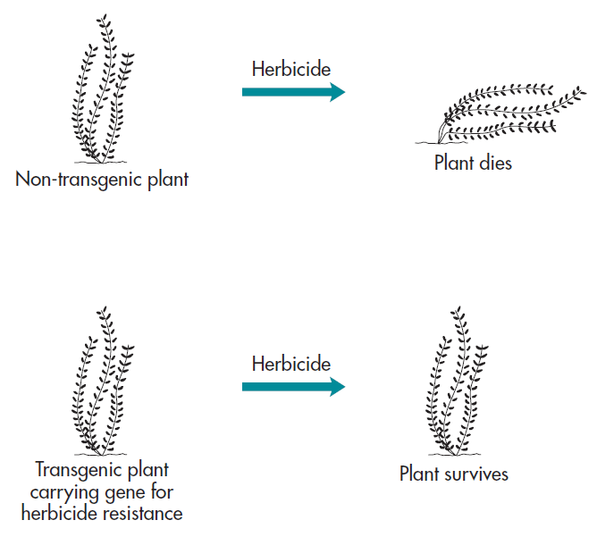
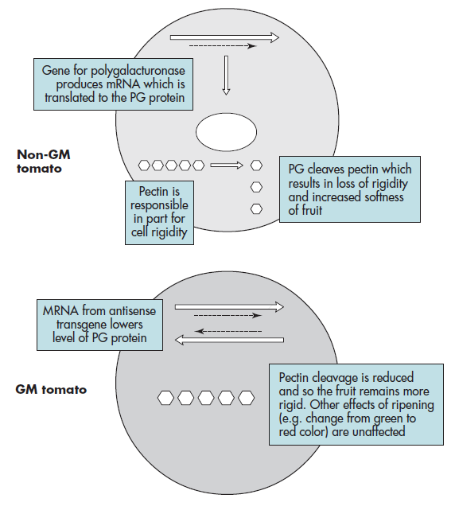
Few Questions????
Why Make Transgenic Organisms?
  There are numerous reasons
as tools in pure research
Changing the phenotype of an organism by expressing a novel gene product
Using transgenic organisms as bioreactors – biopharming
Turning genes off
Analysis of gene expression using reporter genes

Slide 6
General Principles
Introduce the new construct
into a cell of the organism
from which a complete new
organism can be derived
Isolate the gene or genes
of interest
Regenerate a complete
organism from the
transformed cell
Identify organism
containing the transgene
in germ line cells
Identify progeny that
contain the transgene
in all cells
Modify the gene for
suitable expression
or targeting in the
new host
Constructing a transgenic organism

Slide 7

Three Major Methodologies
The Retroviral Vector Method
Major Methods
The Engineered Embryonic Stem Cell
Method
The DNA Microinjection Method

Slide 8
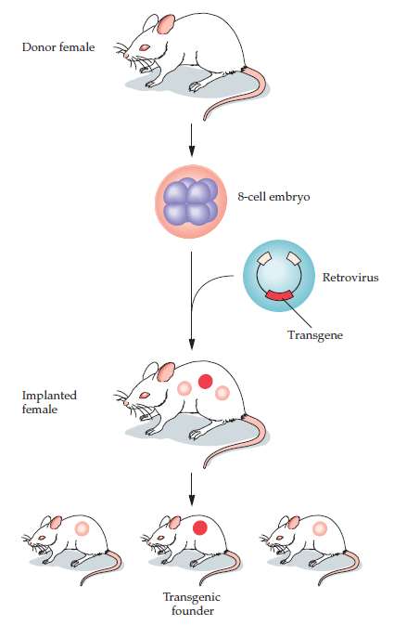
The Retroviral Vector Method
Of the various gene transfer methods, the use of retroviral vectors has the advantage of being an effective means of integrating the transgene into the genome of a recipient cell.
Retroviruses have RNA genomes that are used as templates for reverse transcriptase to synthesize a DNA copy that can be inserted into the host cell genome.

Slide 9
Genome size is 7-10kb ssRNA containing Long terminal repeats(LTR) on both ends that flank rev, gag, pol and other regulatory gene.
When its enter in cytoplasm of host cell it reverse transcribed into DNA then its integrated into the host cell genome (Provirus) and express themselves along with host genome.

Slide 10
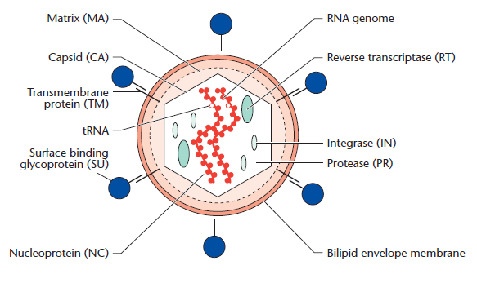
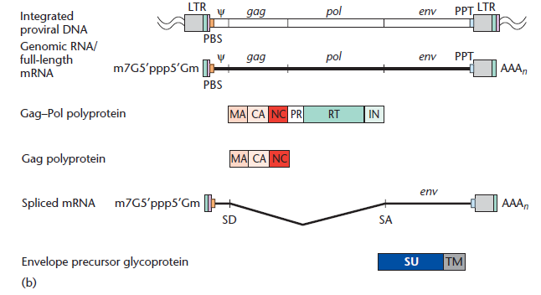
Retroviral Biology

Slide 11
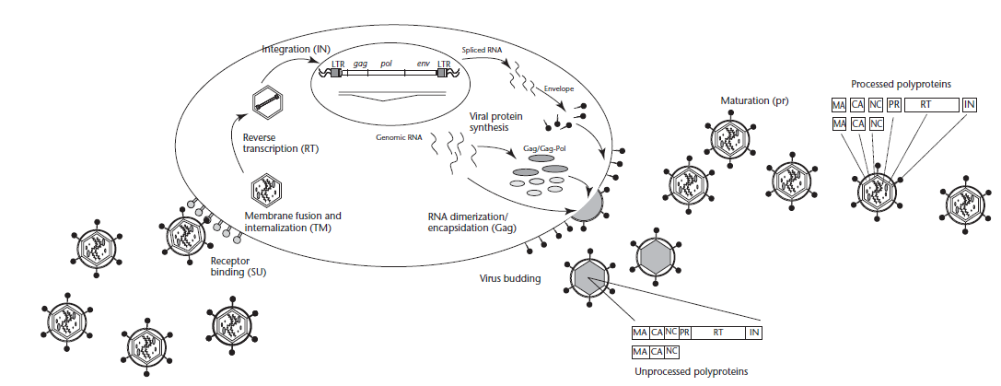
Infection by Retroviruses

Slide 12
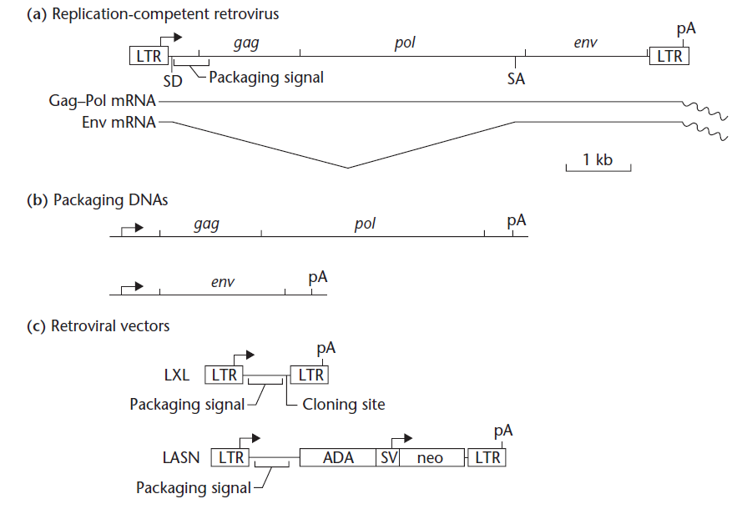
LTR: retroviral long terminal repeat; SD: splice donor; SA: splice acceptor; pA: polyadenylation signal; ADA: adenosine deaminase; SV: simian virus-40 promoter and enhancers; neo: bacterial neomycin phosphotransferase cDNA; Wavy lines: polyA sequences.

Slide 13
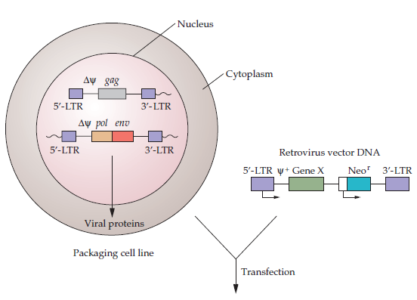
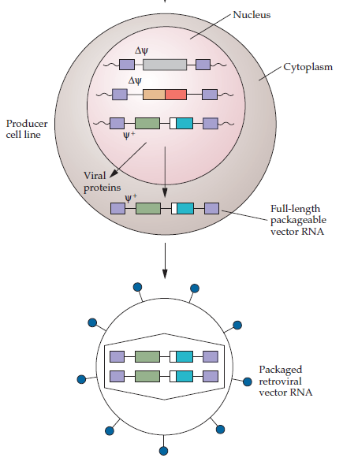

Slide 14
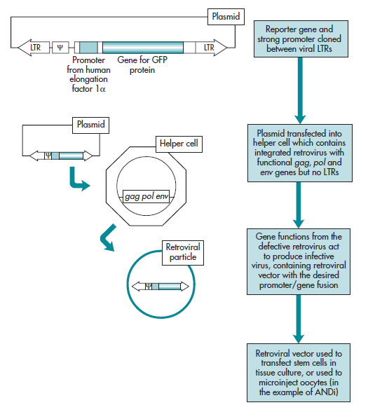
Production and use of retroviral vector

Slide 15
Because of the disadvantages of the retroviral vector method, microinjection of DNA is currently the preferred method for producing transgenic animals.

Slide 16
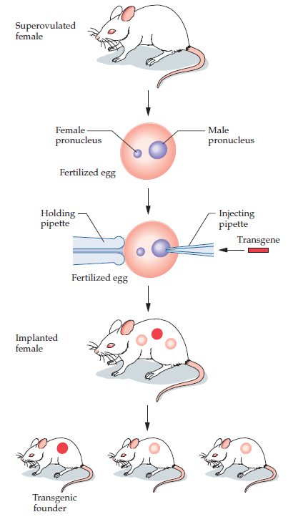
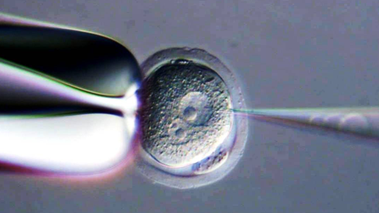

Slide 17
The Engineered Embryonic Stem Cell Method
Cells from the early, blastocyst stage of a developing mouse embryo can proliferate in cell culture and still retain the capability to differentiate into all other cell types—including germ line cells—after they are reintroduced into another blastocyst embryo.
Such cells are called pluripotent embryonic stem cells.

Slide 18
Establishing transgenic mice with genetically engineered embryonic stem (ES) cells.
An embryonic stem cell culture is initiated from the inner cell mass of a mouse blastocyst.
The embryonic stem cells are transfected with a transgene.
After growth, the transfected cells are identified by either the positive-negative selection procedure or PCR analysis.
Populations of transfected cells can be cultured and inserted into blastocysts, which are then implanted into foster mothers.
Transgenic lines can be established by crosses from founder mice that carry the transgene in their germ lines.

Slide 19
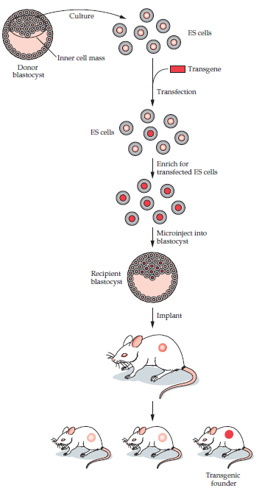

Slide 20
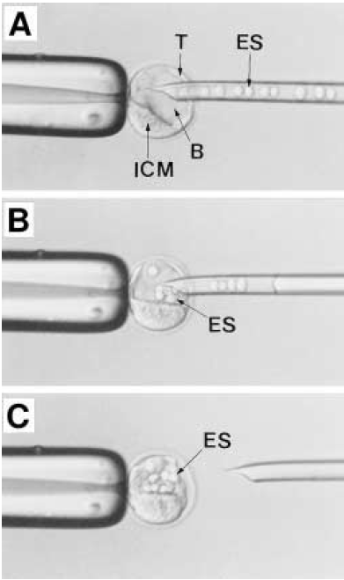

Slide 21
After transfection of embryonic stem cells in culture with a DNA vector that is designed to integrate within a specific chromosomal location, some cells will have DNA integrated at non target (spurious) sites, whereas in other cells, integration will occur at the target (correct) site.
The target site should be located in a section of genomic DNA that encodes no essential products, so that after integration of the input DNA, there is no interference with any developmental or cellular functions.

Slide 22
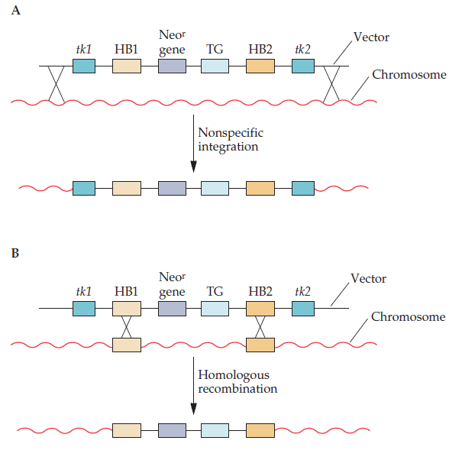
A targeting DNA vector for the positive-negative selection procedure usually contains
Two blocks of DNA sequences (HB1 and HB2) that are homologous to separate regions of the target site;
The transgene, which
will confer a new function on the recipient;
a DNA sequence that codes for resistance to the compound G-418 (Neor);
Two different genes for thymidine kinase (tk1 and tk2) from herpes simplex virus types 1 and 2 (HSV-tk1 and HSV-tk2)
The arrangement of these sequences is key to the positive-negative selection procedure.
Between the two blocks of DNA that are homologous to the target site are the genes for the transgene and Neo resistance gene. Outside of each of the homologous blocks are the genes HSV-tk1 and HSV-tk2.

Slide 23
Positive-Negative Selection
Result of nonspecific integration.
  Both genes for thymidine kinase (tk1 and tk2), the two DNA sequences that are homologous to a specific chromosomal region in the recipient cells (HB1 and HB2), a gene (Neor) that confers resistance to the cytotoxic compound G-418, and the transgene (TG) are incorporated into the chromosome.
  After transfection, cells are selected for resistance to both neomycin and the compound ganciclovir, which becomes cytotoxic to cells that synthesize thymidine kinase. Other nonhomologous integrations may occur and produce inserts with one or the other of the thymidine kinase genes. After treatment with neomycin and ganciclovir, all the cells with nonspecific integration of the input DNA that includes at least one of the thymidine kinase genes are killed.
Result of homologous recombination.
  The product of a double crossover between homologous blocks (HB1 and HB2) of DNA on the vector DNA and on chromosomal DNA does not contain either of the two thymidine kinase genes (tk1 and tk2). After treatment with G-418 and ganciclovir, only cells that have undergone homologous recombination survive.

Slide 24
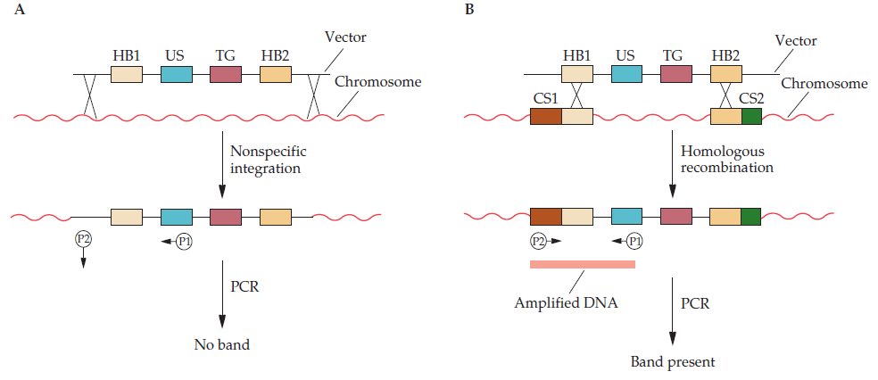
A more direct way to detect embryonic stem cells that carry a transgene at a targeted chromosomal site is to use PCR.

Slide 25
Transgenic Animals Examples
Dolly and other livestock
  In a highly publicized case, a sheep named Dolly was cloned by transfer of a nucleus from a mammary (udder) cell of an adult sheep into an egg cell.
  This was the first demonstration of pluripotency (totipotency) of a nucleus of a differentiated adult cell.
  Since the cloning of Dolly, somatic cell nuclei have been used to clone cattle, goats, sheep, and pigs.

Slide 26
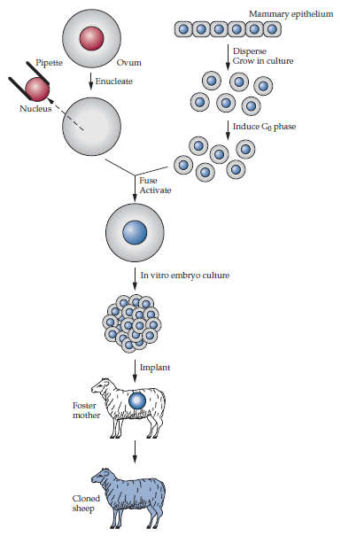
Embryonic, fetal, or adult donor cells from a variety of cell types (e.g., mammary epithelial and ovarian cells, fibroblasts, and lymphocytes) are isolated, cultured, and genetically modified using methods described till now.
Although not always feasible with adult cells, prolonged culture is preferred, because experimenters have additional time to carry out successive genetic alterations, such as inactivating both alleles of a locus or creating multiple gene changes.
After a cell line with a specific genetic modification(s) is established, individual donor cells are fused to an enucleated oocyte with short duration electric pulses.
For example, two 2.5-kilovolt/cm pulses for 10 microseconds each are used to fuse adult cattle fibroblasts with enucleated oocytes.
The pulses simultaneously induce cell fusion and oocyte activation.
Each fused cell is cultured to the blastocyst stage before being transferred into the uterus of a pseudopregnant female.
At birth, genotype analysis is used to confirm the presence of the transgene.

Slide 27
Generally, the surviving animals produced by nuclear transfer are healthy.
However, there is substantial loss of individuals before and after birth, and some of the cloned animals display abnormalities.
Abnormalities, such as increased birth weight, are more prevalent in some livestock animals, for example, in cloned calves and lambs, than in others.
One reason that has been postulated to explain this poor survival is the failure of the, donor genome to undergo epigenetic reprogramming, that is, the pattern of DNA methylation and histone modification of the original donor cell is inappropriately maintained in the cells of the recipient animal.

Slide 28
Transgenic Poultry
Transgenesis could be used to improve the genetic makeup of existing chickens with respect to built-in (in vivo) resistance to viral, bacterial, and coccidial diseases; better feed efficiency; lower fat and cholesterol levels in eggs; and better meat quality.
Several features that are unique to avian reproduction and development make the production of transgenic strains by microinjection of DNA into fertilized eggs extremely inefficient.
For example, during fertilization in birds, several sperm penetrate the ovum instead of one, as usually occurs in mammals.
As a result, it is impossible to identify the male pronucleus that will fuse with the female pronucleus. Also, DNA injected into the cytoplasm of the fertilized egg does not integrate into genomic DNA.
Finally, even if nuclear DNA microinjection were practicable, the technique would be difficult to implement because the avian ovum after fertilization becomes, in rapid succession, enveloped in a tough membrane, surrounded by large quantities of albumin, and enclosed in inner and outer shell membranes.

Slide 29
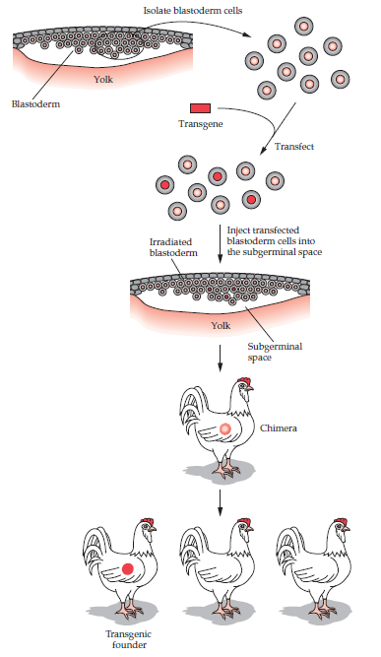
Despite these disadvantages, it is possible to inject a transgene into the region (germinal disc) on the yolk that contains the female and male pronuclei.
The germinal disc is present before the eggshell is formed. After the administration of DNA to a germinal disc, each egg is cultured in vitro, and when an embryo forms, it is placed in a surrogate egg to produce a hatchling.
Despite the technical difficulties, some transgenic lines of chickens have been established by this method.

Slide 30
Transgenic Fish
As natural fisheries become depleted, production of this worldwide food resource has come to depend more heavily on aquaculture.
Transgenes have been introduced by microinjection or electroporation of DNA into the fertilized eggs of a number of fish species, including carp, catfish, trout, salmon, Arctic char, and tilapia.

Slide 31
The pronuclei of fish are not readily seen under a microscope after fertilization; therefore, linearized transgene DNA is microinjected into the cytoplasm of either fertilized eggs or embryos that have reached the four-cell stage of development.
Unlike mammalian embryogenesis, fish egg development is external; hence, there is no need for an implantation procedure. Development of transgenic fish occurs in temperature-regulated holding tanks.
The survival of fish embryos after DNA microinjection is high (35 to 80%), and the production of transgenic fish ranges from 10 to 70%.
The presence of a transgene is scored by PCR analysis of either nucleated erythrocytes or scale DNA.
Founder fish are mated to establish true-breeding transgenic lines.

Slide 32
In addition to enhancing traits that aid the production of fish for food, transgenesis can be used to generate systems for monitoring aquatic pollutants.
One such biosensor system entails the use of transgenic medaka fish genetically engineered to express red or green fluorescent protein under the control of pollutant-responsive promoters.
Transgenic medaka have been developed as biosensors to detect estrogenic compounds in aquatic environments.
A wide variety of industrial chemicals, such as bisphenol A and polychlorinated biphenyls (PCBs), also have estrogenic activity in animals and are used in the manufacture of pharmaceuticals, plastics, paints, detergents, and insecticides.

Slide 33
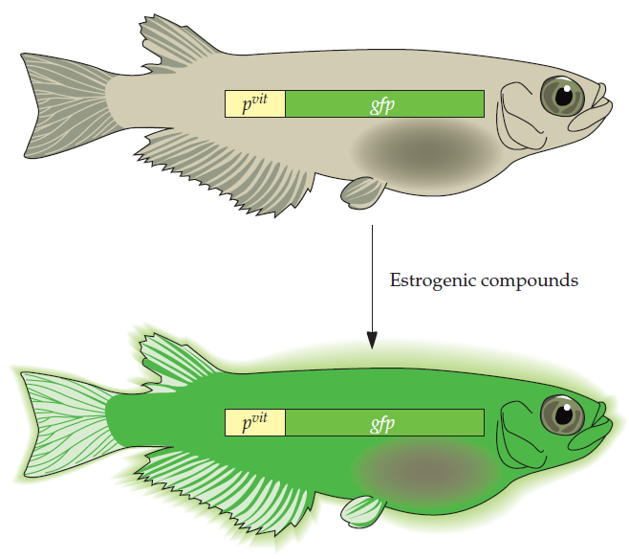
To develop transgenic medaka to monitor levels of natural and synthetic estrogens in water, the estrogen responsive promoter from the medaka vitellogenin gene was cloned upstream of the gene encoding green fluorescent protein and then injected into medaka eggs.
This system can be expanded to include promoters responsive to other environmental toxins, such as heavy metals, that control the expression of red and green fluorescent proteins, in some cases in the same fish.
Each color would indicate the presence of a different pollutant.

