Slide 1
Genomic and cDNA libraries
Tamosa Mukherjee
CUTM

Slide 2
Molecular Techniques to hunt a gene
To analyze a gene or to transfer it to another organism, the gene must first be located and isolated.
Paradoxically, researchers must often clone a gene to find it.
This approach—to clone first and search later—is called “shotgun cloning,” because it is like hunting with a shotgun: a hunter sprays shots widely in the general direction of the quarry, knowing that there is a good chance that one or more of the pellets will hit the intended target.
In shotgun cloning, a researcher first clones a large number of DNA fragments, knowing that one or more contains the DNA of interest, and then searches for the fragment of interest among the clones.

Slide 3
Genomic libraries
A collection of clones containing all the DNA fragments from one source is called a DNA library.
Take all the DNA from a genome, break it up into segments of the right size for our cloning vector, and insert each segment into a different copy of the vector, thereby creating a collection of recombinant DNA molecules that, taken together, represent the entire genome.
Then transform or transduce these molecules into separate bacterial recipient cells, where they are amplified.
The resulting collection of recombinant DNA-bearing bacteria or bacteriophages is called a genomic library.

Slide 4
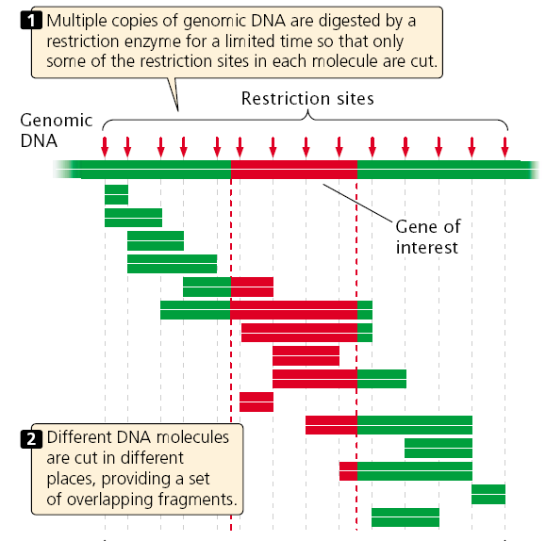
partial digestion

Slide 5
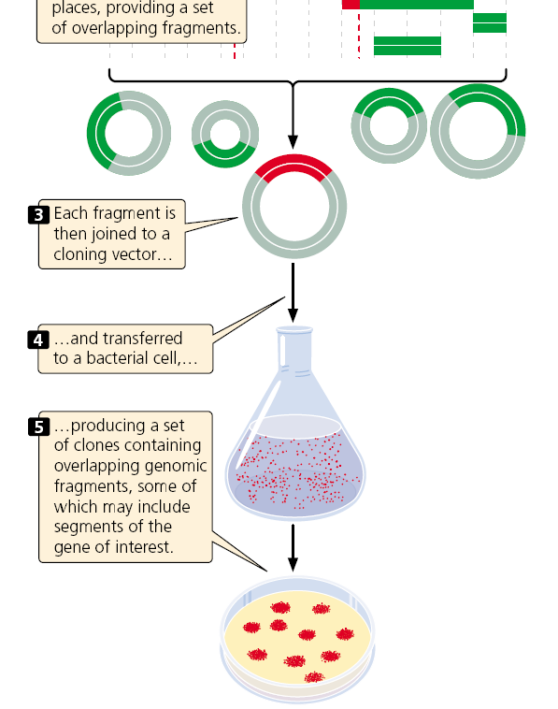
Some clones contain the entire gene of interest, others include part of the gene, and most contain none of the gene of interest.

Slide 6
A genomic library must contain a large number of clones to ensure that all DNA sequences in the genome are represented in the library.
A library of the human genome formed by using cosmids, each carrying a random DNA fragment from 35,000 to 44,000 bp long, would require about 350,000 cosmid clones to provide a 99% chance that every sequence is included in the library.

Slide 7
How many clones do you need?
The haploid human genome is approximately 3 × 10⁹ bp, contained on 23 chromosomes.
The challenge in constructing a recombinant library from a genome of this size is in creating clones in large enough number that the experimenter will be provided with some reasonable expectation that the library will contain the DNA segment carrying the particular gene of interest.

Slide 8
How many clones need to be created to satisfy this expectation?
The answer depends on two properties:
  The size of the genome being fragmented for cloning and
  The average size of the cloned fragments.

Slide 9
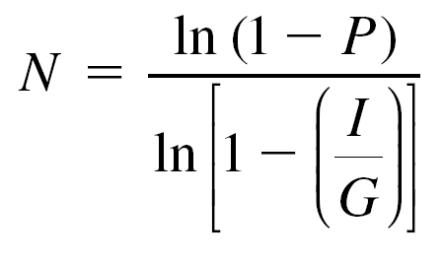
Clark and Carbon (1976) derived an expression based on the Poisson distribution that can be used to estimate the likelihood of finding a particular clone within a randomly generated recombinant library.
The relationship specifies the number of independent clones, N, needed to isolate a specific DNA segment with probability P.
It is given by the equation
Where
I = the size of the average cloned insert, in bp,
G = size of the target genome, in bp.

Slide 10
cDNA libraries
(called a cDNA library because all the DNA in this library is complementary to mRNA)
If we are seeking a specific gene that is active in a specific type of tissue in a plant or animal, then it makes sense to construct a cDNA library from a sample of that tissue.
For example, suppose we want to identify cDNAs corresponding to insulin mRNAs.
The B-islet cells of the pancreas are the most abundant source of insulin, and so mRNAs from pancreas cells are the appropriate source for a cDNA library because these mRNAs should be enriched for the gene in question.

Slide 11
cDNA library has two additional advantages.
First, it is enriched with fragments from actively transcribed genes.
Second, introns do not interrupt the cloned sequences; introns would pose a problem when the goal is to produce a eukaryotic protein in bacteria, because most bacteria have no means of removing the introns.

Slide 12
Disadvantages of cDNA library
It contains only sequences that are present in mature mRNA.
promoters and enhancers are not present
cDNA library represents only those gene sequences expressed in the tissue from which the RNA was isolated.
The frequency of a particular DNA sequence in a cDNA library depends on the abundance of the corresponding mRNA in the given tissue.
In contrast, almost all genes are present at the same frequency in a genomic DNA library.

Slide 13
Creating cDNA library
To create a cDNA library, messenger RNA must first be separated from other types of cellular RNA (tRNA, rRNA, snRNA, etc.).
Most eukaryotic mRNAs possess a string of adenine nucleotides at the 3 end, and this poly(A) tail provides a convenient hook for separating eukaryotic mRNA from the other types.

Slide 14
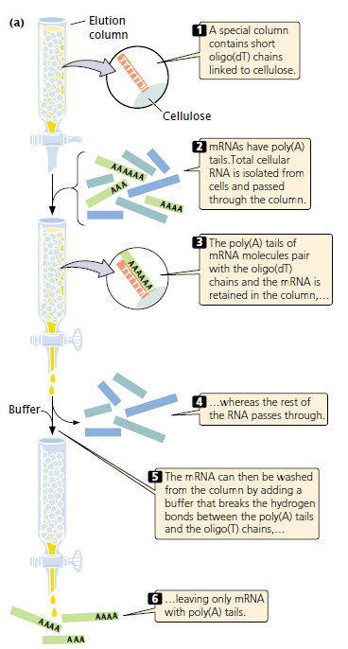
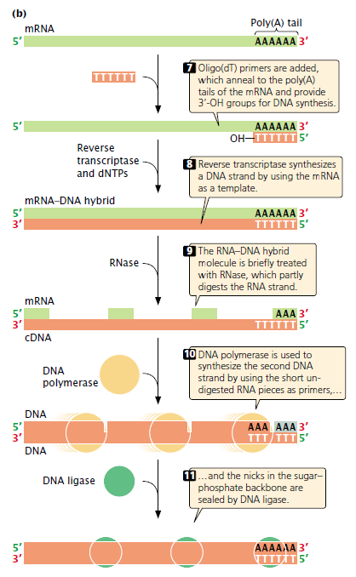

Slide 15
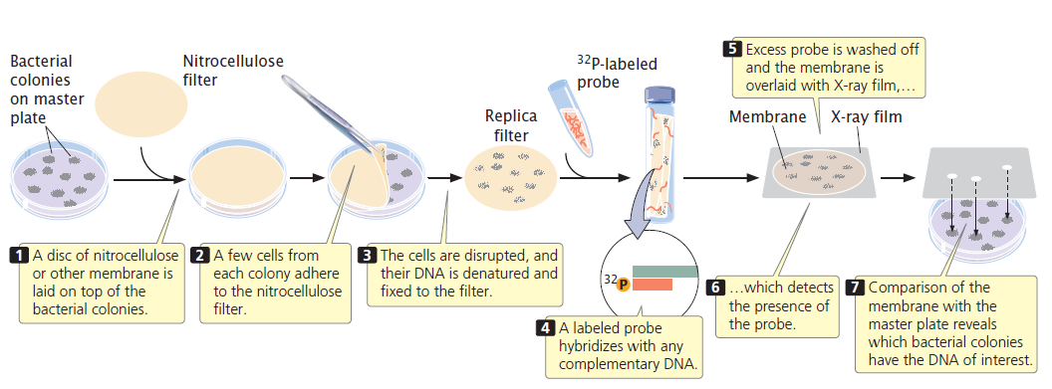
Screening the library for the gene of interest

Slide 16
Cloning
Clone- A clone is an exact copy of an organism, single cell or macromolecule.
Gene clone- It is the production of an exact copy of a particular/single gene or DNA sequence using genetic engineering.
Genetic engineering- It is the process of cloning genes into new organism, or altering a genetic sequence to change the protein product.

Slide 17
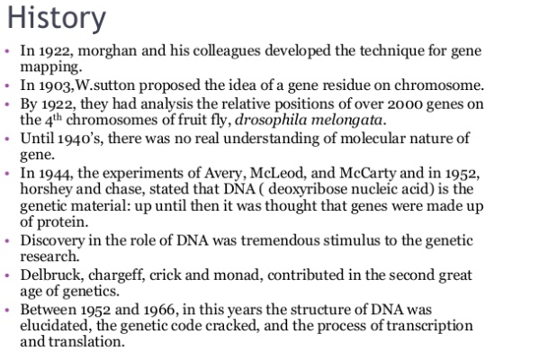

Slide 18
Single gene cloning
Identification and isolation of desired gene or DNA fragments to be cloned.
Insertion of isolated gene in a suitable vector.
Introduction of this vector into a suitable organism/cell called host.
The vector multiplies within the host cell, producing numerous identical copies not only of itself but also of the gene that it carries.

Slide 19
During the division of the host cell, copies of the recombinant DNA molecules are passed to the progeny and further vector replication takes place.
After a large no of cell division, a colony, or clone, of identical host cell is produced. Each cell in the clone contains one or more copies of the recombinant DNA molecule.

Slide 20
