Slide 1
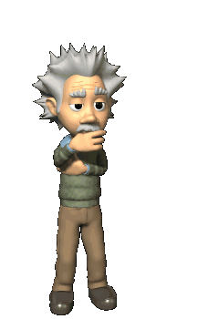
Downstream Processing
PAPER – SP – 2
UNIT - II

Slide 2
Introduction
Industrial fermentations comprise both upstream processing (USP) and downstream processing (DSP) stages.
DSP encompasses all processes following the fermentation.
It has the primary aim of efficiently, reproducibly and safely recovering the target product to the required specifications (biological activity, purity, etc.), while maximizing recovery yield and minimizing costs.

Slide 3
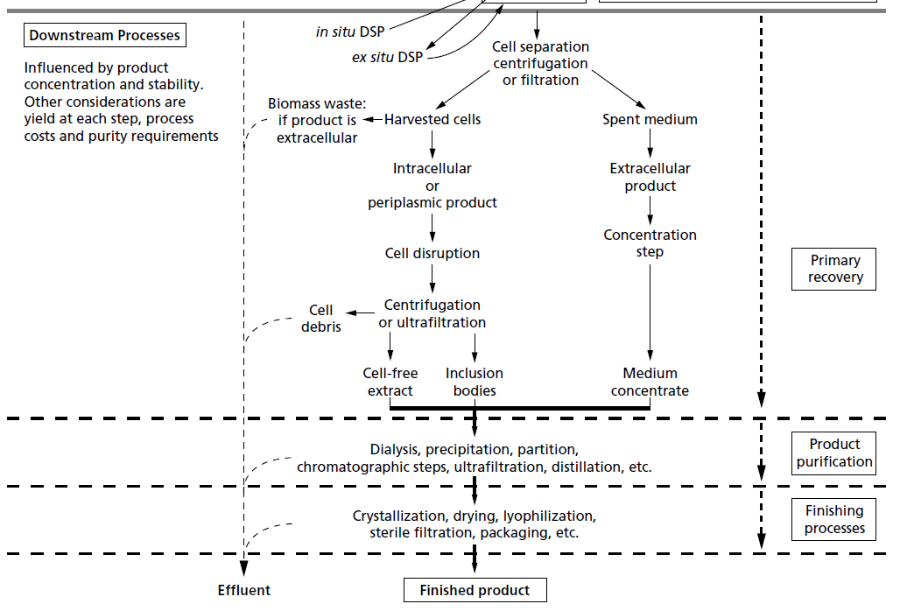
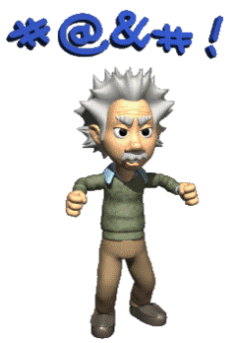
Downstream process

Slide 4
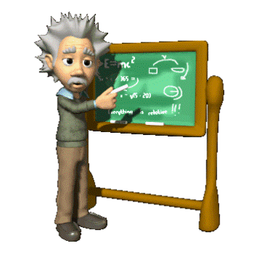
DSP in detail
DSP can be divided into a series of distinct unit processes linked together to achieve product purification
Usually, the number of steps is kept to a minimum.
The specific unit steps chosen will be influenced by the economics of the process, the required purity of the product, the yield attainable at each step and safety aspects.
In many cases, integration of fermentation and DSP is now preferred. Integration can often increase productivity, decrease the number of unit operations and reduce both the overall process time and costs.

Slide 5
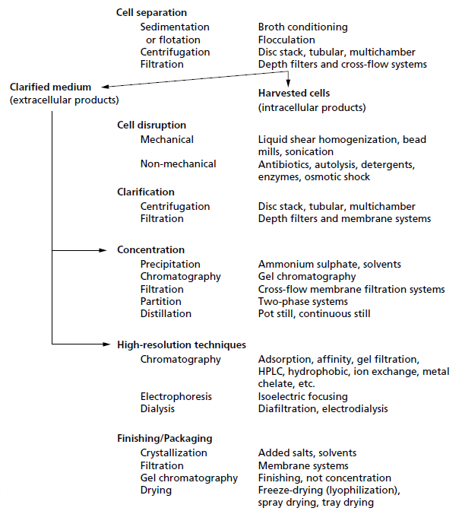
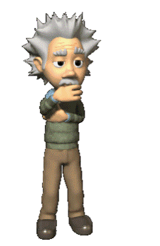

Slide 6
The choice of recovery process
The choice of recovery process IS based on the following criteria:
The intracellular or extracellular location of the product.
The concentration of the product in the fermentation broth.
The physical and chemical properties of the desired product (as an aid to selecting separation procedures).
The intended use of the product.
The minimal acceptable standard of purity.
The magnitude of bio-hazard of the product or broth.
The impurities in the fermenter broth.
The marketable price for the product.

Slide 7
1. REMOVAL OF MICROBIAL CELLS AND OTHER SOLID MATTER
Microbial cells and other insoluble materials are normally separated from the harvested broth by filtration or centrifugation.
Because of the small size of many microbial cells it will be necessary to consider the use of filter aids to improve filtration rates, while heat and flocculation treatments are employed as techniques for increasing sedimentation rates in centrifugation.
Of more current interest is the use of two-phase liquid extraction. Though still most appropriately used for separation of selected soluble components, it is easy to scale up and uses conditions which are gentle on the product.

Slide 8
Foam Seperation
Foam separation depends on using methods which exploit differences in surface activity of materials.
The material may be whole cells or molecular such as a protein or colloidal, and is selectively adsorbed or attached to the surface of gas bubbles rising through a liquid, to be concentrated or separated and finally removed by skimming.
When developing this method of separation, the variables which may need experimental investigation are pH, air-flow rates, surfactants and colligend-collector ratios.

Slide 9
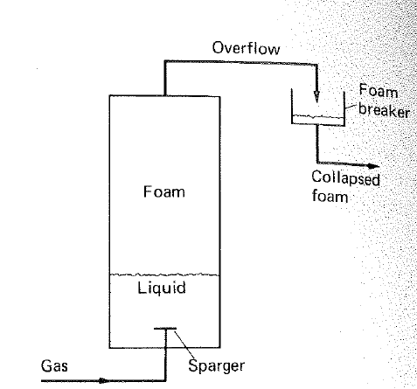

Slide 10
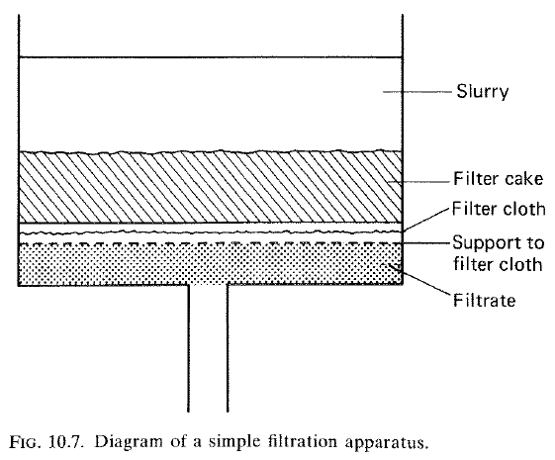
FILTRATION
Filtration is one of the most common processes used at all scales of operation to separate suspended particles from a liquid or gas, using a porous medium which retains the particles but allows the liquid or gas to pass through.

Slide 11
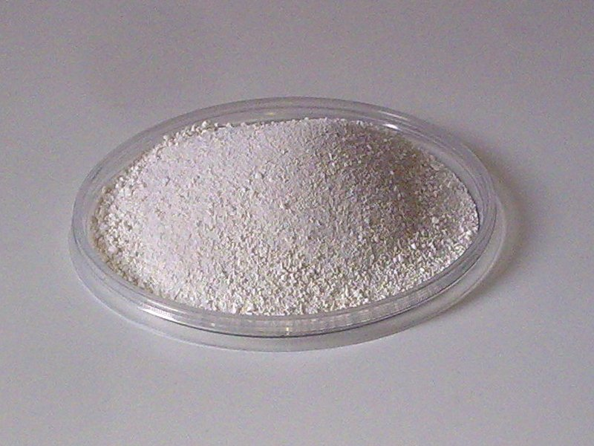
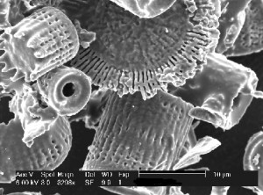
USE OF FILTER AIDS
It is common practice to use filter aids when bacteria or other fine or gelatinous suspensions prove slow to filter or partially block a filter.
Kieselguhr (diatomaceous earth) is the most widely used material.
It has a porocity of approximately 0.85, and, when it is mixed with the initial cell suspension, improves the porosity of a resulting filter cake leading to a faster flow rate.

Slide 12
TYPES OF FILTERS
Batch Filters
PLATE AND FRAME FILTERS
PRESSURE LEAF FILTERS
Continuous Filters
ROTARY VACUUM FILTERS
CROSS-FLOW FILTRATION (TANGENTIAL FILTRATION)

Slide 13
PLATE AND FRAME FILTERS
In this plates and frames are arranged alternately (Fig.2) assembled on a horizontal framework.
Plates are covered with filter clothes and held together by hand screw to prevent leakage between frames. The slurry is fed through the continuous channel by the holes in the corners of the plates and frames.
The filtrate passes through the filter cloth or pad, runs down grooves in the filter plates and is then discharged through outlet taps to a channel.

Slide 14
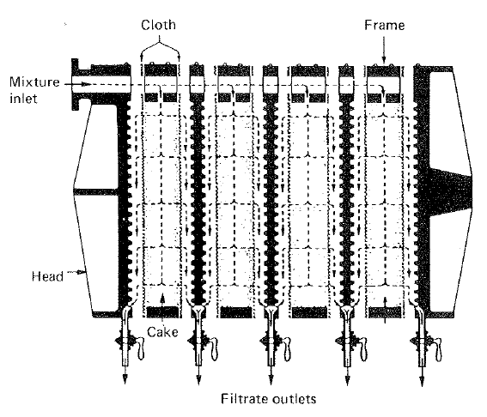
PLATE AND FRAME FILTERS

Slide 15
PRESSURE LEAF FILTERS
These filters incorporates a number of leaves, each consisting of a metal framework of grooved plates which is covered with a fine wire mesh, or occasionally a filter cloth and often precoated with a layer of cellulose fibers.
The slurry is fed into the filter which operated under pressure or by suction with a vacuum pump.
There are three types based on the arrangement of filters.
Vertical metal leaf filter
Horizontal metal-leaf filter
Stacked disc filter

Slide 16
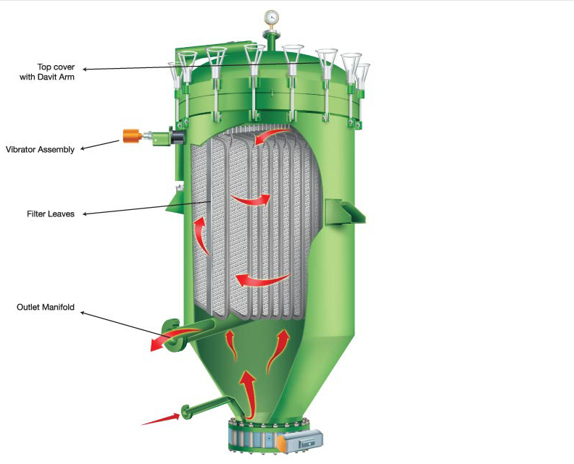
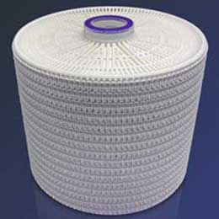
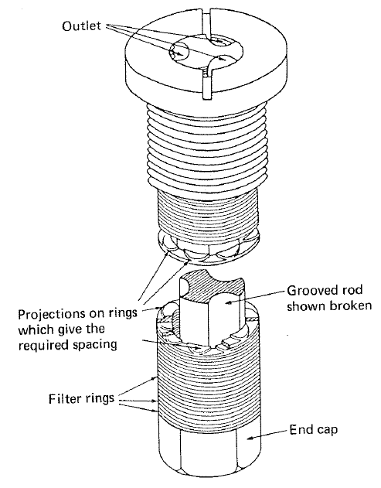
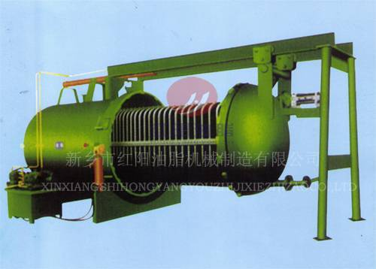

Slide 17
Rotary vacuum filtration
Drum covered with diatomaceous earth matter and allowed to rotate under vacuum with half immersed in the slurry tank.
Small amount of coagulation agent added to broth and pumped into the slurry tank. As drum rotates in the slurry tank under vacuum thin layer of coagulated particles adhere to drum. The layer thickens to from cake. As the cake portion in the drum comes to the upper region which is not immersed in the liquid it is washed with water and dewatered immediately by blowing air over it.

Slide 18
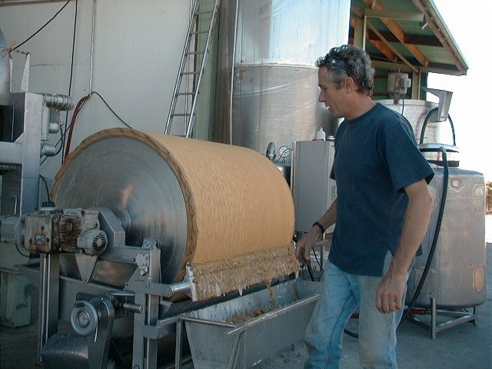
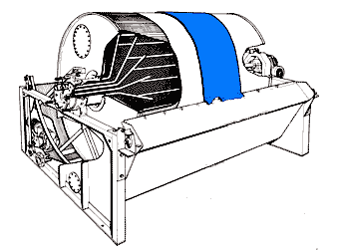
Scrapper Discharge
Scrapper Discharge with per-coating of the drum

Slide 19
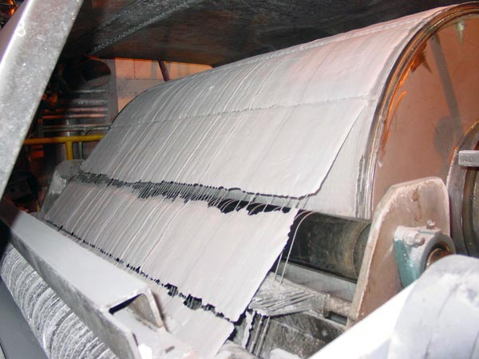
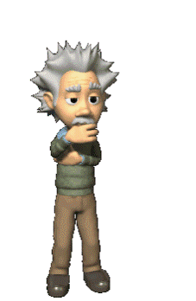
String Discharge

Slide 20
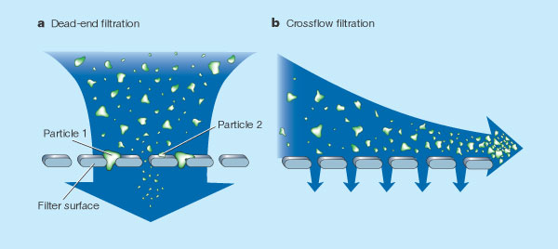
Crossflow FIltration

Slide 21
CENTRIFUGATION
Centrifugation is a common method used to separate cells from cultured broth when….
Filtration is slow and difficult.
The cells or other suspended matter must be obtained free of filter aids.
Continuous separation to a high standard of hygiene is required.
It employs centrifugal force to promote accelerated settling of particles in a solid-liquid mixture.
Separation is achieved by means of accelerated gravitational force by rapid rotation.
The particle size that can be separated range from 0.1μm to 100 μm.

Slide 22
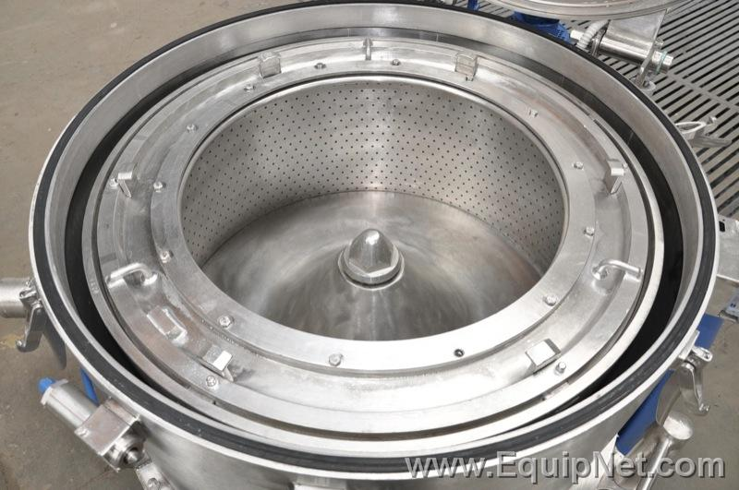
Basket Centrifuge

Slide 23
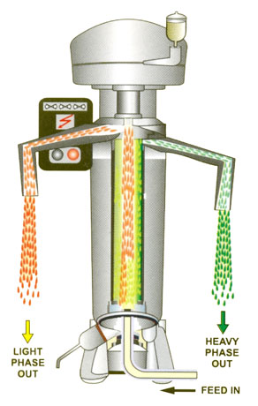
THE TUBULAR-BOWL CENTRIFUGE

Slide 24
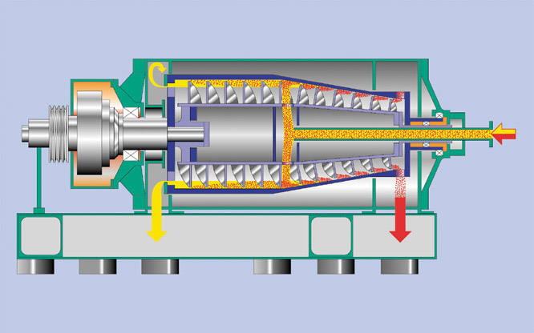
THE SOLID-BOWL SCROLL CENTRIFUGE
Or Decanter Centrifuge

Slide 25
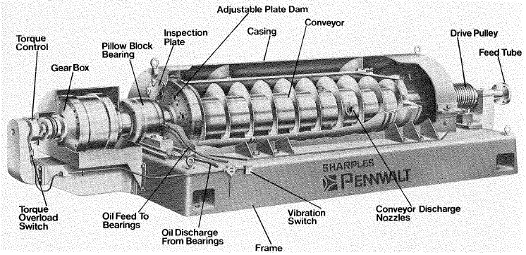
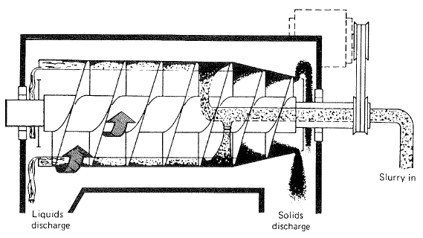

Slide 26
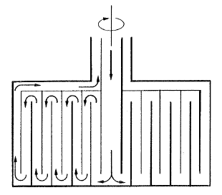
THE MULTICHAMBER CENTRIFUGE
Ideally, this is a centrifuge for a slurry of up to 5% solids of particle size 0.1 to 200 /-tm diameter.
In the multichamber centrifuge (Fig. 10.18), a series of concentric chambers are mounted within the rotor chamber.
The broth enters via the central spindle and then takes a circuitous route through the chambers. Solids collect on the outer faces of each chamber.
The smaller particles collect in the outer chambers where they are subjected to greater centrifugal forces (the greater the radial position of a particle, the greater the rate of sedimentation).

Slide 27
CELL DISRUPTION
Physico-Mechanical Methods
(a) Liquid shear.
(b) Solid shear.
(c) Agitation with abrasives.
(d) Freeze-thawing.
(e) Ultrasonication.

Slide 28
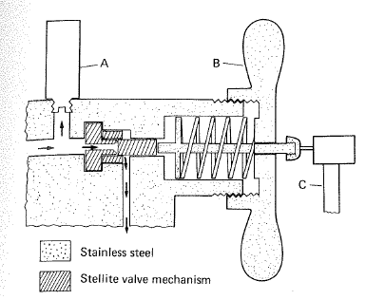
Liquid Shear and Solid Shear
The microbial slurry passes through a non-return valve and impinges against the operative valve set at the selected operating pressure.
The cells then pass through a narrow channel between the valve and an impact ring followed by a sudden pressure drop at the exit to the narrow orifice. The large pressure drop across the valve is believed to cause cavitations in the slurry and the shock waves so produced disrupt the cells.
Disruption is due to a combination
of liquid shear through a narrow
orifice and the presence of ice
crystals.

Slide 29
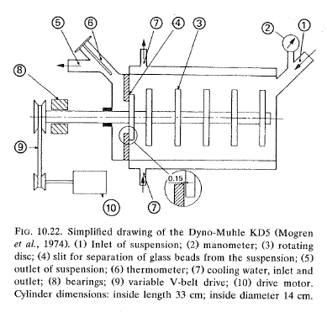
AGITATION WITH ABRASIVES
Mechanical cell disruption can also be achieved in a disintegrator containing a series of rotating discs and a charge of small beads. The beads are made of mechanically resistant materials such as glass, alumina ceramics and some titanium compounds.

Slide 30
FREEZING-THAWING
Freezing and thawing of a microbial cell paste will inevitably cause ice crystals to form and their expansion followed by thawing will lead to some subsequent disruption of cells.
It is slow, with limited release of cellular materials, and has not often been used as a technique on its own, although it is often used in combination with other techniques.

Slide 31
ULTRASONICATION
High frequency vibration (- 20 kHz) at the tip of an ultrasonication probe leads to cavitation, and shock waves thus produced cause cell disruption.
The method can be very effective on a small scale, but a number of serious drawbacks make it unsuitable for large-scale operations.

Slide 32
Chemical methods
DETERGENTS –
quaternary ammonium compounds, sodium lauryl sulphate, sodium dodecyl sulphate (SDS) and Triton X-1OO.
OSMOTIC SHOCK
a sudden change in salt concentration will cause disruption of a number of cell types.
ALKALI TREATMENT
Alkali treatment might be used for hydrolysis of microbial cell wall material provided that the desired enzyme will tolerate a pH of 11.5 to 12.5 for 20 to 30 minutes.
ENZYME TREATMENT
Although this is probably one of the most gentle methods available, unfortunately it is relatively expensive and the presence of the enzyme(s) may complicate futher downstream purification processes.
May be used for partial lysis prior to mechanical disruption

Slide 33
LIQUID-LIQUID EXTRACTION
The separation of a component from a liquid mixture by treatment with a solvent in which the desired component is preferentially soluble is known as liquid-liquid extraction.
It is a classical method for recovery as well as concentration of various products.
Solvent extraction has several advantages such as selectivity of extraction directly from broth or reaction medium, reduction in product loss as the product is just transferred to a second phase and easy scale up.
The choice of solvent selection was based on dielectric point.
The dielectric constant is a measure of the degree of molar polarization of a compound.

Slide 34
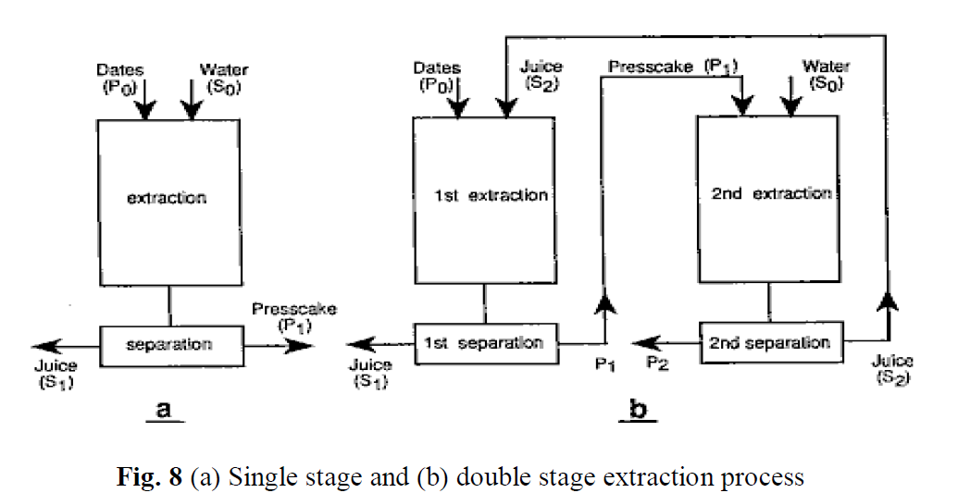
In single stage batch extraction, the aqueous feed is mixed with the organic solvent and after equilibration; the extract phase containing the desired solute is separated out for further processing.
In some cases, a single stage extraction may not be enough and multi stage process is required wherein fresh volume of solvent is contacted with the raffinate.

Slide 35
Continuous extraction can be carried out by co-current or counter current methods.

Slide 36
TWO-PHASE AQUEOUS EXTRACTION
The basic principle involves differential partitioning of solute in two immiscible phases.
Phase separation occurs when hydrophilic polymers are added to an aqueous solution.
At low concentration of polymers, homogenous solution is formed but at discrete concentration rise, two immiscible phases are formed using two aqueous phases with incompatible polymers such as PEG and dextran.
Precipitation - by decreasing the solubility of the solutes the solute can be separated by precipitation
Adsorption - This refers to the binding of molecules or particles to a surface or adsorption of solutes from liquid media onto solids.
Dialysis is a membrane separation used to remove low molecular weight solutes (organic acids, inorganic ions). Dialysis is the movement of molecules by diffusion from high concentration to low concentration through a semi-permeable membrane.
Reverse osmosis is a process where the solvent molecules are forced by an applied pressure to flow through a semi permeable membrane in the opposite direction.

Slide 37
PRODUCT POLISHING
Crystallization
Drying
Lyophilization
Diafiltration

Slide 38
