Slide 1
Cloning Vectors

Slide 2
Vector
A vehicle used to transfer genetic material such as DNA sequence from the donor organism to target cell of recipient organism(Host cell).
Also referred as carrier of DNA sequence.
Also referred as cloning vehicle or cloning DNA.

Slide 3
Characteristics
Self replication and multiplication copies.
Replication origin site.
Cloning site.
Small size and low molecular weight.
Easily isolated and purified.
Selectable marker gene.
Easily isolated in host cell.

Slide 4
Selection of vector
Objective of cloning experiment.
Ease of working.
Knowledge existing about the vector.
Suitability
Reliability
USES
Genomic library
Preparing probes
Genetic engineering experiments

Slide 5
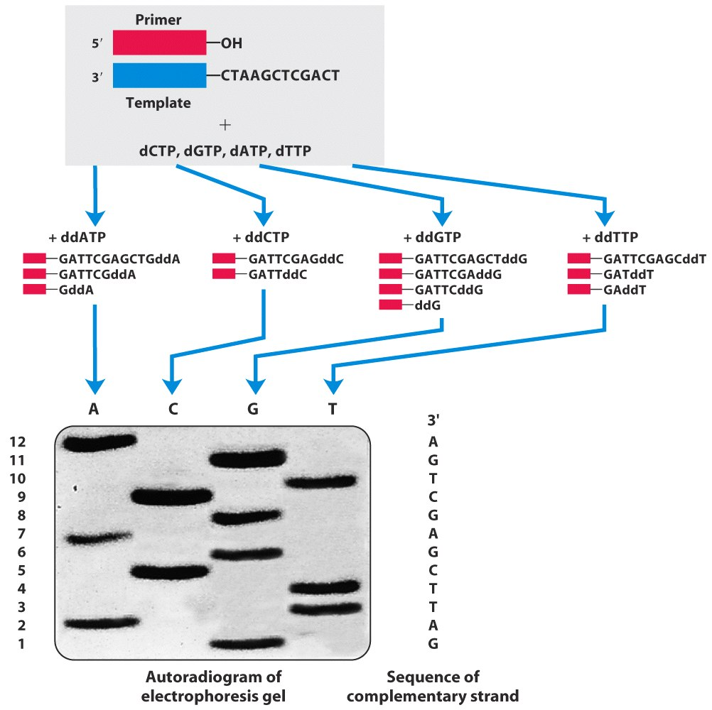

Slide 6
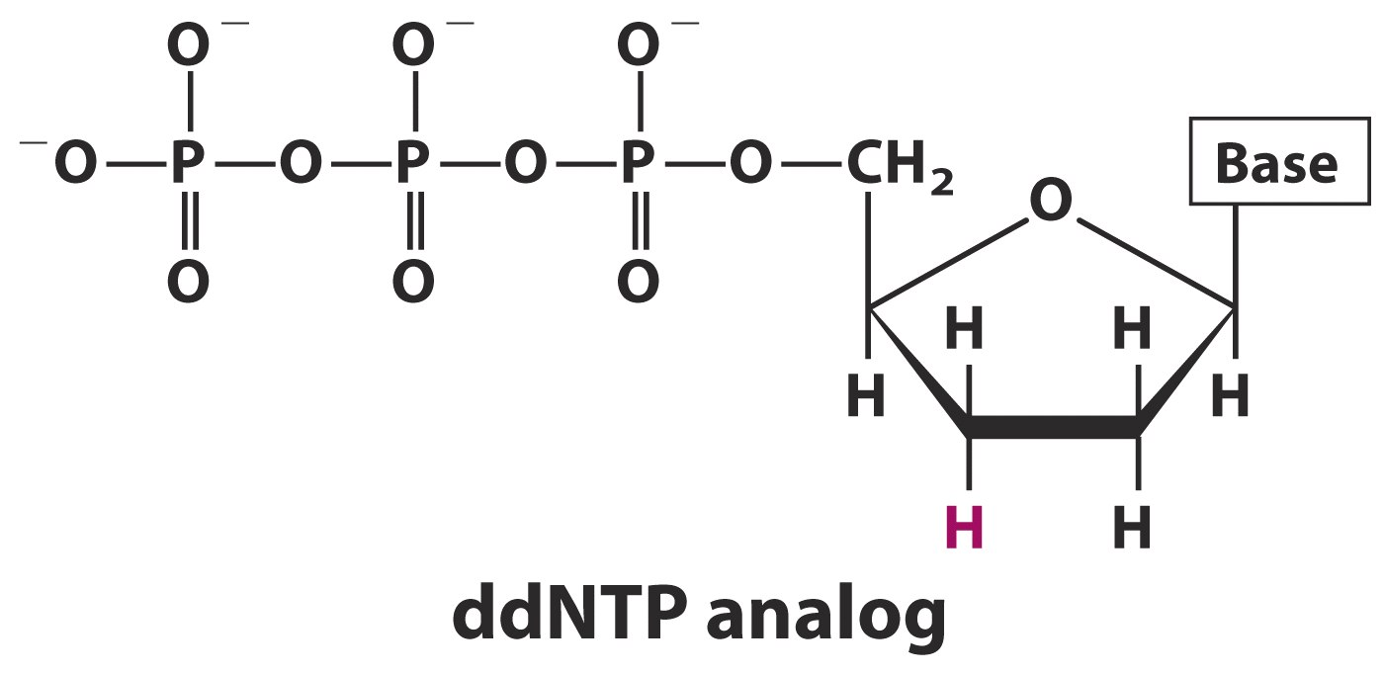
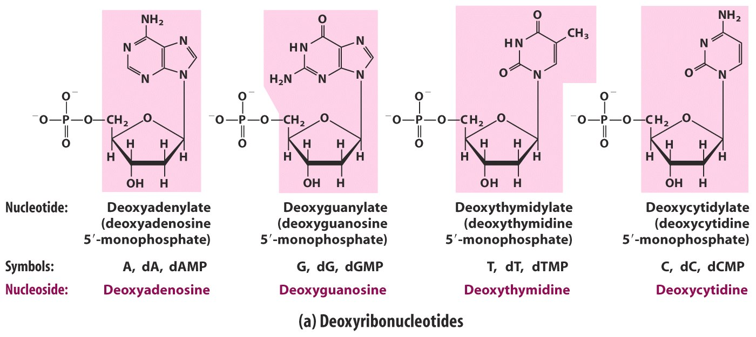

Slide 7
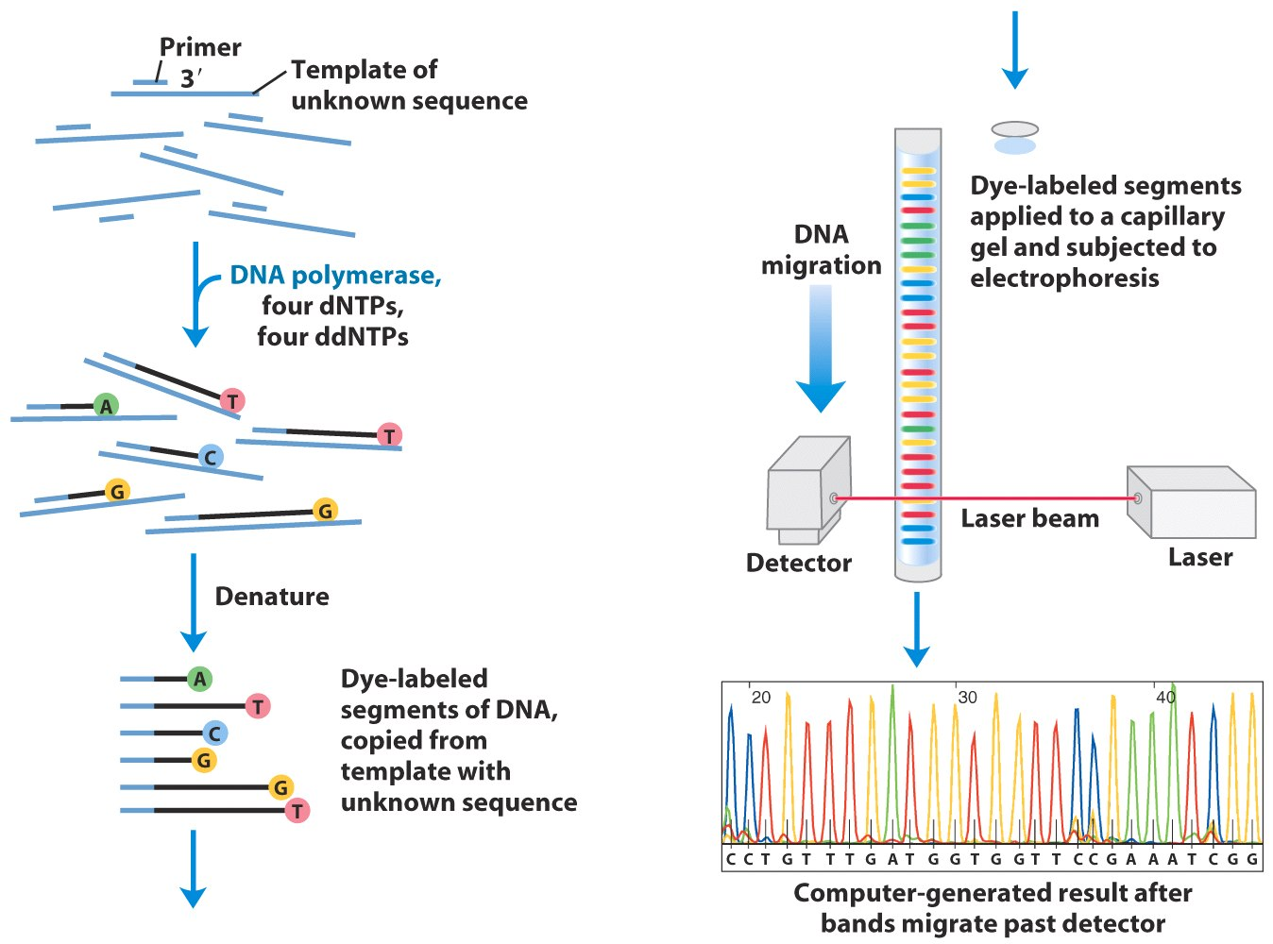

Slide 8
Plasmids
Plasmids are circular molecules of DNA that lead an independent existence in the bacterial cell.
Plasmids almost always carry one or more genes, and often these genes are responsible for a useful characteristic displayed by the host bacterium.

Slide 9
General Characteristics
Most plasmids possess at least one DNA sequence that can act as an origin of replication
The smaller plasmids make use of the host cell’s own DNA replicative enzymes in order to make copies of themselves.
The larger ones carry genes that code for special enzymes that are specific for plasmid replication.
A few types of plasmid are also able to replicate by inserting themselves into the bacterial chromosome called episome.

Slide 10
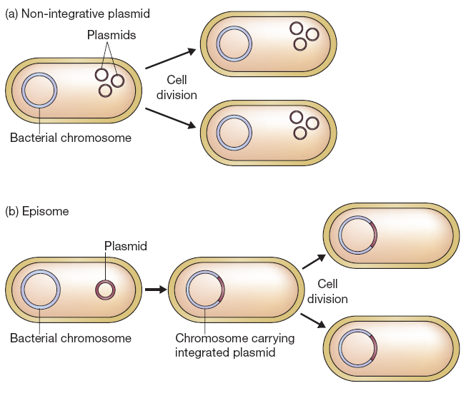

Slide 11
Size and copy number
The size and copy number of a plasmid are particularly important as far as cloning is concerned.
Less than 10 kb is desirable for a cloning vector.
Plasmids range from about 1.0 kb for the smallest to over 250 kb for the largest plasmids so only a few are useful for cloning purposes.
However larger plasmids can be adapted for cloning under some circumstances

Slide 12
The copy number refers to the number of molecules of an individual plasmid that are normally found in a single bacterial cell.
The factors that control copy number are not well understood.
Some plasmids, especially the larger ones, are stringent and have a low copy number of perhaps just one or two per cell.
Others, called relaxed plasmids, are present in multiple copies of 50 or more per cell.
A useful cloning vector needs to be present in the cell in multiple copies so that large quantities of the recombinant DNA molecule can be obtained.

Slide 13
Plasmid classification
1
Fertility or F plasmids
2
Resistance or R plasmids
3
Col plasmids
4
Degradative plasmids
1
Virulence plasmids

Slide 14
F-Plasmids- Contain trs-genes, capable of conjugation and results in expression of sex pilli.
R-Plasmids- Contain genes that provide resistance against antibiotis or poisons.
Col-Plasmids- Code for protein that can kill other bacetria like bacteriocins.

Slide 15
4. Degradative Plasmids- digestion of unusual substance like toluene and salicylic acid.
5. Virulence Plasmids- turn bacteria into plasmids.

Slide 16
Cloning vectors based on E. coli plasmids

Slide 17
Good plasmid cloning vehicles
Three important properties:
low molecular weight
ability to confer readily selectable phenotypic traits on host cells
single sites for a large number of restriction endonucleases, preferably in genes with a readily scorable phenotype.

Slide 18
The simplest cloning vectors, and the ones most widely used in gene cloning, are those based on small bacterial plasmids.
A large number of different plasmid vectors are available for use with E. coli.
They combine ease of purification with desirable properties such as high transformation efficiency, convenient selectable markers for transformants and recombinants, and the ability to clone reasonably large (up to about 8 kb) pieces of DNA.

Slide 19
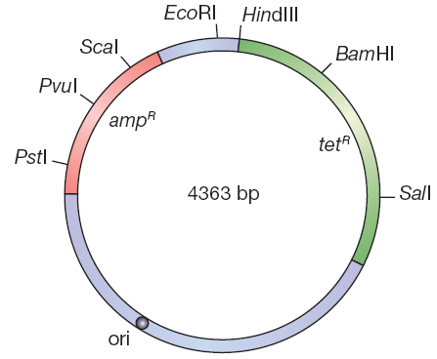
pBR322
One of the first vectors to be developed.
It illustrates the important, fundamental properties of any plasmid cloning vector.

Slide 20
The nomenclature of plasmid cloning vectors
The name “pBR322” conforms with the standard rules for vector nomenclature:
p
BR
322
“BR” identifies the laboratory in which the vector was originally constructed (BR stands for Bolivar and Rodriguez, the two researchers who developed pBR322).
distinguishes this plasmid from others developed in the same laboratory (there are also plasmids called pBR325, pBR327, pBR328, etc.).
indicates that this is indeed a plasmid.

Slide 21
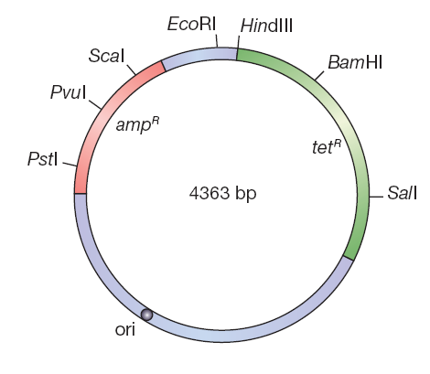
The useful properties of pBR322
The first useful feature of pBR322 is its size (4363 bp).
The second feature of pBR322 is that, it carries two sets of antibiotic resistance genes.
A third advantage of pBR322 is that it has a reasonably high copy number

Slide 22
More sophisticated E. coli plasmid cloning vectors
the majority of these derived from pBR322.
One of the first of these was pBR327, which was produced by removing a 1089 bp segment from pBR322. This deletion left the ampR and tetR genes intact, but changed the replicative and conjugative abilities of the resulting plasmid.

Slide 23
Cont.
As a result, pBR327 differs from pBR322 in two important ways:
pBR327 has a higher copy number than pBR322, being present at about 30–45 molecules per E. coli cell.
Makes this vector more suitable if the aim of the experiment is to study the function of the cloned gene.
The deletion also destroys the conjugative ability of pBR322, making pBR327 a non-conjugative plasmid that cannot direct its own transfer to other E. coli cells.
This is important for biological containment, averting the possibility of a recombinant pBR327 molecule escaping from the test tube and colonizing bacteria in the gut of a careless molecular biologist.

Slide 24
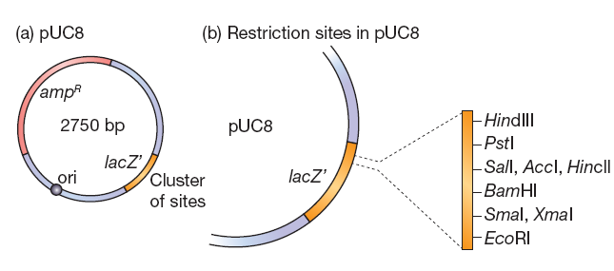
pUC8—a Lac selection plasmid
is descended from pBR322.
The nucleotide sequence of the ampR gene has been changed so that it no longer contains the unique restriction sites: all these cloning sites are now clustered into a short segment of the lacZ′ gene carried by pUC8.

Slide 25
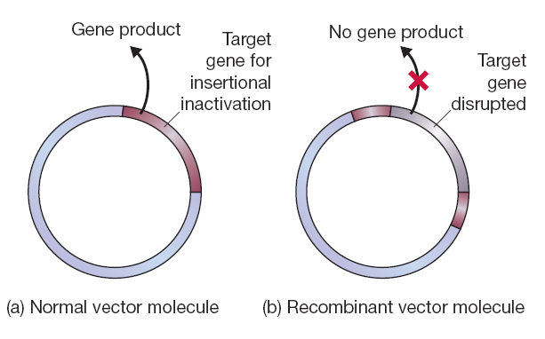
Identification of recombinants
Insertional inactivation
Plating onto a selective medium enables transformants to be distinguished from nontransformants.

Slide 26
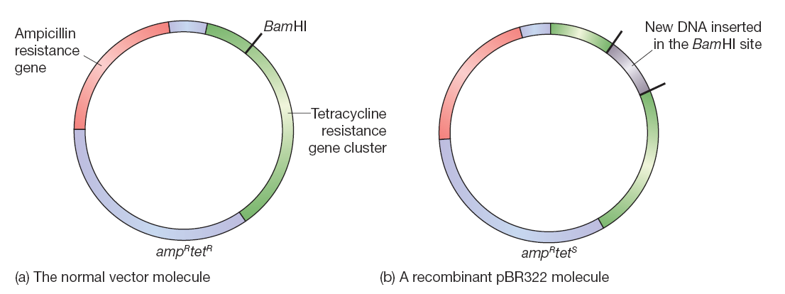

Slide 27
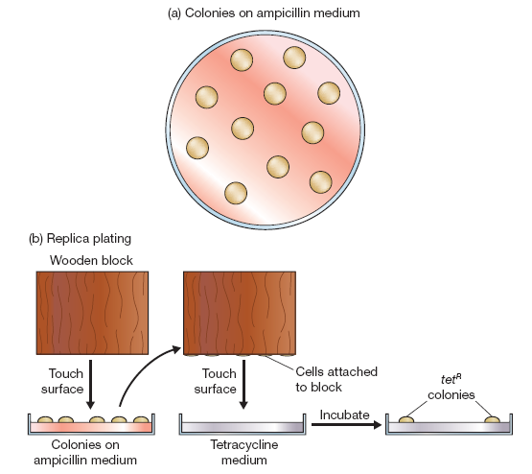

Slide 28
Lac selection
Although insertional inactivation of an antibiotic resistance gene provides an effective means of recombinant identification, the method is made inconvenient by the need to carry out two screenings.
Most modern plasmid vectors therefore make use of a different system.
An example is pUC8.

Slide 29
pUC8 carries the ampicillin resistance gene and a gene called lacZ′, which codes for part of the enzyme β-galactosidase.
Cloning with pUC8 involves insertional inactivation of the lacZ′ gene, with recombinants identified because of their inability to synthesize b-galactosidase

Slide 30
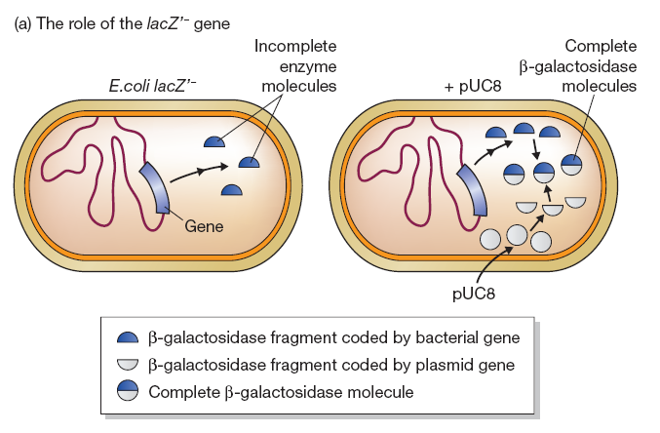

Slide 31
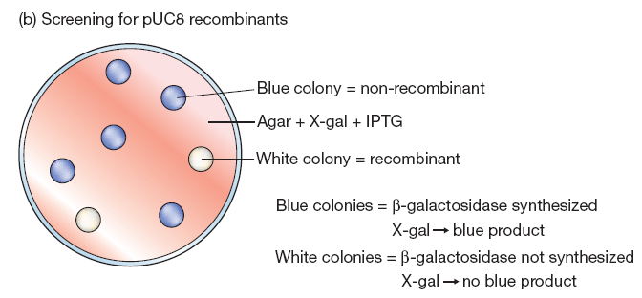
X-gal (5-bromo-4-chloro-3-indolyl-b-D-galactopyranoside)
Isopropylthiogalactoside (IPTG) an inducer of the enzyme
Note that both ampicillin resistance and the presence or
absence of b-galactosidase are tested for on a single agar plate.

Slide 32
pUC8 has three important advantages that have led to it becoming one of the most popular E. coli cloning vectors.
The first of these is - plasmid having a copy number of 500–700 even before amplification.
The second advantage is that identification of recombinant cells can be achieved by a single step process.
The third advantage of pUC8 lies with the clustering of the restriction sites, which allows a DNA fragment with two different sticky ends (say EcoRI at one end and BamHI at the other) to be cloned without resorting to additional manipulations such as linker attachment.

Slide 33
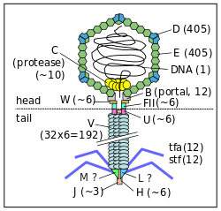
Cloning vectors based on bacteriophage
M13
λ phage
For long piece of DNA to be cloned

Slide 34
Cloning vectors based on λ bacteriophage
The E. coli virus (bacteriophage, or phage) λ has been engineered to be a
vector for inserts in the range of 15 to 20 kb.
After bacteriophage λ infects E. coli by injection of its DNA, two possibilities
exist.
Lytic cycle
Lysogeny cycle

Slide 35
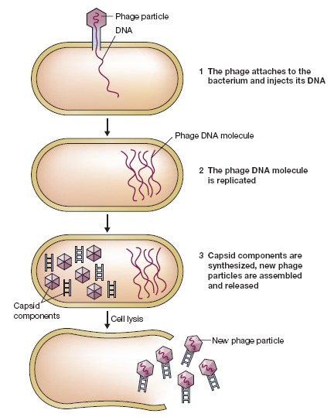

Slide 36
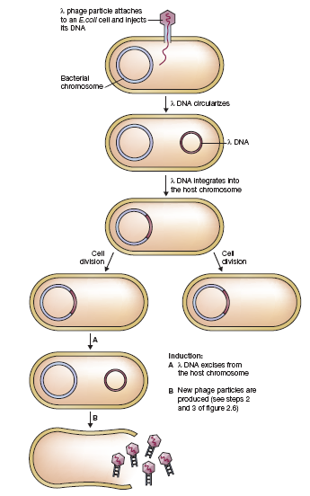

Slide 37
The production and assembly of the heads and tails and the packaging of DNA are a highly coordinated sequence of events.
The DNA within the head of a λ particle is a 50-kb linear molecule with a 12-base single-stranded extension at the 5′ end of each strand. These extensions are called cohesive (cos) ends because they contain sequences that are complementary to each other.
During the early phase of the lytic cycle, DNA replication from the circular molecule creates a linear form of λ DNA that is composed of several contiguous lengths of 50-kb units, i.e., concatemers.

Slide 38
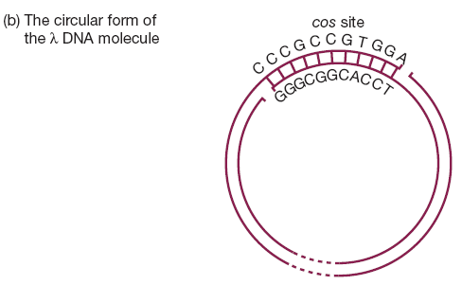

Slide 39
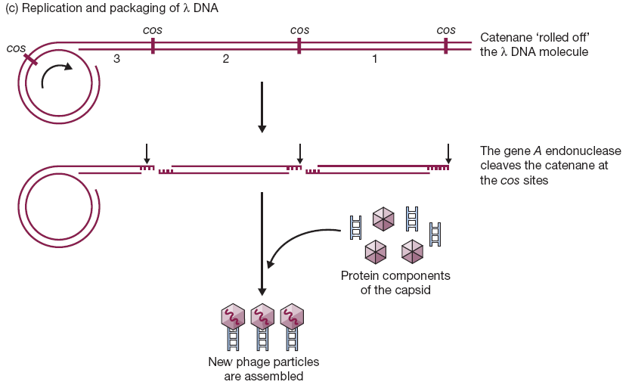

Slide 40
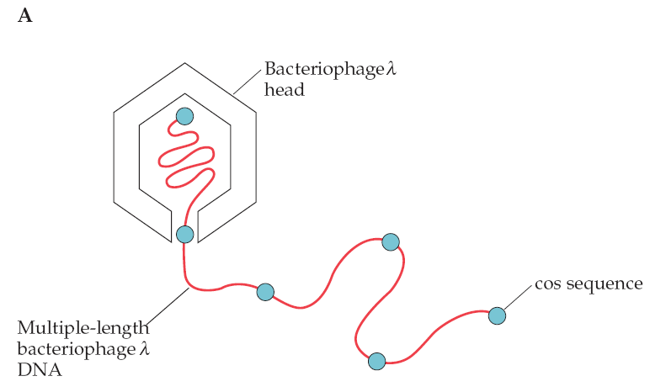
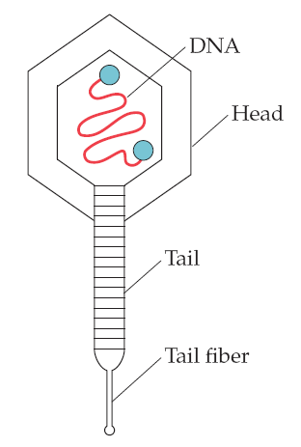
The location of the cos sequences, which are 50 kb
apart in the multiple-length linear λ DNA, ensures that each head receives the correct amount of DNA.
Located at the opening of the head is an enzyme that recognizes the double-stranded cos sequence and cuts the DNA at this site as the DNA is inserted into the head.
By mixing purified empty heads, bacteriophage λ DNA (50 kb), and tail assemblies, infective particles are produced in a reaction tube.

Slide 41
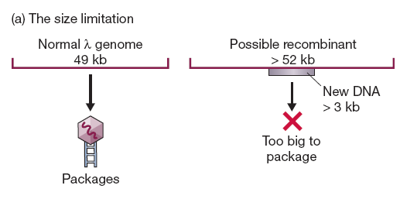
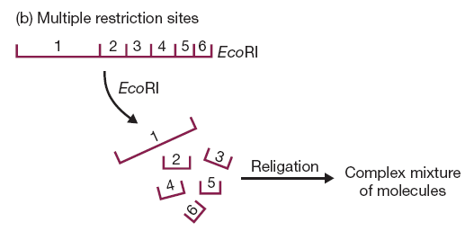
Two problems

Slide 42
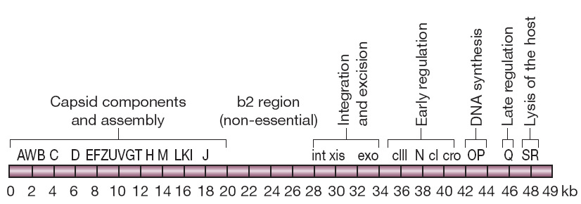
First Problem Solution
by the discovery that a large segment in the central region of the e DNA molecule can be removed without affecting the ability of the phage to infect E. coli cells.
Removal of all or part of this non-essential region, between positions 20 and 35 decreases the size of the resulting e molecule by up to 15 kb. (i.e. 18 kb foreign DNA can be added)

Slide 43
Second Problem Solution
If just one or two sites need to be removed, then the technique of in vitro mutagenesis (p. 200) can be used. For example, an EcoRI site, GAATTC, could be changed to GGATTC, which is not recognized by the enzyme.
Natural selection was used to provide strains of e that lack the unwanted restriction sites.

Slide 44
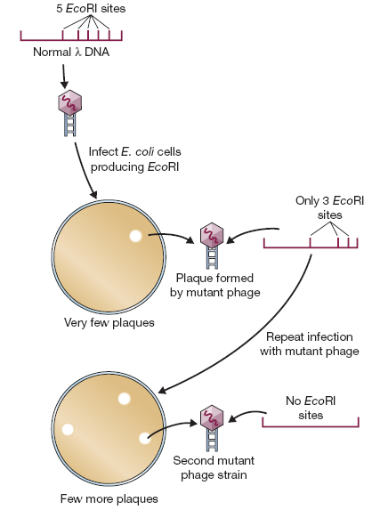

Slide 45
Insertion and replacement vectors
Once the problems posed by packaging constraints and by the multiple restriction sites had been solved, the way was open for the development of different types of λ-based cloning vectors.
λ insertion and
λ replacement (or substitution) vectors.

Slide 46
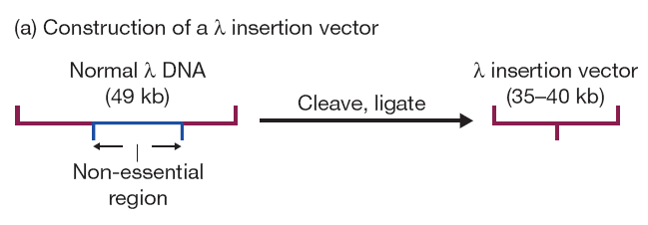
Insertion vectors
With an insertion vector, a large segment of the non-essential region has been deleted, and the two arms ligated together.
An insertion vector possesses at least one unique restriction site into which new DNA can be inserted. The size of the DNA fragment that an individual vector can carry depends, of course, on the extent to which the non-essential region has been deleted.
Two popular insertion vectors are: λgt10 and λZAPII

Slide 47
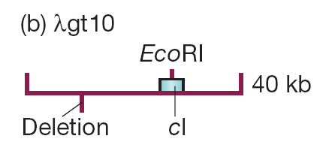
λgt10
which can carry up to 8 kb of new DNA, inserted into a unique EcoRI site located in the cI gene.
Insertional inactivation of this gene means that recombinants are distinguished as clear rather than turbid plaques

Slide 48
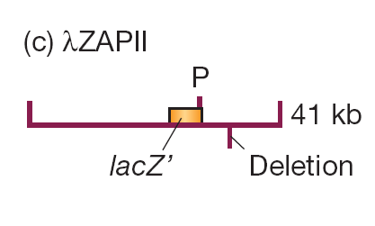
λZAPII
with which insertion of up to 10 kb DNA into any of 6 restriction sites within a polylinker inactivates the lacZ′ gene carried by the vector.
Recombinants give clear rather than blue plaques on X-gal agar.

Slide 49
Replacement vectors
Replacement vectors are generally designed to carry larger pieces of DNA than insertion vectors.
A replacement vector has two recognition sites for the restriction endonuclease used for cloning.
These sites flank a segment of DNA that is replaced by the DNA to be cloned.
Often the replaceable fragment (or “stuffer fragment” in cloning jargon) carries additional restriction sites that can be used to cut it up into small pieces, so that its own re-insertion during a cloning experiment is very unlikely.

Slide 50
Recombinant selection is often on the basis of size, with non-recombinant vectors being too small to be packaged into λ phage heads

Slide 51
Identification of recombinant phages
A variety of ways
Insertional inactivation of a lacZ′ gene
Insertional inactivation of the λ cI gene
Selection using the Spi phenotype
Selection on the basis of λ genome size

Slide 52
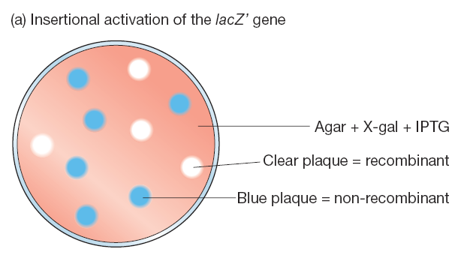
Insertional inactivation of a lacZ′ gene

Slide 53
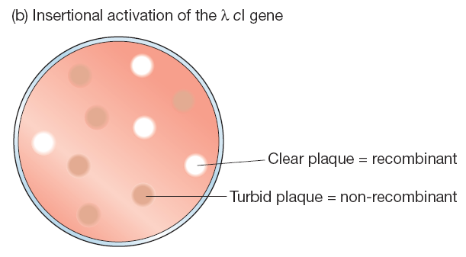
Insertional inactivation of the λ cI gene

Slide 54
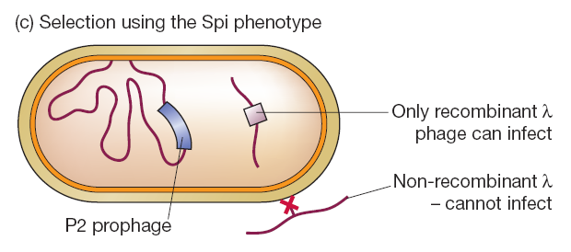
Selection using the Spi phenotype

Slide 55
Cosmid
Most sophisticated type of λ-based vector is the cosmid.
A cosmid is basically a plasmid that carries a cos site
Their design centers on the fact that the enzymes that package the e DNA molecule into the phage protein coat need only the cos sites in order to function
The in vitro packaging reaction works not only with e genomes, but also with any molecule that carries cos sites separated by 37–52 kb of DNA.

Slide 56
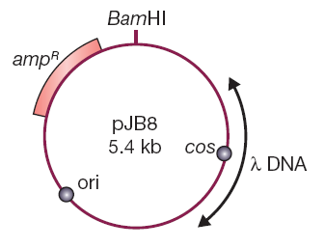

Slide 57
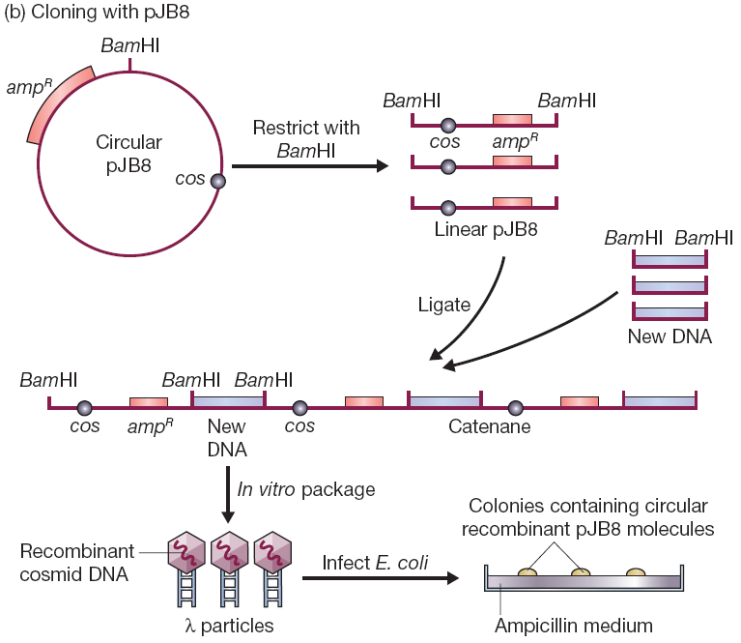

Slide 58
Selection on the basis of λ genome size

Slide 59
Cloning vectors based on M13 phage
M13 is a filamentous phage and is completely different in structure from λ.
M13 DNA molecule is circular, much smaller (6407 bp) and single-stranded.

Slide 60
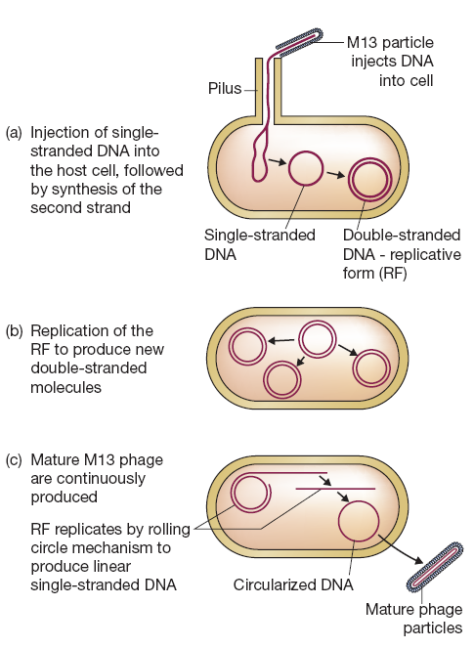
M13 infection cycle

Slide 61
Several features of M13 make this phage attractive as a cloning vector.
The genome is less than 10 kb in size, well within the range desirable for a potential vector.
double-stranded replicative form (RF) of the M13 genome behaves very much like a plasmid.
Easily prepared from E. coli and easy transfection.
Most IMP - genes cloned with an M13-based vector can be obtained in the form of single-stranded DNA.

Slide 62
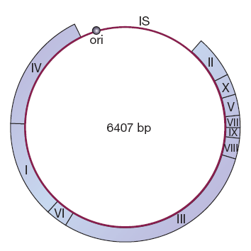
Construction of M13 based vector
The first step in construction of an M13 cloning vector was to introduce the lacZ′ gene into the intergenic sequence.
(M13mp1)

Slide 63
M13mp2
M13mp1 does not possess any unique restriction sites in the lacZ′ gene. It does, however, contain the hexanucleotide GGATTC near the start of the gene.

Slide 64
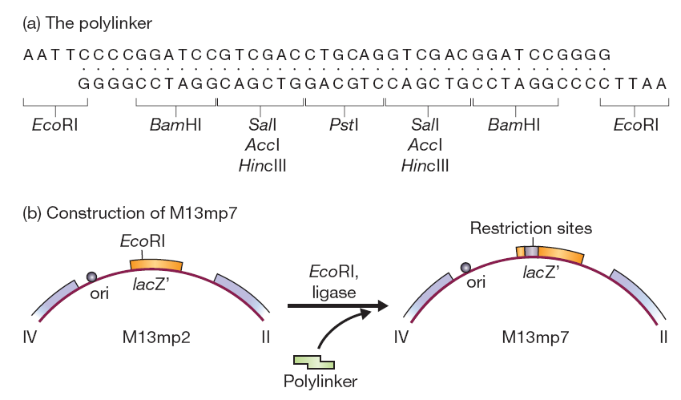
M13mp7
The next step in the development of M13 vectors was to introduce additional restriction sites into the lacZ′ gene.

Slide 65
Phagemid - Hybrid plasmid–M13 vectors
Although M13 vectors are very useful for the production of single-stranded versions of cloned genes, they do suffer from one disadvantage.
size of DNA fregment.
To get around this problem a number of hybrid vectors (“phagemids”) have been developed by combining a part of the M13 genome with plasmid DNA.
An example is pEMBL8

Slide 66
pEMBL8
It was made by transferring into pUC8 a 1300 bp fragment of the M13 genome.
It contains signal sequence recognized by the enzymes that convert the normal double-stranded M13 molecule into single-stranded DNA before secretion of new phage particles.

Slide 67
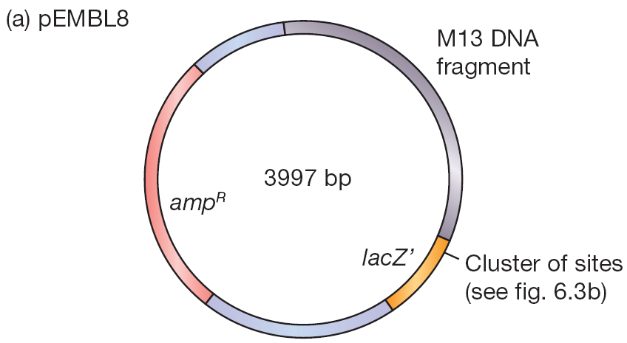

Slide 68
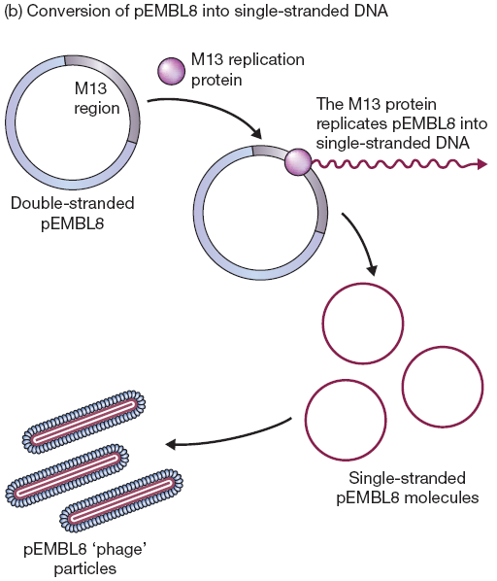

Slide 69
All that is necessary is that the E. coli cells used as hosts for a pEMBL8 cloning experiment are subsequently infected with normal M13 to act as a helper phage, providing the necessary replicative enzymes and phage coat proteins.
It has the polylinker cloning sites within the lacZ′ gene, so recombinant plaques can be identified in the standard way on agar containing X-gal.

Slide 70
Vectors for eukaryotes
Why to use eukaryotes?
aim may not be to study a gene, but to use cloning to obtain large amounts of an important pharmaceutical protein
to change the properties of the organism (e.g., to introduce herbicide resistance into a crop plant).

Slide 71
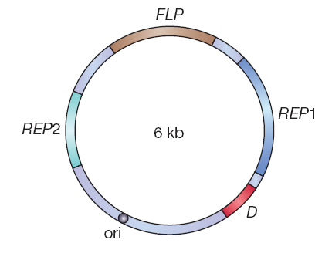
Vectors for Yeast
The 2 µm plasmid, as it is called, is one of only a very limited number of plasmids found in eukaryotic cells.

Slide 72
Selectable markers for the 2 µm plasmid
the gene LEU2
which codes for b-isopropyl-malate dehydrogenase, one of the enzymes involved in the conversion of pyruvic acid to leucine.
a special kind of host organism is needed.
The host must be an auxotrophic mutant that has a non-functional LEU2 gene.

Slide 73
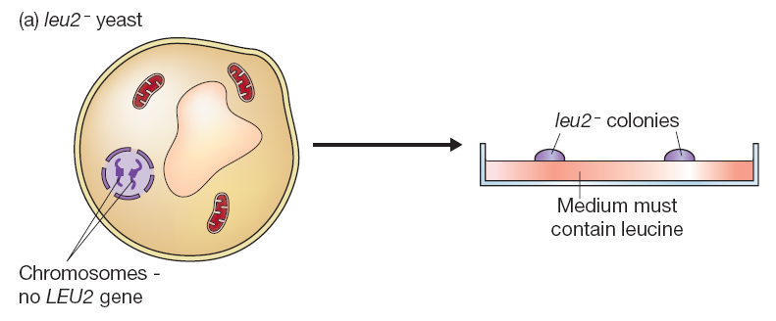
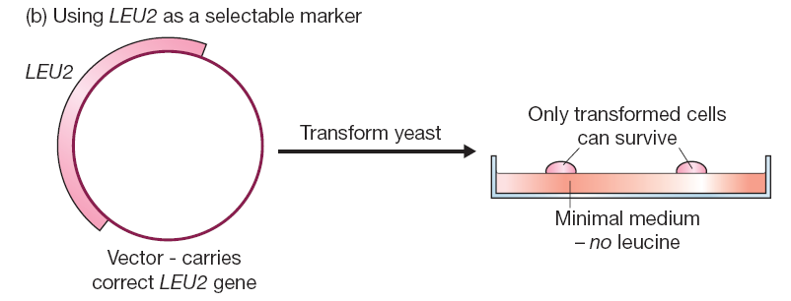

Slide 74
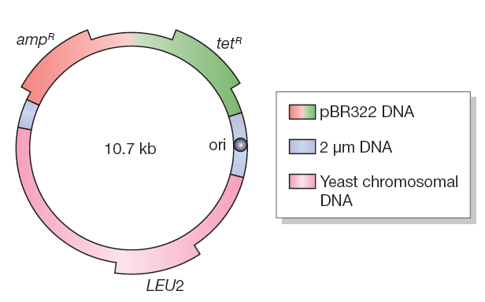
Yeast episomal plasmids (YEps)
It is a shuttle vector.

Slide 75
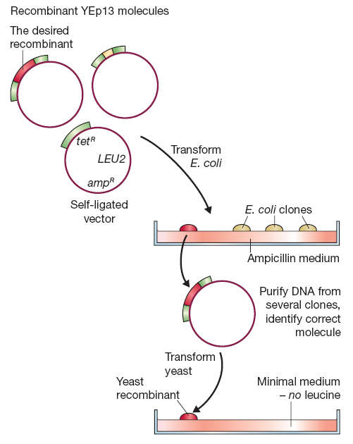
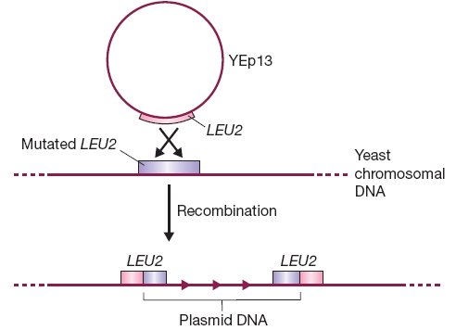

Slide 76
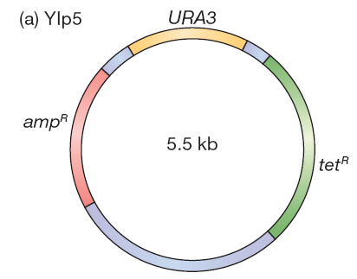
Other types of yeast cloning vector
Yeast integrative plasmids (YIps)
An example is YIp5
orotidine-5′-phosphate decarboxylase
(an enzyme that catalyzes one of the steps in the biosynthesis pathway for pyrimidine nucleotides)

Slide 77
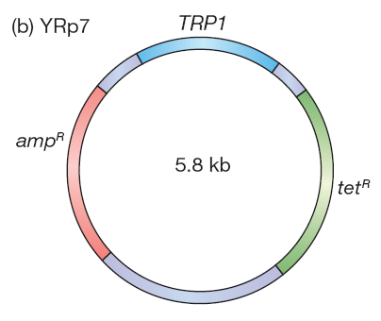
Yeast replicative plasmids (YRps)
YRp7

Slide 78
Yeast Artificial Chromosome
key components of a chromosome
The centromere, which is required for the chromosome to be distributed correctly to daughter cells during cell division;
Two telomeres, the structures at the ends of a chromosome, which are needed in order for the ends to be replicated correctly and which also prevent the chromosome from being nibbled away by exonucleases;
The origins of replication, which are the positions along the chromosome at which DNA replication initiates

Slide 79
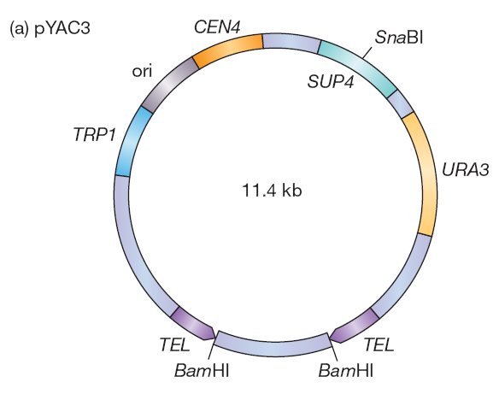
pYAC3
Several YAC vectors have been developed but each one is constructed along the same lines, with pYAC3 being a typical example

Slide 80
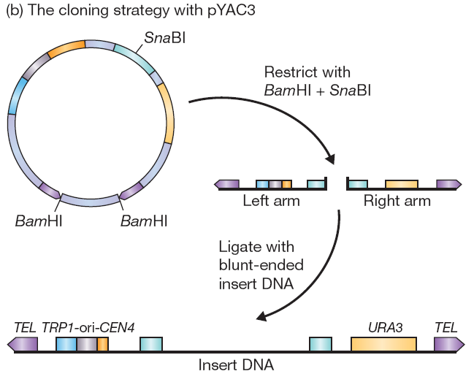

Slide 81
Applications for YAC vectors
to use them to study various aspects of chromosome structure and behavior
Yeast artificial chromosomes opened the way to studies of the functions and modes of expression of genes that had previously been intractable to analysis by recombinant DNA techniques.
important in the production of gene
libraries.

Slide 82
P1-derived artificial chromosomes (PACs)
Phage P1 is a temperate bacteriophage.
Sternberg and co-workers have developed a P1 vector system which has a capacity for DNA fragments as large as 100 kb (twice that of cosmid).

Slide 83
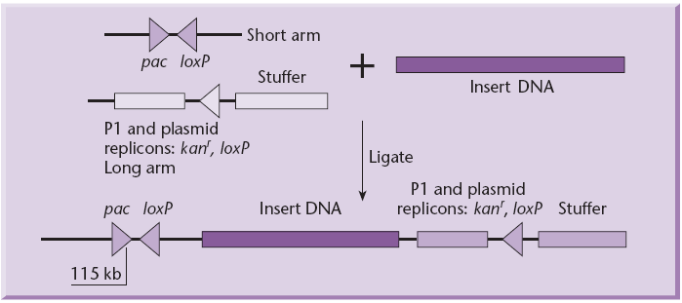
It contains a packaging site (pac) which is necessary for in vitro packaging of recombinant molecules into phage particles.
two loxP sites.
These are the sites recognized by the phage recombinase, the product of the phage cre gene, and which lead to circularization of the packaged DNA after it has been injected into an E. coli host expressing the recombinase.

Slide 84
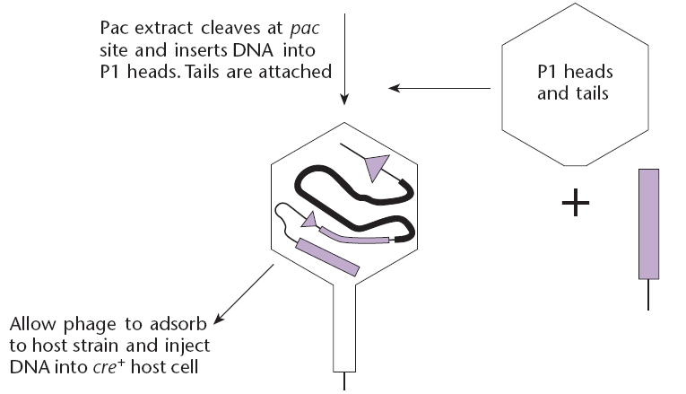
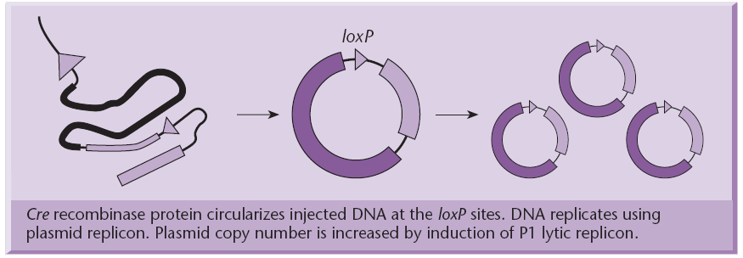

Slide 85
Bacterial Artificial Chromosomes
YAC presented several difficulties
This is based on the single-copy sex factor F of E. coli.
The BAC system is based on the well-studied Escherichia coli F factor.
Replication of the F factor in E. coli is strictly controlled.
The F plasmid is maintained in low copy number (one or two copies per cell), thus reducing the potential for recombination between DNA fragments carried by the plasmid.
Furthermore, F factors carrying inserted bacterial DNA are capable of maintaining fragments as large as 1 mega base pair, suggesting that the F factor is suitable for cloning of large DNA fragments

Slide 86
This vector includes the λ cos N and P1 loxP sites
Two cloning sites (HindIII and BamHI)
Several G+C restriction enzyme sites (e.g. SfiI, NotI, etc.) for potential excision of the inserts.

Slide 87
The first BAC vector, pBAC108L, lacked a selectable marker for recombinants.
But nowadays the original cloning site is replaced with a lacZ gene carrying a multiple cloning site.

