Slide 1
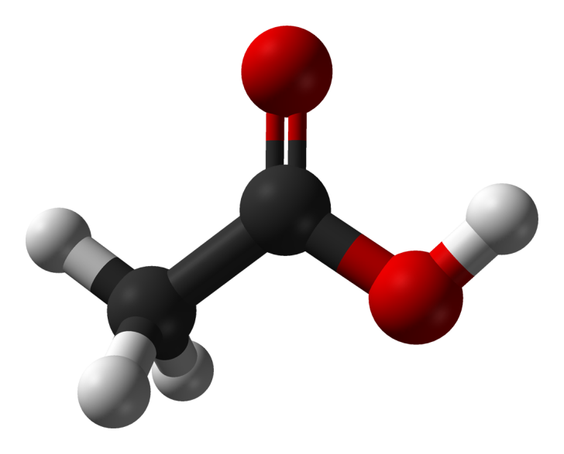
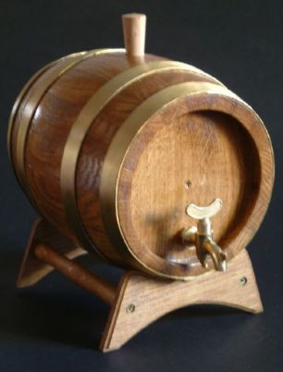
Production of Acetic Acid
Mr. Vikash Kumar
Asst. Prof.
CUTM

Slide 2
Acetic acid was used as a medicinal agent and was probably the first known antibiotic.
Acetic acid (CH3COOH) is the principal constituent of vinegar. The first vinegar was probably a result of spoiled wine, considering that the Latin word acetum means sour or sharp wine. Thus, it has been produced as long as wine making has been practiced and therefore dates back to at least 10 000 BC.

Slide 3
Acetic acid as an industrial chemical is currently produced from fossil fuels and chemicals by three processes: acetaldehyde oxidation, hydrocarbon oxidation, and methanol carbonylation.
It can also be produced by biological routes using either an aerobic or an anaerobic route.

Slide 4
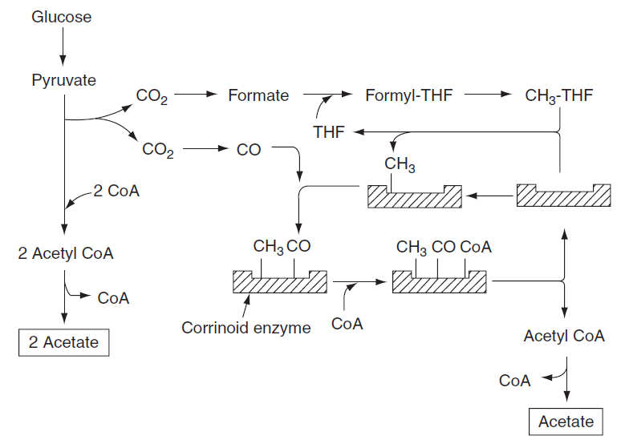

Slide 5
Aerobic Process
Food-grade acetic acid is produced by the two-step vinegar
process.
The first step is the production of ethanol from a carbohydrate source such as glucose.
This is carried out at 30–32 °C using the anaerobic yeast Saccharomyces cerevisiae :
C₆H₁₂O₆ → 2CO₂ + 2CH₃CH₂OH
The second step is the oxidation of ethanol to acetic acid.
2CH₃CH₂OH + O₂ → 2CH₃COOH þ 2H₂O
The overall theoretical yield is 0.67 g acetic acid per gram glucose.
Although a variety of bacteria can produce acetic acid, only members of Acetobacter are used commercially, typically the aerobic bacterium Acetobacter aceti at 27–37 °C.

Slide 6
Anaerobic Process
In the 1980s, another process for production of acetic acid emerged based on anaerobic fermentation using Clostridia.
These organisms can convert glucose, xylose, and some other hexoses and pentoses almost quantitatively into acetate according to the following reaction:
C₆H₁₂O₆ → 3CH₃COOH
Clostridium thermoaceticum is also able to utilize five-carbon sugars:
2C₅H₁₂O₆ → 5CH₃COOH
Typical acidogenic bacteria are Clostridium aceticum, C. thermoaceticum, Clostridium formicoaceticum, and Acetobacterium woodii. Many can also reduce carbon dioxide and other one-carbon compounds to acetate.

Slide 7
Production System
Industrial fermentation processes have evolved from the simple ‘let-alone’ method involving a partially filled open container of wine exposed to air to the ‘field’ fermentation in which a series of casks are filled with wine and inoculated in series by the vinegar produced in the previous casks.
The next technological advance occurred in 1949 when Hromatkar and Ebner applied submerged fermentation techniques to oxidation of ethanol to acetic acid.
The level of gas-phase oxygen is crucial to this process, and thus, efficiency is based on broth aeration with oxygen.

Slide 8
For industrial processes, 10–18% ethanol and 5 times the nutrients used for surface fermentation are the starting conditions for fermentation.
When the concentration of ethanol reaches 0.4–2.4 g l1, 50–60% of the solution is removed and replaced with fresh substrate containing 10–18% ethanol.
There is usually 80 mg of dry bacterial solids per liter. The productivity is 1.7–2.1 g acetic acid per liter per hour, and the process is operated in a semicontinuous manner that helps to minimize variation in the product.

Slide 9
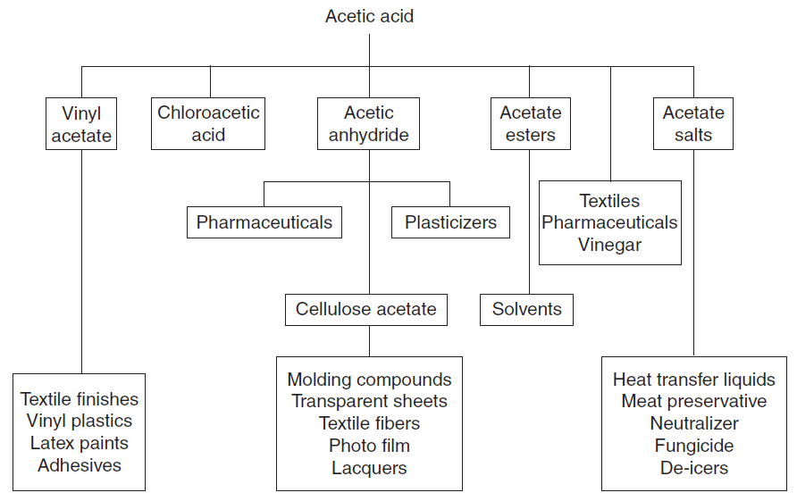

Slide 10
Downstream Processing
Liquid–liquid extraction has been used to recover acetic acid from the chemical manufacture of cellulose acetate, vinyl acetate, and other acetate products.
Extraction solvents are ethers, ketones, or alcohols.
In addition, the relative amounts of dissociated and undissociated acid in the feed solution are important.
Extraction efficiency is high when the organic acid is present in the undissociated (acid) form (i.e., at a low pH).

