Slide 1
Gene Therapy

Slide 2
What is Gene Therapy
Of the over 6000 inherited human diseases catalogued to date, only a few are currently treatable.
Gene therapy—introducing functional copies of a gene into an individual with two defective copies of the gene—is a potential tool for treating inherited human diseases.

Slide 3
Why Gene Therapy is THE LAST OPTION
For many of these diseases, the missing or defective gene product cannot be supplied exogenously, as insulin is supplied to diabetics.
Most enzymes are unstable and cannot be delivered in functional form to their sites of action in the body.
Cell membranes are impermeable to large macromolecules such as proteins; thus, enzymes must be synthesized in the cells where they are needed.
Therefore, treatment of inherited diseases is largely restricted to those cases where the missing metabolite is a small molecule that can be distributed to the appropriate tissues of the body through the circulatory system.

Slide 4
Types of Gene Therapy
Somatic-cell or nonheritable gene therapy
will treat the disease symptoms of the individual but will not cure the disease.
Thus, the defective gene(s) will still be present in the germ-line cells of the patient
Germ-line or heritable gene therapy
is being performed on mice and other animals, but not on humans.
Major moral and ethical considerations are involved

Slide 5
Gene Delivery Methods
Liposome
In this example, the DNA containing the gene of interest is complexed with cationic liposomes.
These complexes are taken into cells by endocytosis, in which a portion of the plasma membrane invaginates and creates an intracellular vesicle known as an endosome. After it is released from the endosome, the DNA may then integrate into the chromosomal DNA via recombination.

Slide 6
Adenosine Deaminase Deficiency
The First Inherited Disease Treated with Gene Therapy
Adenosine deaminase (ADA) is an enzyme involved in purine metabolism.
If both copies of the ADA gene are defective, deoxyadenosine accumulates within the cells
At high concentrations, deoxyadenosine is toxic to lymphocytes
the destruction of T and B cells leads to a form of severe combined immunodeficiency (SCID).
SCID is typically fatal at an early age (generally, 1–2 years old)

Slide 7
On September 14, 1990, the first human gene therapy was approved for a young girl suffering from ADA deficiency.
This work was carried out by a large team of researchers composed of R. Michael Blaese, Kenneth Culver, W. French Anderson.
Prior to this clinical trial, the normal gene for ADA had been cloned into a retroviral vector that can infect lymphocytes.
The general aim of this therapy was to remove lymphocytes from the blood of the young girl with SCID, introduce the normal ADA gene into her cells, and then return them to her bloodstream.

Slide 8
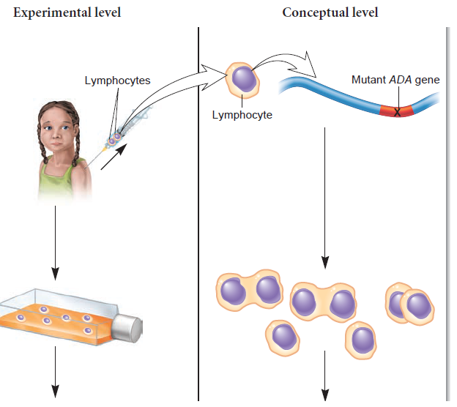
Remove ADA-deficient lymphocytes from the patient with SCID.
Culture the cells in a laboratory.

Slide 9
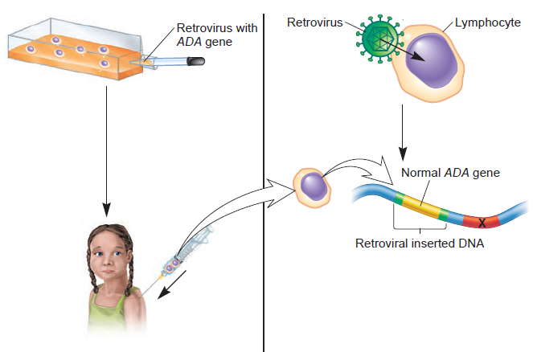
Infect the cells with a retrovirus that contains the normal ADA gene. Retroviruses insert their DNA into the host cell chromosome as part of their reproductive cycle.
Infuse the ADA-gene-corrected
lymphocytes back into the SCID patient.

Slide 10
Cystic Fibrosis
Cystic fibrosis (CF) is a rare recessive disorder with debilitating consequences.
About 1 in 3000 babies whose parents are of northern European descent are affected with this disorder.
CF is caused by a defect in a gene termed the cystic fibrosis transmembrane regulator (CFTR), which encodes a protein that functions in the transport of chloride ions across the plasma membrane of epithelial cells, such as cells lining the respiratory and intestinal tracts.
A defect in membrane transport leads to an abnormality in salt and water balance, which causes a variety of symptoms, particularly an overaccumulation of mucus in the lungs.

Slide 11
CF – The Therapy
CF has been the subject of much gene therapy research.
To implement CF gene therapy, it is necessary to deliver the normal CFTR gene to the lung cells.
Unlike ADA gene therapy, in which the lymphocytes can be treated ex vivo, lung epithelial cells cannot be removed and then put back into the individual.
Instead, researchers must design innovative approaches that can target the CFTR gene directly to the lung cells.

Slide 12
In one protocol, the normal CFTR gene is cloned into an adenovirus, a virus that normally infects lung epithelial cells and causes a lung infection.
This adenovirus, however, has been engineered so it can gain entry into the epithelial cells but not cause a lung infection.
In a second approach, the normal CFTR gene is complexed with liposomes.
When inhaled by the patient via an aerosol spray, the lung epithelial cells take up this liposome complex.

Slide 13
Like ADA gene therapy, CF gene therapy is at an early stage of development. Researchers hope that gene therapy eventually will become an effective method of alleviating the symptoms associated with this disease.

Slide 14
