Slide 1
GOODS & SERVICES TAX (GST) IN INDIA

Slide 2
Tax payer & various Tax Authorities of Local body,State , Central Govt.

Slide 3
IDEAL TAXATION

Slide 4
TAX, SOCIETY, COUNTRY
CIVILIZED SOCIETY PAYS TAX
HONEST TAX PAYERS ARE ASSEST OF NATION.
PAYMENT OF TAX – GRATEFULNESS TOWARDS SOCIETY, SOLIDERS, FARMERS, COUNTRY, ETC.
PAYMENT OF TAX MEANS WEALTH FROM “HAVES” TO “HAVE NOTS”.

Slide 5
Pre-gst Tax structure in India
Tax Structure
Direct Tax
Income Tax
Wealth Tax
Indirect Tax
Central Tax
State Tax
Excise
Service Tax
Custome
VAT
Entry Tax, luxury tax, Lottery Tax, etc.

Slide 6
Subsuming of Existing Taxes
CGST
Central Excise
Additional duties of Custom (CVD)
Service Tax
SGST
VAT/sales tax
Entertainment Tax
Luxury Tax
Lottery Tax
Entry Tax
Purchase Tax
Surcharges and all cesses
IGST
CST

Slide 7
Why GST ?
Distinction between goods & services or mix thereof was a big problem in earlier laws/regime.
Especially in respect of Works Contract Service where both material and service is involved, things become more complex becoz of RCM.

Slide 8
Limitations of current Tax regime :
5. Goods Vs. Services dilemma ?
License Software in CD
Sale of Food In Restaurant
Sale
Services
Manufacturing
Notes:
There is a concept of Goods-Service Continuum; If goods and services are places on a scale with pure goods being on one side and services on the other side, most of the transactions lie some where in between having elements of goods as well as service. State government and Centre are in Court in many cases just to decide as regards the classification as goods or services. The distinction between two is getting blurred with the advent of technology. For instance software is being taxed by treating it as services as well as goods. GST appears to be much more efficient tax and may solve most of the existing inefficiencies in indirect taxation system.

Slide 9
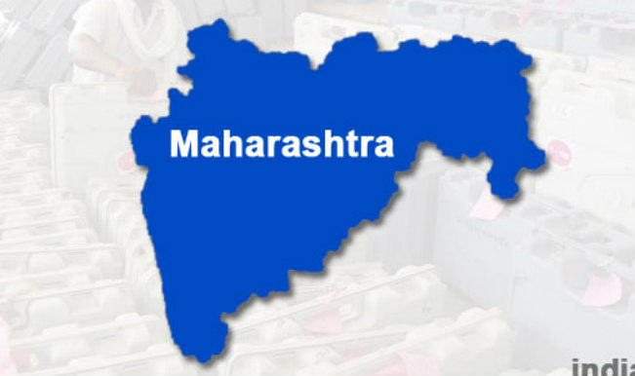
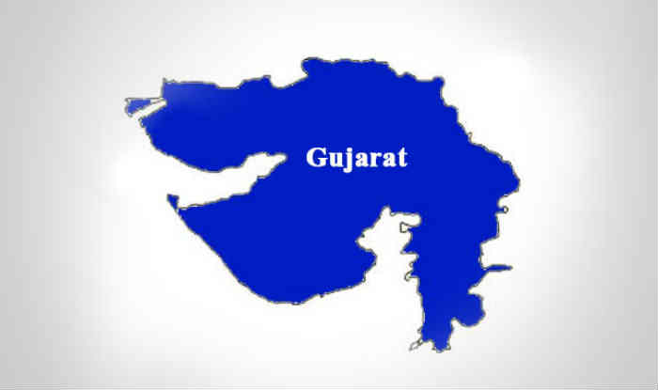
Limitations of current Tax regime :
4. Lack of Uniformity
No Entry Tax
Entry Tax
@ NIL %
@ 4%
Value Added Tax
e.g. on Sugar
Notes:
Harmonisation in the different taxation laws of states appears to be missing many a times. Uniformity is lacking while levying VAT or entry taxes in many states. The companies try to take advantage of tax arbitrages leading to decisions being taken on the basis of tax structure rather than on the basis of pure economic reasons. All this leads to inefficiencies in the system.

Slide 10
IMPORTANCE OF GST
GST IS APPLICABLE TO ALL GOODS & SERVICES, EXCEPT FEW.
EXCEPT AGRI, MEDICAL SERVICES AND EDUCATION, EVERYTHING IS TAXABLE UNDER GST.

Slide 11
WHY GST BETTER THAN EARLIER LAWS ?
GST may not be a very ideal for many people & for many reasons
but in fact things in earlier taxation system had gone to such low & complex level, so further worsening of things was almost impossible, so hopefully things will only get better day by day.

Slide 12
Limitations of current Tax regime :
3. Different Points of Taxation
Limitations of current Tax regime :
Central Excise
(On Manufacturing)
Service Tax
(On provision of Service)
VAT
( On sale of Goods)
Notes:
There are different taxable events with each having issues of definitions, interpretations resulting in overlapping at many places. All this creates confusions with many of the issues reaching courts for a decisions.

Slide 13
JOURNEY OF GST IN INDIA
Vijay Kelkar committee recommended it in 2004 during Atal Bihari Vajpaee Govt.
First Discussion paper was published in 2009, 90% of provisions of today from that paper.
07-05-2015 Loksabha passed it, 03-08-2016 Rajya sabha passed, even J&K passed it.
GST now permanent, roll back impossible even if present political parties gets defeated in next elections.

Slide 14
What u r required to know for GST
CGST, IGST and Cess Act
Rules, notifications, (rate and non rate), circulars, etc.
criminal procedure code,1973, Companies Act, 2013, Indian Evidence Act, 1872, Indian Penal code, Information Technology Act, 2000, Motor Vehicles Act, 1988, Transfer of Property Act, 1882, Special Economic Zone Act, 2005, Income Tax Act, 1961.
Twitter, PIB, etc

Slide 15
Purpose of GST as per constitution
What constitutional amendment says as purpose
(1) to avoid cascading effect
(2) to have common national market.

Slide 16
Unique Concepts/Features:-
IGST/(contribution of India in GST).
DESTINATION BASED TAX
CONSUMPTION BASED TAX
COMPLIANCE RATING
RARE EXAMPLE OF STATE & CENTRAL GOVT CO-OPERATION.
GST COUNCIL- NEW POWER CENTRE
ALL DECISIONS UNANIMOUS, NEVER VOTING.
END OF INSPECOR RAJ ?

Slide 17
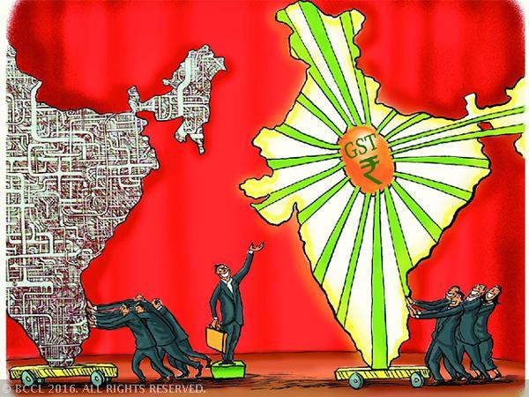
What is GST?
One Tax For
Manufacturing
Trading
Services
ONE NATION: ONE TAX
Notes:
Whether you are manufacturer, trader, dealer, service supplier- all will be considered as same i.e taxpayer. Whether you supply within the same state or anywhere in the country, the rate of tax is same, thereby obviating any need for various forms and border check points which is prevalent today.

Slide 18
WHY GST IS MUST ?
Earlier tax on tax
Exports can not be made tax free.
Under GST:- self police mechanism.
All transactions recorded in book, tax collection will go up.
Pararrel economy ratio expected to go down.
What is easy to print a currency note or cenvat invoice ? .
Matching basis-soul of GST.
Earlier taxation under excise, vat was restricted to those transactions, now 360degree angle is required

Slide 19
IMPACT OF GST AS OF NOW
AS PER ECONOMIC SURVEY :-
Upon implementation of GST, indirect tax base has increased by 50%, 34 lakhs new businesses added to tax base.
Highest registration in Maharashtra, next is UP, Tamil Nadu and Gujrat.
But large increase in registrations in west Bengal.

Slide 20
Impact of GST 2/2
Though turnover is below Rs 20 lakhs, there are 17 Lakhs who have obtained voluntary registrations.
In pre-GST era, revenue collection of center and state was Rs 9.7 Lakhs crore p.a.
It was expected to be Rs.10.9 lakh cr p.a.
In the first year of GST implementation, revenue grew by 11.09%

Slide 21
Impact of GST 3/3
In October,18, 67.45 Lakhs filed GST returns and revenue pm crossed Rs 1,00,710 crore as taxes.
As a result this is going to increase the demand for professionals in future also.

Slide 22
Definition of supply
Section 7(1) for the purposes of this Act the expression “supply” includes
(a) all forms of supply of goods or services or both such as sale, transfer, barter, exchange, licence, rental, lease or disposal made or agreed to be made for a consideration by a person in the course of or furtherance of business;
(b) import of services for a consideration whether or not in the course or furtherance of business…continue

Slide 23
SCHEDULE I Activities to be treated as supply even if made WITHOUT CONSIDERATION
Permanent transfer or disposal of business where, ITC has been availed on such assets.
Supply between related persons OR between distinct persons as specified in section 25.
Gifts up to Rs 50,000 in a financial year by employer to an employee shall not be treated as supply.
Supply of goods by principal to agent & vice versa
Import of services by a taxable person from related person or from his establishment in foreign country in furtherance of business.

Slide 24
Schedule II-to be treated as supply
Transfer of title.
Transfer of goods without transfer of title.
Transfer of title in goods under agreement which stipulates that on payment of full consideration property shall pass at a future date is supply of goods.(hire purchase)
Any lease, tenancy, easement, licence to occupy land is supply of service.
Lease of building or part of it is supply.
Any treatment or process which is applied to another’s goods is supply of goods.
Transfer of business assets.

Slide 25
Continue schedule ii
Renting of immovable property
Construction of complex, building etc intended for sale to a buyer, where part of consideration is received before completion certificate.
Works contract
Supply of food, drinks, etc for consideration
Supply of goods by any unincorporated association or body of person to a member

Slide 26
Schedule III following not supply
Employee to employer.
Services by court or tribunal
Functions by MP, Corporations, and local bodies.
Funeral, burial etc.
Sale of land or building
Actionable claims.

Slide 27
Imp definitions
(6) Aggregate turnover : Total of
Taxable supply
Exempt supply
Export of goods/services
Inter state supplies
BUT NOT
Taxes,
Value on which RCM payable
The said total will be for all India basis for each PAN No.
(exempt supply includes non-taxable supply)

Slide 28
Diff. between composite & mixed supply
(30) Composite supply :-supply consisting of two or more taxable supplies of goods and/or services-naturally bundled-one of them is principal supply.
Ex :- Supply of goods, packing material, transport and insurance is a composite supply and supply of goods is a principal supply.
(74) Mixed supply means two or more individuals supplies of goods or services or any combination thereof made in conjunction with each other by a taxable person for a single price where such supply does not constitute composite supply.
(ex aerated water, canned foods, cakes, dry fruits etc)

Slide 29
What is meant by exempt supply ?
Exempt supply :- means supply of any goods or services or both which attracts nil rate of tax or which may be wholly exempt from tax under Section 11 or under section 6 of the IGST Act and includes non-taxable supply.

Slide 30
What is meant by job work ?
(68) Job Work :- any treatment or process undertaken by a person on the goods belonging to another Registered person

Slide 31
Outward supply
(83) “outward supply” in relation to a taxable person, means supply of goods or services or both, whether by sale, transfer, barter, exchange, licence, rental, lease or disposal or any other mode, made or agreed to be made by such person in the course or furtherance of business;

Slide 32
R C M means ?
(98) “reverse charge” means the liability to pay tax by the recipient of supply of goods or services or both instead of the supplier of such goods or services or both under sub-section (3) or sub-section (4) of section 9, or under sub-section (3) or subsection (4) of section 5 of the Integrated Goods and Services Tax Act;

Slide 33
Valid return ?
(117) “valid return” means a return furnished under sub-section (1) of section 39 on which self-assessed tax has been paid in full;

Slide 34
Registration threshold limit
As per Section 22 of CGST Act, 2017
Every supplier shall be liable to be registered in the state from where he makes taxable supply of goods/services/both
If his aggregate turn over exceeds Rs. 20 Lakhs.
Exemption from registration in CGST Act,2017:- (a) Exclusive supply of exempted goods/services (b) agriculturist.

Slide 35
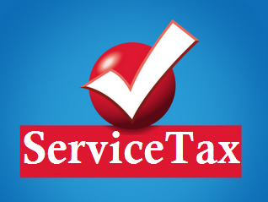
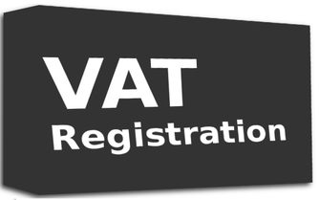
Limitations of current Tax regime :
2. Multiple Registrations
Central Excise
Notes:
Multiple laws require multiple compliances and registrations with no interlinkages amongst them leading to silos being created. In many cases, these different governments- Centre, states are trying to tax same transactions.

Slide 36
REGISTRATION COMPULSORY IN FOLLOWING CASES:-
Persons making inter-state supplies.
Casual taxable persons
Any person who pays tax under reverse charge mechanism.
E commerce operator.
Non resident taxable persons
Any person who is required to deduct tax at source U/s.51.(especially Govt departments & local bodies,)
Any person who supplies goods or services on behalf of others as agent or otherwise.

Slide 37
Regn-continue
Any person who is required to collect tax under section 52.( by e commerce operator)
Every person supplying on line information and data base retrieval service from a place outside India to a person in India, other than a registered person.
Input service distributor
Every electronic commerce operator.
Any other person as notified by Govt.
Grant of Unique Identity Number shall be considered as deemed registration meant for Consulates, Govt Departments, etc.

Slide 38
Process of registration
If liable for registration, required to obtain registration within 30 days from the date he becomes liable to registration 25(1).
PAN is must for GST Registration-25(6)
Other details/documents soft copy required such as adhar, light bill,rent agreement,bank details etc
Online application, verification thru registered mobile phone, email, OTP & verification of PAN. Then electronic submission of application.

Slide 39
Registration -continue
How to read registration no of GST ? 15 digits first two characters state code, next 10 digit PAN No, two characters for entity code and last, check sum character.
Proper officer may get physical verification of premises etc done and shall be required to upload photos, report on GSTN in REG-29 format.

Slide 40
Registration-continue
Every registered person is required to display GST Certificate prominently at principal and additional places of business.
Even if not liable you may get voluntary registered. (Section 22 or 24).

Slide 41
Registration can be amended.
Registration can be cancelled if person does not conduct any business from the declared place or business or issues invoices or bill without supply of goods or service .

Slide 42
Composition scheme of GST
Also referred in the act as person registered under section 10 of the Act.
This Scheme is available to those whose turnover of supply of goods in a financial year does not exceed Rs. 1.5 cr.
PAN based :-Applicable on all transaction on a single PAN whether registered as separate business vertical or registered in separate State/UT

Slide 43
Composition scheme-continue
Scheme is optional.
Option lapses on the day his aggregate turnover exceeds specified limit.
Least compliances.
Quarterly payment-
No ITC
No levy or collection of GST.

Slide 44
RCM for composition scheme
He shall be liable to pay tax under Reverse Charge Mechanism both under Sec.9(3) and Sec.9(4) at regular rate of tax and NOT at composition rate.

Slide 45
Examples of RCM under GST
Import of service
Goods transport agency
Advocate
Long lease of land ( 30 yrs or more)
Services supplied by Govt to business entity( if amount above Rs 5k & turn over of the entity is above 20 Lakhs.
Services by director to company.
Supply of security personnel.

Slide 46
Composition :-applicability
Manufacturer @ 1%
Restaurant @ 5% & turn over of 5 lakhs allowed of other than restaurant.
Traders 1% of aggregate turn over.
No other category is allowed for this scheme.
Tobacco, pan masala, ice cream not covered under this scheme.

Slide 47
Composition scheme
.
Bill of supply in place of invoice.
Quarter return & annual return to be filed.
Inter-state sale or supply not allowed
But can purchase from outside state.
In case of purchase, rejection quite difficult.

Slide 48
Concept of R C M
Receiver of supply has to pay GST in Cash
RCM applies on notified goods & services.
ITC of GST paid under RCM available as credit.
Two types of RCM one for specified goods & services. GTA & Advocate most common.
Another for receipt of goods & services from unregistered person.
RCM of URD as of now not activated, new version awaited once GST is settled.

Slide 49
Job work under GST
Allowed, can send RM on challans.
No GST on sending RM to job workers.
But GST applicable on job work charges, if exceeds limit of Rs 20 Lakhs turn over.
Goods sent for job work to be returned within 180 days, if not GST applies with interest.
Job work challan to have diff series of challan
Good can be sent directly to job worker.
E-way Bill required if value exceeds specified limit.

Slide 50
Input tax credit under GST
ITC of goods, services purchased/used available.
ITC not available on motor, foods, supply for personal use etc.
ITC on vehicle allowed, if used for transport of goods, for driving school, transportation of passanger or vehicle dealers etc.
ITC to be availed on copy of invoice, withiin specified period.

Slide 51
ITC- continue
ITC not allowed on rent a cab, beauty treatment, health insurance,
ITC not allowed on goods stones, theft, caught fire etc.
Three types of ITC- credit of SGST, CGST, IGST.
ITC gets curtailed if utilised for taxable and exempted supply both.

Slide 52
SEQUENCE OF UTILIZATION OF ITC
Payment for | First set off | Then set off
SGST | IGST | SGST
CGST | IGST | CGST
IGST | IGST | CGST & SGST

Slide 53
Refund of GST
On Export of goods/services, GST paid on Raw Material/Input services refundable OR IGST paid on exports.
Inadvertent duty structure
GST for RM is high and GST on FG is low, then refund allowed.
Excess paid GST.
Refund of pre-deposit for appeal
Online application required.

Slide 54
Valuation of supply under GST
As per section 15 of CGST Act, 2017
Sole consideration
Unrelated parties.
Valuation Rules also play important role, have to be referred in many cases.
Crux of valuation :- Story of horse, cat and donation.

Slide 55
E way bill
In Maharashtra upto 1 lakh not required.
For inter state, e way bill required once you cross transportation of Rs 50000
There are some items which are exempted from having e way bill
It has to be generated online.
Eway bill has to accompany the goods in transit.

Slide 56
GST DETAILS RELATING TO CS
CS CAN BE GST PRACTITIONER, OF COURSE HE HAS TO APPLY ON LINE AND GET GST PRACTITIONER NUMBER.
CS ALSO CAN APPEAR BEFORE ADJUDICATING AUTHORITY FOR PERSONAL HEARING.
BUT CS CAN NOT CERTIFY ANNUAL ACCOUNTS/ AUDIT REPORT REQUIRED UNDER GST LAW.

Slide 57
COMPANY SECRETARY CONTINUE
GST PAYABLE @ 18% ON CS SERVICES.
SERVICES BY COMPANY SECRETAY CLASSIFIABBLE UNDER following codes:-
998214 :- Legal documentation & certification services concerning other documents.
998212 :- in case CS appeared for personal hearing.
998216 other legal services n.e.c.
N.e.c.:-not elsewhere classified/residual.

Slide 58
SERVICE ACCOUNTING CODES
Heading no. 9982 |  | Legal and accounting services
Group 99821 |  | Legal services
 | 998211 | Legal advisory and representation services concerning criminal law.
 | 998212 | Legal advisory and representation services concerning other fields of law.
 | 998213 | Legal documentation and certification services concerning patents, copyrights and other intellectual property rights.
 | 998214 | Legal documentation and certification services concerning other documents.
 | 998215 | Arbitration and conciliation services
 | 998216 | Other legal services n.e.c.

Slide 59
Group 99823 |  | Tax consultancy and preparation services
 | 998231 | Corporate tax consulting and preparation services
 | 998232 | Individual tax preparation and planning services

Slide 60
Group 99822 |  | Accounting, auditing and bookkeeping services
 | 998221 | Financial auditing services
 | 998222 | Accounting and bookkeeping services
 | 998223 | Payroll services
 | 998224 | Other similar services n.e.c

Slide 61
Group 99715 |  | Services auxiliary to financial services (other than to insurance and pensions)
 | 997151 | Services related to investment banking such as mergers and acquisition services corporate finance and venture capital services
 | 997156 | Financial consultancy services
 | 997159 | Other services auxiliary to financial services

Slide 62
Heading 9983 |  | Other professional, technical and business services

Slide 63
Group 99831 |  | Management consulting and management services; information technology services
 | 998311 | Management consulting and management services including financial, strategic, human resources, marketing, operations and supply chain management
 | 998312 | Business consulting services including public relations services
 | 998313 | Information technology consulting and support services

