Slide 1

Conjugation in Alkadienes and Allylic Systems
Conjugation: a series of overlapping p-orbitals
The Allyl Group - allylic position is the next to a double
bond
vinyl hydrogen
vinyl carbon
H C
(sp² hybridized)
H
C
C
OH
Cl
allyl alcohol allyl chloride
Allylic Carbocations - carbocation with a vinyl group as a substituent (next to a double bond)
C
C C

Slide 2
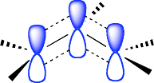
Allyl carbocations are stabilized by resonance
C
C C
C
C C
C
!+ C C !⁺
! +
C
! +
C
C
C C
C
The atoms must remain fixed in all resonance forms. Resonance forms differ only by the placement of electrons
No one resonance form is entirely accurate. The actual structure is a hybrid of all the resonance forms. Resonance forms do not necessarily contribute equally to the resonance hybrid.

Slide 3
10.3: S_{N}1 Reactions of Allylic Halides - allylic halides and sulfonates are more reactive toward than simple alkyl halides toward nucleophilic substitution by the S_{N}1 mechanism
H
H C
H
H _{C} C _{C} CH₃
H
H C
C C
H
CH
H
3
CH₃
C CH₃
_{C C} CH₃
H Cl
H
C C
H CH₃ H CH₃
Resonance stabilized carbocation intermediate
Cl CH₃
over 100x more reactive than (H₃C)C-Cl
H
CH₃
H
H
^{H C} CH₃
C C
H OH
H
C CH₃
C C
85 : 15
OH CH₃

Slide 4
10.4: S_{N}2 Reactions of Allylic Halides - allylic halides and sulfonates are more reactive toward than simple alkyl halides toward nucleophilic substitution by the S_{N}2 mechanism
H
H C Cl
C C
H
H C Nu
C C
~ 80x more reactive than
Cl-CH₂CH₂CH₂CH₃
S 2
N
H
H H
H
H H

Slide 5
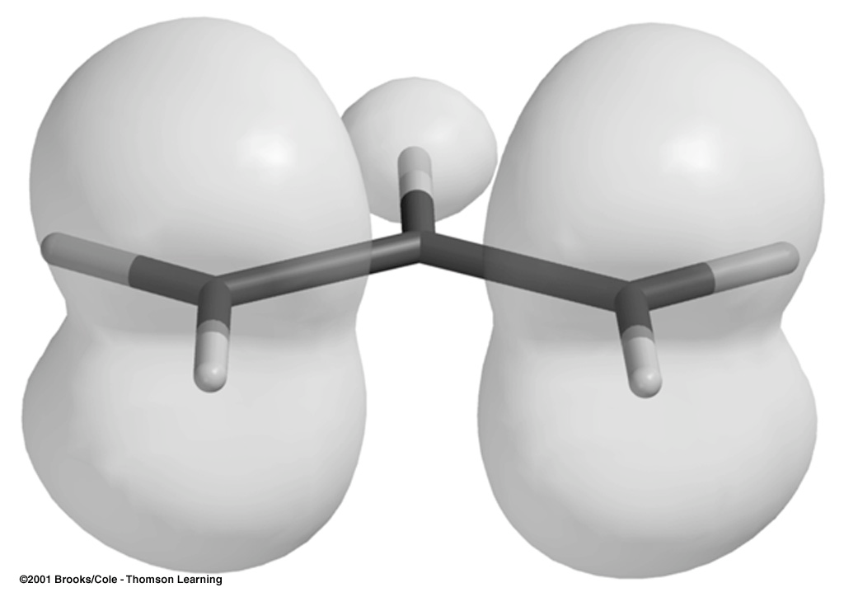
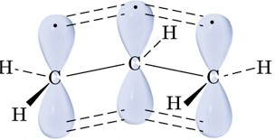
10.5: Allylic Free Radicals
1/2 •
C
_{C} 1/2 •
C
C
•
•
C
C
C
C
C
1 1/2 bonds
Map of the electron density due to the unpaired electron (the “spin”)

Slide 6
Free Radical Stabilities are Related to Bond-Dissociation Energies
410 kJ/mol
•
CH CH CH—H
CH₃CH₂CH₂
+
H•
CH₃CH₃ CH—H
397 kJ/mol
•
(CH₃)₂CH—H
(CH₃)₂CH + H•
380 kJ/mol
•
(CH₃)₃C—H
(CH₃)₃C
+ H•
368 kJ/mol •
H₂C CHCH₂—H H₂C CHCH₂ H•
+
C—H bond is weaker in propene because the resulting allyl
radical is more stable than the alkyl radicals.

Slide 7

10.6: Allylic Halogenation - Allylic halogenation of an alkene takes place through a free radical mechanism.
Br
O
NBS, h!
N Br
CCl₄
O
N-bromosuccinimide (NBS)

Slide 8
Limitation: Allylic halogenation is only useful when all of the allylic hydrogens are equivalent and the resonance forms of allylic radical are equivalent.
NBS, h!
•
•
Br
+
Br
10.7: Allylic Anions
C
C C
C
C C
C
!- C C !-

Slide 9
_ CH₃CH₂CH₂ ++
pK_{a} ~ 60
_{H}+
CH₃CH₃CH—H
_
pK ~ 43
H C CHCH —H
a
H₂C CHCH₂
+
_{H}+
2 2
10.8: Classes of Dienes
Diene: molecule with two double bonds
C-C
single bond
C C C
C=C
double bonds
Alkene
Diene
Cumulated Diene (allene)
Conjugate Diene
Conjugated diene: alternating double and single bonds

Slide 10
10.9: Relative Stabilities of Dienes
Recall from Chapter 6 that heats of hydrogenation (ΔH°_{H2}) was used to measure the relative stability of isomeric alkenes
Figure 10.4 (p. 396)
H₂, Catalyst
ΔH°_{H2}
-126 KJ/mol
H₂, Catalyst
-252 KJ/mol
(2 x 126 = 252)
-111 KJ/mol
(126 - 111 = 15)
H₂, Catalyst
H₂, Catalyst
-226 KJ/mol
the double bonds of conjugated dienes are more stable than isolated double bonds.

Slide 11
10.10: Bonding in Conjugated Dienes
When the carbons of a conjugate diene all lie in the same plane, the π-molecular orbitals overlap.
• •
The four π-electrons of a conjugated diene • •
are delocalized over the four p-orbitals
• •• _
_
•
+
+
Bond lengths in pm
H₃C CH₃ H₂C CH₂ H₂C CH CH₃
153 133 151
H₂C CH CH CH₂
H₂C CH CH CH₂
146
134

Slide 12
There are three conformations of butadiene.
The (lower case) s prefix designates a conformation around
single (σ) bond.
H
H C
C H
H C
C H
H
s-trans
H
H C
C H
C H
H C
H
s-cis
180° rotation of the central σ-bond
The perpendicular conformation is 16 KJ/mol higher in energy than the s-cis
Energy
90° rotation of the central σ-bond
The s-cis conformation is 12 KJ/mol higher in energy than the s-trans
s-cis
s-trans

Slide 13

O
H
n
Vitamin A (retinal)
poly-acetylene
Arene
β-carotene
lycopene
alkenes conjugated to carbonyls
O
O
H
acrolein
(!,″-unsaturated aldehyde, enal)
cyclohexenone
(!,″-unsaturated ketone, enone)
alkenes conjugated to non-bonding pairs of electrons
O
R
O
N

Slide 14



10.11: Bonding in Allenes (please read)
sp hybridized
C C C
sp² hybridized
10.12: Preparation of Dienes
Preparation of conjugated dienes (1,3-dienes) from alkenes: allylic bromination followed by dehydrohalogenation
Br
NBS, h!
(CH₃)₃CO ⁻ K⁺
CCl₄

Slide 15

10.13: Addition of Hydrogen Halides to Conjugated Dienes
Isolated dienes: double bonds react independently. Conjugated dienes: the π-bonds of a conjugated diene react as a single unit.
Electrophilic Addition to Conjugated Alkenes: The addition of HX to butadiene. Recall that the addition of HX to alkenes follows Markovnikov’s Rule
X
X
The observed product is derived from the most stable carbocation intermediate
H-X
+
H₃C H₃C
CH₃
H
not observed
The addition of HX to a conjugated diene occurs to give a resonance stabilized allyl carbocation

Slide 16
H Br
H
H
Br
Br
H
Br
H
The distribution of products is
Br
1,2-addition
1,4-addition
dition)
dependent upon | (d | irect addition) | (conjugate ad
temperature | 25 °C | 44% | 56%
 | -80 °C | 81% | 19%
At low temperature the reaction is under kinetic control, the major product is the one that forms fastest.
The reaction is under thermodynamic control at higher temperature, the major product is the most stable.

Slide 17
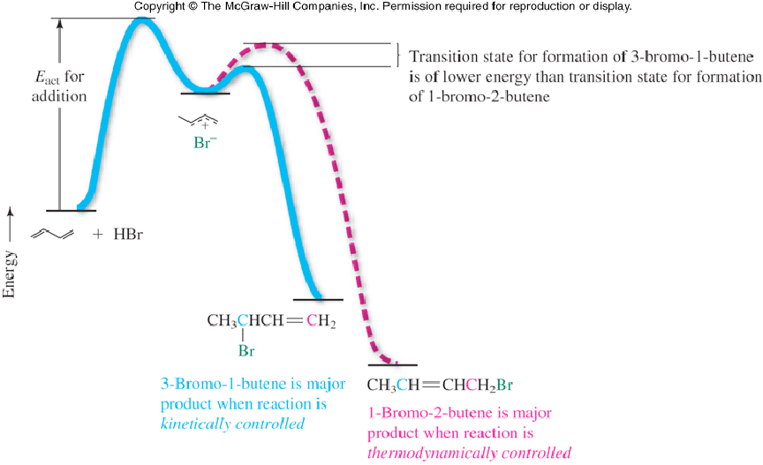
Figure 10.8
ΔG°_{act} (1,2-addition) < ΔG°_{act} (1,4-addition) The 1,2-addition product is formed faster than the 1,4-addition products. Kinetics (rate) favors 1,2-addition
ΔG° (1,4-addition) > ΔG° (1,2-addition) The 1,4-addition product is more stable than the 1,2-adition products. Thermo- dynamics favors 1,4-addition

Slide 18
10.14: Halogen Addition to Dienes
Electrophilc additions of other electrophile to dienes give similar results
Br₂ Br
Br
+
Br
Br
37 %
63 %
1,4-addition
1,2-addition
Br₂
Br
Br
+
Br
+
Br
Br
Br
3 %
1,2-addition
21 %
1,2-addition
76 %
1,4-addition

Slide 19
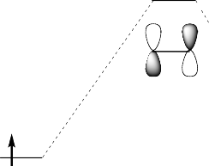
10.16: The π Molecular Orbitals of Ethylene and 1,3-Butadiene
π-MO’s of ethylene (from Chapter 2)
!-antibonding MO Lowest Unoccupied
ψ₂ Molecular Orbital (LUMO)
!-bonding MO
Highest Occupied Molecular Orbital (HOMO)
ψ₁

Slide 20
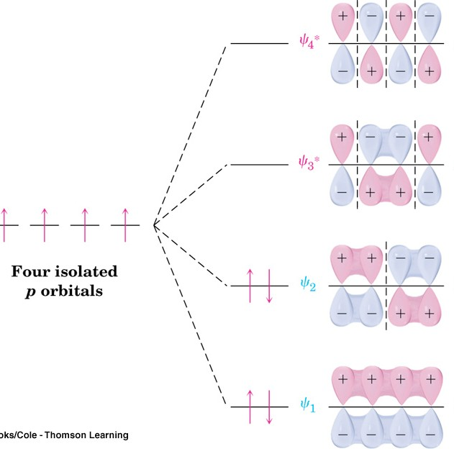
π-molecular orbitals of butadiene
3 Nodes
0 bonding interactions
3 antibonding interactions ANTIBONDING MO
2 Nodes
bonding interactions
antibonding interactions ANTIBONDING MO
1 Nodes
2 bonding interactions
1 antibonding interactions BONDING MO
0 Nodes
3 bonding interactions
0 antibonding interactions BONDING MO
ψ₂ is the Highest Occupied Molecular Orbital (HOMO)
ψ₃ is the Lowest Unoccupied Molecular Orbital (LUMO)

Slide 21
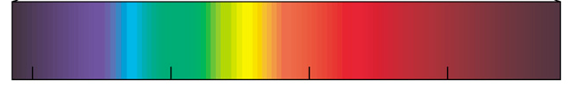
Molecular orbitals of conjugated polyenes
Antibonding
Energy
Bonding
H₂C CH₂
180 nm
217 nm
258 nm
290 nm
380 nm 400 nm 450 nm | 500 nm | 550 nm | 600 nm | 700 nm | 780 nm
violet-indigo ^{blue} | green | yellow | orange | red

Slide 22






The Diels-Alder Reaction (a very important reaction) - Reaction between a conjugated diene and an alkene (dienophile) to give a cyclohexene.
‡
Diene
Dienophile
transition state
cyclohexene
Mechanism:
concerted - reaction (bond breaking and bond forming) takes place in a single step.
Cycloaddition - non-cyclic reactant react to form a cyclic product
Pericyclic - cyclic “aromatic-like” transition state
‡
=
Diels-Alder Transition State
Benzene

Slide 23







The Diels-Alder reaction is favored by electron withdrawing groups on the dienophile and electron donating groups on the diene.
H | H | O | O | O
H | H | H | R |  | OR
ethylene (unreactive)
conjugated carbonyls (aldehydes, ketones and esters)
O
O
N
C
CO₂R
O
O
O
Good dienophiles
The diene must adopt an s-cis conformation to be reactive:
s-trans
(unreactive conformation)
s-cis
(reactive conformation)
very unreactive diene
very reactive diene

Slide 24
Stereochemistry of the Diels-Alder Reaction:
The stereochemistry of the alkene reactants (dienophile) is preserved in the product.
O
H
O
H
!
+
O
O
H
H
O
O
O
O
H
+
H
CH₃
!
CH₃
H₃C
H
H
CH
3
O
O
H
+
H
CH₃
!
CH₃
H
CH₃
CH₃
H

Slide 25

10.17: A π Molecular Orbital Analysis of the Diels-Alder Reaction
HOMO
diene
ψ₂ of butadiene
ψ₂ of ethylene
LUMO
dienophile
The orbitals between the diene and dienophile involved in bond formation are in phase - symmetry allowed.
CH₂ CH₂
CH₂ CH₂
HOMO
orbitals are
out of phase
LUMO
Symmetry forbidden

