Slide 1




Slide 2
CONTENTS:
INTRODUCTION
DEFINITIONS
TYPES OF DRUG MASTER FILES
SUBMISSIONS TO DRUG MASTER FILES
AUTHORIZATION TO REFER TO A DRUG MASTER
FILE
PROCESSING AND REVIEWING POLICIES
HOLDER OBLIGATIONS
IX. CLOSURE OF A DRUG MASTER FILE.

Slide 3
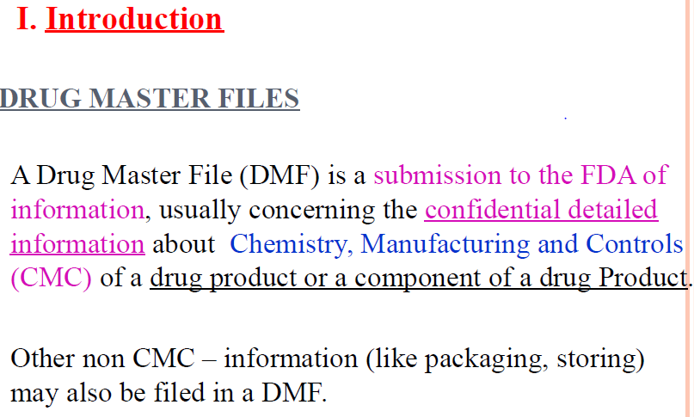

Slide 4
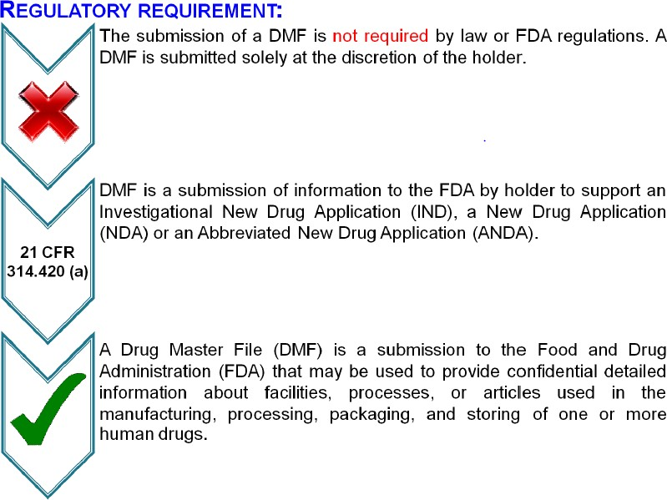

Slide 5
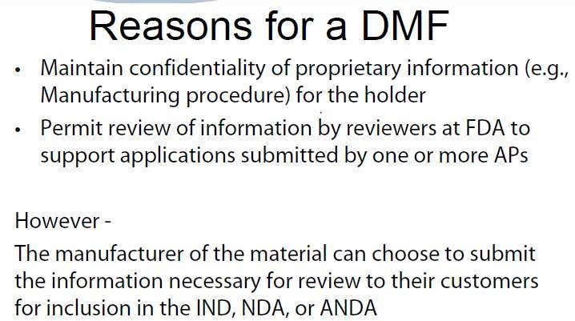

Slide 6
DEFINITIONS
Agency means the Food and Drug Administration.
Holder means a person who owns a DMF.
Agent or representative means any person who is appointed by a DMF holder to serve as the contact for the holder.
Applicant means any person who submits an application or abbreviated application or an amendment or supplement to them to obtain FDA approval of a new drug or an antibiotic drug and any other person who owns an approved application.

Slide 7
Letter of authorization means a written statement by the holder or designated agent or representative permitting FDA to refer to information in the DMF in support of another person's submission.
Transmittal Letter = Cover Letter Annual Report = Annual update
Customer = Applicant = Authorized Party (AP)

Slide 8
TYPES OF DRUG MASTER FILES
Type I | Manufacturing Site, Facilities, Operating Procedures, and Personnel
Type II | Drug Substance, Drug Substance Intermediate, and Material Used in Their Preparation, or Drug Product
Type III | Packaging Material
Type IV | Excipient, Colorant, Flavor, Essence, or Material Used in their Preparation
Type V | FDA Accepted Reference Information

Slide 9
Type I Manufacturing Site, Facilities, Operating Procedures, and Personnel
A Type I DMF is recommended for a person outside of the United States to assist FDA in conducting on site inspections of their manufacturing facilities.
The DMF should describe the manufacturing site, equipment capabilities, and operational layout.
A map showing its location with respect to the nearest city.
As per Jan. 12, 2000 Final Rule notice : Elimination of Type I DMFs done by July 10, 2000.

Slide 10
Type II: Drug Substance, Drug Substance Intermediate, and Material Used in Their Preparation, or Drug Product.
(1) Drug Substance Intermediates, Drug Substances, and Material Used in Their Preparation
Summarize all significant steps in the manufacturing and
controls of the drug intermediate or substance.
Detailed guidance is found in the following guidelines:
Guideline for Submitting Supporting Documentation in Drug Applications for the Manufacture of Drug Substances.
Guideline for the Format and Content of the Chemistry, Manufacturing, and Controls Section of an Application.

Slide 11
(2) Drug Product
Manufacturing procedures and controls for finished dosage forms should be submitted in an IND, NDA, ANDA Application.
If this information cannot be submitted in an IND, NDA, ANDA Application, it should be submitted in a DMF.
Type II DMF is submitted for a drug product following these
guidelines:
Guideline for the Format and Content of the Chemistry, Manufacturing, and Controls Section of an Application.
Guideline for Submitting Documentation for the Manufacture of and Controls for Drug Products
Guideline for Submitting Samples and Analytical Data for Methods Validation

Slide 12
Type III: Packaging Material
Each packaging material should be identified by the intended use, components, composition, and controls for its release.
The names of the suppliers or fabricators of the components used in preparing the packaging material and the acceptance specifications should also be given.
Data should be submitted as outlined in the
"Guideline for Submitting Documentation for Packaging for Human Drugs and Biologics."
Toxicological data on these materials would be included under this type of DMF, if not otherwise available by cross reference to another document.

Slide 13
Type IV Excipient, Colorant, Flavor, Essence, or Material Used in their Preparation
Each additive should be identified and characterized by its method of manufacture, release specifications, and testing methods.
Toxicological data on these materials would be included under this type of DMF, if not otherwise available by cross reference to another document.
The DMF should include any other supporting information and data that are not available by cross reference to another document.

Slide 14
Usually, the official compendia and FDA regulations for
Color additives (21 CFR Parts 70 through 82),
Direct food additives (21 CFR Parts 170 - 173),
Indirect food additives (21 CFR Parts 174 - 178),
Food substances (21 CFR Parts 181 - 186) may be used as sources for release tests, specifications, and safety.
CFR= Code of Federal regulation.

Slide 15
Type V: FDA Accepted Reference Information
If any holder wishes to submit information and supporting data in a DMF that is not covered by Types I – IV then Type-V is used.
FDA discourages the use of Type V DMF's for miscellaneous information, duplicate information, or information that should be included in one of the other types of DMF's.
As specified in 21 CFR 314.420(a)(5), DMF holders wishing to submit a Type V DMF must obtain clearance from the FDA

Slide 16
Prospective Type V DMF holders should send their request to dmfquestion@cder.fda.gov, including the following:
An explanation of the necessity for filing the information in a Type V DMF
The proposed Subject (Title) of the DMF
The rationale for not submitting the information in an IND, NDA, or ANDA.
The clinical division that will be reviewing the information, if applicable.
Exception: Since FDA reviews manufacturing facilities for sterile processing used to support multiple applications these can be filed in a Type V DMF without pre-clearance.

Slide 17
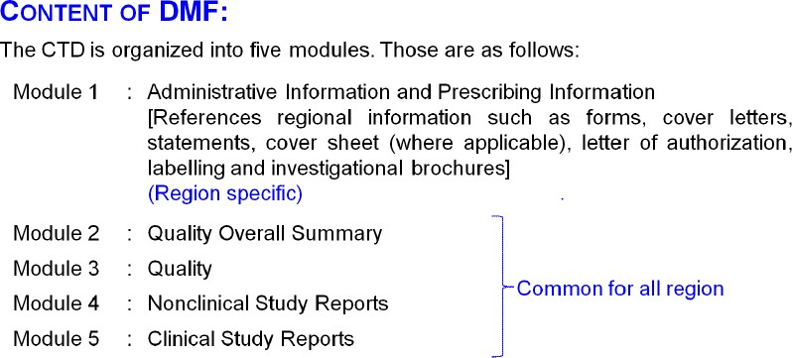

Slide 18
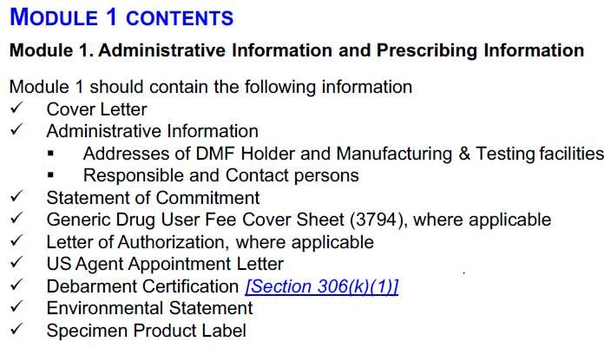

Slide 19
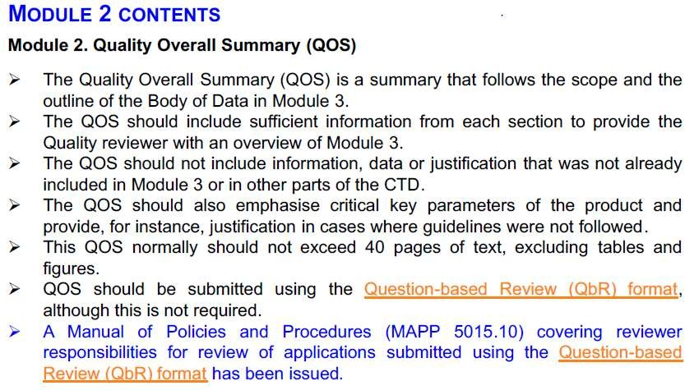

Slide 20
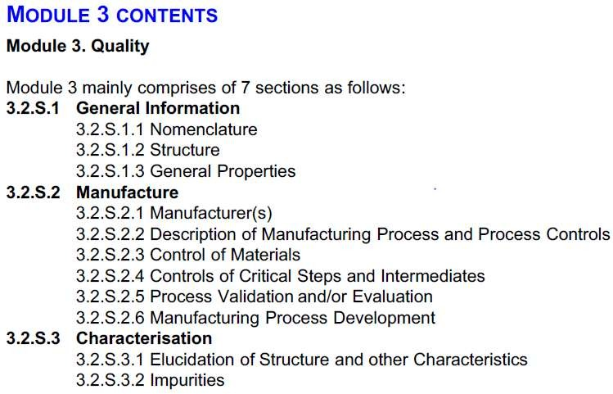

Slide 21
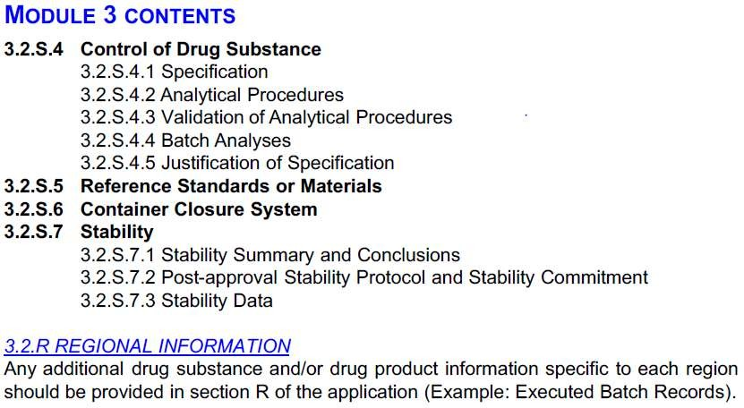

Slide 22
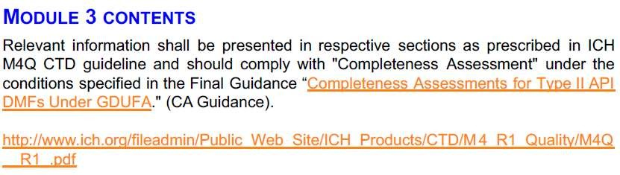
It is not necessary to submit all Modules i.e. Module 4 and 5.
However, Module 1 and all Sections within Modules 2 and 3 should be submitted for ALL types of DMFs.

Slide 23
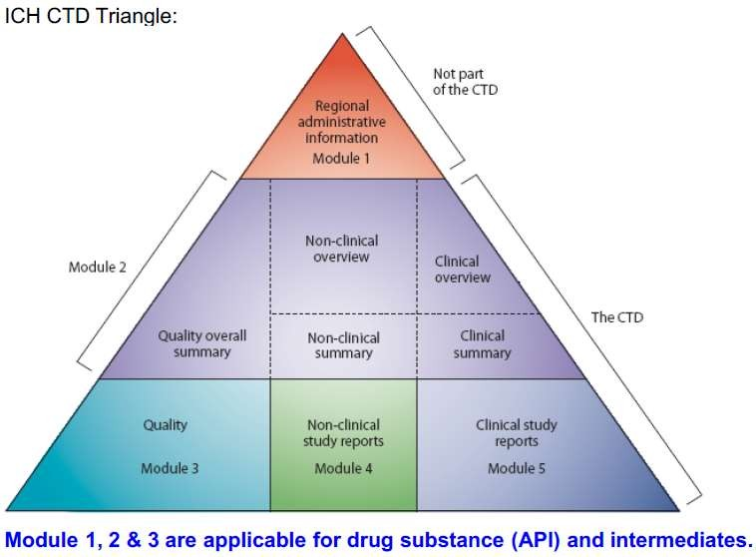

Slide 24
SUBMISSIONS TO DRUG MASTER FILES
The DMF must be in the English language. Whenever a submission contains information in another language, an accurate certified English translation must also be included.
DMF Contains:
– Transmittal (cover) letter
– Administrative information
– Technical information (DMF types) 4 - Format, Assembly, and Delivery
Follow the Guideline at www.fda.gov/cder/guidance/dmf.htm Binders recommended http://www.fda.gov/cder/ddms/binders.htm

Slide 25
Original Submissions
Initial/first time submission is known as Original submission.
Amendments
Change in the content of original submission i.e. specifications, validations, etc.
For each submission covering letter should be prepared to facilitate processing of documents, list the Submission type in bold type in the header on the cover letter.

Slide 26
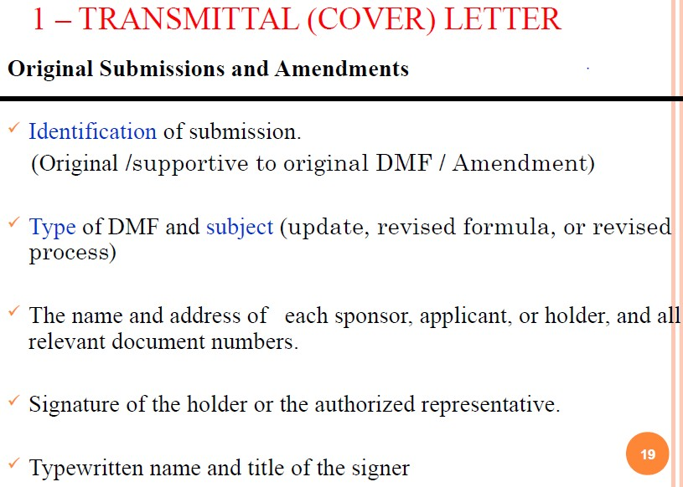

Slide 27
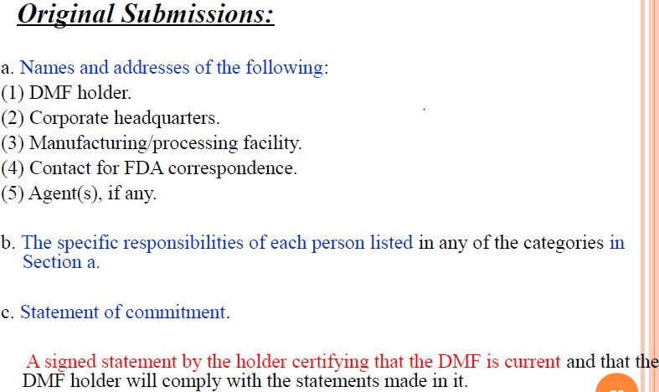
2 . Administrative information

Slide 28
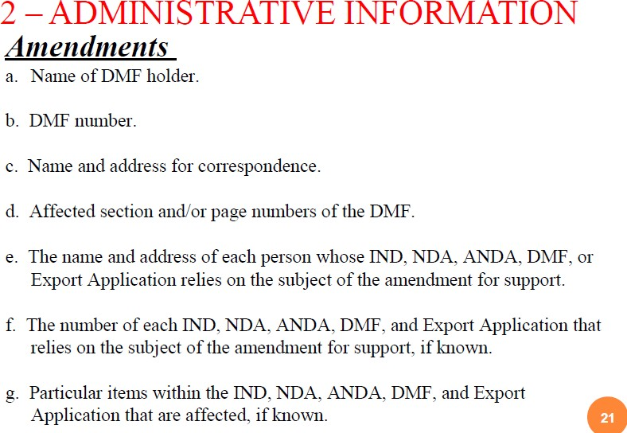

Slide 29
4. Format, Assembly and Delivery
Holder sends the DMF two copies (original and duplicate) to
Drug Master File Staff, Food and Drug Administration, 5901-B Ammendale Rd.
Beltsville, MD 20705-1266.
The original and duplicate copies must be collated, fully assembled, and individually jacketed.
U.S. standard paper size (8-1/2 by 11 inches) is preferred.
Occasionally large pages are used to present a floor plan, synthesis diagram, batch formula, or manufacturing instructions. Those pages should be folded and mounted.

Slide 30
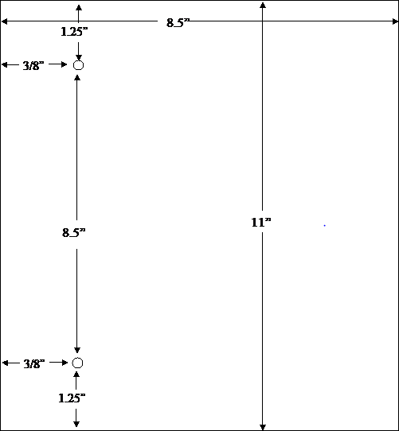
Page Measurements

Slide 31
Beginning on May 5, 2018, new DMFs, as well as all documents submitted to existing DMFs, must be submitted using the Electronic Common Technical Document (eCTD).
DMF submissions that are not submitted in eCTD format after this date will be rejected.
Electronic Submission Gateway (ESG) Holder sends the DMF in Electronic Common Technical Document (eCTD) format through the ESG http://www.fda.gov/ForIndustry/ElectronicSubmissionsG ateway/default.htm
Choose "CDER" as the Center and "eCTD" as the “submission type“

Slide 32
Physical Media (CD-ROM, DVD or USB drive) Holder sends the DMF on physical medium in eCTD format to the address on previous slide
See the Transmitting Specifications website when transmitting via physical media (CD\DVD) http://www.fda.gov/downloads/Drugs/DevelopmentAppr ovalProcess/FormsSubmissionRequirements/ElectronicSub missions/UCM163567.pdf
Pre-assigned Number
A pre-assigned number is required for an e-DMF. May also be obtained for paper DMF.
See “Requesting a Pre-Assigned Application number” http://www.fda.gov/Drugs/DevelopmentApprovalProces s/FormsSubmissionRequirements/ElectronicSubmissions
/ucm114027.html.

Slide 33
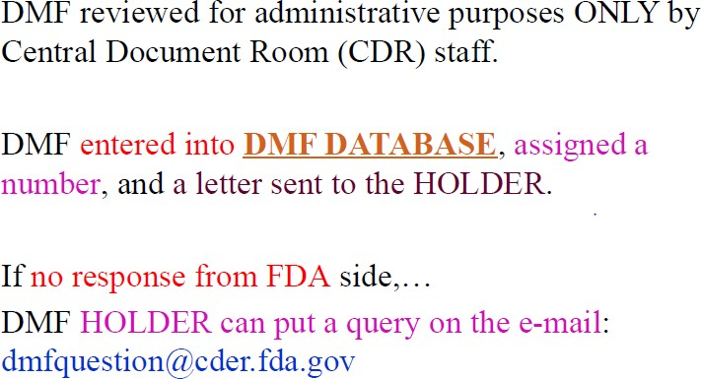

Slide 34
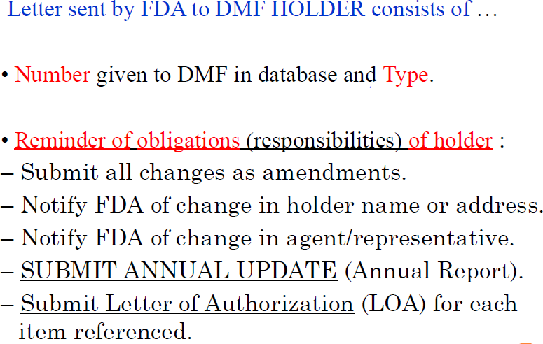

Slide 35
AUTHORIZATION TO REFER TO A DRUG MASTER FILE
Letter of Authorization (LOA) to FDA:
Before FDA can review DMF information in support of an application, the DMF holder must submit in duplicate to the DMF a letter of authorization permitting FDA to reference the DMF.
If the holder cross references its own DMF, the holder should supply in a letter of authorization.
The holder should also send single copy of the LOA to the affected applicant, sponsor, or other holder to include LOA in the application.

Slide 36
The letter of authorization should include the following:
The date.
Name of DMF holder.
DMF number.
Name of person(s) authorized to incorporate information in the DMF by reference.
Specific product(s) covered by the DMF.
Submission date(s) of 5, above.
Section numbers and/or page numbers to be referenced.
Statement of commitment that the DMF is current and that the DMF holder will comply with the statements made in it.
Signature of authorizing official.
Typed name and title of official authorizing reference to the DMF.

Slide 37
PROCESSING AND REVIEWING POLICIES
Public availability of the information and data in a DMF is determined under 21 CFR Part 20, 21 CFR 314.420(e), and 21 CFR 314.430.
DMF review will be in Three stages
  Administrative review.
  Initial completeness assessment.
  Scientific assessment / Technical review

Slide 38
An original DMF submission will be examined on receipt to determine whether it meets minimum requirements for format and content.
If the submission is administratively acceptable, FDA will acknowledge its receipt and assign it a DMF number.
If the submission is administratively incomplete or inadequate, it will be returned to the submitter with a letter of explanation from the Drug Master File Staff, and it will not be assigned a DMF number.

Slide 39
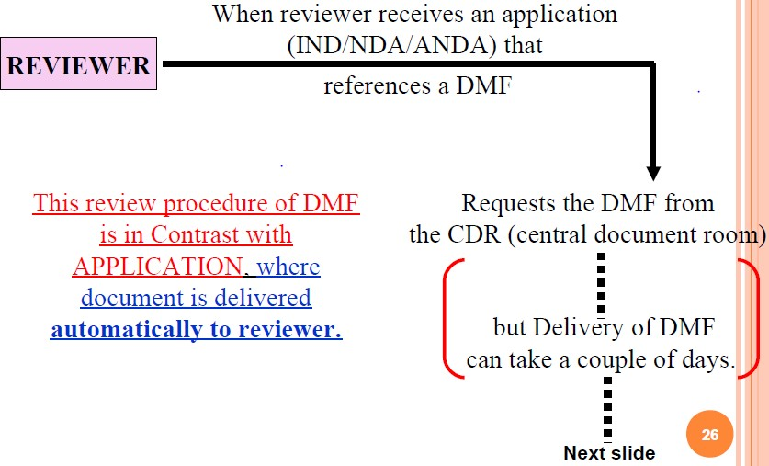

Slide 40
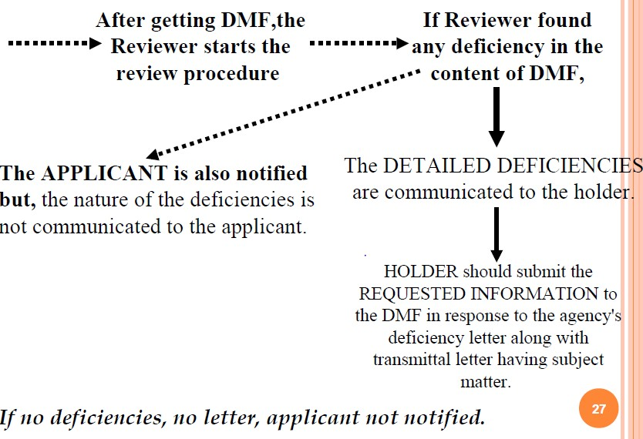

Slide 41
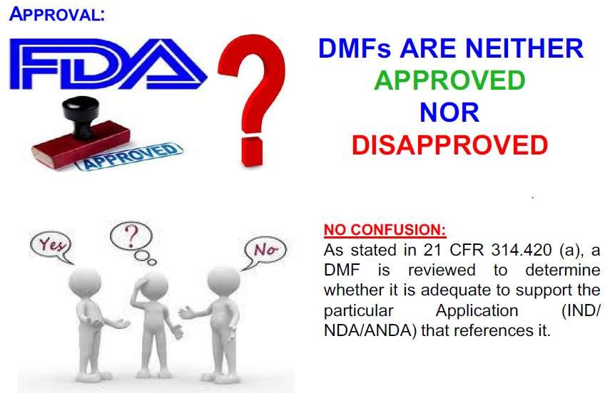

Slide 42
HOLDER OBLIGATIONS
Notice Required for Changes to a DMF
Listing of Persons Authorized To Refer to a DMF
Annual Update
Appointment of an Agent
Transfer of Ownership

Slide 43
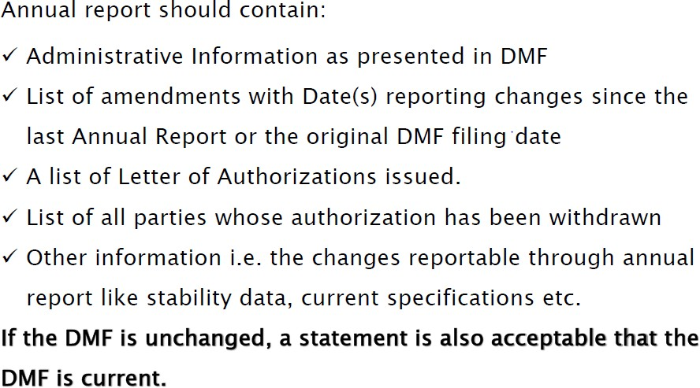

Slide 44
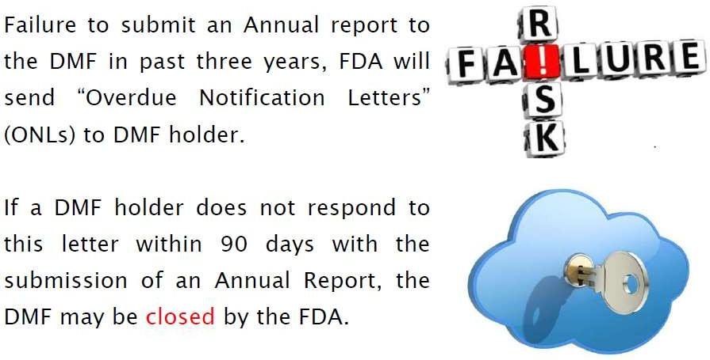

Slide 45


