Slide 1




NDA AND ANDA REGULATORY APPROVAL
PROCESS

Slide 2

NDA AND ANDA REGULATORY APPROVAL PROCESS
◆ The submission of new dug application (NDA) to the food and drug administration (FDA )is an official request by pharmaceutical company (applicant) to sell and market a drug .
◆ When complete , an NDA contain thousand of pages non clinical , clinical and drug chemistry information that supports the proposed labelling of the product .
◆ New drug application (NDA) is the submission to the USFDA ( UNITED STATES FOOD AND DRUG ADMINISTRATION ) or concerned regulatory authority of the country containing clinical and non-clinical test data / analysis report along with drug chemistry information .
◆ NDA is submitted by innovator company to the FDA for purpose of review of various activity carried out during the various phases clinical studies before final marketing authorization to the new pharmaceutical product.

Slide 3
◆ The information contained in NDA should the satisfy FDA review team to reach the
following key decisions ;-
The new drug safe and effective in its proposed use (s) , and whether the benefits of the drug out past the risks .
The new drug’s proposed labelling and package insert is appropriate .
The method used in manufacturing of new drug and controls used to maintain the quality are adequate to preserve the drug’s identity , strength , quality and purity .
The NDA document should explain detailed information of ;-
clinical trials
The data generated result of animal studies
Ingredient of new drug
Manufacturing process
Labelling
packaging
How the drug behaves in the body

Slide 4
◆ The NDA to be submitted to FDA is prepared in multiple copies as follows ;
1. ARCHIVED COPY – it contains all sections of the NDA including cover later , form FDA-356 h (application to market a new drug for human use ) administrative section , NDA index and all technical sections .
It is the only copy that contains the case report tabulation and case report form .
REVIEW COPY –It contains a NDA technical section along with the cover letter , form FDA-356 h , NDA index as well as individual table of content , the labelling section and application summary
FIELD COPY – This is required by the FDA inspector during pre-approval facilities inspections .
in the addition to the content review copy it includes the CMC and method validation package.

Slide 5
◆ In takes 12-15 years and hundreds dollers to get a new drug from the pharmacy cell .
◆ Then application is made to the US food and drug administration (FDA) to begin testing the drug in human .
◆ Only 1 in 1000 the compound that enters makes it to human testing .

Slide 6
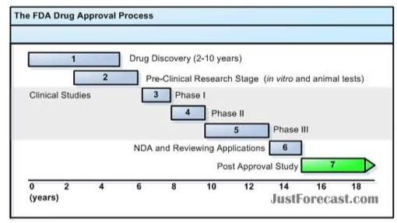


Slide 7

NDA section | Number of copies to be submitted
Cover letter , 356 h form ,section 13- 20 | 07
index | 07
Labelling | 07
Applic ation summary | 07
CMC and method validation pa ckage | 03
Non-clinic al pharma cology and toxicology | 02
Human pharma cokinetics and bioavailability | 02
microbiology | 02
Clinic al data | 02
Safety updates | 02
statistic al | 02
Case report for tabulation | 01
Case report forms | 01

Slide 8
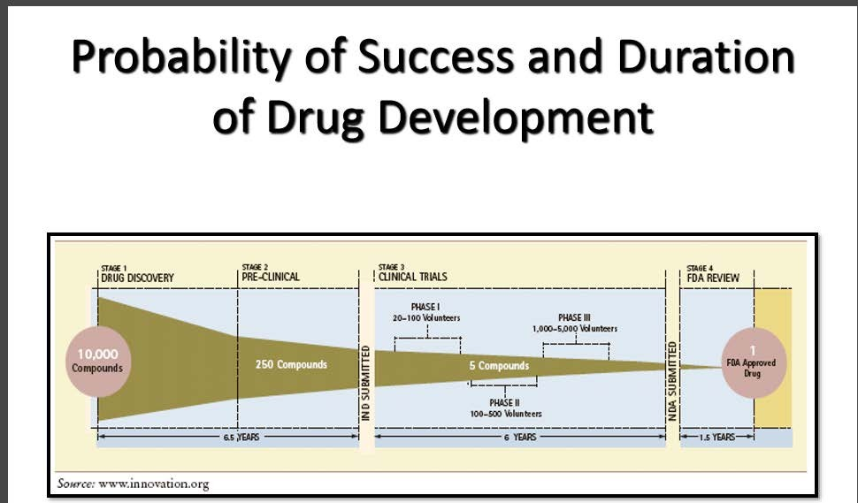


Slide 9
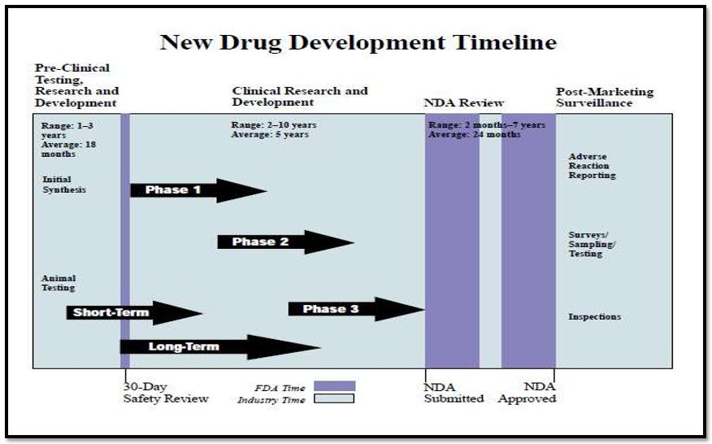

Slide 10
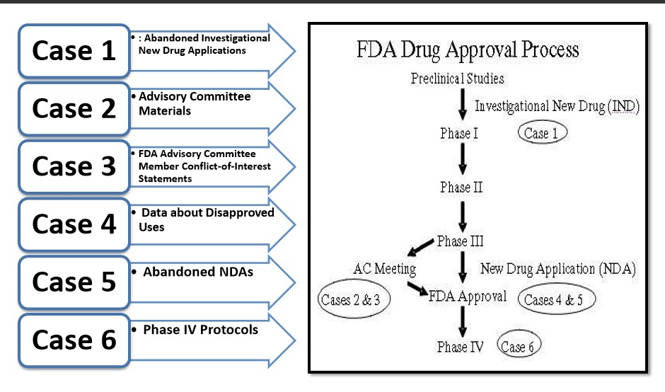

Slide 11
ABBREVIATED NEW DRUG APPLICATION (ANDA)
◆ An abbreviated new drug application (ANDA) contains data which submitted to FDA’s CDER ,office of generic drugs ; provides for the review and ultimate approval of a generic drug product .
◆ Once approved , an applicant may manufacture and market the generic drug product to provide safe , effective , low cost alternative to the public .
◆ All approved products , both innovator and generic , are listed in FDA’s with therapeutic equivalence (orange book) .

Slide 12
◆ A generic has similar effect in terms of rate and extents of absorption approved product , which has proved by generic company .
◆ ANDA approval for a pharmaceutical product authorizes and certifies an entry of a generic version of innovator product in the market .
◆ ANDA are used when the patent of generic version of innovator drug is expired .
◆ The ANDA should propose the same active ingredient any change in the condition originally approved .
◆ The generic company meet innovator product by bioavailability , bioequivalence , pharmaceutical equivalence , dosage form ,strength etc.

Slide 13
◆ It termed ‘Abbreviated ‘ because they generally not required preclinical (animal) and clinical
(human) data to establish safety and effectiveness .
◆ Basic generic drug requirement are ;-
Same active ingredients
Same rout administration
Same dosage forms
Same strength
Same condition use
Inactive ingredient already approval in NDA

Slide 14
◆ GOAL OF ANDA
To reduce the price of drug
To reduce time development
Increase the bioavailability of the drug in comparison to reference list drug .

Slide 15
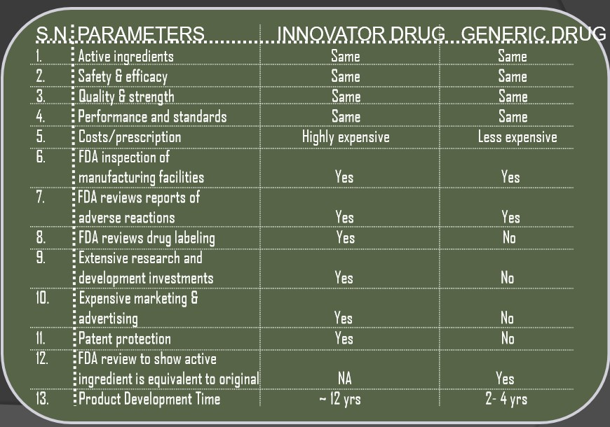

Slide 16

Requirement for filling an ANDA
The time of filling an ANDA application ,the applicant seeking approval of particular drug (innovator drug or patent expired drug ) make one of four certification about legal status of patent status they are ;-
The required patent information has not been filed .
The patent has expired .
That patent has not expired , but will expire on a particular date .
That the patent is unenforceable , invalide or will not infringed by the drug for which the ANDA applicant seeks approval (paragraph IV)

Slide 17
TYPES OF ANDA OR GENERIC DRUG OR 505 (j) FILLING
While filling an ANDA , the generic company has to choose one of the following four options ;-
Para I – The drug has not been patented . patent information is not available in orange book .
Para II –The patent for the drug has already expired .
Para III – The patent for product exists but the generic company wants to enter the market after the date of patents expiry passes .
Para IV - Patent is not infringed upon or is invalid .
Para iv is used for the product for which some or all the applicable by to file the product . Which does not infringe these patents or applicant invalidates the granted patents .
on succesfull outcome the generic applicant enjoy the six months exclusively in the market .
Para IV filling are most lucrative , tedious , tedious , time consuming and expensive of the para I ,para II and Para III .

Slide 18


Applicant certifies that the patent is invalid or not infringed by its product even though original patent has not expired
Applicant may get 180 days of exclusively period if patent holder does not sue within 45 days
If patent holder sue within 45 days then 30 months stay is observed in FDA action towards approval
of ANDA to applicant
30 months stay expire
ANDA approval by FDA 1ST generic applicant with 180 days exclusively
Yes
N O
N O
Court rules in favour of generic ,then ANDA may approve to generic and 180 days of exclusivity will be granted to first applicant
FDA may approves ANDA upon expiry of patent and one or more generic come in market
Court rules in favour of brand name ,then no ANDA and 180 days of exclusively is approved till expiry of patent

Slide 19


