Slide 1
INSTITUTIONAL ETHICS COMMITTEE

Slide 2
SLIDE INDEX
INTRODUCTION
DECLARATION OF HELSINKI
ISTITUTIONAL ETHICS COMMITTEE
STRUCTURE
MEMBERS
FUNCTION OF IEC
SUBMISSION OF APPLICATION
REVIEW
DECISSION
CONFLICT OF INTEREST
CONCLUSION

Slide 3
INTRODUCTION
The ethical and scientific standards for carrying out biomedical research on human subjects have been developed and established in international guidelines, including
Declaration of Helsinki,
CIOMS-International Ethical Guidelines for Biomedical Research Involving Human Subjects, and
WHO and ICH Guidelines for Good Clinical Practice.
.

Slide 4
National Guidelines
ICMR – Ethical guidelines for biomedical research on
human participants.
Indian GCP Guidelines
Principle of precaution and risk minimization states that due care and caution must be taken at all stages of research to ensure that research participant and those affected by it including community are put to minimum risk, suffer from no known irreversible adverse effects

Slide 5
A cardinal principle of research involving human
participants is ‘respect for the dignity of persons’.
All guidelines require the ethical and scientific review of biomedical research alongside informed consent

Slide 6
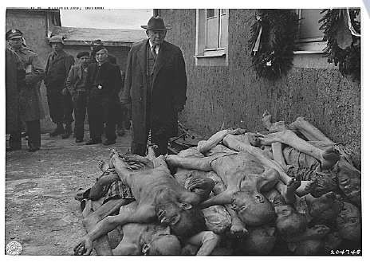

Slide 7
DECLARATION OF HELSINKI
The World Medical Association has developed the Declaration of Helsinki as a statement of ethical principles to provide guidance to physicians and other participants in medical research involving human subjects. Medical research involving human subjects includes research on identifiable human material or identifiable data.
PRINCIPLES:
It is the duty of the physician in medical research to protect the life, health, privacy, and dignity of the human subject.
Medical research involving human subjects must conform to generally accepted scientific principles

Slide 8
Appropriate caution must be exercised in the conduct of research which may affect the environment
The design and performance of each experimental procedure involving human subjects should be clearly formulated in an experimental protocol.
The research protocol should always contain a statement of the ethical considerations involved and should indicate that there is compliance with the principles enunciated in this Declaration.
This independent committee should be in conformity with the laws and regulations of the country in which the research experiment is performed. The committee has the right to monitor ongoing trials

Slide 9
Medical research involving human subjects should be conducted only by scientifically qualified persons and under the supervision of a clinically competent medical person.
Every medical research project involving human subjects should be preceded by careful assessment of predictable risks and burdens in comparison with foreseeable benefits to the subject or to others
Physicians should cease any investigation if the risks are found to outweigh the potential benefits or if there is conclusive proof of positive and beneficial results.
Medical research is only justified if there is a reasonable likelihood that the populations in which the research is carried out stand to benefit from the results of the research

Slide 10
The subjects must be volunteers and informed participants in the research project.
Every precaution should be taken to respect the privacy of the subject, the confidentiality of the patient’s information and to minimize the impact of the study on the subject’s physical and mental integrity and on the personality of the subject.
For a research subject who is legally incompetent, physically or mentally incapable of giving consent or is a legally incompetent minor, the investigator must obtain informed consent from the legally authorized representative in accordance with applicable law
In publication of the results of research, the investigators are obliged to preserve the accuracy of the results.

Slide 11
IRB (Institutional Review Board) or ERB (Ethics Review Board) or REB (Research Ethics Board).

Slide 12
INSTITUTIONAL ETHICS COMMITTEE (IEC)
Independent body constituted of medical, non-medical, scientific and non-scientific members whose responsibility is to ensure the protection of the rights, safety and well-being of human subjects involved in the trial by, among other things, reviewing, approving & providing continuing review of trial protocol & amendments.

Slide 13
STRUCTURE OF IEC
Composition:
Multidisciplinary and multisectorial in composition
Number of persons- 8-12
Specific members of IECs:
Chair person should preferably be from outside the Institution to maintain the independence of the Committee.
Member secretary, from same institution should conduct the business of the Committee

Slide 14
MEMBERS OF IEC
Chair person
1-2 basic medical scientists
1-2 clinicians from various institutes
One legal expert or retired judge
One social scientist/representative of NG voluntary agency
One philosopher/ethicist/theologian
One lay person
Member Secretary

Slide 15
ECs should establish standard operating procedures that state
the functions and duties of the EC, membership requirements,
the terms of appointment,
the conditions of appointment, the offices,
internal procedures, and the quorum requirements

Slide 16
FUNCTIONS OF IEC
To provide competent review of all ethical aspects of the project
Undertake review free from bias and influence
Provide advice to the researchers on all aspects of welfare and
safety of research participants
To protect dignity, rights and well-being of the potential research participants.

Slide 17
To ensure universal ethical values and international scientific standards in terms of local community values and customs.
To assist in the development and the education of research community responsive to local health care requirements.

Slide 18
SUBMISSION OF APPLICATION OF RESEARCH TO IEC
The following documents must be submitted:
Trial Protocol (in prescribed format)
Patient Information Sheet and Informed Consent Form and its translations
Investigators brochure
Principal Investigator’s current C.V.
Insurance policy/ compensation for participation
Investigators Agreement with the sponsor

Slide 19
REVIEW OF PROJECT
Scientific evaluation should be completed before ethical evaluation
Evaluate possible risks to the subjects with proper justification
Expected benefits

Slide 20
Adequacy of documentation for ensuring privacy,
confidentiality and justice issues
The ethical review should be done through formal meetings and should not resort to decisions through circulation of proposals
Decisions are preferably arrived at by consensus

Slide 21
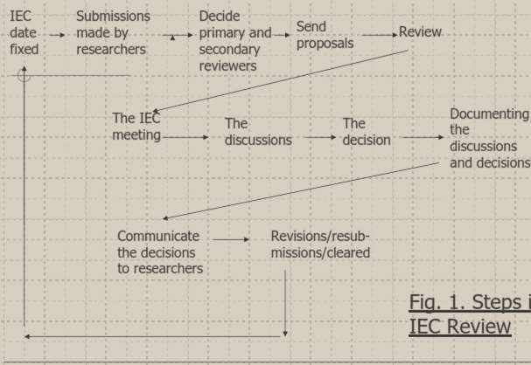

Slide 22
The IEC’s member secretary shall screen the proposals for their completeness and depending on the risk involved categorize them into:
Expedited review
Full review
Exempted from review

Slide 23
FULL REVIEW
All research proposals presenting with more than minimal
risk.
Projects that involve vulnerable population (children,
psychiatric patients etc.,)
Full review is carried out in cases involving
(a) collection of blood samples
(b) Prospective collection of biological specimens eg. Skin appendages, excreta saliva, placenta, amniotic fluid, sputum etc

Slide 24
EXPEDITED REVIEW
Those with no more than minimal risk to research
participants may be subjected to this review
Ex: clinical studies of drugs and medical devices
the research involves already approved drugs
when a adverse event or unexpected adverse reaction is
reported

Slide 25
EXEMPTED FROM REVIEW
Proposals with less than minimal risk
Ex: research on educational practice,
instructional technics, curricula,
classroom management methods

Slide 26
Following are considered for ethical review
Scientific design and conduct of study
Recruitment of Research Participants
Care and Protection of Research Participants
Protection of research participant confidentiality
Informed Consent Process

Slide 27
SCIENTIFIC DESIGN AND CONDUCT
OF STUDY
Appropriateness of study design
Statistical methodology including sample size calculation
Risk vs anticipated benefits for research participants.
Justification for Controls used
Withdrawal criteria of participants
Criteria for termination of trial
Adequacy of monitoring and auditing the conduct of research.
Site facilities for handling emergencies.
Reporting and Publication issues

Slide 28
RECRUITMENT OF RESEARCH PARTICIPANTS
Study population – demographic characteristics
Means by which participants are contacted and recruited.
Means by which full information is conveyed to research participants or their representatives
Criteria for recruitment Inclusion criteria Exclusion criteria

Slide 29
CARE AND PROTECTION OF RESEARCH PARTICIPANTS
Suitability of investigator qualifications and experience for
proposed study.
Medical care to be provided to participants during and after research.
Adequacy of medical supervision
Steps taken if participants voluntarily withdraw from study
Informed consent
Insurance and indemnity arrangements

Slide 30
PROTECTION OF RESEARCH PARTICIPANT CONFIDENTIALITY
Description of persons who will have access to personal data of research participants, including medical records and biological samples.
Measures taken to ensure the confidentiality and security of personal information concerning research participants.

Slide 31
INFORMED CONSENT PROCESS
Adequacy, completeness and understandability of written and oral information given to participants or their legal representatives
Clear justification for intention to include research
individuals who cannot consent
Assurance that participants will receive any new information that becomes available
Contact details of persons whom the participants need to contact for any complaints or queries.

Slide 32
DECISION
Out right approval (at most, only very minor changes are suggested. The application contained all necessary information.)
Approval with modifications (there is enough information to judge the study, but clarification or changes are needed)
Resubmit with more information (there is not enough
information to judge the application appropriately
Outright disapproval (there is no way the researcher can ethically do study)

Slide 33
RECORDS
Constitution & composition of IEC.
CV of all members & records of training
SOPs of the IEC
National & International guidelines
Copies of protocol submitted for review
All correspondence with IEC members and Investigators regarding application, decision and follow up.

Slide 34
Agenda of all IEC meetings and Minutes signed by chairperson
Copies of decisions communicated to applicants
Notifications issued for premature termination of study
Final report of the study
All records must be safely maintained completion/termination of study for 3 years.
after

Slide 35
REVIEW
Periodic Review:
Ongoing research may be reviewed at regular intervals of six months to one year
Continuing Review:
The IEC has the responsibility to continue reviewing approved projects for continuation, new information, adverse event monitoring, follow up.
Interim Review:
Interim Review – decide special circumstances for review by sub-committee – re-examination of proposal already examined by IEC.

Slide 36
CONFLICT OF INTEREST
A conflict of interest is a set of conditions in which professional judgment concerning a primary interest (such as a patient’s welfare or the validity of the research) tends to be unduly influenced by a secondary interest (such as financial gain)

Slide 37
CONCLUSION
An Institutional Ethics Committee is a mandatory requirement as per the ICMR which is the over –seeing body of medical research in India
It is an Independent body constituted of medical, non- medical, scientific and non-scientific members whose responsibility is to ensure the protection of the rights, safety and well-being of human subjects involved in the trial

Slide 38
Thank U

