Slide 2
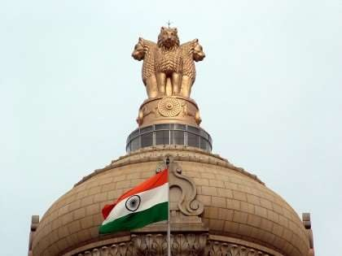
DRUGS REGULATORY SYSTEM IN INDIA
2

Slide 3
Drug Regulatory Authority
The drug regulatory authority (DRA) is the agency that develops and implements most of the legislation and regulations on pharmaceuticals.
Its main task is to ensure the quality, safety and efficacy of drugs, and the accuracy of product information.
This is done by making certain rules that the manufacture, procurement, import, export, distribution, supply and sale of drugs, product promotion and advertising, and clinical trials are carried out according to specified standards.

Slide 4
Functions of Regulatory Authority:
Product registration (drug evaluation and authorization,
and monitoring of drug efficacy and safety).
Regulation of drug manufacturing, importation, and distributions.
Regulation & Control of drug promotion and information.
Adverse drug reaction (ADR) monitoring.
Licensing of premises, persons and practices.
Main goal of drug regulation is to guarantee the safety,
efficacy and quality of drugs.

Slide 5
Medical Regulatory Structure In INDIA
National Drug Authority
(NDA)
CDSCO NEW DELHI
Ministry of Health & Family Welfare
State F&D Administrations
For each state and Territories
State level Authority

Slide 6
Distribution of Powers Between State Govt. & Central Govt.
Regulatory control over the quality, safety and efficacy of drugs in the country is exercised through a central legislation called the Drugs and Cosmetics Act, 1940 and the Rules made there under.
State Governments - Licensing of manufacturing and sales premises.
Central Government- Imports, Permissions for marketing of New Drugs in the country, and for conduct of Clinical Trials.

Slide 7
The Ministry of Health and Family Welfare (MHFW) is an Indian government ministry charged with health policy in India. It is also responsible for all government programs relating to family planning in India.
The ministry is composed of two departments: 1)Departments of Health and Family Welfare. 2)Department of Health Research.

Slide 8
Department of Health-
13 National Health Programmes.
Medical council of India (MCI)
Food safety and standards Authority India (FSSAI)
Central Drugs Standard Control Organisation (CDSCO)
Department of Welfare-
Central Drug Research Institute(CDRI) Lucknow.
Indian Council Of Medical Research(ICMR) New Delhi.
Department of Health Research- (DHR) has a scheme to provide advanced training in India and abroad to medical and health research personnel in cutting edge research areas concerning medicine and health to create trained human resource for carrying out research activities.

Slide 9
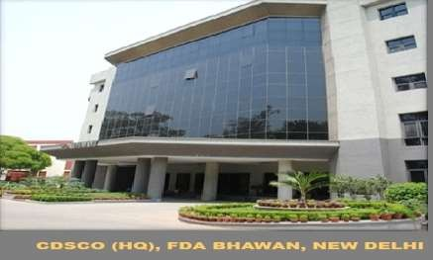
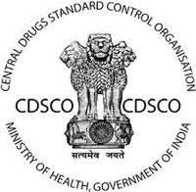
CDSCO (Central Drug Standard Control Organization)
CDSCO (Central Drug Standard Control Organization)
National regulatory body for Indian Pharmaceuticals and medical devices.
Within CDSCO, DCGI (Drug Controller General of India) regulates pharmaceutical and medical devices under gamut of Ministry of Health and Family Welfare ( MHFW).

Slide 10
10
10

Slide 12
Functions of CDSCO
To protect and promote public health .
To safeguard and enhance the public health by assuring the safety, efficacy & quality of the drugs, cosmetics, medical devices.
Regulatory control over import, manufacturing, sale & distribution of drugs.
Approval of certain drugs & clinical trials
Meetings of DCC, DTAB.
Approval for licenses as Central License Approving Authority
Co-ordination with activities of State Drug Control Organization

Slide 13
Central Drug Laboratory, Kolkata (CDL)
Statutory Lab. Of Gov. Of India over control of Drug & cosmetics act, 1940
Oldest QC lab.
Statutory Functions:
Analytical QC of majority of imported drugs available in Indian market.
QC of drugs & cosmetics manufactured in India.
Acting as appellate authority in matters relating to quality of drugs.

Slide 14
Other functions:
Collection, storage, distribution of International Standards, Int. reference preparation of drugs and p’ceutical substances.
Training to drug analyst.
Training to WHO fellows from abroad on modern methods of
drug analysis.
Other laboratories:
CDTL, Mumbai
CDTL, Tamil nadu
CDTL, Hydrabad
RDTL, Guhawati
RDTL, Chandigarh
CDL, Kasauli

Slide 15
Drugs Controller General of India (DCGI)
He/ she is responsible for approval of New Drugs ,
Medical devices & Clinical Trials to be conducted in India.
He / She is Appointed by Central Govt.
The DCGI is advised by the Drug Technical Advisory Board (DTAB) and the Drug Consultative Committee (DCC)

Slide 16
Ministry of Health and family welfare
DGHS
CDSCO
DCGI
DTAB
DCC

Slide 17
Drug Technical Advisory Board (DTAB)
Ex-Officio:
Director General of Health Services (Chairman)
Drugs Controller, India
Director of the Central Drugs Laboratory, Calcutta
Director of the Central Research Institute, Kasauli
President of Medical Council of India
President of the Pharmacy Council of India
Director of Central Drug Research Institute, Lucknow

Slide 18
Nominated:
Two persons by the Central Government.
One person by the Central Government from the pharmaceutical industry
Two persons holding the appointment of Government Analyst under this Act,

Slide 19
Elected:
One person, to be elected by the Executive Committee of the Pharmacy Council of India,
One person, to be elected by the Executive Committee of the Medical Council of India,
One pharmacologist to be elected by the Governing Body of the Indian Council of Medical Research;
One person to be elected by the Central Council of the Indian Medical Association;
One person to be elected by the Council of the Indian Pharmaceutical Association

Slide 20
FUNCTION:
To advise the Central Government and the State Governments on technical matters.
To carry out the other functions assigned to it by this Act.

Slide 21
The Drugs Consultative Committee(DCC)
It is also an advisory body constituted by central government.
Constitution:
Two representatives of the Central Government
One representative of each State Government

Slide 22
Functions:
To advise the Central Government, the State Governments and the Drugs Technical Advisory Board on any other matter tending to secure uniformity throughout India in the administration of this Act.
There is separate “ The Ayurvedic , Siddha , & Unani Drugs Consultative Committee constituted under sec 33 D of the Act.

Slide 23
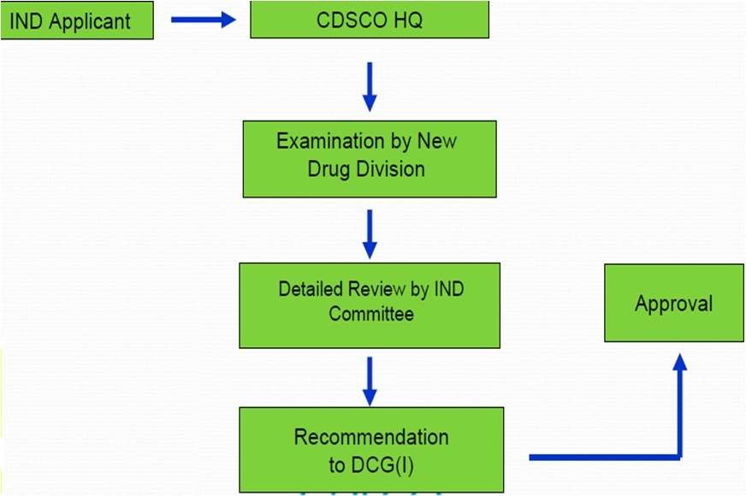
APPROVAL OF INVESTIGATIONAL NEW DRUG (IND)
23

Slide 24
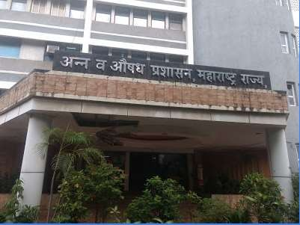
STATE FDA (MAHARASHTRA)

Slide 25
State FDA ( Maharashtra)
Food And Drug Administration is the state prime organisation of consumer protection.
It is Law enforcement agency.
The regulations implemented by the following independent section
Food & Drug Section
Food & Drug Control Laboratories

Slide 26
A) Food & Drug Section
For drug Section following Acts are implemented by Govt.
Drugs and Cosmetics Acts 1940 and Rules there under 1945
Drugs and Magic Remedies ( Objectionable Advertisements) Act’1954.
Essential Commodities Act’ 1955 there under Drugs Price Control Order’ 2013.
Narcotics Drugs and Psychotropic Substance Act’ 1985.
Poison Act 1919 and Rules there under and Maharashtra Poison Rule 1976.

Slide 27
State Administrative Structure
Drug Commissioner
Joint Commissioner Asst commissioner Drug Inspector Supporting Staff

Slide 28
Duties Performed by Administration
Drug Selling / distribution
Sale of medicine only under supervision of Pharmacist
Sale of prescription drugs on the vaild prescription only.
Sale of drug by valid bills only
Control on Price of Drug (Drugs Price Control Order’ 2013)
Drugs and Magic Remedies (Objectionable Advertisements) Act’ 1954

Slide 29
B)Food and Drug Control Laboratories
Food Lab
PFA is Central Act , State FDA enforces since 1970.
The samples are drawn by the Food inspectors are sent for analysis to Public Health Lab
There are Two Labs under control of commissioner, FDA at
Mumbai & Aurangabad.
Drug Lab
For testing of D&C as stated under section 20 and 33f of D&C Act 1940 and rules there under, Maharashtra state has established Drug Control Lab at Mumbai

