Slide 2
CONTENT:
Introduction
Clinical drug development
Regulatory bodies
Schedule Y
ICH E6(R1) guidelines
ICMR guidelines
Inclusion and exclusion criteria
Clinical Trial Registry
Contents of protocol
Comparison study between USFDA and CDSCO

Slide 3
CLINICAL TRIALS:
ICMR ( Indian Council of Medical Research ) : A clinical trial is any research/study that prospectively assigns human participants or groups of humans to one or more health-related intervention(s) to evaluate the effects on health outcomes.
The intervention could be drugs, vaccines, biosimilars, biologics, Phytopharmaceuticals, radiopharmaceuticals, diagnostic agents, public health interventions, socio-behavioural interventions, technologies, devices, surgical techniques or interventions involving traditional systems of medicine, etc.
Clinical trials are usually well-controlled studies.
They use a design that allows comparison of participants treated with an investigational product (IP)/any intervention to a control population (receiving placebo or an active comparator), so that the effect of the IP/intervention can be determined and differentiated from effects of other influences, such as spontaneous change, placebo effect, concomitant treatment/intervention or observer expectations.

Slide 4
INDIA : A HUB FOR CLINICAL TRIALS
POPULATION - The current population of India is 1,357,130,707 as of Monday, September 17, 2018, based on the latest United Nations estimates.
Huge patient load
Wide variety of diseases
Low operational cost
Sufficient infrastructure

Slide 5
CLINICAL DRUG DEVELOPMENT PHASE:
Preclinical data
IND filing IND approval Phase 1
Phase 2
CLINICAL STUDY
Phase 3
NDA filed NDA approval
Marketing permission
Phase 4

Slide 6
REGULATORY BOADIES :

Slide 7
CENTRAL DRUG STANDARD CONTROL ORGANISATION (CDSCO)
The Central Drugs Standard Control Organization (CDSCO), headed by the Drug Controller General of India (DCGI), lays down the regulations for the conduct of clinical trials in India.
Main objective is to standardize clinical research and to assure safety, efficacy, quality of drugs, cosmetics and medical devices.
It is essential that now all clinical trials conducted in India should as per the International conference of Harmonization-Good Clinical Practices Guidelines (ICH-GCP) for clinical trials and follow the recently amended Schedule Y of the Drugs and Cosmetics Act.

Slide 8
INSTITUTIONAL REVIEW BOARD/ INDEPENDENT ETHICS COMMITTEE/ ETHICS COMMITTEE :
Protecting the rights, welfare and well-being of participants
1. Basic Medical Scientists (Preferably One Pharmacologist)
Ensuring compliance with relevant local, state and federal laws and regulations.
They often conduct some form of risk benefit analysis
2. Clinicians
INSTITUTIONAL REVIEW BOARD / INDEPENDENT ETHICS COMMITTEE (IRB/IEC):
3. Legal Expert
4. Social Scientist / Representative Of Non-
governmental
Number of members is 5+1 without gender bias
Ensuring compliance with and policies and regulations.
5. Voluntary Agency / Philosopher / Ethicist / Theologian Or A Similar
Person
Employing the highest ethical standards for human research protections
6.Lay Person from the community.

Slide 9
CLINICAL TRIAL PROTOCOL:
D&C ACT SCHEDULE Y : REQUIREMENTS AND GUIDELINES FOR PERMISSION TO IMPORT AND / OR MANUFACTURE OF NEW DRUGS FOR SALE OR TO UNDERTAKE CLINICAL TRIALS
ICH GUIDELINES E6(R2) GOOD CLINICAL PRACTICE: INTEGRATED ADDENDUM TO ICH E6(R1) : CLINICAL TRIAL PROTOCOL AND PROTOCOL AMENDMENT(S)
ICMR NATIONAL ETHICAL GUIDELINES FOR BIOMEDICAL AND HEALTH RESEARCH INVOLVING HUMAN PARTICIPANTS : ETHICAL CONSIDERATION

Slide 10
SCHEDULE Y :
Clinical Trial:
Approval for clinical trial
Clinical trial on a new drug shall be initiated only after the permission has been granted by the Licensing Authority, and the approval obtained from the respective ethics committee.
All trial Investigator(s) should possess appropriate qualifications, training and experience and should have access to such investigational and treatment facilities as are relevant to the proposed trial protocol.
Protocol amendments if become necessary before initiation or during the course of a clinical trial, all such amendments should be notified to the Licensing Authority in writing along with the approval by the ethics committee.
2. Responsibilities of Sponsor
Sponsor is responsible for implementing and maintaining quality assurance systems to ensure that the clinical trial is conducted and data generated, documented and reported in compliance with the protocol and Good Clinical Practice (GCP).
Sponsors are required to submit a status report on the clinical trial to the Licensing Authority at the prescribed periodicity.
In case of studies prematurely discontinued for any reason including lack of commercial interest in pursuing the new drug application, a summary report should be submitted within 3 months.

Slide 11
SCHEDULE Y :
In case of injury or death occurring to the clinical trial subject, the sponsor shall make payment for medical management of the subject and also provide financial compensation for the clinical trial related injury or death.
The sponsor (whether a pharmaceutical company or an institution) shall submit details of compensation provided or paid for clinical trial related injury or death, to the licensing authority within thirty days of the receipt of the order of the licensing authority.
3. Responsibilities of the investigator(s):
Responsible to conduct the trial according to the protocol and the GCP guidelines
Investigator should ensure that adequate medical care is provided to the participant
for any adverse events.
Investigator(s) shall report all serious and unexpected adverse events.
The investigator shall provide information to the clinical trial subject through informed consent process
He shall also inform the subject or his/her nominees(s) of their rights to contact the sponsor for conduct of the clinical trial for the purpose of making claims in the case of trial related injury or death

Slide 12
SCHEDULE Y :
4. Informed consent:
The investigator must provide information about the study verbally as well as using a patient information sheet, in a language that is non-technical and understandable by the study subject.
The subject’s consent must be obtained in writing using an ‘informed consent form 'which
have been approved by the ethics committee and furnished to the licensing authority.
Where a subject is not able to give informed consent , the same may be obtained from a
legally acceptable representative.
If the subject or his/her legally acceptable representative is unable to read/write – an impartial witness should be present during the entire informed consent process who must append his/her signatures to the consent form.
5. Responsibilities of the ethics committee:
The ethics committee should exercise particular care to protect the rights, safety and well being of all vulnerable subjects participating in the study.
Ethics committee(s) should make, the periodic study progress reports and audit reports
furnished by the sponsor and/or by visiting the study sites.
In case an ethics committee revokes its approval accorded to a trial protocol, it must
record the reasons for doing so.
In case of serious adverse event occurring to the clinical trial subject, the ethics committee shall forward its report on the serious adverse event, after due analysis, along with its opinion on the financial compensation, if any, to be paid by the sponsor or his representative

Slide 13
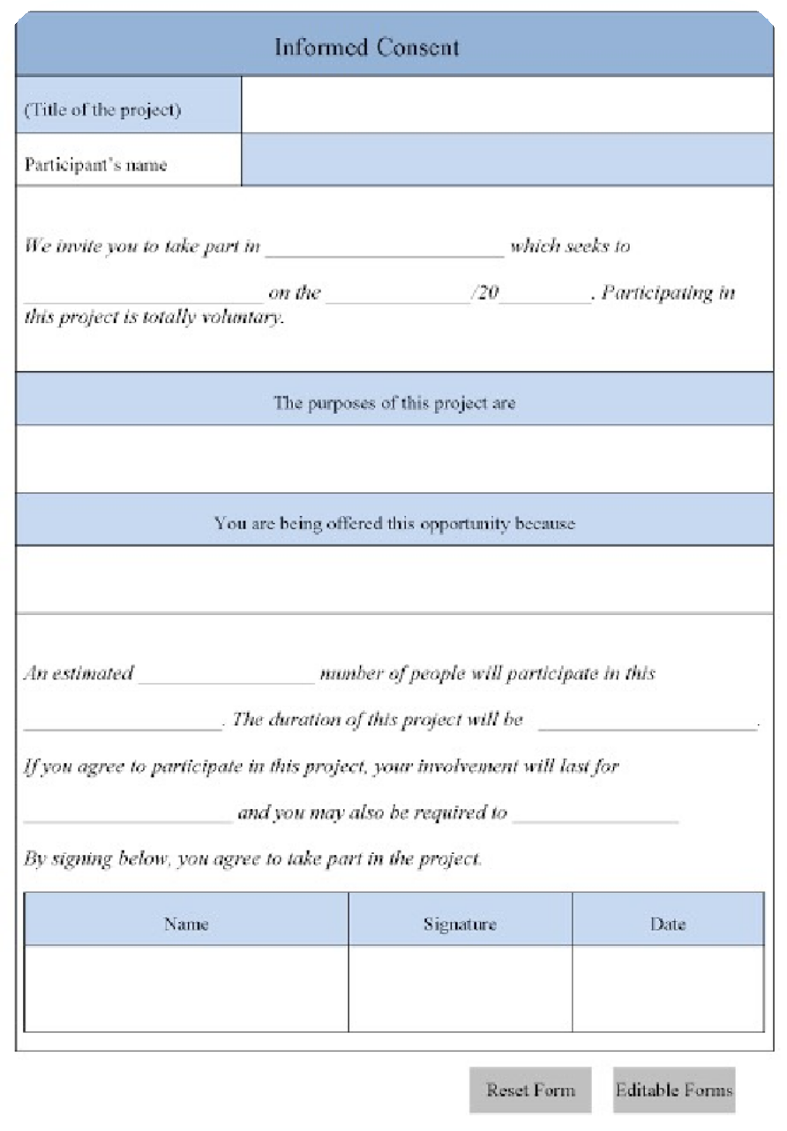
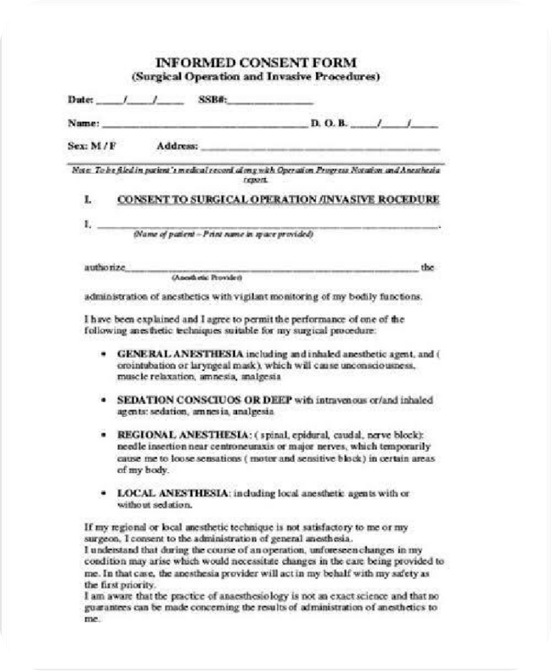
SCHEDULE Y : INFORMED CONSENT FORM

Slide 14
SCHEDULE Y : PHASES OF CTs

Slide 15
SCHEDULE Y :
6. Human pharmacology (phase I):
The objective of studies in this phase is the estimation of safety and tolerability with the initial administration of an investigational new drug into human(s).
Have non-therapeutic objectives and may be conducted in healthy volunteers subjects or certain types of patients
Objectives:-
Maximum tolerated dose
Pharmacokinetics
Pharmacodynamics
Early measurement of drug activity
7. Therapeutic exploratory trials (Phase II):
The primary objective of Phase II trials is to evaluate the effectiveness of a drug for a particular indication or indications in patients.
Additional objectives of Phase II studies can include evaluation of potential study endpoints, therapeutic regimens and target populations (e.g. mild versus severe disease) for further studies in Phase II or III.
These studies should be closely monitored. An important goal for this Phase is to determine
the dose(s) and regimen for Phase III trials.
Doses used in Phase II are usually (but not always) less than the highest doses used in Phase I.

Slide 16
SCHEDULE Y :
8. Therapeutic confirmatory trials (phase III):
Phase III studies have primary objective of demonstration or confirmation of therapeutic benefit(s).
Phase III may also further explore the dose-response relationships (relationships among dose, drug concentration in blood and clinical response), use of the drug in wider populations, in different stages of disease, or the safety and efficacy of the drug in combination with other drug(s).
9. Post Marketing Trials (Phase IV):
Post Marketing trials are studies performed after drug approval and related to the approved indication(s).

Slide 17
ICH GUIDELINES E6(R2) :
Provides international ethical and scientific quality standard for designing, conducting, recording and reporting trials
The principles established in this guidance may also be applied to other clinical investigations for the safety and well- being of human subjects.
Compliance with this standard provides public assurance that the rights, safety, and well-being of trial subjects are protected.
ICH GUIDELINES E6(R2)
The European Union, Japan, and The United States, as well as those of Australia, Canada, The Nordic Countries, and the world health organization.
Provide a unified standard to facilitate the mutual acceptance of clinical data by the regulatory authorities in these jurisdictions.

Slide 18
ICH GUIDELINES E6(R2) :
6. CLINICAL TRIAL PROTOCOL AND PROTOCOL AMENDMENT(S)
Protocol title, protocol identifying number, and date. Any amendment(s) should also bear the amendment number(s) and date(s).
Name and address of the sponsor and monitor (if other than the sponsor).
Name and title of the person(s) authorized to sign the protocol and the protocol amendment(s) for the sponsor.
Name, title, address, and telephone number(s) of the sponsor's medical expert (or dentist when appropriate) for the trial.
Name and title of the investigator(s) who is (are) responsible for conducting the trial,
and the address and telephone number(s) of the trial site(s).
Name, title, address, and telephone number(s) of the qualified physician (or dentist, if applicable), who is responsible for all trial-site related medical
Name(s) and address(es) of the clinical laboratory(ies) and other medical and/or
technical department(s) and/or institutions involved in the trial.

Slide 19
ICH GUIDELINES E6(R2) :
Background Information
Name and description of the investigational product(s).
A summary of findings from nonclinical studies that potentially have clinical
significance and from clinical trials that are relevant to the trial.
Summary of the known and potential risks and benefits, if any, to human subjects.
Description of and justification for the route of administration, dosage, dosage
regimen, and treatment period(s).
A statement that the trial will be conducted in compliance with the protocol, GCP, and
the applicable regulatory requirement(s).
Description of the population to be studied.
References to literature and data that are relevant to the trial and that provide background for the trial.
6.3 Trial Objectives and Purpose
A detailed description of the objectives and the purpose of the trial.

Slide 20
ICH GUIDELINES E6(R2) :
Trial Design
The scientific integrity of the trial and the credibility of the data from the trial depend substantially on the trial design. A description of the trial design should include:
A specific statement of the primary endpoints and the secondary endpoints, if any, to be measured during the trial.
A description of the type/design of trial to be conducted (e.g., double-blind,
placebo-controlled, parallel design) and a schematic diagram of trial design, procedures, and stages.
A description of the measures taken to minimize/avoid bias, including:
Randomization
Blinding.
A description of the trial treatment(s) and the dosage and dosage regimen of the
investigational product(s). Also include a description of the dosage form, packaging, and labeling of the investigational product(s).
The expected duration of subject participation, and a description of the sequence and duration of all trial periods, including follow-up, if any.
A description of the "stopping rules" or "discontinuation criteria" for individual subjects, parts of trial, and entire trial.

Slide 21
ICH GUIDELINES E6(R2) :
Accountability procedures for the investigational product(s), including the placebo(s)
and comparator(s), if any.
Maintenance of trial treatment randomization codes and procedures for breaking codes.
The identification of any data to be recorded directly on the CRFs (i.e., no prior
written or electronic record of data), and to be considered to be source data.
Selection and Withdrawal of Subjects
Subject inclusion criteria.
Subject exclusion criteria.
Subject withdrawal criteria (i.e., terminating investigational product treatment/trial
treatment) and procedures specifying:
When and how to withdraw subjects from the trial/investigational product Treatment
The type and timing of the data to be collected for withdrawn subjects
Whether and how subjects are to be replaced
The follow-up for subjects withdrawn from investigational product treatment/trial treatment.

Slide 22
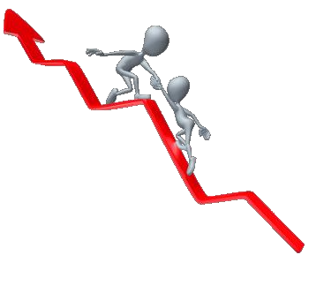
ICH GUIDELINES E6(R2) :
Treatment of Subjects
The treatment(s) to be administered, including the name(s) of all the product(s), the dose(s), the dosing schedule(s), the route/mode(s) of administration, and the treatment period(s), including the follow-up period(s) for subjects for each investigational product treatment/trial treatment group/arm of the trial.
Medication(s)/treatment(s) permitted (including rescue medication) and not permitted
before and/or during the trial.
Procedures for monitoring subject compliance.
Assessment of Efficacy
Specification of the efficacy parameters.
Methods and timing for assessing, recording, and analyzing efficacy parameters.
Assessment of Safety
Specification of safety parameters.
The methods and timing for assessing, recording, and analyzing safety parameters.
Procedures for eliciting reports of and for recording and reporting adverse event
and intercurrent illnesses.
The type and duration of the follow-up of subjects after adverse events.

Slide 23
ICH GUIDELINES E6(R2) :
Statistics
A description of the statistical methods to be employed, including timing of any
planned interim analysis(ses).
The number of subjects planned to be enrolled. In multicenter trials, the numbers
of enrolled subjects projected for each trial site should be specified. Reason for
choice of sample size, including reflections on (or calculations of) the power of the trial and clinical justification.
The level of significance to be used.
Criteria for the termination of the trial.
Procedure for accounting for missing, unused, and spurious data.
Procedures for reporting any deviation(s) from the original statistical plan (any deviation(s) from the original statistical plan should be described and justified in protocol and/or in the final report, as appropriate).
The selection of subjects to be included in the analyses (e.g., all randomized subjects,
all dosed subjects, all eligible subjects, evaluable subjects).

Slide 24
ICH GUIDELINES E6(R2) :
Direct Access to Source Data/Documents
The sponsor should ensure that it is specified in the protocol or other written agreement that the investigator(s)/institution(s) will permit trial-related monitoring, audits, IRB/IEC review, and regulatory inspection(s), providing direct access to source data/documents.
Quality Control and Quality Assurance
Ethics
Description of ethical considerations relating to the trial.
Data Handling and Record keeping
Financing and Insurance
Financing and insurance if not addressed in a separate agreement.
Publication Policy
Publication policy, if not addressed in a separate agreement.
Supplements
(NOTE: Since the protocol and the clinical trial/study report are closely related, further relevant information can be found in the ICH Guidance for Structure and Content of Clinical Study Reports.)

Slide 25
ICMR GUIDELINES :
All research involving human participants should be conducted in accordance with the basic and general ethical principles. The researcher and the team are responsible for protecting the dignity, rights, safety and well-being of the participants enrolled in the study.
2.1 Benefit-risk assessment
The social and scientific value of research should justify the risk, which is the probability of causing discomfort or harm anticipated as physical, psychological, social, economic or legal.
Type of risk | Definition/description
Less than minimal risk | Probability of harm or discomfort anticipated in the research is nil or not expected.
Minimal risk | Probability of harm or discomfort anticipated in the research is not greater than that ordinarily encountered in routine daily life activities of an average healthy individual
Minor increase over minimal risk or Low risk | Increment in probability of harm or discomfort is only a little more than the minimal risk threshold.
More than minimal risk or High risk | Probability of harm or discomfort anticipated in the research is invasive and greater than minimal risk.

Slide 26
ICMR GUIDELINES : BENEFIT-RISK RATIO

Slide 27
ICMR GUIDELINES :
2.2 Informed consent process
Informed consent protects the individual’s autonomy to freely choose whether or not to participate in the research.
Informed consent should explain medical terminology in simple terms and be in a language
that the participant understands.
In certain circumstances audio/audio-visual recording of the informed consent process may be required, for example in certain clinical trials as notified by CDSCO.
2.3 Privacy and confidentiality
Privacy is the right of an individual to control or influence the information that can be
collected and stored and by whom and to whom that information may be disclosed or shared.
Confidentiality is the obligation of the researcher/research team/organization to the participant to safeguard the entrusted information.
It includes the obligation to protect information from unauthorized access, use, disclosure,
modification, loss or theft.
2.4 Distributive justice
Research should not lead to social, racial or ethnic inequalities.

Slide 28
ICMR GUIDELINES :
2.5 Payment for participation
Travel related expenses, for inconvenience incurred, time spent and other incidental expenses
Not be made to pay for any expenses incurred beyond routine clinical care
If there are provisions, participants may also receive additional medical services at no cost.
EC must review and approve the payments (in cash or kind or both) and free services and the processes involved, and also determine that this does not amount to undue Inducement.
2.6 Compensation for research-related harm
Research participants who suffer direct physical, psychological, social, legal or economic Harm as a result of their participation are entitled, after due assessment, to financial Or other assistance to compensate them equitably for any temporary or permanent Impairment or disability.
In case of death, participant’s dependents are entitled to financial compensation.
The researcher is responsible for reporting all to the EC within 24 hours of Knowledge.
The institution should create in-built mechanism to be able to provide for Compensation, such as a corpus fund in the institution.

Slide 29
ICMR GUIDELINES :
2.7 Ancillary care
Participants may be offered free medical care for non-research-related conditions or incidental findings if these occur during the course of participation in the research, provided such compensation does not amount to undue inducement as determined by the EC.
2.8 Conflict of interest
Conflict of interest (COI) is a set of conditions where professional judgment concerning a primary interest such as participants welfare or the validity of research tends to be unduly influenced by a secondary interest, financial or non-financial (personal, academic or political).
If COI is inherent in the research, it is important to declare this at the outset and
establish appropriate mechanisms to manage it.

Slide 30
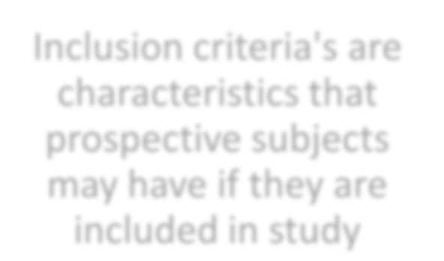
INCLUSION AND EXCLUSION CRITERIA :
Race
Age
Ethnicity
Inclusion criteria's are characteristics that prospective subjects may have if they are included in study
Diseased
condition
Sex

Slide 31
INCLUSION AND EXCLUSION CRITERIA :
Exclusion criteria are those characteristics that disqualify prospective subjects from inclusion in the study.
Poorly justified reasons for exclusion | Any criteria unless the condition or intervention is specific to the criterion, or the criterion has a direct bearing on condition/intervention/results
Strongly justified reasons for exclusion | Unable to provide informed consent Placebo or intervention would be harmful Lack of equipoise (intervention harmful) Effect of intervention difficult to interpret
Potentially justified reasons for exclusion | Individual may not adhere Individual may not complete follow up Individuals do not have reliable information

Slide 32
CLINICAL TRIALS REGISTRY – INDIA :
It is housed at the National Institute of Medical Statistics, ICMR, New Delhi.
Trial registration is purely online, paperless process and free of charge
The CTRI software application was modified and implemented on 15thMarch
2011.
It makes the information available to both public and healthcare professionals in an unbiased, scientific and timely manner to create a
complete, authentic and readily available data of all ongoing and completed clinical trials.
To increase awareness and accountability of all the participants of the clinical
trials and also for public access

Slide 33
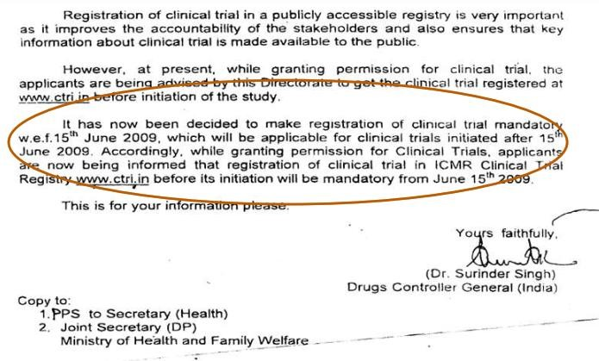
CLINICAL TRIALS REGISTRY – INDIA :

Slide 34
CONTENTS OF PROTOCOL :
3.Objectives (including study scheme)
1.Introduction
2.Abstract
4.Background
5.Rationale
7.Study design/methods (including drug/device info)
10.Clinical Assessment Clinical Laboratory Measurements
6.Eligibility criteria
8.Criteria For
Evaluations
9.Study
Treatments
11.Evaluations by visit
12.Adverse effect reporting
14.Discontinuation and Replacement of subjects
15.Protocol violations
13.Documentation
16.Statistical section (including analysis and monitoring)
17.Administrative, Ethical , Regulatory consideration
18.Subject
confidentiality
19.Reference/
Appendices
20.Publication

Slide 35
PROTOCOL FORMAT :

Slide 36
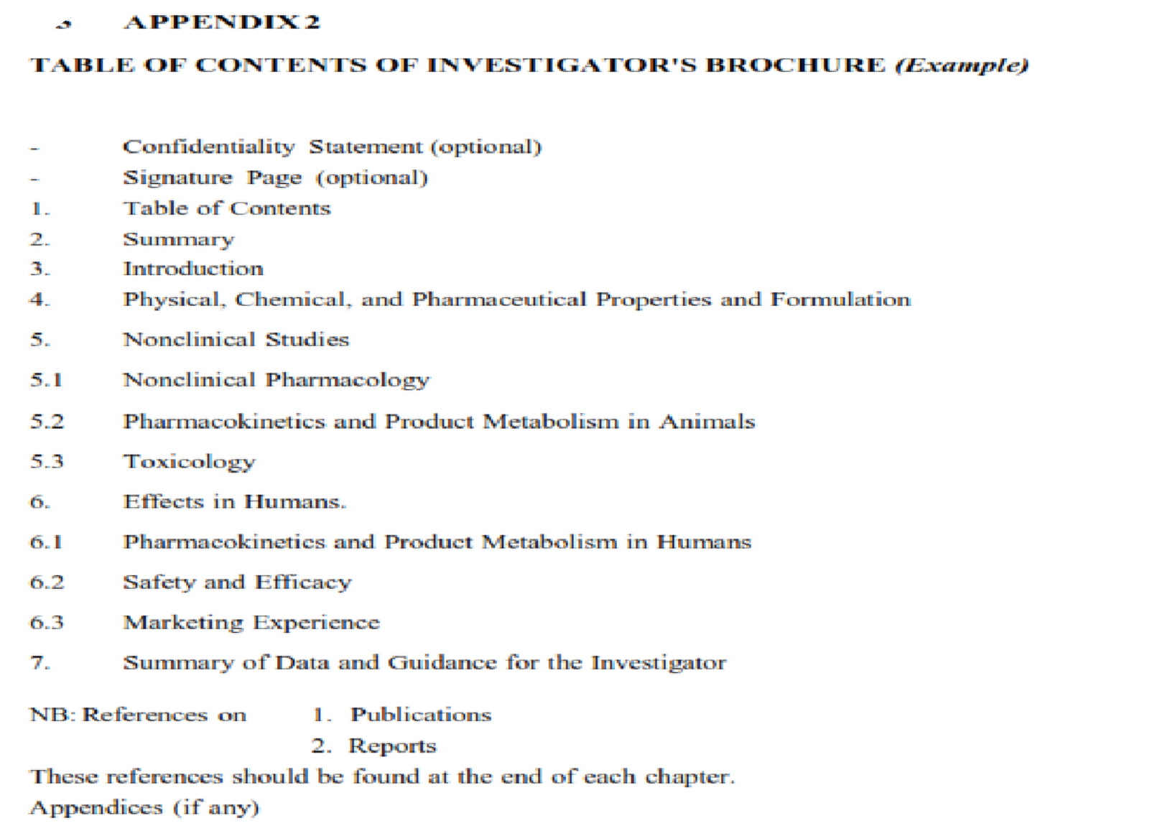
INVESTIGATOR’S BROCHURE :

Slide 37
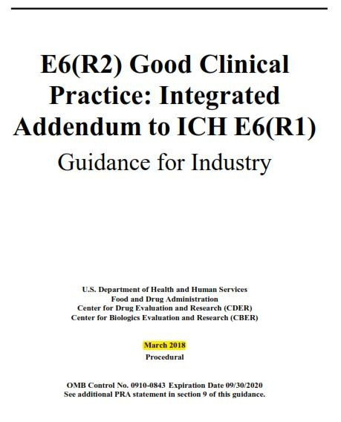
ICH E6(R2) GUIDELINE
ICMR GUIDELINE

Slide 38
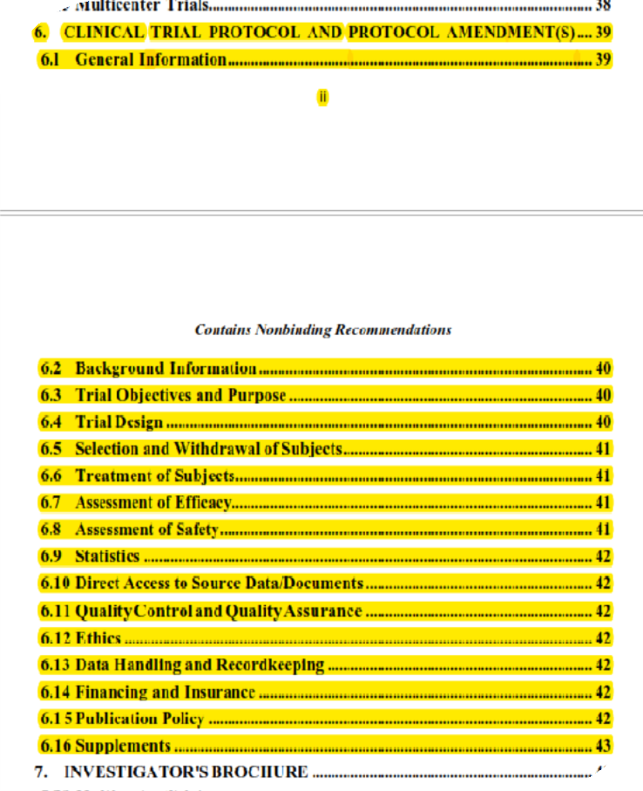
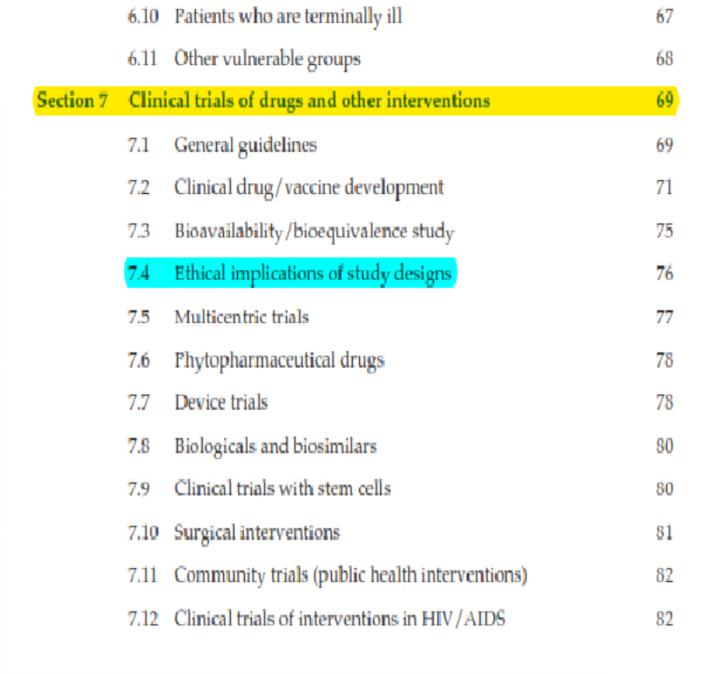
ICH E6(R2) GUIDELINE
ICMR GUIDELINE

Slide 39
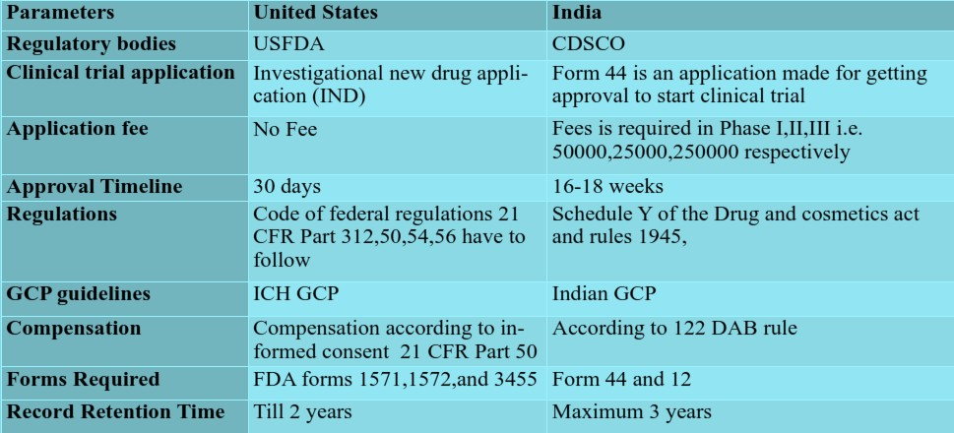
COMPARISION STUDY:

Slide 40
REFERENCES :
ICH GUIDELINES E6(R2) ;Good Clinical Practice: Integrated addendum to ICH E6(R1) : clinical trial protocol and protocol amendment(s) U.S. Department of Health and Human Services ,Food and Drug Administration ,Center for Drug Evaluation and Research (CDER),Center for Biologics Evaluation and Research (CBER) , March 2018
D&C ACT; SCHEDULE Y; Requirements and guidelines for permission to import and / or manufacture of new drugs for sale or to undertake clinical trials, May 28, 2017
NATIONAL ETHICAL GUIDELINES FOR BIOMEDICAL AND HEALTH RESEARCH INVOLVING HUMAN PARTICIPANTS, Published by-Director-General ; INDIAN COUNCIL OF MEDICAL RESEARCH 2017
UNDERSTANDING CLINICAL TRIALS , ICT Booklet 1ST Edition, UK Clinical Research Collaboration

Slide 41
REFERENCES :
INJURY AND DEATH IN CLINICAL TRIALS AND COMPENSATION: RULE 122 DAB,Ravindra. B. Ghooi 013 Oct-Dec; 4(4): 199–203.
REGULATORY PROCESS AND ETHICS FOR CLINICAL TRIALS IN INDIA(CDSCO) L EVANGELINE, NVN Mounica, V Sharmila Reddy, MV Ngabhushanam, D Nagarjuna Reddy and Brahmaiah Bonthagarala, The Pharma Innovation Journal 2017; 6(4): 165-169
A PROSPECTIVE RANDOMISED, OPEN, MULTICENTRE, PHASE III STUDY TO ASSESS DIFFERENT DURATIONS OF ANASTROZOLE THERAPY AFTER 2 TO 3 YEARS TAMOXIFEN AS ADJUVANT THERAPY IN POSTMENOPAUSAL WOMEN WITH BREAST CANCER,Protocol templet,2016
REGULATIONS GOVERNING CLINICAL TRIALS IN INDIA, EUROPE AND USA- A COMPARATIVE STUDY Agarwal Pooja*, Priyanka B International Journal of Drug Regulatory Affairs; 2017, 5(1), 30-39
COMPARATIVE STUDY OF THE REGULATORY GUIDELINES FOR CLINICAL TRIALS IN THE UNITED STATES AND INDIA Vijay Kumar, Shruti Chopra, March, 2016

