Slide 2
It is defined for a paper submission as a set of pages, numbered sequentially and divided from other documents by a tab.
A document can be equated to a file for an electronic submission.

Slide 3
CTD WAS OFFICIALLY SIGNED OFF IN NOVEMBER 2000, AT 5TH ICH CONFERENCE, SAN DIEGO,CALIFORNIA.
CTD
eCTD

Slide 4
The objective is to increase international harmonization of technical requirements to ensure that safe, effective, and high quality medicines are developed and registered in the most efficient and cost‐effective manner.
Activities have been undertaken to promote public health, prevent unnecessary duplication.

Slide 5
What is ICH ?
The complete name of ICH is the "International Conference on Harmonization of Technical Requirements for Registration of Pharmaceuticals for Human Use".
The purpose is to make recommendations on ways to achieve greater harmonization in the interpretation and application of technical guidelines and requirements for product registration in order to reduce or prevent the need to duplicate the testing carried out during the research and development of new medicines.
This unique project brings together the participants in the
three regions to discuss scientific and technical aspects of product
registration

Slide 6
The focus of the is to provide a common format for the preparation of a well structured submission according to the modular framework described in the ICH guidelines of the Common Technical Document for Registration for Human Use (ICH Topic M4).
The CTD guidance indicates where and how available information is to be presented.
The CTD is not intended to indicate what studies are actually required (Authorities can ask for specific types of data).

Slide 7
CTD is a joint effort of 3 Regulatory Agencies-
European Medicines Agency (EMEA, Europe)
Food and Drug Administration (FDA, USA) and
Ministry of Health, Labour and Welfare (MHLW, Japan).
CTD is maintained by ICH through Expert working group (EWG). It has been adopted by several other countries including Canada and Switzerland

Slide 8
These different steps are called STATUS of that Guideline-
STATUS | FUNCTIONALITY
STEP 1 | Development of Consensus
STEP 2 | Text released for Consultation
STEP 3 | Consultation outside ICH
STEP 4 | ICH Guidelines Finalized
STEP 5 | Implementation

Slide 9
Avoid generating and compiling different registration dossiers Common format will significantly reduce the time and resources Facilitates simultaneous submission in three regions Facilitates exchange of information among regulatory authorities Faster availability of new medicines.

Slide 10
The CTD is organized into FIVE modules:
Module 1: Regional Administrative Information.
Module 2: Introduction, Quality Overall Summary, Nonclinical Overview, Clinical Overview, Nonclinical Written and Tabulated Summaries, Clinical Summary
Module 3: Quality
Module 4: Nonclinical Study Reports
Module 5: Clinical Study Reports.

Slide 11
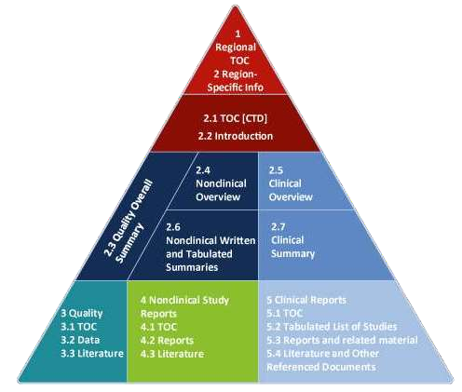
The Common Technical Document is organized into five modules. Module 1 is region specific and modules 2, 3, 4 and 5 are intended to be common for all regions.

Slide 12
1. ADMINISTRATIVE
FDA form 356h
Cover letter
Patent information
Department Certification
Field copy certification
User Fee cover sheet
Financial disclosure information

Slide 13
CTD Table of content
CTD Introduction
Quality Control Summary
Non-Clinical Overview
Clinical Overview
Non Clinical Summary
Clinical Summary

Slide 20
The eCTD is the electronic equivalent to the CTD.
Why electronic?
–Improve the submission and review process
–Increase accuracy of the submission
–Decrease total costs
This specification has been developed by the ICH M2 Expert Working group and maintained by the eCTD Implementation Working group in accordance with the ICH Process.

Slide 21
eCTD Changes
XML based eCTD backbone replaces PDF Tables of Content (index xml file). The purpose of this file is two‐fold:
Manage meta‐data for the entire submission
Constitute a comprehensive table of contents and provide corresponding navigation aid
Increase document granularity in accordance with ICH eCTD agreements.
Life Cycle Management:
–Composed at least of an initial submission
–Incremental updates
–Only what was changed needs to be re‐submitted

Slide 22
eCTD Specification v 3.2
eCTD is a message specification for the transfer of files and metadata from industry to regulatory.
The eCTD Specification version 3.2 describes many optional folders and file names.

Slide 23
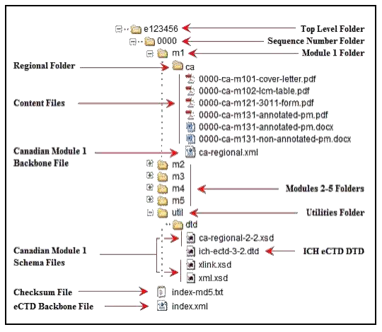

Slide 24
eCTD SUBMISSION CHECKLIST-
eCTD Software
Software training and support from the supplier
Compiling and eCTD
eCTD hyper linking
QC of eCTD
Submit eCTD on CD/DVD or Use electronic gateway

Slide 25
eCTD Implementation-
eCTD is implemented in 2009
ICH‐eCTD is an internationally driven standard designed to reduce cost in the administration, assessment and archiving of applications for marketing authorization of medicinal products for human use, to reduce the use of paper and streamline the assessment process making the system more efficient.
Unlike CTD the eCTD is not mandatory in Europe (highly
recommended).
NCAs are progressively adapting their infrastructure, processes and legislation to be able to receive and handle paperless applications for marketing authorization by 2009.

Slide 26
Benefits of eCTD
Improved handling and archiving of submissions
Better information management Support of Life Cycle Management
Immediate Access to complete and up‐to‐date information
Search functionality for assessors and increased tracking ability
Facilitated evaluation and better visibility of the process
Reduced workload and reuse of information for assessment reports
Controlled communication with external experts
Better use of resources
Simplified business process
Better communication with industry

Slide 27
SFDA Plan for Submission-
Application form should be submitted online
SFDA will require the product file in both CTD (Hardcopy) and eCTD (Softcopy) format
Product file registration should follow the current requirements, but in CTD format

Slide 28
SFDA Prospective for Submission
Learning process
Step by step implementation
Review of the business process
Build a workflow system
Pilot phase
Smooth transition

