Slide 1
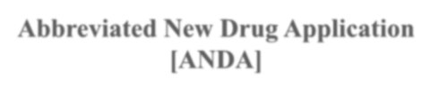




Abbreviated New Drug Application [ANDA]

Slide 2
ANDA
An Abbreviated New Drug Application (ANDA) contains data which when submitted to FDA's CDER, Office of Generic Drugs, provides for the review and ultimate approval of a generic drug product.
Once approved, an applicant may manufacture and market the generic drug product to provide a safe, effective, low cost alternative to the public.
All approved products, both innovator and generic, are listed in FDA's Approved Drug Products with Therapeutic Equivalence Evaluations (Orange Book).

Slide 3
ANDA
“A drug product that is comparable to a brand/reference listed drug product in dosage form, strength, route of administration, quality and performance characteristics, and intended use”.
It termed "abbreviated" because they generally not required to include preclinical (animal) and clinical (human) data to establish safety and effectiveness.
Basic Generic Drug Requirements are:
Same active ingredient(s)
Same route of administration
Same dosage form
Same strength
Same conditions of use
Inactive ingredients already approved in a similar NDA

Slide 4
Goal of ANDA
To reduce the price of the drug.
To reduce the time development.
Increase the bioavailability of the drug in comparison to references list drug.

Slide 5
Innovator Vs Generics
S.N. PARAMETERS INNOVATOR DRUG GENERIC DRUG
1. Active ingredients Same Same
2. Safety & efficacy
Same
Same
3. Quality & strength
Same
Same
4. Performance and standards
Same
Same
5. Costs/prescription
Highly expensive
Less expensive
6. FDA inspection of
manufacturing facilities
Yes
Yes
7.
FDA reviews reports of
adverse reactions
Yes
Yes 8.
No
FDA reviews drug labeling
Yes
9.
Extensive research and
development investments
Yes

Slide 6
Generic Drug Approval
In 1970 FDA established the ANDA as a mechanism for the review and approval of
generic versions.
Before 1978, generic product applicants were required to submit complete safety and efficacy through clinical trials.
Post 1978, applicants were required to submit published reports of such trials documenting safety and efficacy.
Neither of these approaches was considered satisfactory and so originated Hatch Waxman Act on 1984.

Slide 7
Indispensability Ground For Generics
Contain the same active ingredients as the innovator drug (inactive ingredients may
vary).
Must be identical in strength, dosage form, and route of administration.
Must have same use/indications.
Must be bioequivalent.
Must have same batch requirements for Identity, Safety & Purity.
Must follow strict standards of FDA's GMPs.

Slide 8
Hatch-Waxman Act
Commonly known as “Drug Price Competition & Patent Term Restoration Act” of 1984.
“The Hatch-Waxman Act is an act dealing with the approval of generic drugs and associated conditions for getting their approval from FDA, market exclusivity, rights of exclusivity, patent term extension and Orange Book Listing.”
Necessitated By :
Absence of Generic drug manufacturing.
Cumbersome regulatory procedures.
Patients were denied the option of cheaper drugs.

Slide 9
General Provisions of the Act
Maintaining list of patents which would be infringed.
Only Bioavailability studies and not clinical trials needed for approval.
Para I, II, III and IV certifications.
Data exclusivity period for New Molecular Entities. (NMEs)
Extension of the original patent term.
The “Bolar” Provision.

Slide 10
Recent additions to the Hatch-Waxman Act
Under the “Medicare Prescription Drug and Modernization Act”, 2003:
Non-extension of the 30-month period.
Time limit for informing patent owner.
Provision for allowing declaratory judgment.
Benefit of exclusivity for several ANDAs filed on same day allowed.

Slide 11






ANDA CERTIFICATION CLAUSES
PARAGR APH III
PARAGR APH IV
PARAGR APH I
PARAGR APH II

Slide 12


PARA-I
PARA-II
Required patent information has not been filed.
Patent has expired
FDA may approve generics immediately, one or more applicants may enter.
FDA may approve generics immediately, one or more applicants may enter.
12

Slide 13
PARA-III
PARA-IV
Patent not expired, will be expired on a specific date.
Patent is invalid or non infringed by generic applicant.
FDA may approved ANDA effective on the date of expiration, one or more applicant may enter.
Generic applicant file notice to patent holder.
13

Slide 14











PARA IV
CERTTIFICATION
After 45 days Patent Holder doesn’t sue
applicant ► FDA
may approve ANDA.
After 45 days Patent Holder sues the Applicant ► 30months stay granted to Patent Holder.
ANDA Applicant granted approval.
30 Months stay expired
30 Months stay not expired.
For the first Applicant the EMR of 180 days starts with court’s decision.
Subsequent approvals for EMRs are granted after expiry of first applicant’s 180 days.

Slide 15





30 Months stay not expired
If judgement’s in favour of Patent Holder ► FDA can not approve ANDA untill patent expiry.
Judgement favouring
ANDA ► EMR of 180
days begins for first applicant.
First Applicant enters, subsequent applicants enter only after expiry of EMR for the First Applicant.
No entry occurs
untill Patent Expiry.

Slide 16















ANDA REVIEW PROCESS
APPLICANT
ANDA
ACCEPTABLE & COMPLETE
REFUSE TO FILE- LETTER ISSUED
NO
YES
B.E. REVIEW
CHEMISTRY/MICRO REVIEW
REQUEST FOR PLANT INSPECTION
LABELING REVIEW
B.E. REVIEW ACCEPTABLE
CHEMISTRY/LABELING REVIEW ACCEPTABLE
YES
NO
NO
PREAPPROVAL INSPECTION
ACCEPTENCE
NOT APPLICABLE LETTER
B.E. DEFICIENCY LETTER
NO
YES
APPROVAL DEFERRED PENDING SATISFACTORY RESULTS
ANDA APPROVED
16

Slide 17
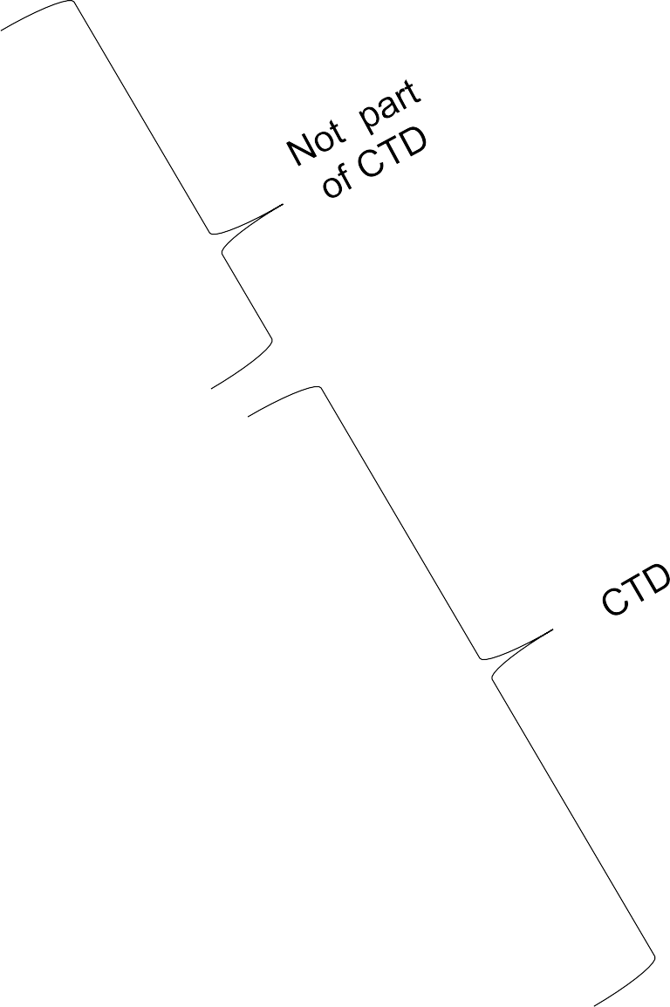





The CTD Triangle
Regional
Admin.
Information
MODULE 1
Non
Clinical
Clinica
l
^{O}C^{v}l^{e}in^{r}i^{v}c^{i}al
Quality Overall summa ry
Noºn^{ve}C^{r}l^{v}in^{ie}i^{w}cal Summary
Su^{e}m^{w}mary
Non Clinical Report
MODULE 4
Clinical Report
Quality
MODULE 3
MODULE 5
17

Slide 18
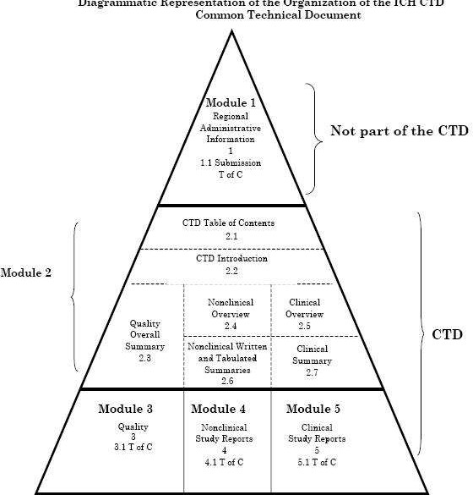

Slide 19
MODULES IN A CTD
MODULE I: Administrative and Prescribing Information
Table of Contents.
Includes data of Administrative Documents entailing:
Patent Information on patented product.
Patent Certifications.
Debarment certification.
Prescribing information like Package and container labels, packaging inserts, patient leaflets,
etc.
Labelling Comparison between Innovator and Generic drug.

Slide 20
MODULE II: SUMMARIES AND OVERVIEWS
Table of Contents.
Introduction to Summary Documents.
Overviews and Summaries: Module II should contain documents like:
  M4Q: The CTD- quality
  M4S: The CTD- safety
  M4E: The CTD- efficacy
MODULE III: information on product quality
Table of Content.
Body of Data.
Literature Reference.

Slide 21
MODULE IV: NON CLINICAL STUDY REPORTS
Not required in ANDA Filing.
MODULE V: CLINICAL STUDY REPORTS
Table of Contents.
Study Reports including Case Report Forms and Case Report Tabulations.

Slide 22



ANDA CONTENTS
CTD MODULES ANDA REQUIREMENT
Module 2
Common Technical Document
Summaries
Module 3
Quality
yes
yes
Module 4
Nonclinical Study Reports (Animal studies)
Module 5
Clinical Study Reports (BA/BE studies)
no
yes

Slide 23

NDA CONTENTS
CTD MODULES NDA REQUIREMENT
Module 2
Common Technical Document
Summaries
Module 3
Quality
yes
yes
Module 4
Nonclinical Study Reports
yes
Module 5
Clinical Study Reports
yes

Slide 24



IND CONTENTS
CTD MODULES IND REQUIREMENT
Module 2
Common Technical Document Summaries
Module 3
Quality
yes
yes
Module 4
Nonclinical Study Reports (Animal studies)
Module 5
Clinical Study Reports
yes
no

Slide 25
Broad outline for ANDA
Product must meet appropriate standards of
Identity,
Strength,
Quality and
Purity
Efficacy and safety should be equivalent to branded product already established

Slide 26
Information required for filing ANDA
Product’s formulation
Manufacturer’s procedure
Control procedure
Testing,
Facilities
Dissolution profile
Labeling

Slide 27
Recommendations For E-ctd
PDF Files with version 3.0 of Acrobat Reader
Use of Embedded fonts in the Portable Document Format
A Print area of 8.5 inches by 11 inches and margin of 1 inches is ensured on sides.
Scanned Documents should be avoided as Source Documents.
Hypertexts can be indicated by Blue-Texts or by rectangles using thin lines.

Slide 28
Numbering on the PDF and Documents should be included as same.
Security or Passwords should not be included.
Full Indexes should be included.
Electronic Signatures may be added, Procedures are being employed for archival of the same.

Slide 29
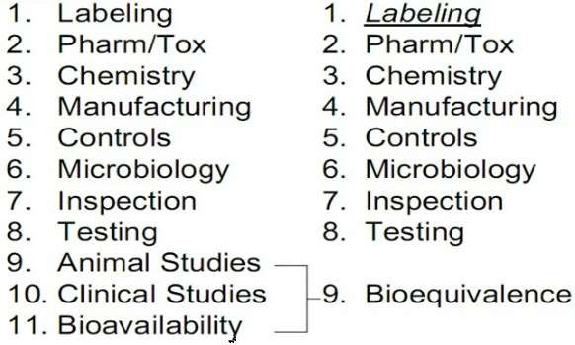
NDA Vs ANDA Review Process
NDA REQUIREMENT ANDA REQUIREMENT

Slide 30
First-Time Generic Drug Approvals - July 2011
Generic Drug Name Generic Manufacturer | Brand Name | Approval Date
FONDAPARINUX DR. REDDY'S | ARIXTRA | 7/11/2011
SODIUM LABORATORIES | INJECTION
INJECTION ^{LIMITED}
ALFUZOSIN TEVA | UROXATRAL | 7/18/2011
HYDROCHLORID PHARMACEUTIC | EXTENDED-
E EXTENDED- ALS USA | RELEASE
RELEASE TABLETS | TABLETS
ALFUZOSIN SUN PHARMA | UROXATRAL | 7/18/2011
HYDROCHLORID GLOBAL FZE | EXTENDED-
E EXTENDED- | RELEASE
RELEASE TABLETS | TABLETS
PARICALCITOL SANDOZ | ZEMPLAR | 7/27/2011
INJECTION CANADA, INC. | INJECTION

Slide 31
Patent Certification condition for ANDA
Described in section 505(j)(2)(A)(vii) of the Act.
I Patent Not Submitted to FDA –
Approval effective after OGD scientific determination
II Patent Expired –
Approval effective after OGD scientific determination
III Patent Expiration Date (honored) –
Tentative approval after OGD scientific determination, final approval when patent expires
IV Patent Challenge –
Tentative approval after OGD science determination, final approval when challenge won

Slide 32
Paragraph IV certification
According to section 505(j)(2)(B)(i), 2157 CFR
The ANDA applicant must provide appropriate notice of a paragraph IV certification to each owner of the patent that is the subject of the certification and to the holder of the approved NDA to which the ANDA refers
And by Section 505(j)(5)(B)(iv)
An incentive for generic manufacturers to file paragraph IV certifications and to challenge listed patents as invalid, or not infringed, by providing for a 180-day period of marketing exclusivity

Slide 33
Patent Challenge Successful – Award of 180-Day Exclusivity Period
Awarded to first ANDA holder to file a complete application with patent challenge
Protection from other generic competition – blocks approval of subsequent ANDAs
Protection triggered by:
First commercial marketing
Forfeiture provisions

Slide 34
Orphan Drug Exclusivity (ODE)
Orphan drug refers to a product that treats a rare disease - affecting fewer than 200,000 Americans
7 years exclusivity
Granted on approval of designated orphan drug
OGD works with the Office of Orphan Products

Slide 35






























Difference between NDA &ANDA

Slide 36


ANDA
DETAILS
NDA
IND
1.Chemistry,manufacturing, and controls
yes
Yes
Yes
2.Nonclinical pharmacology
and toxicology (Animal data)
Yes
No
Yes
3. Human pharmacokinetics and bioavailability
Yes
Yes
No
4. Microbiology
Yes
Yes
No
Yes
(BABE studies)
5.Clinical data
Yes
No
6.Statistical
Yes
Yes
Yes

Slide 37
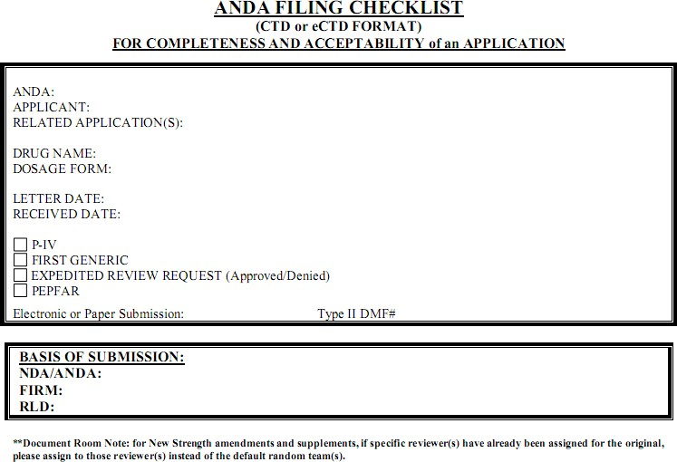

Slide 38
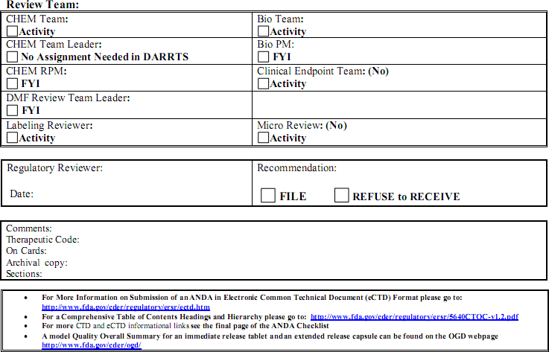

Slide 39
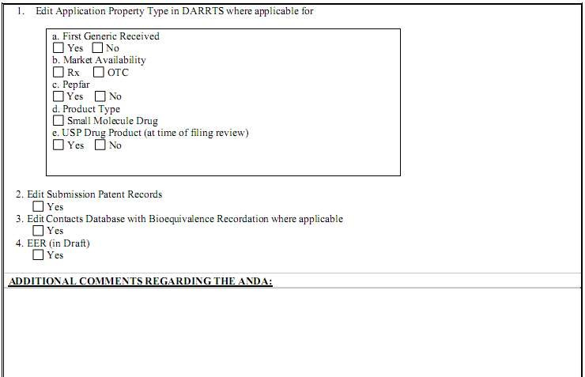

Slide 40
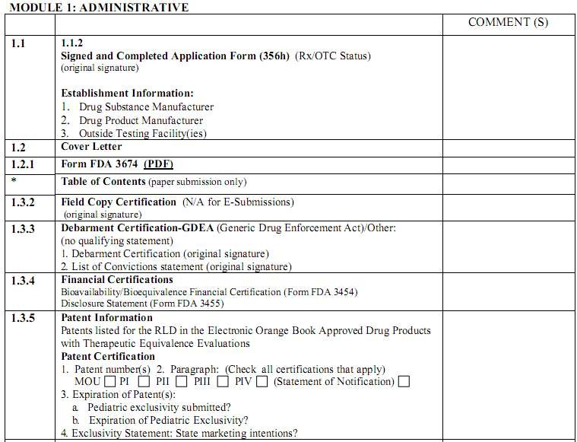

Slide 41
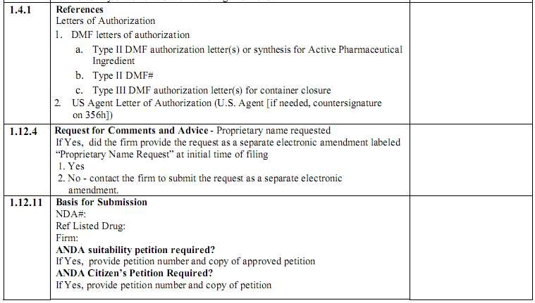

Slide 42
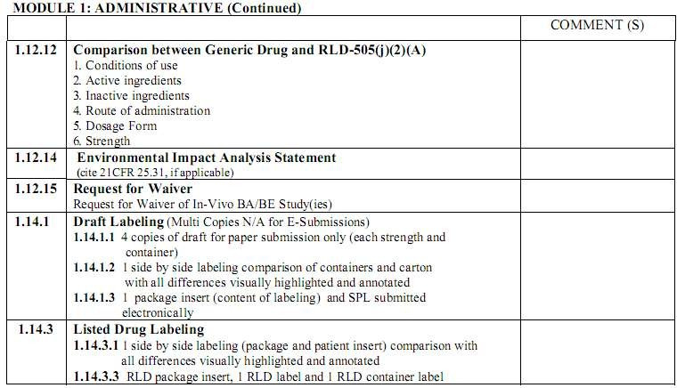

Slide 43
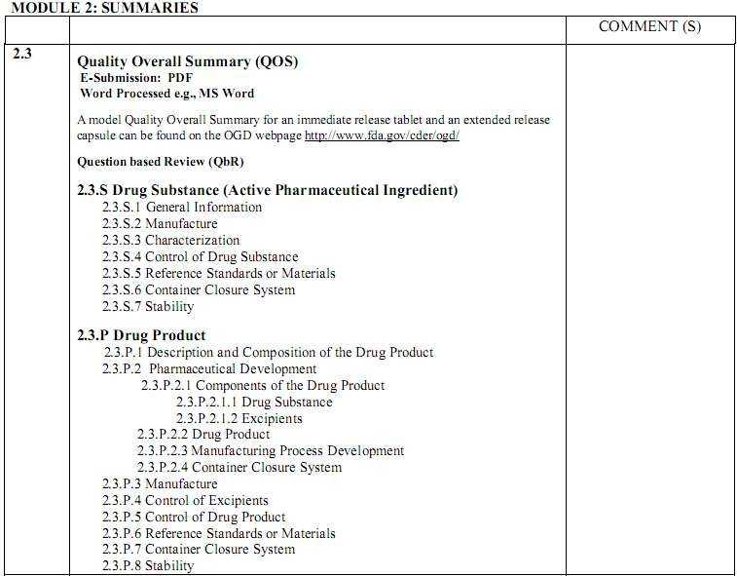

Slide 44
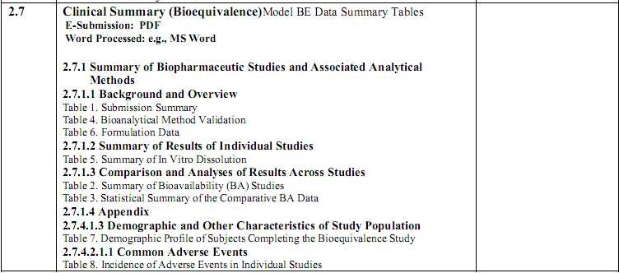

Slide 45
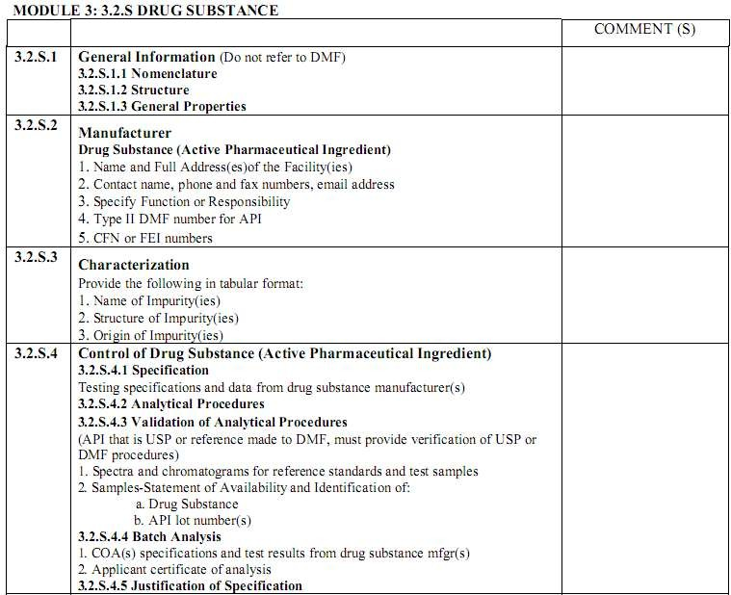

Slide 46
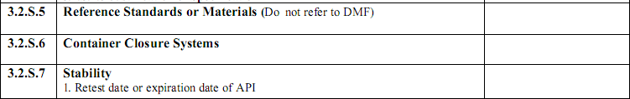
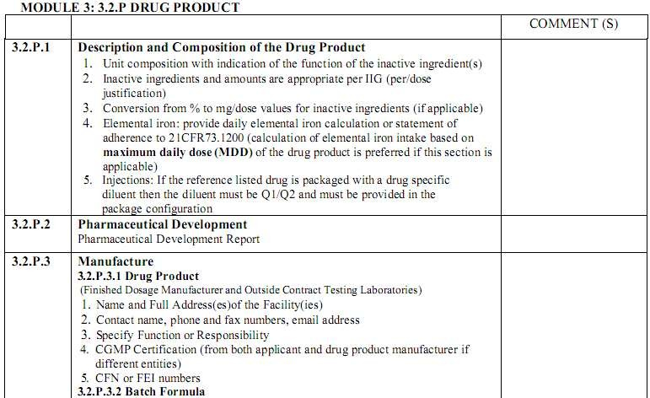

Slide 47
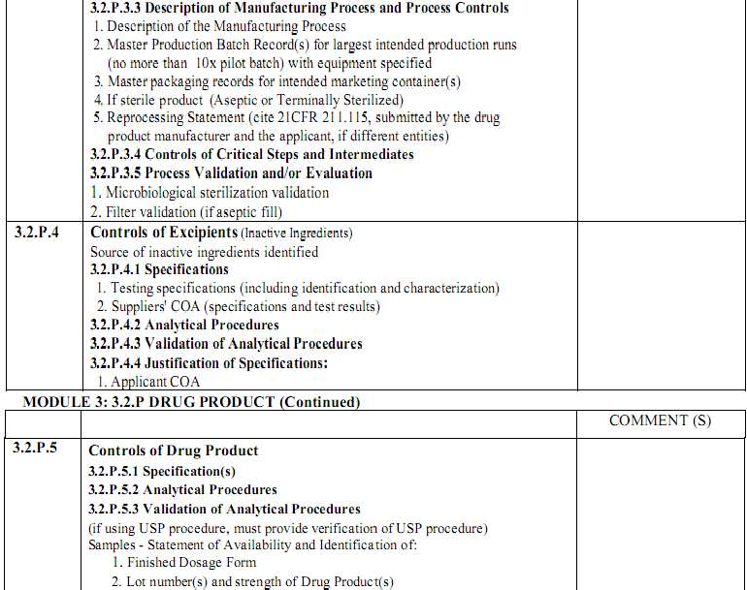

Slide 48
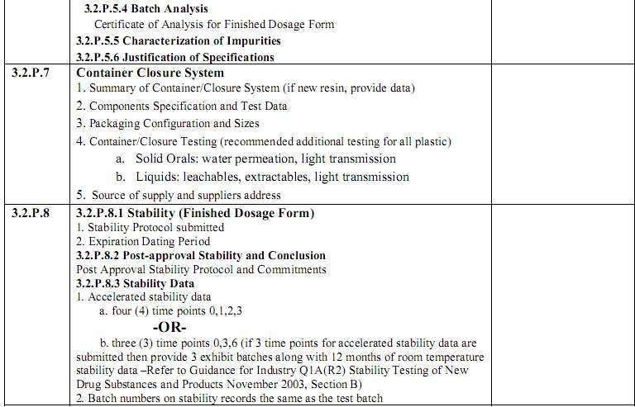

Slide 49
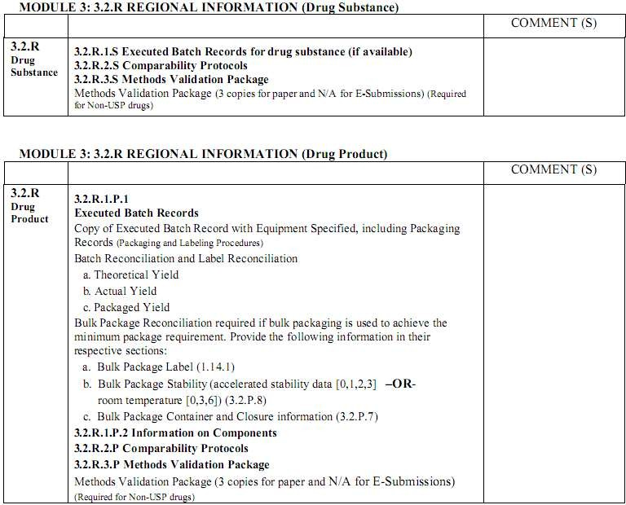

Slide 50
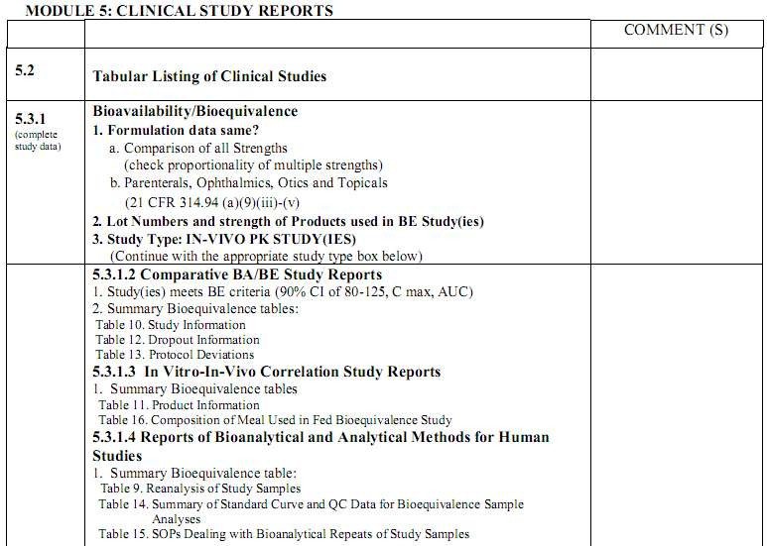

Slide 51
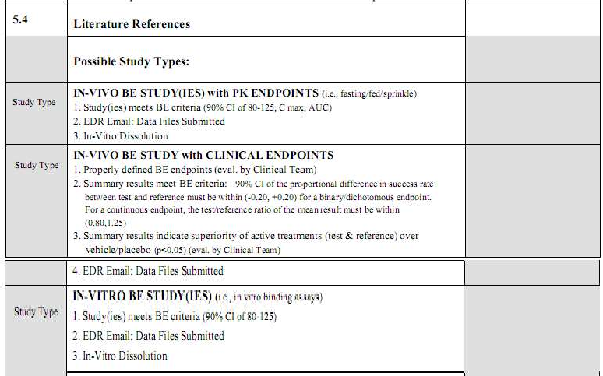

Slide 52
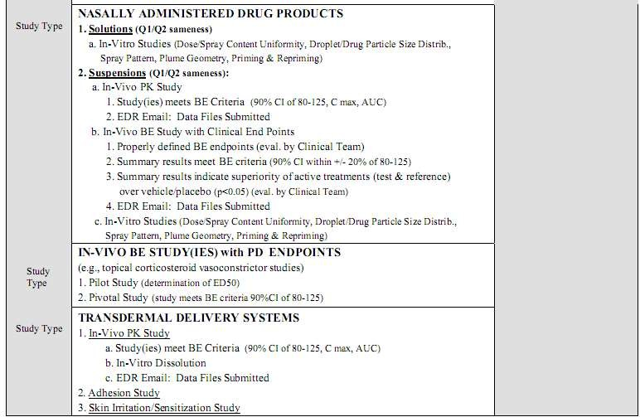

Slide 53


