Slide 1
TOPIC NAME:
KNEE JOINT X RAY VIEWS

Slide 2
ANATOMY OF KNEE JOINT

Slide 3
VIEWS OF KNEE X RAY INDICATIONS
VIEWS :
Knee AP x ray view.
Knee LATERAL x ray view.
Knee SKYLINE x ray view.
INDICATIONS:
Trauma.
Bony tenderness at the head of the fibula.
Isolated patella tenderness.
Patient is unable to flex the knee to 90 degree.
If the patient is unable to weight bear.
Suspected osteoarthritis.

Slide 4
Detecting joint effusion.
Infection.
Fractures.
Post op cases like TKR(Total Knee Replacement)
CONTRA INDICATIONS:
Pregnancy.
Risk vs benefits are calculated.

Slide 5
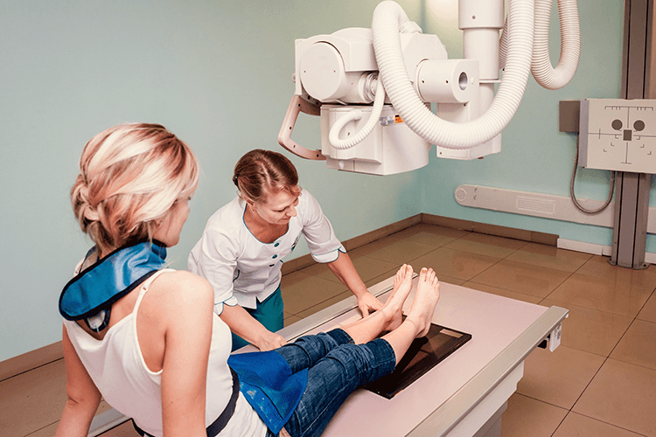
PREPARATIONS
Collect history from the patient.
Patient is asked to remove all radio opaque materials.
Wear hospital gown.
Shielding is provided to the patient.
If female patient comes to x ray chaperone is necessary.
At the time of exposure ,patient is asked to take breathe ,exposure is taken during arrested inspiration.

Slide 6
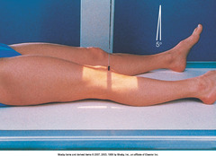
POSITIONING
KNEE AP X RAY POSITIONING:
Patient lies supine on x ray table with affected side knee on the cassette with that side hip and knee flexed slightly.
Leg and ankle are immobalised with sand bags.
It is ensured that patella placed at the centre of the cassette,side is marked beam is collimated.

Slide 7
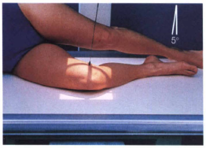
KNEE LATERAL X RAY VIEW:
Patient sits on x ray table with knee and legs in lateral position.
Affected knee is placed on the cassette.
Leg is immobalisied with sand bags ,side is marked beam is collimated.

Slide 8
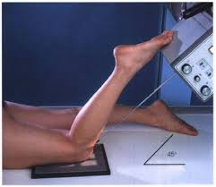
SKYLINE VIEW (inferio superior view of patella):
Patient will be in prone position on x ray table un affected leg is rested comfortably while affected knee id flexed.
The foot is extended and held with looped bandage around it, so that the flexed knee is immobalisied in that position by patient himself.

Slide 9
CENTERING :
KNEE AP—it is done 2.5 cms below the apex of patella.
KNEE LATERAL—done on anterior aspect of medial condyle of tibia.
SKYLINE --- it is done behind the apex of patella,central beam is directed 15 degree toverttical

Slide 10
TECHNIQUE:
KVP:70
mAS:10
FSS:Small
FFD:10cms
Without grids
CASSETTE SIZE:12 x 10 inches

