Slide 1
FOREST MENSURATION
Mrs.Sonia Panigrahi
Assistant Professor
Department of Agronomy and Agroforestry

Slide 2
Diameter and girth measurements
•
•
to estimate stem cross-sectional area; done at breast height because:
can not be done at bases, which may be covered with grasses/shrubs/ thorns and have root swell etc.
can not be done at stumps which are not cut at same heights
it is a convenient height conventionally being used, and extensive database exist
it is a uniform point of measurement which helps in standardizing diameter/girth measurement

Slide 3
DBH at 4’6” or 1.37 m in India, Mynmar, South Africa, Malaya and some other former British Colonies
DBH at 4’3” or 1.3 m in USA, Canada, Europe including UK and most other countries of Commonwealth (recommended by FAO as a standard for international adherence)
International symbol for diameter at breast height is d
•
•
•

Slide 4
Description of Diameter and Girth measurements
DBH : Diameter at breast height
GBH : Girth at breast height
O.B. : Over bark
U.B. : Under bark
Basal Area: Sectional area at breast height

Slide 5
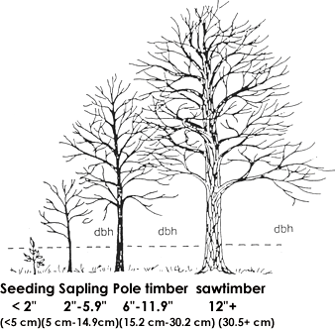

Slide 6
Standard Rules in Diameter / Girth measurement
Loose bark/ creepers if found on the tree especially near
breast height should be removed before measuring the diameter
B.H.
1.37m

Slide 7
Standard Rules in Diameter/Girth measurement
Mark BH by means of measuring stick or any standard…
Mark the BH point
+
B.H.
1.37m

Slide 8
Standard Rules in Diameter/Girth measurement
+
B.H.
1.37m
Ground is flat and the tree is straight

Slide 9
Standard Rules in Diameter/Girth measurement
B.H.
Measure DBH along the tree stem and not vertically, on the side of the lean in case the tree is leaning and the ground is flat
1.37m
Ground is flat but the tree is leaning

Slide 10
Standard Rules in Diameter/Girth measurement
B.H.
1.37m
Measure DBH on the up hill side on sloping ground
Sloping ground but the tree is straight

Slide 11
Standard Rules in Diameter/Girth measurement
Measure DBH along the tree stem and not vertically, on the side of the lean
B.H.
1.37m
Sloping ground and the tree is leaning

Slide 12
Measure DBH along the tree stem and not vertically, on the side of the lean
B.H.
1.37m
Sloping ground and the tree is leaning

Slide 13
contd…
DBH measured not at 1.37 m but mark shifted up or down (as little as possible) to a more normal position of the stem
B.H.
1.37m
Tree stem is abnormal at breast height level

Slide 14
Standard Rules in Diameter/Girth measurement
contd…
BH
BH
BH
1.37m
1.37m
1.37m
Counted as one tree
Each fork treated as a separate tree
Counted as one or two depending on the place of measurements
Tree stem is forked

Slide 15
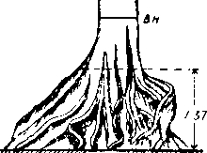
contd…
B.H.
DBH measured at the lowest point above which the abnormal formation is not likely to extend
Tree stem has buttress at breast height level

Slide 16
Some points to be taken care of while taking measurement of trees
Remove moss, creepers, lichens and also loose bark
before taking measurements
Record GBH in m and to the nearest cm
•
•

Slide 17
Instruments used in diameter and girth measurements
Common ones
•
•
•
Wooden scale Tape Callipers
Uncommon ones
•
•
•
•
Wedge prism Relaskop Dendrometer Altimeter
Contd…

Slide 18
Choice of instrument depends upon
Whether tree is standing or felled
Degree of accuracy required
Availability
Ease in working

Slide 19
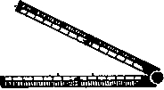
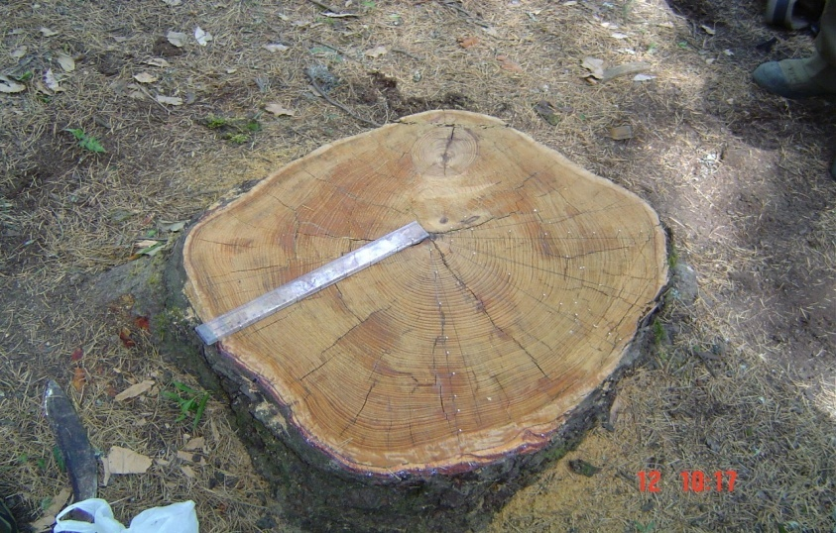
contd…
Wooden scale
Flat wooden piece marked in cm & mm
Available in various sizes viz. 30cm, 60cm
Folding depend on length
Used for measurement of diameter of stump or end section of logs
Mainly used for stem/ stump analysis

Slide 20
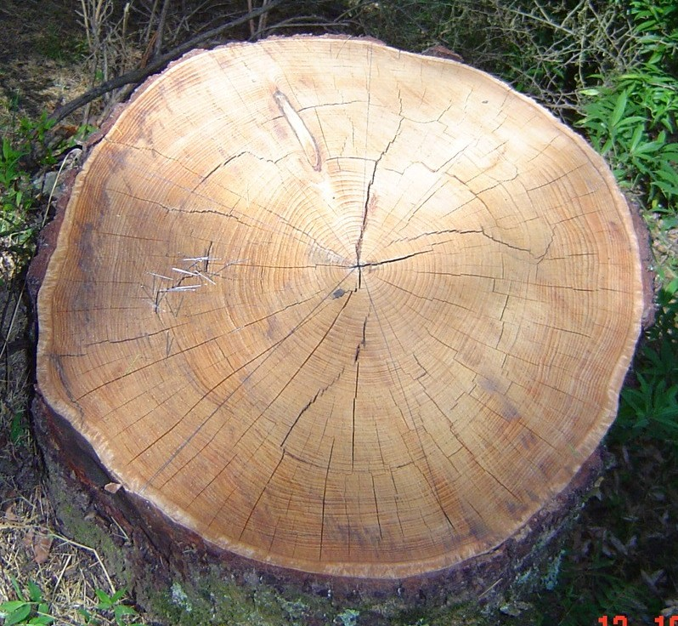
Wooden scale
Rules for measurement
Dia measured along the line passing through the pith
–Two diameters, one each along major axis & one ⊥ to it are measured in case of eccentric stump/log
Reading to be taken just above the mark i.e. vertically

Slide 21
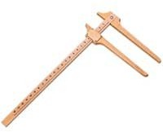
Instruments used in measurements
contd…
Callipers
•
•
Generally made of wood or Al
Used for measuring diameter of standing trees
A graduated rule & 2 arms
One arm is fixed & at right angle to the rule; other arm is movable along the rule
Normally arm length is half the length of rule
Calipers up to 120cm length are used in practice
•
•
•
•

Slide 22
Callipers
Depending upon the desired degree of accuracy rule is divided into units
For routine forest works callipers marked in cm and showing Diameter classes painted in different colours are used

Slide 23
Diameter | Colour
0-10 cm | Black
10-20 cm | White
20-30 cm | Red
30-40 cm | Black
40-50 cm | Yellow
50-60 cm | Blue
60-70 cm | Pink

Slide 24
Method of Use
•
•
•
Tilt the movable arm inwards to make it free to move
Make a wide gap between the arms so that it fit into the stem
Graduated rule made to touch the tree
Movable arm shifted inwards in the tilted position till the tree touches both the fixed and the movable arms
Movable arm is then slowly brought in ⊥ position to the graduated scale
Pressed so as to squeeze out any loose bark as well as ensure that there is no gap between the arms and use tree
Note the diameter reading on the rule
•
•
•
•
•

Slide 25
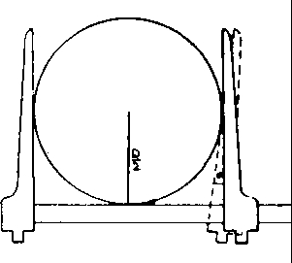

Slide 26
How is dbh measured for an elliptical stem? (using callipers)
–If cross section is elliptical, two readings should be taken after properly locating major axis and measuring it first, then take reading at ⊥ to it

Slide 27
How are measurements taken?
1
2
•
•
Callipers must be placed at right angle to axis of tree
Movable arms should be well opened before placing the calliper
Two arm and scale arm must be in contact with tree and movable arm should be at right angles to the scale arm Reading must be taken before removal
•

Slide 28
Precaution in use of Callipers
Movable arms should be well opened before placing the calliper
Reading must be taken before removal
Callipers must be placed at right angle to axis of tree
Two arm and scale arm must be in contact with tree and movable arm should be at right angles to the scale arm
If cross section is elliptical, two readings should be taken after properly locating major axis and measuring it first, then take reading at ⊥ to it

Slide 29
Advantages and disadvantages of Callipers
Advantages
Dia can be read directly and thus instrument can be applicable for precise scientific work.
Can be used by unskilled labour
Errors are + and - and neutralizes each other
Disadvantages
Awkward to carry
Two measurement difficult to take in hilly area
Wooden ones absorb moisture in humid conditions

Slide 30
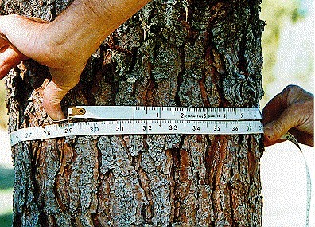
Tape – used for trees & logs
Made up of cloth, reinforced cloth, plastic or steel
Of varying length
End of tape is generally of some metal
For tree measurement tape are generally 3 & 5 meter long
Usually calibrated in metric system on one side and British system on another side
•
•
•
•

Slide 31
Precaution in use of Tape
Old tapes should not be used
Take care not to twist at the time of use
Must lie in a plane perpendicular to the axis of tree
Remove climber or branches of nearby shrub if it comes in between the girth of tree

Slide 32
Advantages and disadvantages of Tape
Advantages
Convenient
Only one measurement needed
Disadvantages
If tree has rough bark, the tape exaggerates the diameter
Slower in dense shrub growth
Knots swellings affects girth measurement

Slide 33
Tape and callipers - comparison
•
Practicability – tape is small & light whereas callipers are heavier
Price – tape is much cheaper that callipers History – tapes are most commonly used
– For large trees tapes are used
•
•
contd…

Slide 34
Tape and callipers - comparison
•
Use – use is faster and more accurate
both are easy to use in accessible locations
for inaccessible locations callipers are less useful because of its weight & measurement with a tape is faster that two measurements with callipers tapes are more accurate than callipers
tape negotiates whole circumference of the tree → gives better measurement
for non-circular trees tape overestimates girth, callipers are better

Slide 35



Slide 36
Relation between diameter and girth of trees
•
For a circle the ration between the diameter (d) & girth (g) is 1/π or 0.3182
Trees have irregular cross-sections so this ratio (d/g) is not equal to 0.3182
This ratio varies from species to species
•
•

Slide 37
Species | f = d/g
Acacia catechu | 0.3104
Bombax ceiba | 0.3135
Cedrus deodara | 0.3136
Pinus roxburghii | 0.3093
Dalbergia sissoo | 0.3098
Shorea robusta | 0.3119
Tectona grandis | 0.3160

Slide 38
Diameter and Girth Class
•
Measurement of trees are done and then recorded in suitable dia/ girth classes
Practice in India
Type of tree | Tree maturity dia (dbh) | Dia class interval | Girth class interval
Small sized | 30 cm | 2 cm | 5 cm
Medium sized | 30 to 50 cm | 5 cm | 15 cm
Large Sized | 50 cm & above | 10 cm | 30 cm

Slide 39
Diameter and Girth Class
Dia class | Colour
0-20 cm | Blank
20-30 cm | Green
30-40 cm | Red
40-50 cm | Yellow
50-60 cm | Black
60-70 cm | White
70cm & above | Blue
•
Standard colour code for dia/ girth classes
Facilitates easy and fast recording
Measurement can be taken by illiterate labourers
•
•

Slide 40
Common errors in dbh measurement leading to wrong calculation of area/volume
Area for circle = (π a²)/4 Area for ellipse = (π a b)/4
a
In case of noncircular tree
If only a is measured → over estimation of area
If only b is measured → under estimation of area
Therefore two dia are measured
a
b

Slide 41
Better way of measurement leading to less error in area/volume calculation
Two diameters d₁ & d₂ for ellipse
One way – average the two dia and then calculate area
Another way – calculate areas separately and then average
First is better as less error involved in area calculation

