Slide 1
Skill course on Poultry Farming
ABC01(0-4-0)
Session: 7
Transfer technique in case of layer and broiler birds from broiler houses to grower houses, transfer techniques incubator and hatchery, sterilization and cleanliness of the incubator hatches etc. maintaining cleanliness of hatching eggs etc.

Slide 2
Fumigation of hatching eggs
Fumigating with 3x concentration of formaldehyde for 20 minutes will kill about 97.5 to 99.5% of the organisms on the shells.
One ‘x’ concentration means 20 g of KMnO4 with 40 ml of formalin for 100 cubic feet (3x means 60 g of KmnO4 + 120 ml of formalin for 100 cubic feet).

Slide 3
Cold Storage
When the eggs are not set immediately after receiving, they should be kept in cold rook at the temperature of 65 degree F and 75% relative humidity.

Slide 4
Warm eggs prior to setting in incubator
Approximately 6 hours prior to placing eggs in the setter they should be moved from the egg-cooler room to normal room temperature.
Here, atmospheric air condenses over eggshell and form water droplets over eggshell, which is called as ‘Sweating’.
It is advantageous to warm eggs before placing them in the incubator by avoiding creation of low temperature in the machine by placing cool eggs directly.

Slide 5
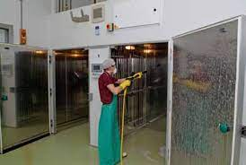
Washing and cleaning of incubator and Hatcher
Cleaning the hatchery between hatches is of primary importance.
The setters and setter room, every piece of equipment must be thoroughly vacuumed, scrubbed, disinfected and fumigated.

Slide 6
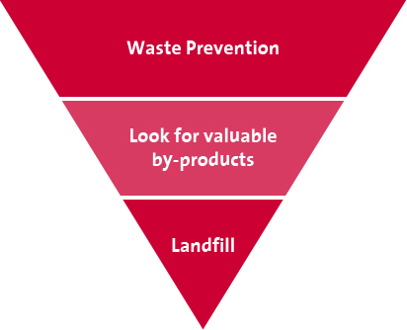
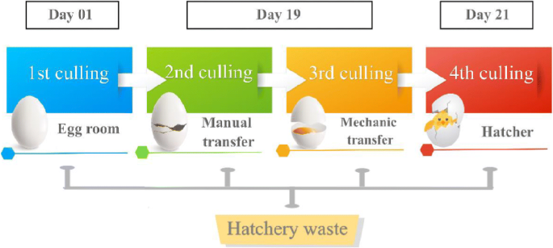
Disposal of waste
Hatchery wastes include infertile and non-hatched eggs, and dead and cull chicks that should be disposed in such a manner not to create problem to the neighbors and also not to contaminate the hatchery premises.

Slide 7
Transportation of poultry
Everyone involved in handling and transporting poultry must accept the responsibility of humane handling and minimizing stress to the birds during catching, loading, transporting, unloading and processing.
During transportation of poultry, one should not
1. Carry poultry by their head, neck, wings or tail.
2. Transport birds in bags.
3. Transport birds with their legs tied.
4. Transport birds in the trunk of a car.
5. Mix mature males or different species of poultry in a single crate or cage during transport.

Slide 8
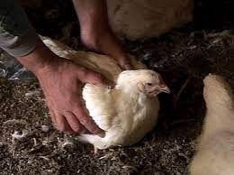
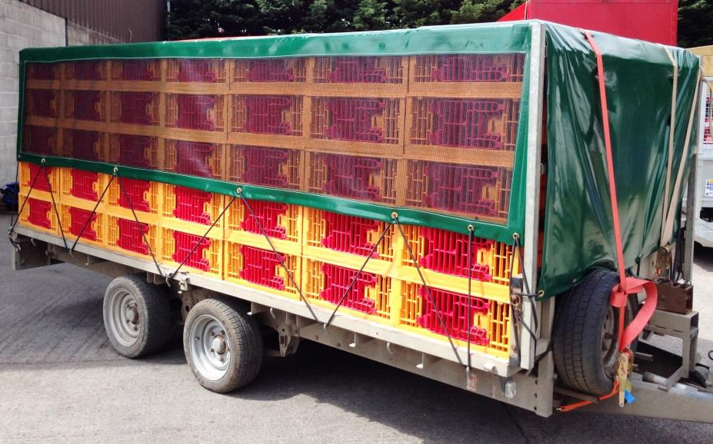
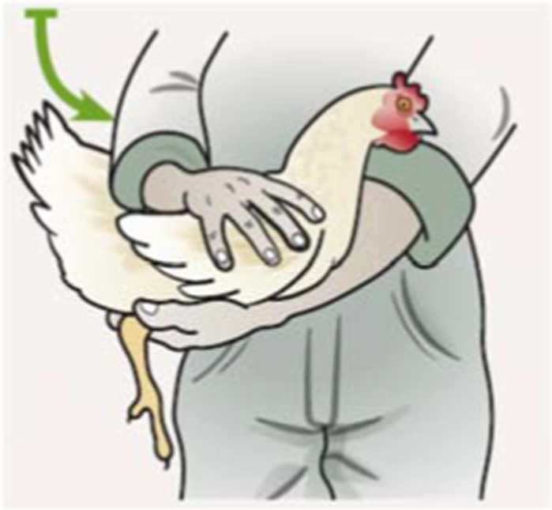
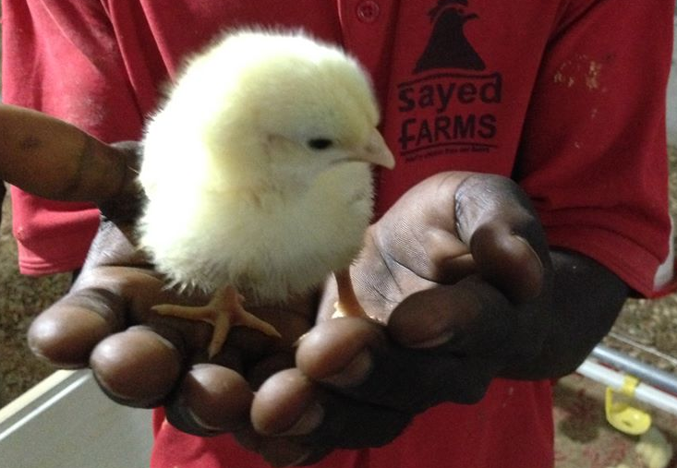

Slide 9
Proper handling and transportation of poultry will
improve the well-being of poultry by reducing handling and transport stress.
address customer/societal concerns and regulatory oversight (e.g. company reputation, retail audit requirements, government regulations, etc.) and,
have positive financial implications for the poultry handling, transportation and processing sectors (e.g. minimize mortalities, maximize yields, protect meat quality, shelf life, etc.), and safeguard product integrity (e.g. food safety, etc.).

Slide 10
Thank you

