Slide 1
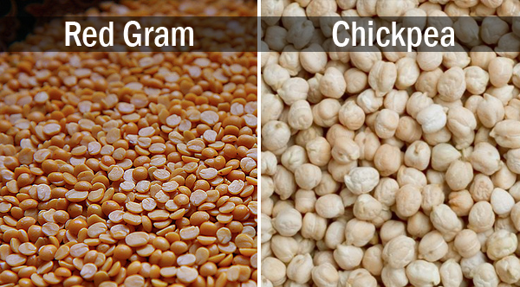
Pests of pulses

Slide 2
GRAM CATERPILLAR Helicoverpa armigera Noctuidae: Lepidoptera
DISTRIBUTION:
It is observed through out the year on one or the other crops viz., peas, tomato, cotton, maize, tobacco, safflower, groundnut, chillies etc.
APPEARANCE:
Moth is stout with dark yellow olive grey or brown wings crossed by a dark band near outer margin and a dark spot near costal margin of forewings and hindwings pale with a dark apical border.

Slide 3
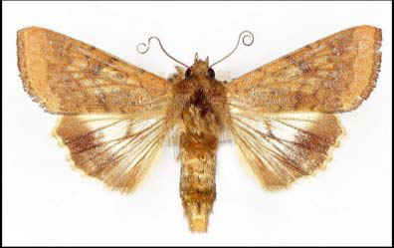

Slide 4
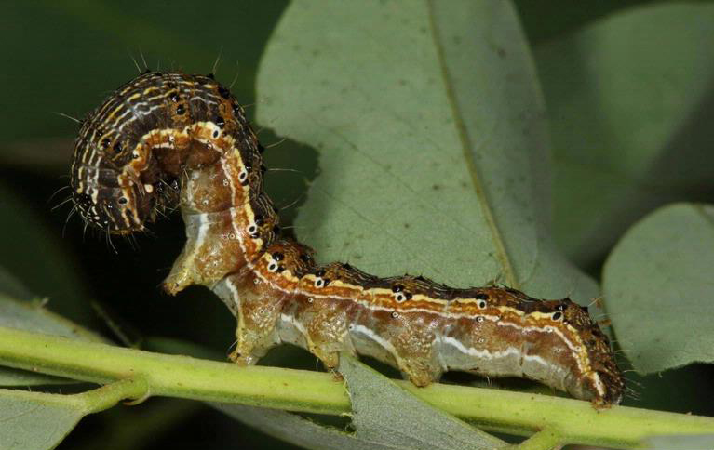
Full grown caterpillar is dark green or reddish brown or brownish and marked with a white broken lines and a prominent white line along lower part of sides.

Slide 5
LIFE CYCLE:
Yellowish shiny, sculptured eggs are laid singly on tender parts of plants.
Each female lays 300-400 eggs.
Egg period is 2-4 days.
Larval period 18-25 days.
Full grown caterpillar drops down and pupates in soil.
Pupa is dark brown and adult emerges in 6-21 days.

Slide 6
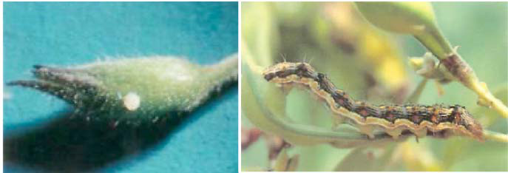
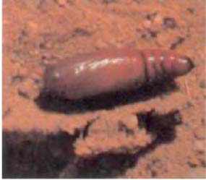

Slide 7
NATURE OF DAMAGE:
The young caterpillars feed on the tender foliage and as they grow they bore into the pods and destroy the seeds, while feeding it thrusts its head inside the pod leaving the rest of its body outside.
SYMPTOMS OF DAMAGE:
Large round on each locule

Slide 8
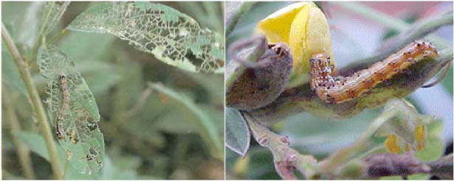

Slide 10
IPM
It is a major pest on redgram and gram. Hence IPM is important.
Initial crop growth phase
Deep summer ploughing to expose pupae in soil
Crop rotation with less favourable crops like jowar, gingelly, blackgram, horsegram, dry paddy (in redgram)
B. Raising intercrops like greengram, blackgram in 7 rows in kharif redgram and jowar in 2 rows in rabi redgam encourage and conserve natural enemies viz., Campoletis chloridae, Carcelia illote, Apanteles sauros
Raising jowar in 4 rows all around redgram crop will serve as guard crop ·

Slide 11
0
In bengal gram, mustard, coriander as intercrops
Selection of tolerant varieties like ICPL – 332, LRG – 41 and varieties with recuperating ability like LRG – 30.
Clipping of a terminal twig upto one feet at 90 – 100 DAS to remove ovipositional niches (depending on moisture availability in soil)
Raising of redgram in rabi season to avoid pest.
C. From flowering
Erect pheromone traps @ 10/ha to monitor the pest.
Light traps during August – September; November – December

Slide 12
When eggs and early instar larvae are noticed spray NSKE 5 % or neem based insecticides
Use of microbial insecticides
o NPV 200 LE/ha
o B.t formulation 400g or 400 ml/ac thrice at weekly interval in evenings in winter.
Mechanical shaking of redgram plants and collection and destruction of dislodged grown up larvae
Avoid indiscriminate use of insecticides, synthetic pyrethroids and mixtures.

Slide 13
On need basis spray
Chlorpyriphos 2.5 ml/l at initiation of flowers
Quinalphos 2 ml/l or acephate 1.5 g/l at flowering and fruiting using 750 – 1000 l of spray fluid with High Volume sprayer.
In severe incidence, indoxacarb 1 ml/l or spinosad 0.3 ml/l ·
Adopt community approach.

Slide 14
REDGRAM PLUME MOTH Exelastis atomosa; Spenarches caffer Pterophoridae: Lepidoptera
DISTRIBUTION:
It is a specific pest of redgram in India, AP. Assam, Bihar, Maharashtra and Tamilnadu.
APPEARANCE:
Moth is slender, less than 12 mm long and are grey with long narrow wings.
The forewings are divided into two parts and hindwings into three parts and provided with a fringe like border.
The full grown caterpillar is about 12 mm long greenish brown, and are fringed with short hairs and spines all over the body.

Slide 15
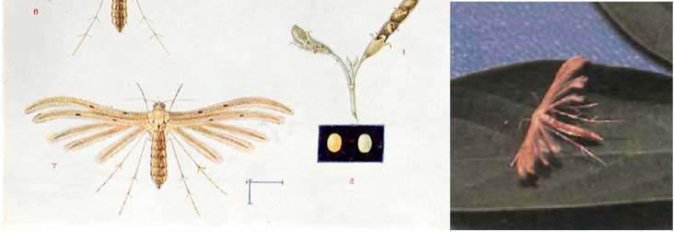

Slide 16
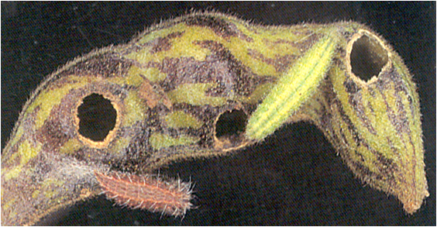

Slide 17
LIFE CYCLE:
Minute, single eggs are laid on flower buds and pods.
Egg period is 4-5 days.
Larval period is 14-30 days.
Pupation is on pod surface or burrows of infested pods.
Pupa is also fringed with short hairs.
Pupal period is 4-8 days.
Pupa looks like larva except for the colour which is brown.

Slide 18
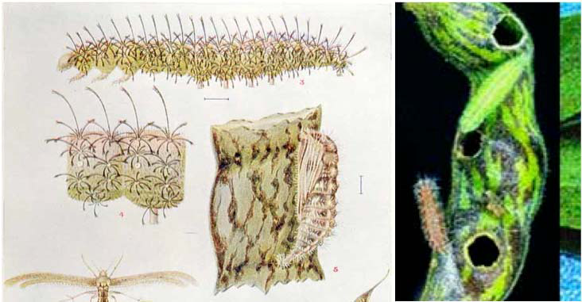

Slide 19
NATURE OF DAMAGE:
Tiny caterpillar scrapes the pod surface and cuts a hole and thrusts the head into it and feeds on seed by remaining outside.
The caterpillars bore into green pods and feed on the developing seeds which are more or less completely devoured or eaten away and also feeds on flower buds.
This pest is usually found at flowering and known to cause heavy damage to redgram.
Attack by this pest can cause severe bud, flower and pod drop.
The larva never enters inside the pod and feeds remaining outside the pod.

Slide 20
SYMPTOMS OF DAMAGE:
Small hole on seeds.
Dropping of flower buds and flowers in severe cases.
Completely eaten and devoured seeds.
MANAGEMENT
Collection of caterpillars by shaking shoots and their destruction in initial stages.
Apantels sp parasitise larvae.
Foliar sprays should commence at 50% flowering with or quinalphos 2 ml/l or carbaryl 3 g/l

Slide 21
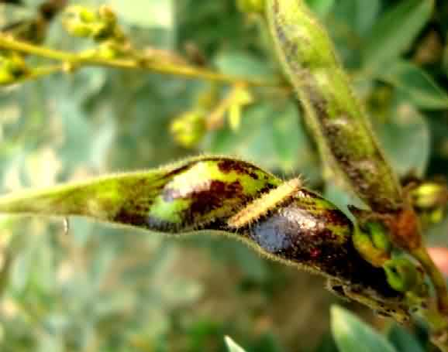

Slide 22
REDGRAM POD FLY Malanagromyza obtusa (Agromyzidae: Diptera)
DISTRIBUTION:
It is a major pest of redgram, soybean and cowpea.
Attack is more in north and central India and Karnataka.
In North India 80 per cent damage to crop is reported.
The other hosts are sorghum, cowpea, safflower, bhendi etc.
APPEARANCE:
Adult is a black fly with strong legs and ovate abdomen.
Its eye are distinct, wings are clear veined, brownish yellow at their bases.
Maggot is creamy white in colour.

Slide 23
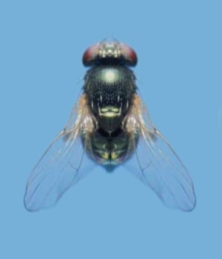

Slide 25
LIFE CYCLE:
Small black fly thrusts its minute eggs into the tissues of the tender pod and flower buds.
Fly pierces pericarp with ovipositior and lay eggs which are seen like needles projecting inwards from the pods.
Female fly lays 4 eggs per pod and 80 eggs in its life time.
Egg period is 3 days.
Larval period is 6-10 days.
Full grown maggot pupates inside larval grooves in pods. Pupal period is 8-12 days.
Adults emerge by cutting the thin spot already made by maggot.

Slide 26
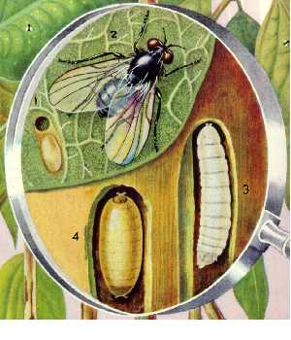

Slide 27
NATURE OF DAMAGE:
Tiny maggots burrow into pods and feed on young seeds.
In affected pods, no visual symptoms are observed regarding its entrance.
Initially larva bores into epidermis without rupturing the seed coat.
In the second and third instar stages, the larva bores into cotyledons and in most instances one seed is sufficient for the maggot to complete its development.
The final instar larva leaves the seed pupates either in the pod cavity or in the pod wall tissue.
The damaged seeds are unfit for consumption.

Slide 28
SYMPTOMS OF DAMAGE:
Discolouration of the infested pods visible in green podded varieties.
At the later stage of infestation, the holes about 1mm in diameter covered with a thin membrane readily seen on the infested pod.
Exit holes visible after the adult emergence.

Slide 29
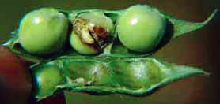
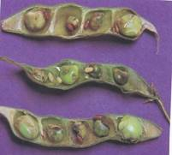

Slide 30
MANAGEMENT
Early sowing in endemic areas
Removal of affected pods of first brood during winter.
Pre-pupal stage is parasitized by Euderus agromyzae and pupa is parasitized by Euderus lividus.
Foliar sprays with monocrotophos 1.5 ml/l or dimethoate 2 ml/l are effective against larva and endosulfan 2 ml/l against adult flies.

Slide 31
STEM FLY Ophiomyia phaseoli Agromyzidae: Diptera
The pest attacks the crop at early stage.
It is a major pest of cowpea, soybean, blackgram and greengram.
Eggs are thrusts into tender part of the stem/ petiole.
Maggot tunnels the stem and feeds on the internal contents.
When the stem is split open the distint tunnel can be observed along with excreta.
Drooping of the first two leaves and wilting of the plants are observed due to the damage.

Slide 32
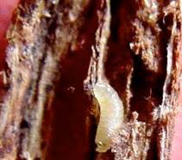

Slide 33
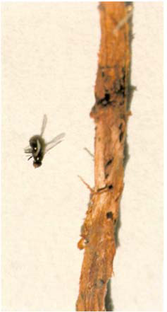

Slide 34
Growing varieties like LBG-611, LBG-402 are promising against stem fly, high seed rate, seed treatment with carbosulfan @ 40g/kg seed or thiamethoxam @ 4g/kg and foliar application of monocrotophos 1.6ml/l or acephate 1.5g/l are effective measures.

Slide 35
SPOTTED POD BORER Maruca vitrata Pyralidae: Lepidoptera
Moth is with dark brown forewings with white club shaped cross band along anterior margin and white hindwings with dark brown border.
The caterpillar with short hairs on black warts webs together the flowers and feeds on them.
It also bores into pods at one end and eats up the ripening seeds.
Mass excreta can be seen at the entrance of larval burrow.

Slide 36
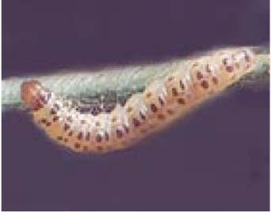
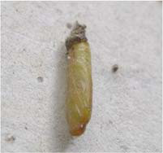
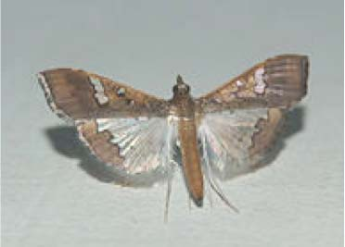

Slide 37
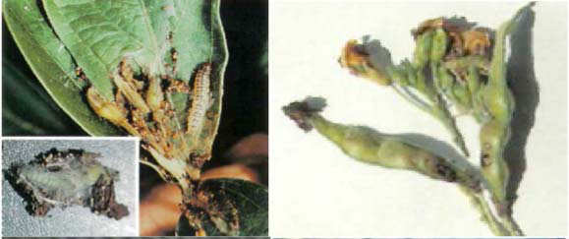
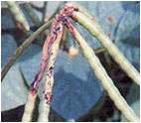

Slide 38
MANAGEMENT:
Foliar spray from flower bud initiation with combination of chlorpyriphos 2.5 ml/l or quinalphos 2 ml/l or novaluron 0.75 ml/l or spinosad 0.75 ml/l or lamda cyhalothrin 1 ml/l in combination with dichlorvos 1 ml /l at wekly intervals is effective

Slide 39
BEAN APHIDS Aphis craccivora Aphididae: Hemiptera
Both nymphs and adults suck sap from tender leaves and shoots resulting in twisting of leaves, poor pod development, devitalization of plants and sooty mould. It acts as a vector of Rosette disease in groundnut and broad bean virus in pea.
It is s polyphagous pest. Redgram and other pulses, citrus etc are other host plants. Spraying with tobacco decoction (1 kg tobacco boiled in 10 lit of water for ½ hour and make up to 30 lit + 100 g soap) and systemic insecticides like dimethoate 2 ml/l or phosphamidon 2 ml/l or malathion 2 ml/l are effective.

Slide 40
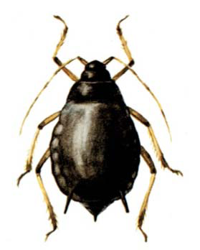

Slide 41
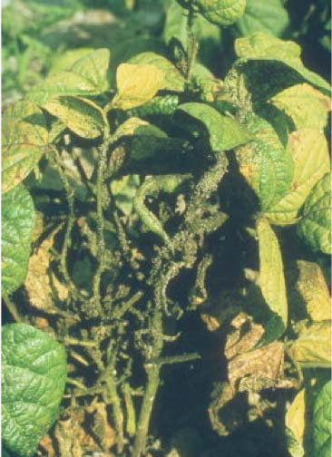

Slide 42
REDGRAM POD BUG Cavigralla gibbosa, Riptortus linearis Coreidae: Hemiptera
Hundreds of nymphs and adults suck sap from the shoots and pods.
Shoots fade, pods shrivel and seeds with dark patch loose germination capacity due to the feeding of bugs.
Collection of bugs and their destruction by dipping into kerosinized water and dusting or spraying with carbaryl 10D 10 kg/ac or foliar spray with dimethoate 2 ml/l or monocrotophos 1.5 ml /l are effective.

Slide 43
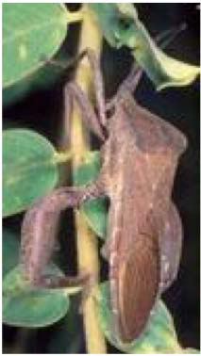
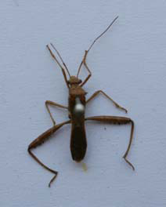
Riptortus linearis Anoplocnemis phasiana

Slide 44
LEAFHOPPER Empoasca kerri Cicadellidae: Hemiptera
Small greenish yellow nymphs and adults suck sap from leaves resulting in severe case, the leaves turn brown, dry and brittle, a condition called “hopper burn”.
Attacked leaflets become cup shaped and yellow at edges. Heavy attack result in the leaflets turning red-brown with subsequent defoliation and stunting.
Collection of bugs and their destruction of infested leaves, seed treatment with carbosulfan @ 30-40g/kg seed, spraying with thiamethoxam 0.4g/l or imidacloprid 0.4 ml/l have been found effective.

Slide 45
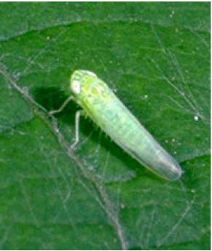

Slide 46
GREEN POD BORING CATERPILLAR OR LENTIL POD BORER Etiella zinckenella Pyralidae: Lepidoptera
It occurs on redgram, horsegram and other pulses and green manure crop like sunhemp.The larvae feed on floral parts, newly formed pods and seeds in developing pods. Faecal pellets inside damaged pods and small round holes on redgram pods plugged with excreta can be noticed.
Management of gram caterpillar is effective against this pest.

Slide 47
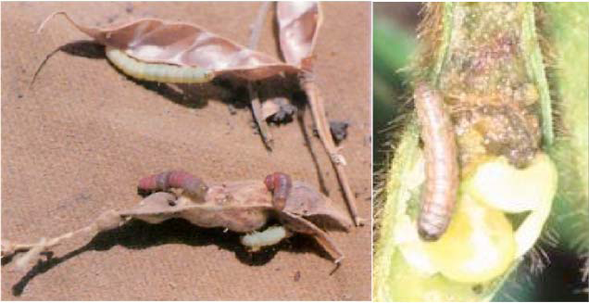
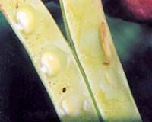

Slide 48
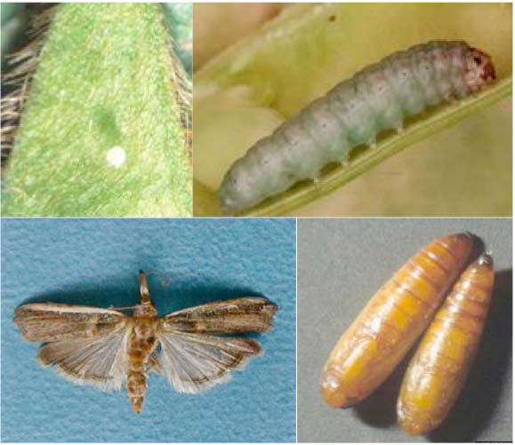

Slide 49
RED GRAM MITE Aceria cajani Eriophyidae: Acarina
It infests underside of tender leaves, causing yellowing of leaves and suppression of flowering and fruiting.
It transmits pigeonpea sterility mosaic virus. A single eriophyiid mite is sufficient to transmit disease.
Disease can be identified from a distance as patches of bushy, pale green plants without flowers or pods.
Leaves are small, show a light and dark green mosaic pattern
Destruction of perennial and volunteer pigeonpea and the ratooned growth of harvested plants provide reservoir of mite vectors and pathogens, growing tolerant varieties like ICPL 87119, ICPL 227, Jagruthi, Bahar and foliar spray with dicofol 3 ml/l or wettable sulphur 3g/l in early stages of plant growth will control mite vector

