Slide 1
Digital Marketing & Marketing Communications – Session I
Learning Objectives:
After completion of this session, the learner will be able to know:
What is the difference between domain and website?
What is the difference between traffic, leads and flow?
By:
Dr. Sisir Ranjan Dash
School of Management
Digital Marketing Planning and Structure
Topics to be Covered:
Understanding Traffic
Understanding leads
What is a domain?
What is a website?
What is the difference between domain and website?
Meaning of flow

Slide 2
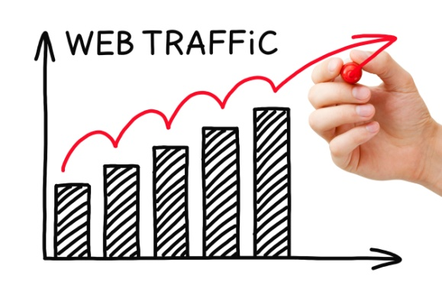
Understanding Traffic
Website traffic refers to web users who visit a website. Web traffic is measured in visits, sometimes called "sessions," and is a common way to measure an online business effectiveness at attracting an audience.
Web traffic is important — but not the only thing:
How long did users stay?
What % of users made a purchase?
How much does it cost to bring in a visitor?

Slide 3
Understanding ‘Leads’ in Digital Marketing
What is a lead in digital marketing?
A lead in digital marketing is the communication details that you use to contact your customer or potential customer about your product or service..
01
Why leads are important in digital marketing?
The main purpose of sourcing, collecting and storing leads is so that you can have the ability to broadcast messages to the people within the niche group regularly, with items that would be of interest to the group..
02
How leads can be obtained?
Some people use automatic email delivery systems, known as autoresponders. Messages are loaded into the autoresponder service, and sent at timed intervals, and sometimes marketers use broadcast messages once they have built a sufficient email list.
Leads can be obtained by advertising in newsletters and by making joint venture deals with other businesses in the niche group, of whom already have a profitable and responsive email list.
03

Slide 4
Thank You
My Curiosity is all Yours

