Slide 1

Centurion
UNIVERSITY
INSECT PESTS OF POMEGRANATE
Centurion University of Technology and Management
Shaping Lives...Empowering Communities...

Slide 2
PESTS OF POMEGRANATE
POMEGRANATE BUTTERFLY / ANAR BUTTERFLY
Deudorix isocrates
Lycaenidae: Lepidoptera
DISTRIBUTION
It is the most important and destructive pest of pomegranate and distributed throughout the country, also infesting guava, annona, apple, ber, citrus, litchi, tamarind, wood apple, soap nut, etc.
APPEARANCE
Butterfly is bluish brown with an orange spot on each of the forewings and black spots on the hindwings with a tail like extension at the lower margin of hindwings.
It is active in bright sun

Slide 3
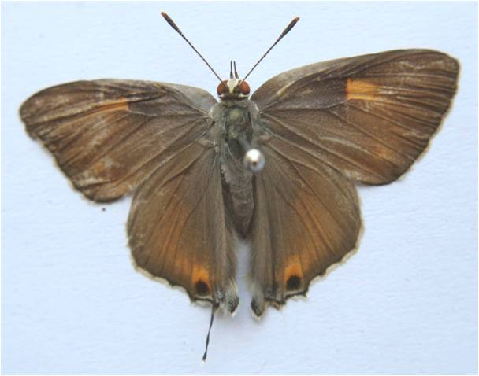

Slide 4
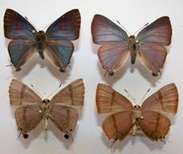

Slide 5
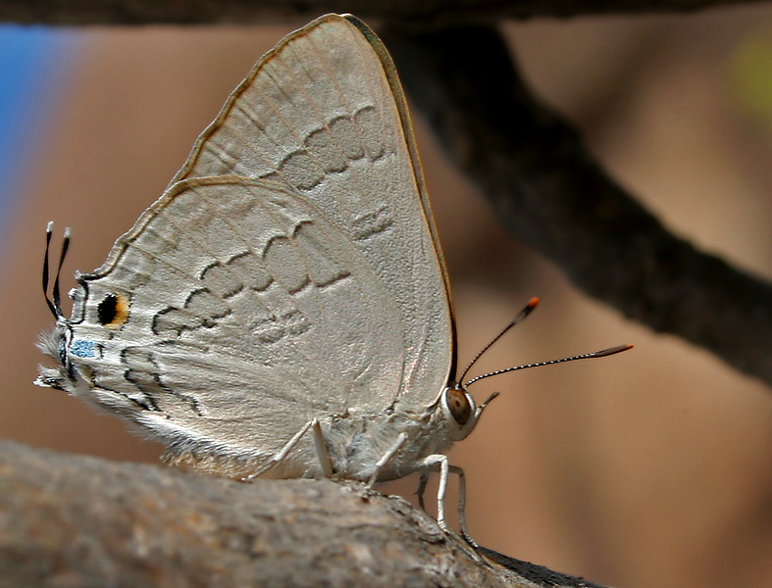

Slide 6
Caterpillar is stoutly built dirty brown in colour, with light patches, a few short hairs and measures about 16-20 mm long
LIFE HISTORY
Eggs are laid singly on calyx of flowers or tender fruits.
Egg period is 7-10 days.
Larval period is 18-47 days
The full grown larva comes out, secures the stalk of the fruit to the stem with a silky secretion, returns to inside of fruits and pupates on fruit stalk.
Pupal period 7-34 days.
Total life cycle takes about 1-2 months.

Slide 7
There may be 4 overlapping generations in a year
NATURE OF DAMAGE
Larva after hatching bores into the fruit and feeds on the seeds. Entry hole heals up.
The fruit appears healthy but the caterpillar inside feeds on pulp and seeds just below the rind.
It is only when the grown up caterpillar comes out, a round hole is seen through which juices come out.
A single fruit may harbour half a dozen caterpillars..

Slide 8
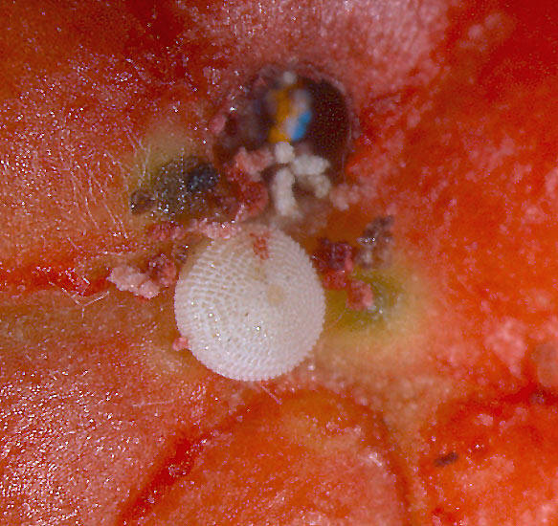

Slide 9
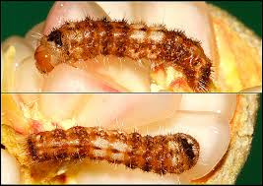

Slide 10
SYMPTOMS OF DAMAGE
Offensive smell and excreta of caterpillar at the entry hole.
The affected fruits ultimately falling down
Feeding injury also cause rotting of the fruits. Up to 50% fruit damage is observed
MANAGEMENT
Destruction of fallen infested fruits checks the spread.
Removal of flowering weeds especially of Compositae family.
Though expensive, bagging of fruits with polythene or paper bags or cloth bags soon after the fruit set prevents the pest attack

Slide 11
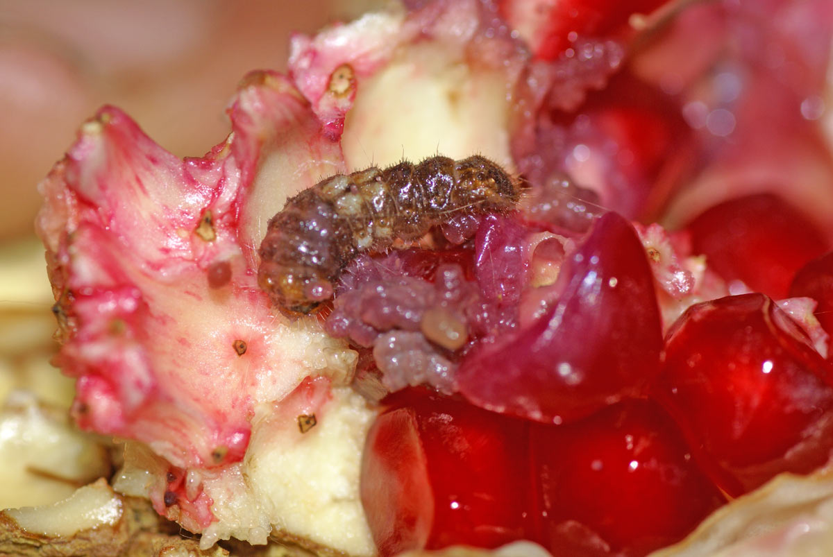

Slide 12
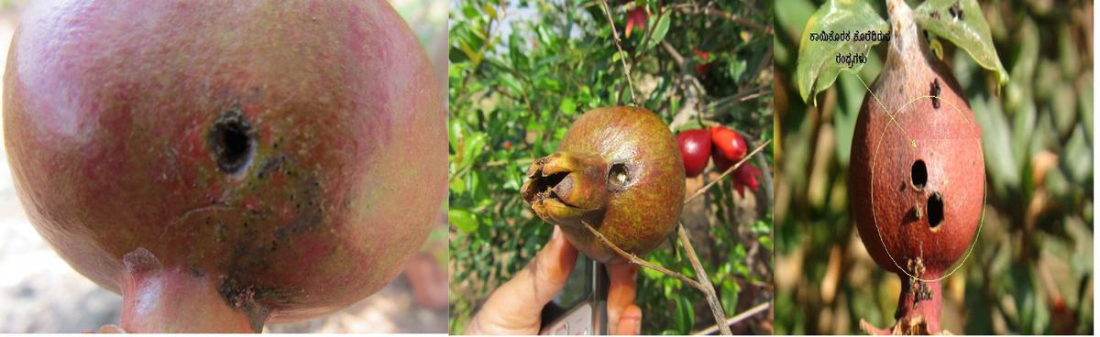

Slide 13
During flowering and flower bud stage, endosulfan 2ml/l is recommended.
After 15 – 20 days,a spray application of dichlorvos @ 1 ml. /L or carbaryl 3g

Slide 14
THRIPS
Anaphothrips oligochaetus (Flower and fruit thrips)
Rhipiphorothrips cruentatus Leaf thrips
Scirtothrips dorsalis
Thripidae: Thysanoptera
These are found through out country. A. oligochaetus infests flower stalks, sepals, petals and fruits with their rasping sucking type of feeding.
As a result, flowers are shed and fruits show scab like rough surface.
R. cruentatus and S. dorsalis lacerate the leaves and suck oozing out sap causing curling of leaves.
At flower bud initiation, foliar spray with dimethoate 2ml/l or fipronil 2ml/l is effective.

Slide 15
FRUIT SUCKING MOTHS
Eudocima fullonica E. materna
Noctuidae: Lepidoptera
Moths pierce the fruits with their proboscis for feeding thus causing injury.
The detailed biology and their management have been furnished under pests of citrus.
Fruits show tiny holes from which juices oozes out when pressed.
Later fungi and bacteria accelerate rotting.

