Slide 1

Centurion
UNIVERSITY
PESTS OF VEGETABLE CROPS AND
THEIR MANAGEMENT
Centurion University of Technology and Management
Shaping Lives...Empowering Communities...

Slide 2
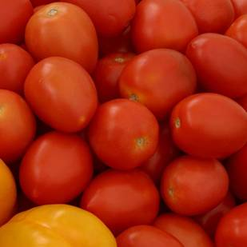
INSECT PESTS OF TOMATO AND THEIR MANAGEMENT

Slide 3
Common name | Scientific name | Family | Order
1. Tomato fruit borer | Helicoverpa armigea | Noctuidae | Lepidoptera
2. Serpentine leaf miner | Liriomyza trifolii | Agromyzidae | Diptera
3. Leaf eating caterpillar | Spodoptera litura | Noctuidae | Lepidoptera
4. White fly | Bemecia tabaci | Aleyrodidae | Hemiptera
5. Thrips | Thrips tabaci | Thripidae | Thysanoptera
6. Striped mealy bug | Ferrisia virgata | Psuedococcidae | Hemiptera

Slide 4
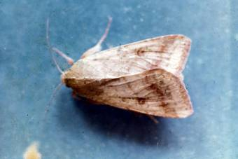
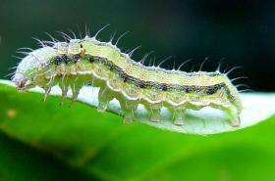
TOMATO FRUIT BORER
Helicoverpa armigera: Noctuidae: Lepidoptera
APPEARANCE :
Moth is stout, medium sized with brownish/greyish forewings with a dark cross band near outer margin and dark spots near costal margins with a wing expanse of 3.7 cm.
Caterpillars are of varying color. Body covered with radiating hairs. Initially brown and later turn greenish with darker broken lines along the side of the body.

Slide 5
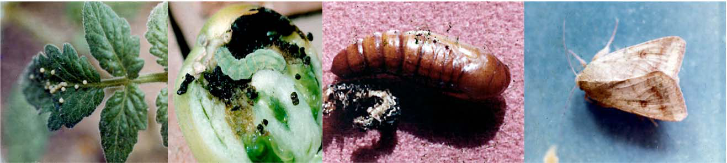
LIFE HISTORY:
The spherical, yellowish eggs are laid singly on tender parts and buds of plants. The egg period lasts for 2-4 days.
The larval period lasts for 18-25 days.
The full grown caterpillar pupates in the soil in an earthen cell and emerges in 16-21 days.

Slide 6
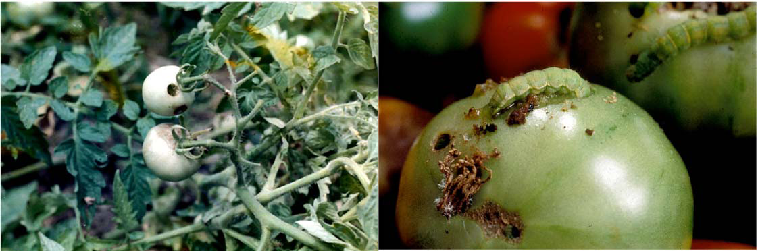
SYMPTOMS OF DAMAGE
Single caterpillar can destroy 2-8 fruits.
The larvae bore into the fruits and make them unfit for consumption and marketing.
Presence of circular holes and larva feeding by thrusting only a part of its body into tomato fruit

Slide 7
Management
Collect and destroy the infected fruits and grown up larvae.
*Grow simultaneously 40 days old American tall marigold and 25 days old tomato seedling at 1:10 rows
Setup pheromone trap with Helilure at 12/ha
Collection and destruction of damaged fruits and grown up caterpillars.
Release Trichogramma pretiosum @ 1 lakh nos. /ha/release at an interval of 7 days starting from flower initiation stage based on ETL of 10% damage.

Slide 8
For Helicoverpa armigera: HaNPV 1.5 x 10¹² POBs/ha i.e. NPV of H. armigera 0.43% AS @ 3.0 ml/lit or 2 % AS @ 1.0 ml per lit
For Spodoptera litura: Sl NPV 1.5 x 10¹² POBs/ha
Provide poison bait with carbaryl 50 WP 1.25 kg, rice bran 12.5 kg, jaggery 1.25 kg and water 7.5 lit/ha
Spray Bacillus thuringiensis 2g/lit or any one of the following insecticide

Slide 9
InsecticideDose
Azadirachtin 1.0 % EC (10000 ppm)2.0 ml/ lit.
Indoxacarb 14.5 % SC8 ml/10 lit.
Flubendiamide 20 WG5 g/10 lit.
Novaluron 10 % EC7.5 ml/10 lit.
Phosalone 35 % EC13 ml/10 lit.
Quinalphos 25 % EC1.0 ml/ lit.

Slide 10
SERPENTINE LEAF MINER
Liriomyza trifolii Agromyzidae: Diptera
***It has been introduced pest into India through chrysanthemum cuttings.
APPEARANCE:
It is a pale yellowish fly, measuring 1.5 mm in length.
Maggots are minute, apodous, pale orange yellowish in colour.

Slide 11
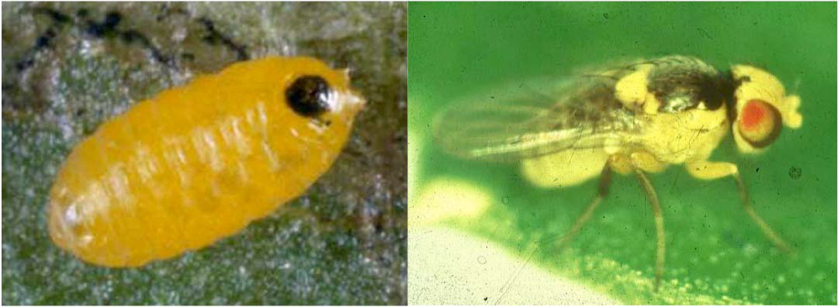

Slide 12
LIFE HISTORY:
The female fly punctures upper surface of leaf to lay eggs singly. The egg hatches in 4 days.
Full grown maggot measures 3 mm.
Larval duration is about 7 days.
Pupation is in soil.
Some pupae are found in leaves.
Total life cycle takes 3 weeks.
Generally it does not cause economic damage.

Slide 13
SYMPTOMS OF DAMAGE:
Maggot feeds on chlorophyll mining in between epidermal layers.
Leaves with serpentine mines
Drying dropping of leaves in severe cases
MANAGEMENT:
Collect and destroy mined leaves
Spray NSKE 5%

Slide 14
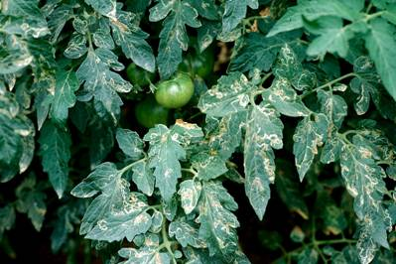
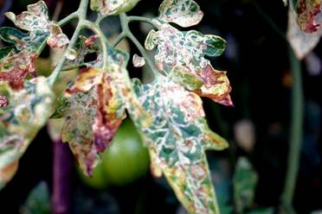
Leaf mining damage on leaves

Slide 15
Leaf eating caterpillar
Spodoptera litura, Noctuidae, Lepidoptera
APPEARANCE:
Identification of the pest
Egg: -masses appear golden brown
Larva: - pale greenish with dark markings
Gregarious in the early stages
Adult
Forewings – brown colour with wavy white marking
Hind wings- white colour with a brown patch along the margin

Slide 16
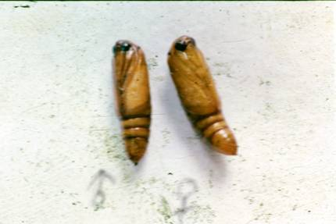
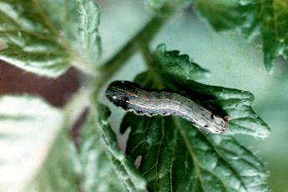
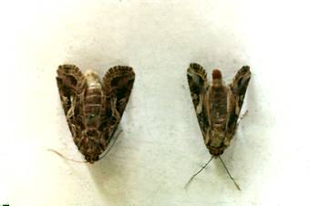
Larva
Pupa
Adult

Slide 17
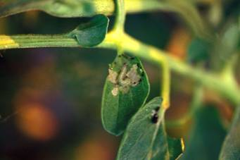
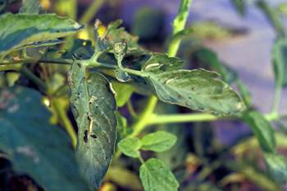
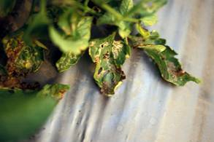
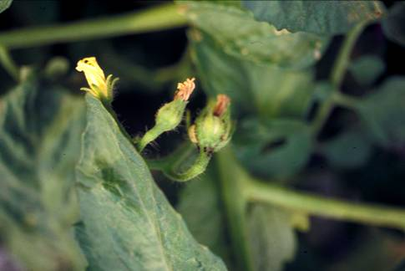
SYMPTOMS OF DAMAGE
Young larva scrap leaves on ventral surface
Grownups defoliate crops
Larval feeding
scrapping
Foliar damage
flower damage

Slide 18
Management
Plough the soil to expose and kill the pupae
*Grow castor along border and irrigation channel as trap crop
Flood the field to drive out the hibernating larvae
Set up light trap @1/ha
Pheromone traps (Pherodin SL) @ 15/ ha to attract male moths
Collect and destroy egg masses in castor and tomato
Hand pick grown up larvae and kill them
Spray Sl NPV @ 1.5 X 1012 POBs / ha + 2.5 Kg crude sugar + 0.1 % teepol
Poison bait {Rice bran 5 Kg + Molasses or Brown sugar 500g + Carbaryl 50 WP 500g+ 3lit of water/ha}
Mix the ingredients well – Kept around the field in the evening hours
Spray chlorpyriphos 20 EC 2lit/ha or dichlorovos 76 WSC 1 lit/ha

Slide 19
Whitefly: Bemisia tabaci
Symptoms of damage
Chlorotic spots
Yellowing
Downward curling and drying of leaves.
** Vector of tomato leaf curl disease.

Slide 20
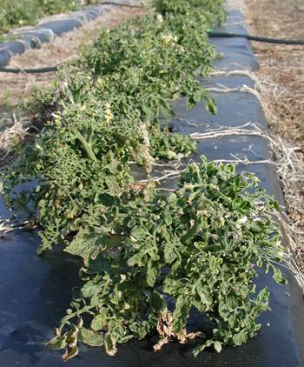
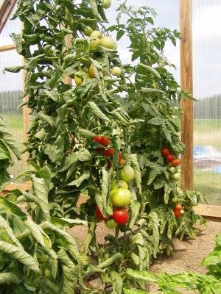
Tomato leaf curling

Slide 21
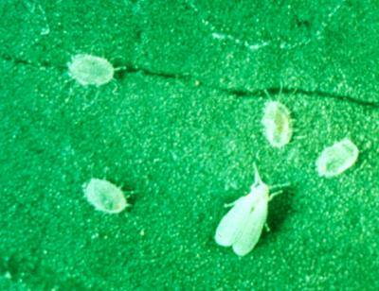
Marks of Identification
Egg-pear shaped, light yellowish, stalked
Nymph: On hatching - Oval, scale-like, greenish white
Adult: White, tiny, scale-like adults

Slide 22
Management
Uproot and destroy the diseased leaf curl plants
Use nitrogen and irrigation judiciously.
Remove alternate weed host Abutilon indicum
Use yellow sticky traps at 12/ha to attract and kill insects.
Apply carbofuran 3% G @ 40 kg /ha or spray any one of the following insecticides
Dimethoate 30 % EC1.0 ml/lit. Malathion 50 % EC1.5 ml/ lit. Oxydemeton –Methyl 25 % EC1.0 ml/ lit. Thiamethoxam 25 % WG4.0 ml/10 lit.

Slide 23
5. Thrips: Thrips tabaci, F. rankliniella
Symptoms of damage
Silvery streaks on leaf surface
pre-mature dropping of flowers
Bud necrosis.
***Vector of tomato spotted wilt virus.
Identification of the pest
Nymphs: yellowish
Adult: dark coloured with fringed wings

Slide 24
Management
Mechanically uproot the diseased plants and destroy them
Use yellow sticky traps @ 15/ ha
Release larvae of Chrysoperla cornea @ 10,000/ ha
Spray methyl demeton 25 EC @ 1lit/ha or dimethoate 30 EC @1lit/ha

Slide 25
Striped mealybug: Ferrisia virgata
Symptoms of damage
Presence of white, cottony mealy bugs on the leaves and twigs
Stunted growth.
Identification of the pest
Crawler: Yellowish to pale white in colour
Adult: Females apterous, long, slender covered with white waxy secretion

Slide 26
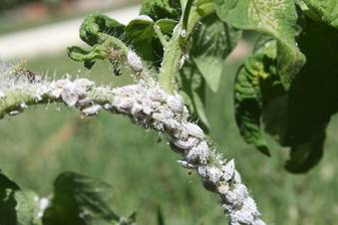
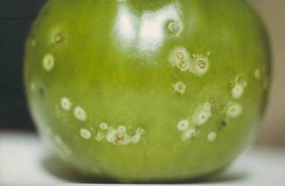
Nymphs and adults
Spot like canker

Slide 27
Management
Spray neem oil 0.5% along with teepol 1 ml/lit
Spray any following insecticides
Phosphomidon 40 SL 2ml/lit
  Imidacloprid 80.5 SC 0.6 ml/lit
  Chlorpriphos 20 EC 2ml/lit
  Thiamethoxam 25 WSG 0.6 mg/lit
  Profenophos 2ml/lit

