Slide 1
Centurion
UNIVERSITY
PESTS OF VEGETABLE CROPS AND
THEIR MANAGEMENT
Centurion University of Technology and Management
Shaping Lives...Empowering Communities...

Slide 2
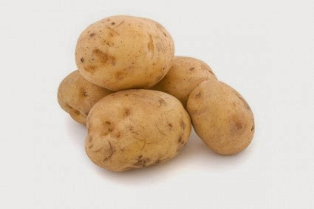
Insects pests of Potato and Sweet potato

Slide 3
POTATO TUBER MOTH Phthorimaea operculella Gelechiidae: Lepidoptera
It is one of the introduced pests into our country from Italy through Bombay port and is also found feeding on brinjal, tomato and tobacco leaves
APPEARANCE
The adult is a delicate moth with 7 mm body length and wing expanse is 20 mm. Forewings are greyish brown in colour and tapering.
The hind wings are whitish in colour. Both wings are fringed with long hairs along the apical and the basal margins. Moth has conspicuously long antennae.

Slide 4
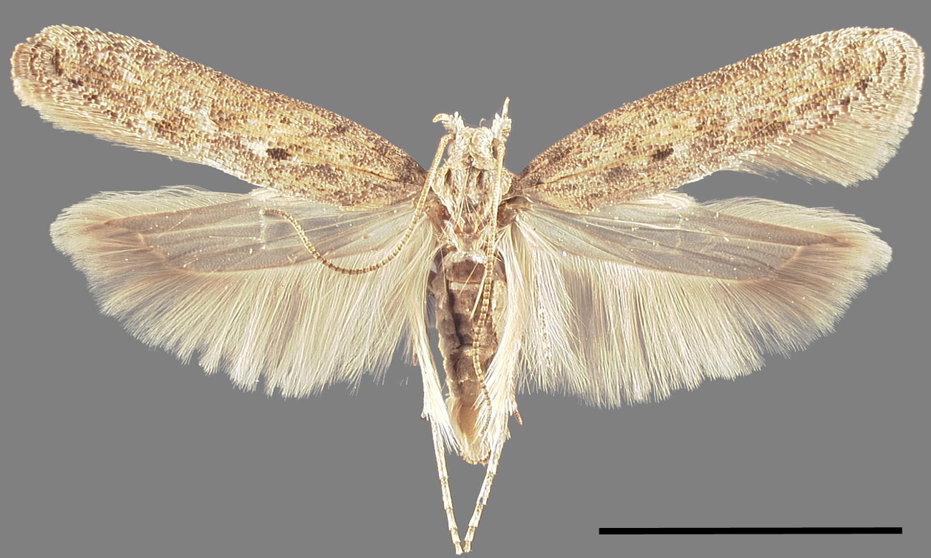

Slide 5
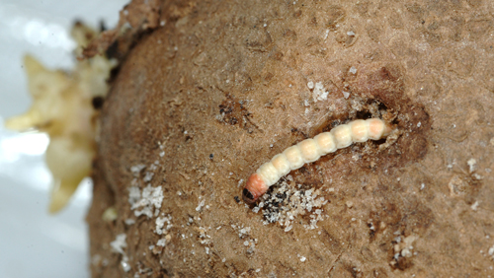

Slide 6
Caterpillar is white in colour with dark brown head and prothoracic shield with a few scattered short hairs on the body.
LIFE HISTORY
On emergence, the moths mate and the female begins to lay eggs within 24 hours.
Each female lays 100-150 eggs in 4-5 days.
Eggs are laid around the eyes or cracks of the skin of the exposed tubers.
Eggs hatch in about 3 -6 days.

Slide 7
Larval period is 5-16
Full grown caterpillar comes out of the gallery and pupates on the outside of tubers or any other convenient place, constructing a cocoon of silk and frass material.
Pupa is pale brown and pupal period is about a week.
8 -9 generations are completed in one storage season.
NATURE OF DAMAGE
The caterpillar acts as a leaf miner in field, boring into petiole and main shoots and at later stages attacks underground tubers.

Slide 8
In storage, the damage ranges from 30-70% under improper storage. The damage results in
SYMPTOMS OF DAMAGE
Loss of leaf tissue, death of growing points, weakening or breaking of stems (field)
Irregular shaped galleries with excrement near tuber eyes
MANAGEMENT
Frequent earthing up to cover the exposed tubers
Collection and destruction of affected tubers
Spraying of carbaryl 3 g/l(600g in 200l of spray fluid)

Slide 9
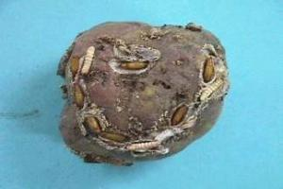

Slide 10
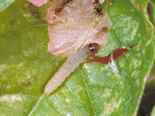
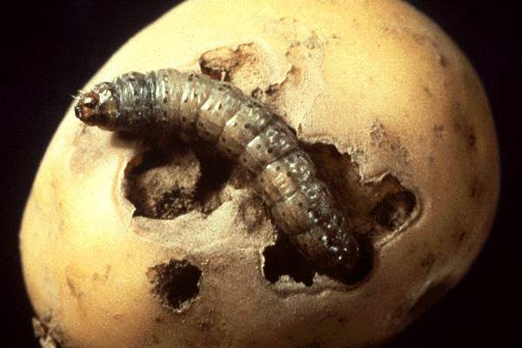

Slide 11
In the stores
Storing the tubers under 3 cm thick layer of sand
Storage bags in the godowns sprayed with malathion 3ml/l
Fumigating the stores with carbon disulphide or carbon tetrachloride or methyl bromide

Slide 12
SWEET POTATO WEEVIL Cylas formicarius Apionidae: Coleoptera
APPEARANCE
It is a wingless, ant–like steel black weevil with a brown elongated snout and thorax.
The grub is pale yellow in colour and legless.
LIFE HISTORY
The female bites small cavities on veins and tubers and lays about 200 eggs singly.
The eggs hatch in 3-5 days.
The grub pupates inside larval burrow in vine or tuber.
Weevil emerges after 7 -10 days.
Total life history takes about 4 -6 weeks

Slide 13
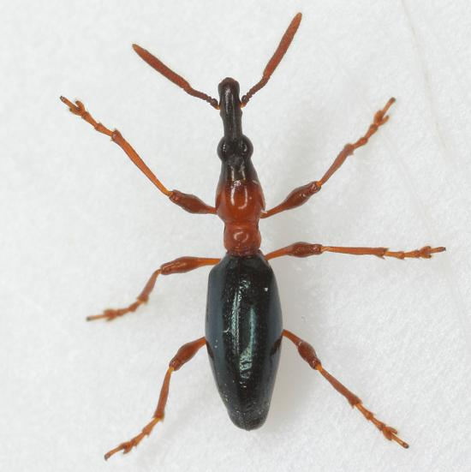

Slide 14
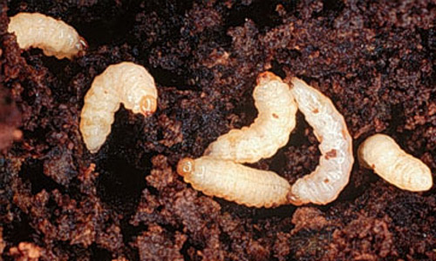

Slide 15
The grub pupates inside larval burrow in vine or tuber
Weevil emerges after 7 -10 days.
Total life history takes about 4 -6 weeks
NATURE OF DAMAGE
The grubs bore into the stems of vines and also into the tubers in the field as well as in storage, feeding on the inner contents and spoiling them.
The adult weevil also feeds on leaves, vines and tubers.

Slide 16
SYMPTOMS OF DAMAGE
Their presence inside the tubers can be detected by the development of dark black patches on outside of the tuber
The tubers become unfit for consumption.
MANAGEMENT
In field
Infested portions should be destroyed. Healthy vines should be used for planting purposes.
Treating planting material by immersing in a solution of chlorpyriphos 2.5ml+ carbendazim 3g per litre of water.
The cracks in the field closed by hoeing to minimize damage

Slide 17
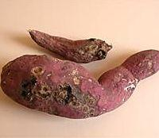

Slide 19
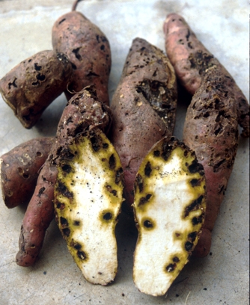

Slide 20
Earthing up at 60 DAP
Use of pheromone traps @ 1/100 sq.m.for mass trapping and destruction of males even up to 15 days after harvest.
Crop rotation
In the stores:
Management in stores is same as under potato tuber moth

Slide 21
TORTOISE BEETLES -Aspidomorpha miliaris Chirida bipunctata Cassida circumdata Cassididae: Coleoptera
The beetle has its thorax and wing cases (elytra) flattened and widened to cover the head and greater part of legs like the carapace of tortoise, hence the name tortoise beetle.
The female lays eggs singly on lower side of leaves.
The grubs feed by scraping the surface tissue of the leaves. They have characterstic habit of carrying on their backs, the exuviae and excrements.
The damage is caused by both adults and grubs feeding on plant parts. Pupation takes place on the leaves.
Total life cycle takes about 2 -4 weeks.
Foliar spray with carbaryl 3 g or fenitrothion 2ml/l is effective

Slide 22
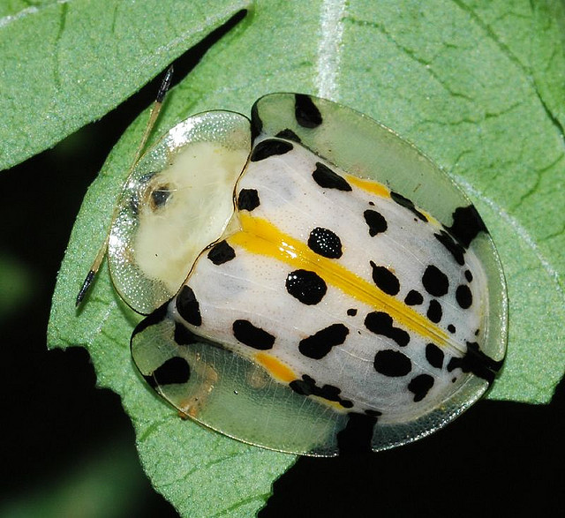
Aspidomorpha miliaris

Slide 23
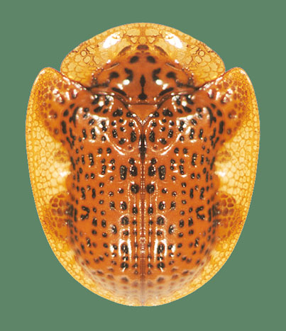
Chirida bipunctata

Slide 24
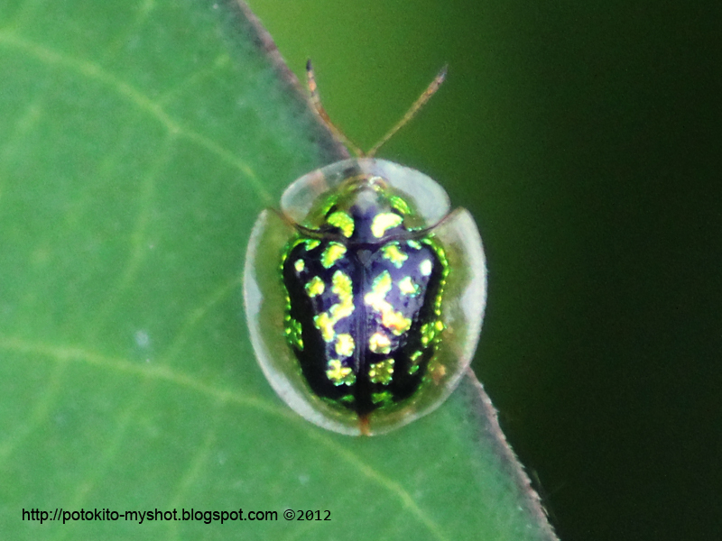
Cassida circumdata

