Slide 1

Centurion
UNIVERSITY
PESTS OF ORNAMENTAL PLANTS
Centurion University of Technology and Management
Shaping Lives...Empowering Communities...

Slide 2
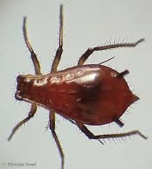
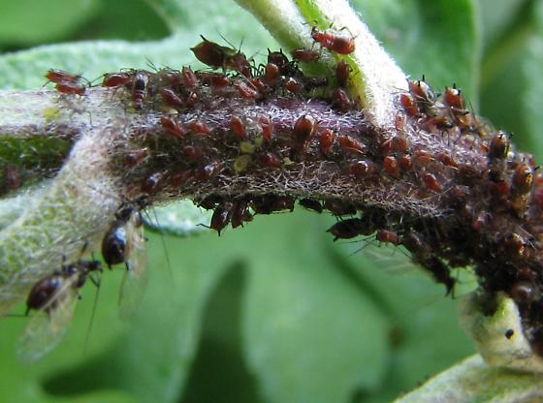
CHRYSANTHEMUM BLACK APHIDS
Macrosiphoniella sanborni
Aphididae: Hemiptera
Nymphs and adults infest tender shoots sucking sap and causing yellowing and drying of tender shoots, devitilization and stunted growth.
Foliar sprays with malathion 2ml/l or monocrotophos 1.6ml/l or phosphamidon 0.5ml/l are effective.

Slide 3
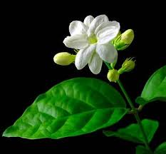
Centurion
UNIVERSITY
PESTS OF JASMINE
Centurion University of Technology and Management
Shaping Lives...Empowering Communities...

Slide 4
JASMINE STINK BUG
Antestiopsis cruciata
Pentatomidae: Hemiptera
Nymphs and adults suck sap from flowers, tender plant portions causing heavy damage to flowers and yellowing and drying of leaves.
Sometimes, they feed in large numbers on tender shoots and buds preventing flower formation.
Foliar spray with malathion 2ml/l or monocrotophos 1.6ml/l or phosphamidon 0.5ml/l after removing all flowers including very tender ones is effective.

Slide 5
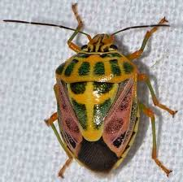

Slide 6
JASMINE BUD WORM
Hendecasis duplifascialis
Pyralidae: Lepidoptera
Greenish caterpillar attacks two or three buds and buds are webbed together by silken threads.
Petals are eaten away by larva resulting in buds with bore holes, webbings soiled with excreta.
Pupation is in soil.
Foliar sprays with malathion 2ml/l or dimethoate 2ml/l or endosulfan 2ml/l are effective.

Slide 7
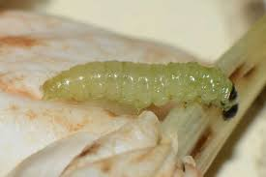
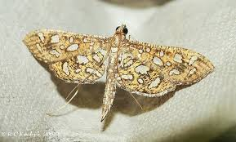

Slide 8
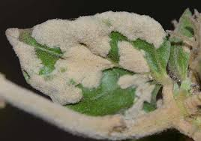
JASMINE GALL/ FELT MITE
Aceria jasmini
Eriophyidae: Acarina
It produces white felt like hairy outgrowth on the leaf surface, tender stems and buds leading to stunted growth and suppression of flower development
Dusting sulphur 8 – 10 Kg/ac is recommended.

Slide 9
Centurion
UNIVERSITY
PESTS OF ROSE
Centurion University of Technology and Management
Shaping Lives...Empowering Communities...

Slide 10
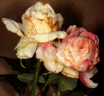
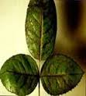
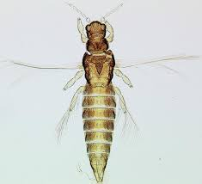
THRIPS
Rhipiphorothrips cruentatus
Thripidae: Thysanoptera
Nymphs are reddish and adults are dark brown or black in colour.
Both nymphs and adults infest leaves and flowers as a result, leaves turn sickly, crinkled and malformed and flower buds fail to open, become deformed.
Foliar spray with carbaryl 3g/l or malathion 2ml/l or monocrotophos 1.6 ml/l or phosphamidon 0.5ml/l after removing flowers including tender ones.

Slide 11
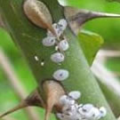
SCALE
Lindingaspis rossi, Aonidiella aurantii
Diaspididae: Hemiptera
Red scales completely cover the stem.
Both nymphs and adults suck sap causing drying and death of plants
Rubbing off scales with cotton soaked in kerosene, diesel or methylated spirit, cutting and burning the affected branches, foliar sprays with malathion 2ml/l two roundsm, at pruning and during March – April are found to be effective

Slide 12
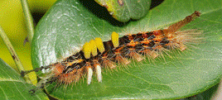
ROSE LEAF CATERPILLARS
Euproctis fraterna
Lymantriida Lepidoptera
Caterpillars defoliate the plants. Foliar spray with monocrotophos 1.6 ml/l or phosphamidon 2 ml/l or carbaryl 3 g/l after removing flowers is effective

Slide 13
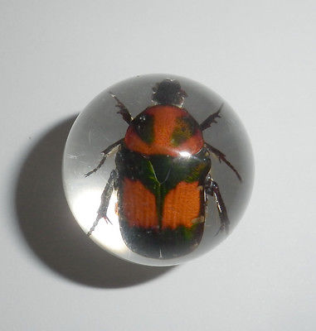
ROSE CHAFER BEETLE
Oxycetonia versicolor
Cetoniidae: Coleoptera
Beetles are red coloured with black markings.
Adults feed on leaves, flowers during night causing irregular feeding marks on buds and flowers.
Soil drenching with lindane or some other soil insecticide around rose plants, dusting malathion 5D 15 Kg/acre in evening hours or foliar spray with endosulfan 2ml/l are effective.

