Slide 1

Centurion
UNIVERSITY
PESTS OF VEGETABLE CROPS AND
THEIR MANAGEMENT
Centurion University of Technology and Management
Shaping Lives...Empowering Communities...

Slide 2
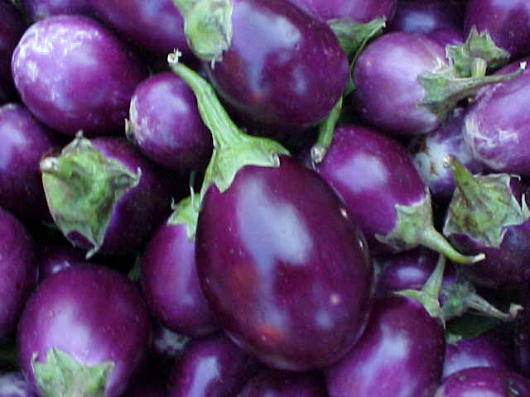
Pests of Brinjal And Their
Management

Slide 3
Common name | Scientific name | Family | Order
1. Epilachna beetle, spotted leaf beetle , Hadda beetle | Epilachna vigintioctopunctata, Epilachna dodecastigma | Coccinellidae | Coleoptera
2. Brinjal shoot and fruit borer | Leucinodes orbonalis | Pyralidae | Lepidoptera
3. Brinjal stem borer | Euzophera perticella | Pyralidae | Lepidoptera
4. Aphids | Aphis gossypii, Myzus persicae | Aphididae | Hemiptera

Slide 4
Common name | Scientific name | Family | Order
4. Leaf hoppers | Amrasca biguttula biguttula, Cestius phycitis | Cidadellidae | Hemiptera
5. Brinjal lace wing bug | Urentius hystricellus, U. sentis | Tingidae | Hemiptera
6. Brinjal leaf webber | Psara bipunctalis | Pyralidae | Lepidoptera
7. Red spider mite | Tetranychus telarius | Tetranychidae | Acarina

Slide 5
EPILACHNA BEETLE /SPOTTED LEAF BEETLE/ HADDA BEETLE:
Epilachna vigintioctopunctata, Epilachna dodecastigma
Coccinellidae: Coleoptera
Marks of identification:
Beetle is small round to slightly oblong in shape measuring about 5 mm in length and 3.5 mm in width.
The underside of the beetle is flat while the upper side is convex.
It is light brick red or pinkish in colour bearing 12-28 small black dots on the pronotum and elytra. These black dots are symmetrically placed in a crescent manner. Adult lives for one month to more than two months.

Slide 6
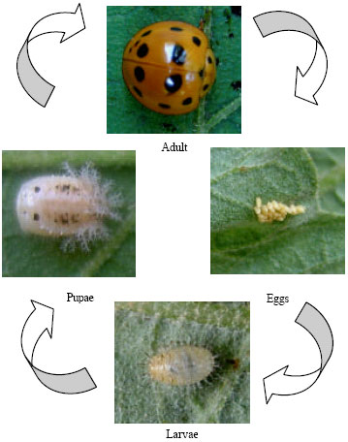
The freshly hatched grub is yellowish and turns to creamy yellow white, when full grown.
The grub is broad in front and narrows posteriorly and is covered with spiny structures all over.

Slide 7
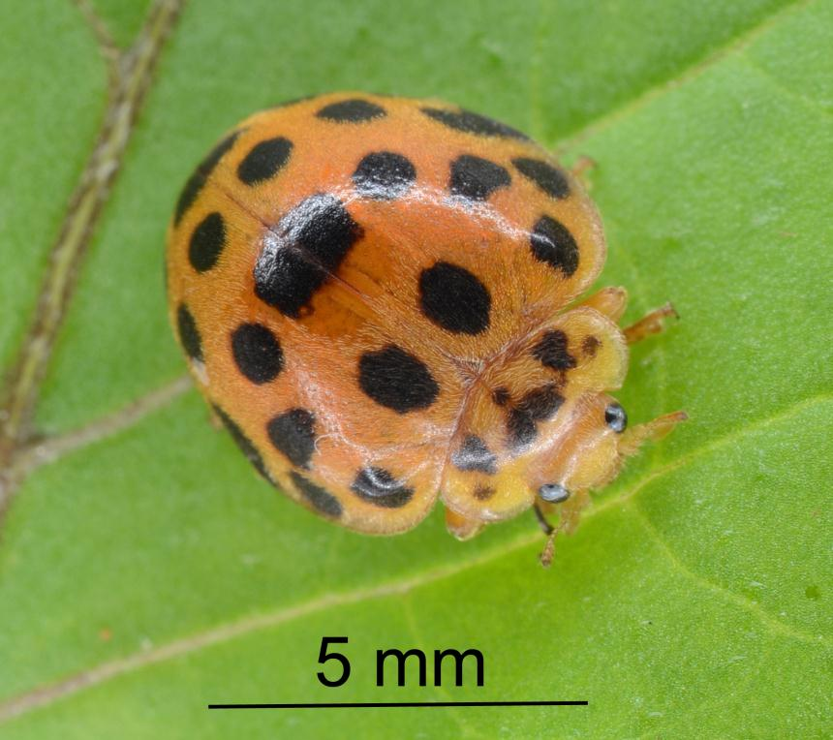
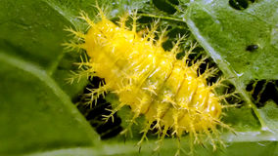
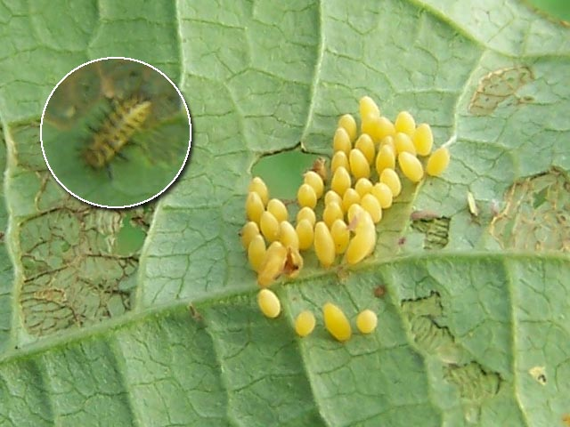

Slide 8
LIFE HISTORY:
The yellow elliptical eggs are laid generally on the under surface of leaves in batches of hundreds, glued to the leaf surface in a vertical position.
Egg period about 3-4 days.
Larval period lasts for 10-35 days
Pupation takes place on the leaf surface.
The full grown grub attaches the last segment of its abdomen to the leaf surface by means of a sticky secretion and the pupa is formed within the last larval skin which splits on the dorsal side.
The pupal period varies from 3-6 days
Total life cycle takes 17 to 50 days.

Slide 9
SYMPTOMS OF DAMAGE
The minute grubs damaging the plant by feeding on the fresh matter of the leaf surface leaving veins and veinlets.
The grown up grubs become voracious feeders, found in batches.
Both the grubs and adults confine their feeding activities generally to the under surface of leaves.

Slide 10
The activity of the pest is more on the lower leaves resulting in
Damaged leaves presenting a lace like appearance as the green matter in between the veins is eaten away (skeletonisation of leaves).
Affected leaves, depending upon the area damaged, drying up and in severe infestation, presenting sickly appearance.

Slide 11
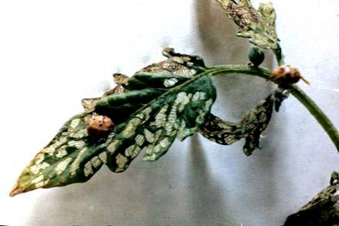
Skeletonisation of leaves

Slide 12
MANAGEMENT:
Hand picking will prove effective as the beetles are sluggish during the morning hours
If the area is small, collection and destroying the egg masses which can be spotted easily.
Egg parasitoid- Tetrastichus ovularum, larval parasitoid - Uga menoni suppress the population during March – July
Organic compounds of plant origin are effective.
Foliar spray with DDVP 1 ml/l in nursery as well as planted crop or carbaryl 3 g/l or profenofos 2ml/l or quinalphos 2 ml/l.

Slide 13
BRINJAL SHOOT AND FRUIT BORER
Leucinodes orbonalis Pyralidae: Lepidoptera
APPEARANCE:
Moths are medium in size with white wings having large brown patches and red markings.
Wing span measures about ¾ of an inch.
The head and thorax are blackish brown.
The full grown caterpillar is pinkish with sparingly distributed hairs on warts on the body with a brownish head.
It measures 16-20 mm long.
Larval period lasts 15 days.
ETL: 1-5% of fruit damage.

Slide 14
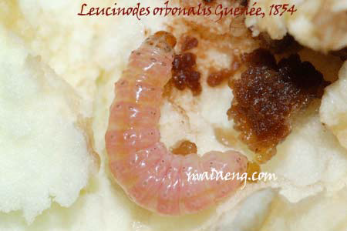
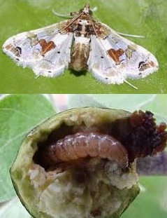
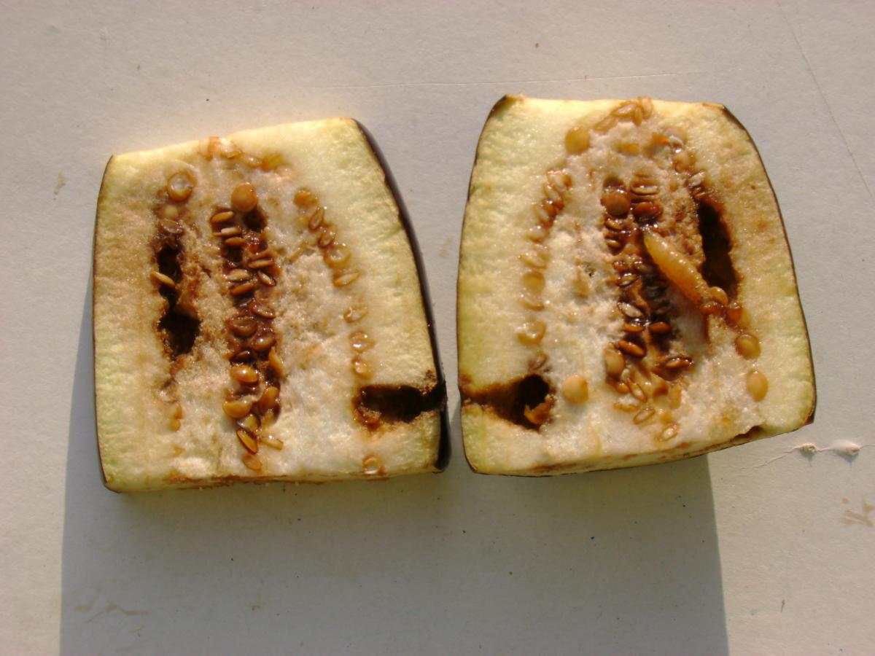

Slide 15
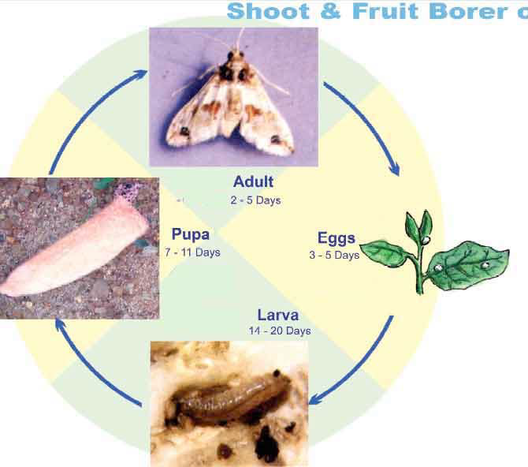
LIFE HISTORY:
The female moth lays about 80-120 eggs singly on tender shoots and developing fruits of brinjal.
Incubation period is 3-5 days
The full grown caterpillar generally pupates outside the bore holes on the stem, fruit stalks etc .in a dark buff coloured cocoon in dirty brown silk.
Moth emerges in about 6-8 days.

Slide 16
SYMPTOMS OF DAMAGE:
If infestation occurs during vegetative phase, caterpillars enter into the petiole, midribs and young shoots.
During fruiting stage caterpillars enter into fruits make holes and feed inside.
Initially, the entry hole is so small that it is not visible. Later, fruits bear large circular holes plugged with excreta.
The infested fruits are unfit for consumption and marketing..
The pest is active throughout the year except winter.
In Nursery no damage is observed.
Transplanted seedlings are also damaged by this pest.

Slide 17
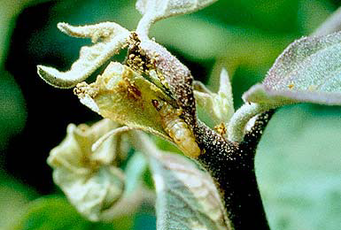
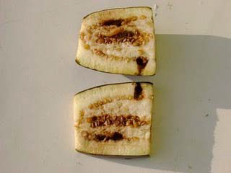
The damage results in
Drooping of tender shoots and wilting in vegetative stage
Holes on the infested fruits filled with excreta

Slide 18
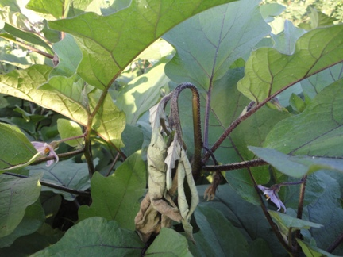
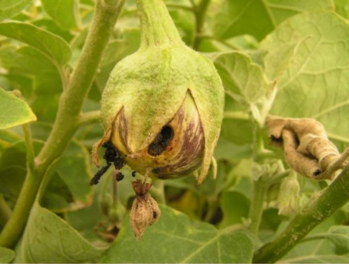
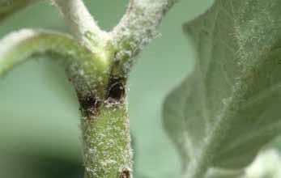
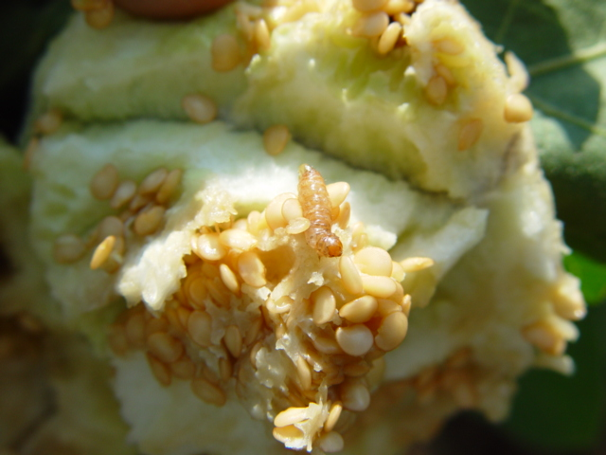

Slide 19
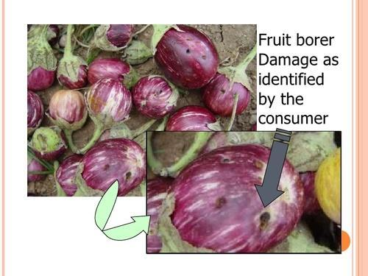

Slide 20
MANAGEMENT:
The damaged portions of the plants should be removed and destroyed.
Continuous cropping of brinjal and potato in the same area encourages the pest activity and hence proper rotation should be followed.
Variety Bhagyamathi is tolerant to the pest damage and suitable for coastal Andhra.
Erecting pheromone traps @4/acre
Larval parasitoids, Trathala flavoorbitalis, Microbracon greeni, suppress the population.
Three spraying with carbaryl 3 g/l or profenofos 2ml/l or cypermethrin 1 ml/l at 10 day interval from 3 weeks after transplanting

Slide 21
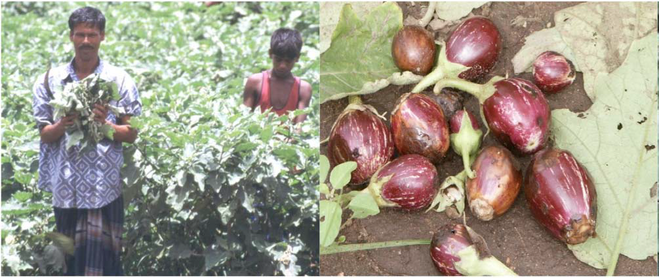
Remove infested shoots by hand Remove and bury infested fruits

