Slide 1
Centurion
UNIVERSITY
INSECT PESTS OF GRAPEVINE
Centurion University of Technology and Management
Shaping Lives...Empowering Communities...

Slide 2
GRAPEVINE FLEA BEETLE Scelodonta strigicollis Chrysomelidae: Coleoptera
APPEARANCE
Adult is a shiny flea beetle with a metallic bronze colour and six black patches on the elytra and is 4.5 mm long.
Adults have characteristic habit of falling down and feigning death when disturbed
LIFE HISTORY
The females lay eggs about one month after emergence and continue from middle of March to middle of October.
Eggs are laid beneath the bark in groups of 20-40.
A female lays about 220-569 eggs in 10-14 installments during its life of 8 -12 months.

Slide 3
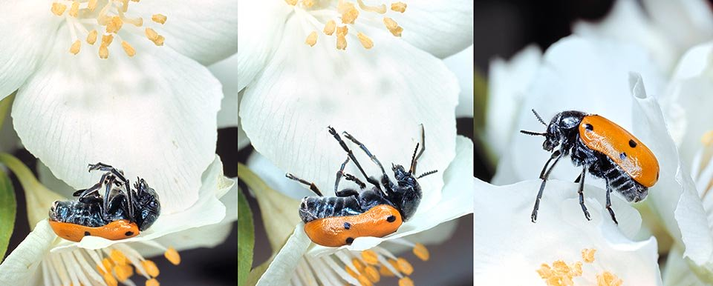

Slide 4
They feed on mature leaves cutting elongated holes on the leaf lamina like shot holes. The damage results in
SYMPTOMS OF DAMAGE
Complete fed sprouting buds.
Shot holes (rectangular cuttings) on mature leaves
MANAGEMENT
Adult beetles may be collected and killed.
Removal of loose bark in rainy season after pruning to expose and eliminate eggs and adults found underneath

Slide 5
First spraying when buds swell in early morning or evening hours to kill beetles and second spray after 10 days with monocrotophos 1.6 ml/l or carbaryl 3.0 g/l or imidachloprid 0.3 ml/l or quinalphos 2ml/l.

Slide 6
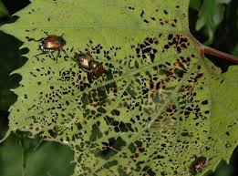

Slide 7
GRAPEVINE THRIPS Rhipiphorothrips cruentatus Thripidae: Thysanoptera
APPEARANCE
Adults are minute, pale, blackish brown, found on the underside of leaves.
LIFE HISTORY
Adults appear in March and lay eggs on the underside of leaves by making slits in leaf tissue, placing one egg in each slit.
About 50 eggs are laid by each female.
The egg is dirty white and bean shaped.
Eggs hatch in 3 -8 days,

Slide 8
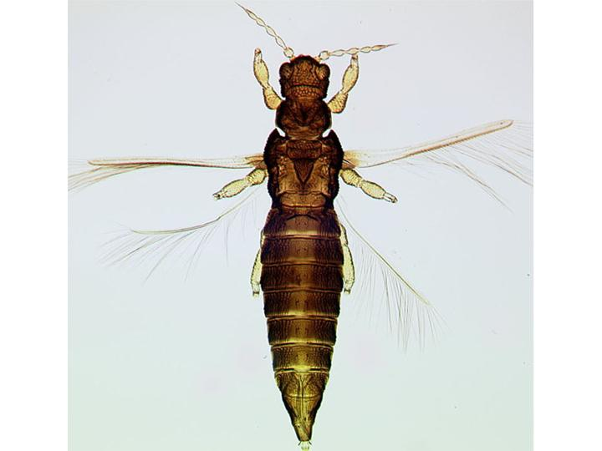

Slide 9
Young nymphs on hatching feed on the undersurface of leaves.
Nymphal period is 9 -20 days
Pupation on leaves and pupae possess locomotion and crawls when disturbed.
Pupal period is 2 -5 days.
NATURE OF DAMAGE
Young nymphs on hatching feed on the undersurface of leaves. Both the nymphs and adults lacerate tender foliage and suck the oozing sap.

Slide 10
The attacked leaves appear silvery initially and later turn brown and give withered appearance, curl up and drop off the plants.
Severely affected vines do not bear fruits. If fruits are attacked, they develop corky layer on the fruits and turn brown. Infestation results in
SYMPTOMS OF DAMAGE
Silvery patches on the affected leaves.
Brown corky patches on fruits (scab)

Slide 11
MANAGEMENT
Removal of weeds in and around garden.
Cutting of infested branches and burning.
Spraying dimethoate2ml/l or methyl demeton 2.0 ml/l or thiamethoxam 0.25 g/l.

